Slide 1

DIGITAL SKILLS
DS3
ASSIF HUSSAN

Slide 2
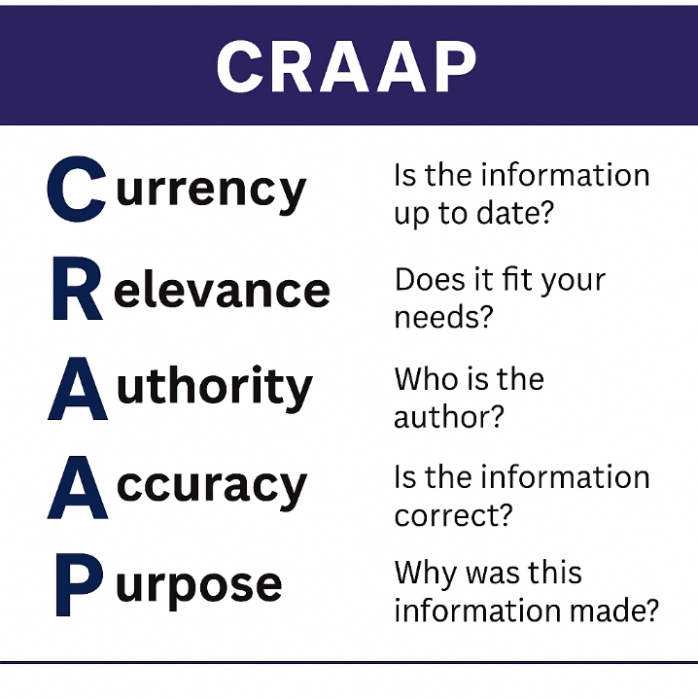
Week 3

Slide 3
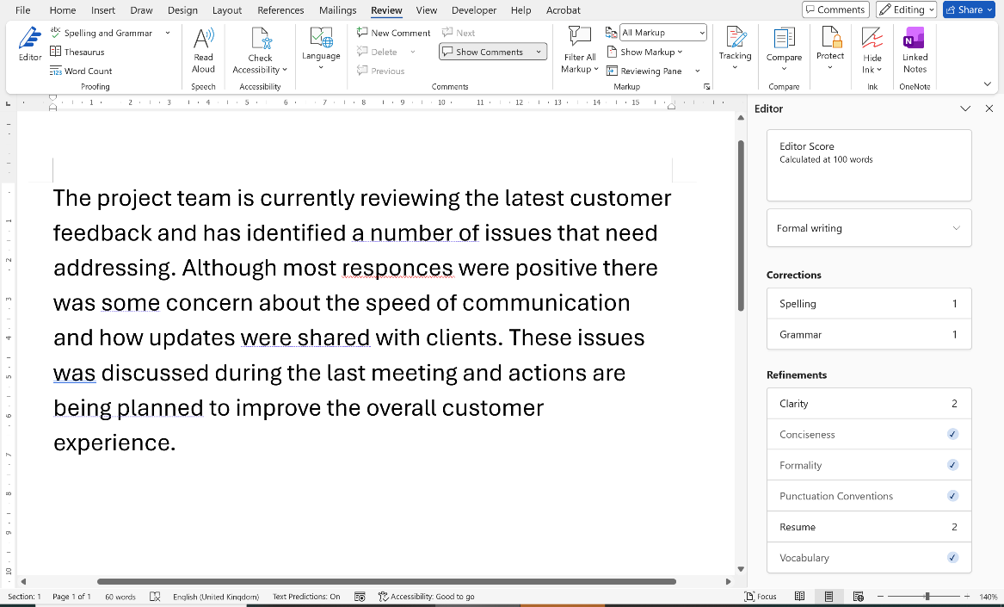
Week 6
Word includes tools to check writing:
Spelling
Grammar
You decide what to accept or ignore.
These tools:
Highlight possible problems
Make suggestions
Are not always correct

Slide 4
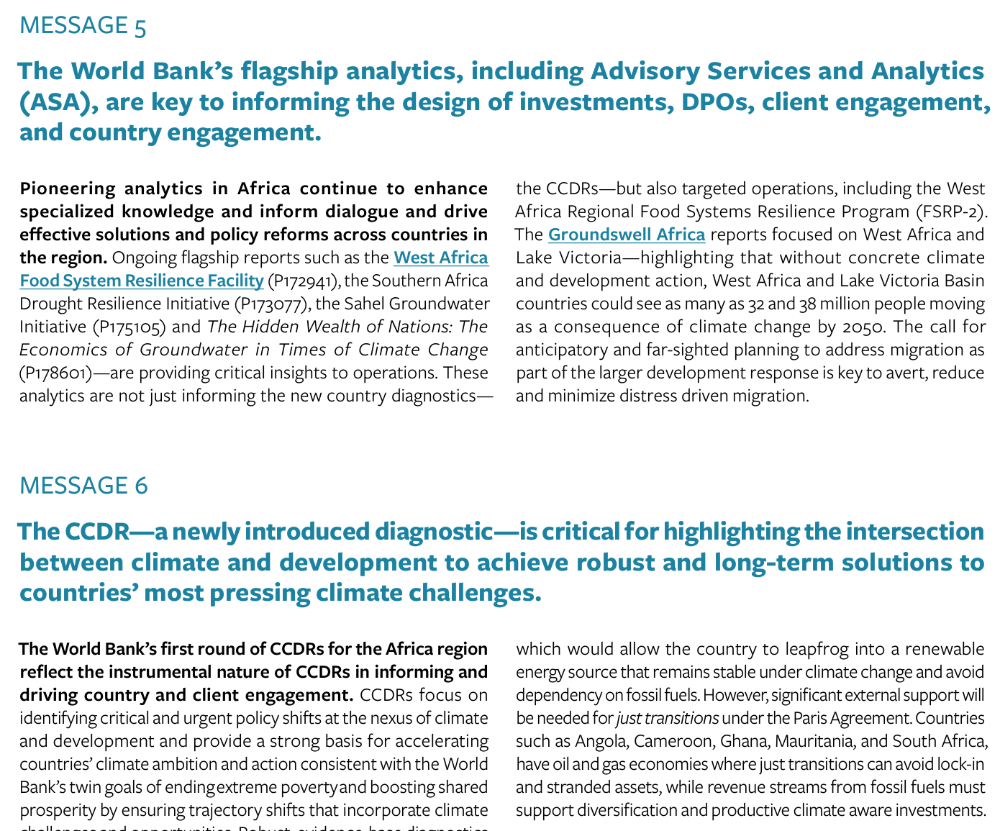
Week 9
Structure helps readers:
  Find information
  Understand faster
  Avoid confusion
  It is important to follow a structure when writing a business report as
Readers often:
  Scan first
  Look for structure
  Then read details

