Slide 1
surname, Terhas Sultan
Student ID:2442420
Module name: Psychology in Health and Social Care
Module code: LCHS4010
Lecturer name, Farah Wiita

Slide 2
Acknowledge use AI
For this assessment, I have used Generative AI for Grammarly and spelling for proofreading purposes only. In line with the permitted use stated in the assessment specification. All research and writing are my own work.

Slide 3
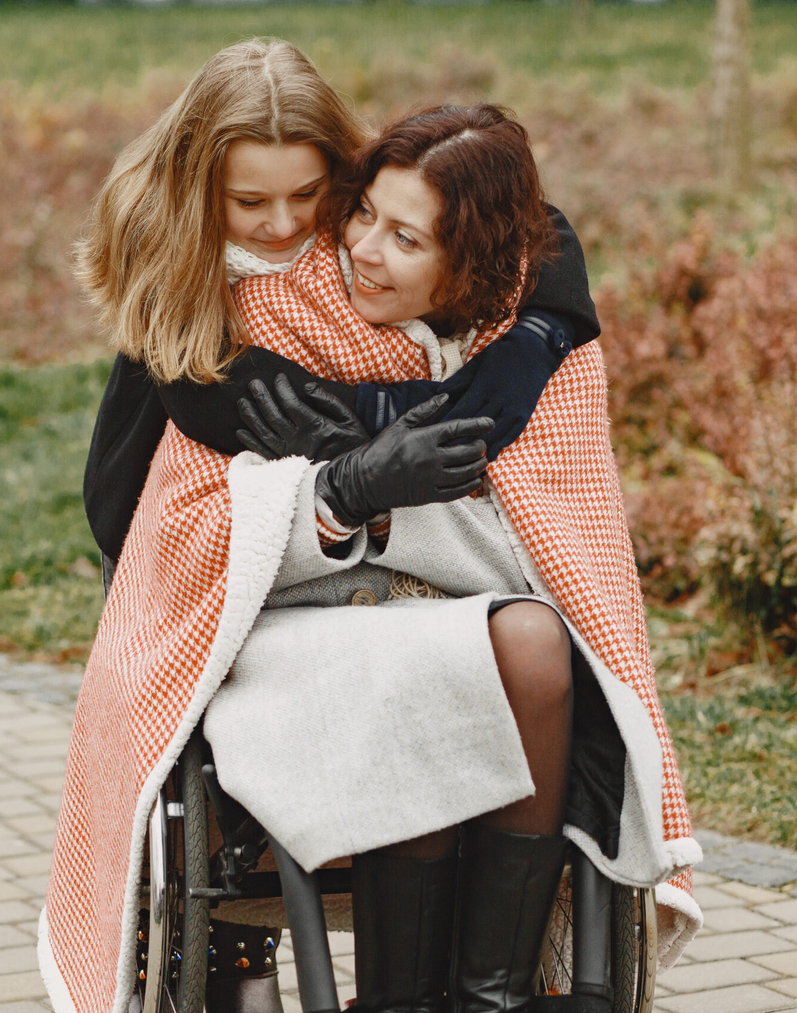
Introduction
Jenny is just 16 years old and has a lot of responsibility
She has cared for her mum for 5 years
My chosen theory is Erikson’s psychosocial theory (Erikson,1950)
The purpose of this presentation is to explain the theory
Jenny’s situation and support methods
evaluate weaknesses and strengths

Slide 4
What is Erikson’s Theory
Erikson’s theory explains how people grow through the 8 stages
He believes the stages present a challenge to solve
The teenage stage focuses on identity and confusion
Teenagers explore who they are and what they want to believe in life

Slide 5

The ideas of the theory
Each stage builds on the one before
The idea is that social experience plays a big role in who we become
Solving stages gives confidence and identity
A weak sense of identity can lead to insecurity, confusion, or even rebellion.
Teenagers need time to explore who they are

Slide 6
How does it link to Jenny?
Jenny is in the identity and role confusion stage (Erikson,1950)
At this stage, she will want to explore interests, values, and goals, which will help her form her own unique identity.
However, caring for her mum may stop her from exploring her identity as she will not have the freedom to, which can lead to her finding the process too overwhelming or distressing; she may experience role confusion.
Less time for friends and hobbies.
Unsure about her future.

Slide 7
Jennys needs
Jenny has no time for herself
She may not have many social interactions
Needs emotional support
Supporting her at home, caring and school
To build confidence and identify herself
plan her future and make her own choices

Slide 8
Strategy to support Jenny
Give Jenny a counsellor
Allow her more freedom to hang out with her friends
reduce her duties with home care support
Introduce her young carer support group
Encourage hobbies and social activities
Encourage participation in clubs, sports, or community groups
Discuss different career paths without pressuring them into a single direction.

Slide 9
Nature and Nurture
Biology
Her brain is still developing
Affects her trust and mistrust
Stress affects mood, sleep and concentration
Environment
Loss of her dad and lack of support
Mum’s health problems
Caring duties and fewer social supports
Lack of support

Slide 10
Strengths of Erikson’s Theory
Looks at the whole lifespan,
Helps identity development and competence
Helps identify emotional and social needs
Our Experience and relationship help shape who you become,
Understand why people act differently.
It helps to explain why someone struggles later

Slide 11
Weaknesses of Erikson’s Theory
Stages can feel too general; not everyone develops the same way
No clearer order like the theory suggests
Does not explain cultural differences
Does not include much biology or mental health
Some ideas are hard to measure or prove.

Slide 12
In Conclusion
In conclusion, Jenny has been a young carer for her mum for 5 years.
According to Erikson’s Theory, teenagers are trying to find who they are,
Jenny spends a lot of time caring for her mum, and she may not have time for social interaction, as well as thinking about her future
Her situation can make it harder for her to build her own identity.
On the other hand, caring has also made her strong, mature and responsible.
Young Carers like Jenny need strong emotional support to grow in a healthy way
Notes:
Harder

Slide 13
List reference
Dunkel, C.S., 2009. Eriksonian lifespan theory and life history theory: An integration using the example of identity formation. Review of general psychology, 13(1), pp.13-23.
Hammond, C.A. (2010) Application of the modified Erikson psychosocial stage inventory: 35 years in review. Western Journal of Nursing Research, 42(5), pp.481–493
Hamachek, D.E., 1988. Evaluating self‐concept and ego development within Erikson's psychosocial framework: A formulation. Journal of Counselling Development, 66(8), pp.354-36
McLean, K.C., 2017. Erikson’s theory of psychosocial development. The SAGE encyclopedia of intellectual and developmental disorders. London: SAGE.
Shaffer, D.R. (2009). Social and Personality Development. 6th ed. Belmont: Wadsworth.
Erikson, EH., 1968, Identity: Youth and Crisis. New York
;

