Slide 1




Let’s take a look at
Enterprise Troopers
P151589
Lynda Westhead
Big Ideas Wales (2019) Welsh Government (2019)
Notes:
These can be changed to reflect your school’s specific rules.

Slide 2

Aims of this presentation
Understanding of terminology involved in the initiative
What may be needed to support and foster entrepreneurial thinking & creativity
Enterprise Troopers aims and structure
Rationale behind the scheme
Additional benefits and skills developed
Possible challenges
Concluding thoughts/recommendations

Slide 3


Define entrepreneurship
Enterprise – creative ideas, identifying a unique opportunity, having confidence to proceed with these.(Nixon, 2004 cited in Higher Education Academy, 2006).
Entrepreneurial Skills – Resiliency, Vision/Focus, Committed, Resourceful, Communication and persuasion (Forbes, 2013).
Entrepreneurial Thinking – Attitudes and Intentions (Bacigalupo et al, 2016).
Innovation – a new way of doing something, product of a creative idea (Veeraraghavan, 2009).
NESTA (2019) Development is fuelled by creativity, innovation and enterprising ideas and suggestions.

Slide 4
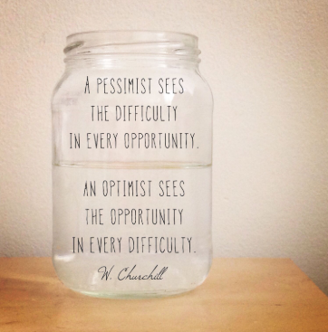
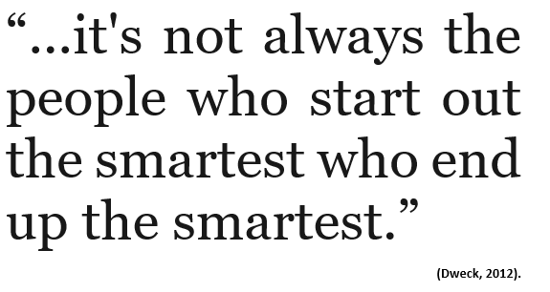
mindset
(Quotesberry, 2014)

Slide 5

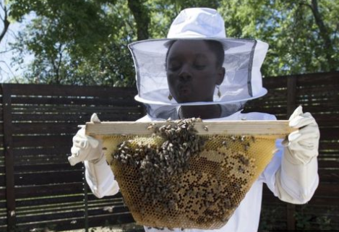



Entrepreneurial children?... Really?
Meet Mikaila Ulmer – Austin TX
Grandmother’s 1940’s recipe – included honey.
Feared bees – researched bees to overcome
10% profits to bee conservation groups

Slide 6
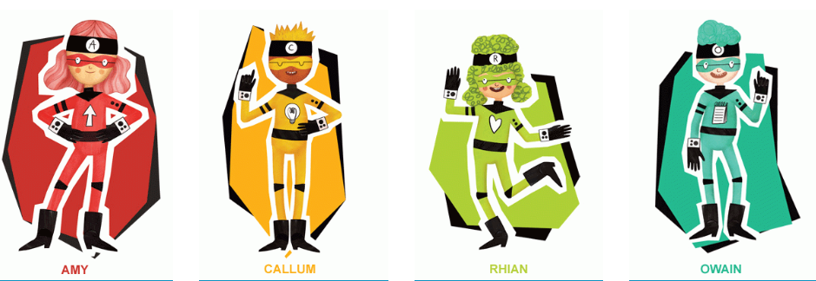
Enterprise Troopers Aims &structure
Competition for 5 – 11 year olds
Part of the Welsh Government's Youth Entrepreneurship programme – Big Ideas Wales.
Competition open to all schools who can demonstrate degree of enterprise.
4 characters to represent the ACRO entrepreneurship model – Amy, Callum, Rhian and Owain.
New activity implemented in school or existing.
(Big Ideas Wales, 2019) (Welsh Government, 2019).

Slide 7
Enterprise troopers
Rationale
PSE Framework (2008) - Developing social skills – self esteem, positive social interaction. (7-19)
YES PLAN (2010- 2015) Prosperity for all – economy growth (Youth Entrepreneurship Strategy).
Successful Futures (2015) – Enterprising, creative contributors. Ready for world of employment (Welsh Government, 2018).
Unchartered territory in terms of economic and employment future – World Economic Forum (2009) & Reynolds (2016).
Welsh Baccalaureate – developing skills for life and work -learning through doing (14-19 compulsory).
Literacy and Numeracy Framework – (5 -14)
  Oracy across the curriculum developing numerical reasoning
  Reading across the curriculum using number skills
  Writing across the curriculum using measuring skills
  using data skills
(Welsh Government, 2019)

Slide 8
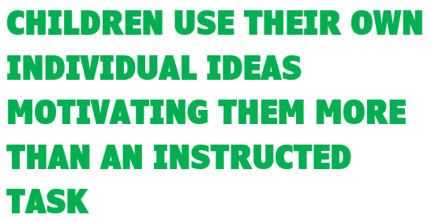






Slide 9

Intended skills developed using the initiative
Attitude: goal setting, the ability to motivate oneself, the capacity to understand what drives self initiative, resilience, commitment.
Creativity: being able to express individualistic ideas that represent personal visions, problem solving , identifying creating opportunities.
Relationships: ability to understand the views of others, communication, teamwork, negotiation.
Organisation: planning, resourceful, identifying and overcoming challenges or possible risks, preparing back-up plans to overcome issues.
Encouraging an individual to develop into a citizen who can contribute to the growth of the economy in Wales.
(Welsh Government, 2019)

Slide 10
Other skills benefits developed by enterprise troopers
Reynolds (2016) enterprise group tasks can “break down learning barriers”, giving a voice to those who would not normally speak aloud, through group problem-solving.
Critical thinking skills – researching information and making informed decisions, the ability to determine who to trust, valuable life skill (Galinsky, 2010).
The ability to adapt and apply their enterprise, creativity and resourcefulness in an uncertain economical climate.
Self-evaluation and reflection which can be used in all areas of life (Tarrant, 2017).

Slide 11

Possible challenges
TIME MAY NOT BE FULLY DEDICATED TO THE INITIATIVE
THE TEACHERS INTEREST AND MINDEST TOWARDS THE PROJECT
AGE LIMIITED TO 5-11 YEARS
CREATIVE AND ENTERPRISING THOUGHTS CANNOT BE FORCED.
ONLY 4 PUPILS MAY ATTEND THE COMPETETION AWARDS AND HEATS.
(Which Franchise, 2014)

Slide 12
Conclusion
Entrepreneurial thinking will help children throughout their lives and in many situations.
The Enterprise Troopers scheme is a great start to developing skills – but some amendments may be beneficial to allow creativity to flow.
It is clear that the TRANSFERABLE skills developed through this initiative are of high benefit to all participants.
Wales is definitely tackling the development of life skills at every possible opportunity which will develop the welsh youths of today into resilient, enterprising contributors to our future economy and society.

Slide 13
Reference List
Amabile, T. (1997). “Entrepreneurial creativity through motivational synergy”, Journal of Creative Behavior, Vol.31, No.1, pp.18-26
Bacigalupo, M. et al., 2016. EntreComp the entrepreneurship competence framework., Luxembourg: Publications Office.
Big Ideas Wales (2019) National Primary School Competition – The Enterprise Troopers https://businesswales.gov.wales/bigideas/welcome-partners-area/national-primary-school-competition-enterprise-troopers (Accessed: 21 March 2019).
British Library (2019) What is the Definition of an Entrepreneur? https://www.bl.uk/business-and-ip-centre/articles/what-is-the-definition-of-an-entrepreneur (Accessed: 24 March 2019).
Business Wales (2019) Youth Entrepreneurship Strategy https://businesswales.gov.wales/bigideas/youth-entrepreneurship-strategy (Accessed: 23 March 2019).
Dweck, C.S., 2012. Mindset, London: Robinson
Forbes (2013) The Top Skills Every Entrepreneur Needs https://www.forbes.com/sites/aileron/2013/11/26/the-top-skills-every-entrepreneur-needs/#42908a7b76e3 (Accessed: 16 March 2019).
Galinsky, Ellen. (2010). Mind in the making: the seven essential life skills every child needs. New York: Harper.
Higher Education Academy (2006) Enterprise, Skills and Entrepreneurship https://www.heacademy.ac.uk/system/files/1enterprise_project_body.pdf (Accessed: 22 March 2019).
Jeffrey (2018) The 13-year-old who built a best-selling lemonade brand https://www.bbc.co.uk/news/business-44860428 (Accessed: 20 March 2019).
National Endowment for Science Technology and the Arts (2019) Nesta is a global innovation foundation https://www.nesta.org.uk/about-us/ (Accessed: 20 March 2019).

Slide 14
References continued…
Quotesberry (2014) http://quotesberry.com/post/64756691677/a-pessimist-sees-the-difficulty-in-every-opportunity-an ( Accessed: 21 March 2019).
Reynolds, E. (2016) Why should children learn about social enterprise? https://www.britishcouncil.org/voices-magazine/why-should-children-learn-about-social-enterprise (Accessed: 20 March 2019).
Tarrant, P., 2013. Reflective practice and professional development, London: SAGE.
Veeraraghavan, V., 2009. Entrepreneurship and Innovation. Asia Pacific Business Review, 5(1), pp.14–20.
Welsh Government (2008) Personal and social education framework for 7-19 year olds in Wales https://learning.gov.wales/docs/learningwales/publications/130425-personal-and-social-education-framework-en.pdf (Accessed: 19 March 2019).
Welsh Government (2014) National and Literacy Framework https://learning.gov.wales/resources/browse-all/nlnf/?lang=en (Accessed: 20 March 2019).
Welsh Government (2018) Successful Futures Looking at the Curriculum and Assessment Arrangements in Wales https://gov.wales/sites/default/files/publications/2018-03/succesful-futures-a-summary-of-professor-graham-donaldsons-report.pdf ( Accessed: 19 March 2019).
Welsh Government (2019) Understanding Entrepreneurship - The ACRO Model https://businesswales.gov.wales/bigideas/understanding-entrepreneurship-acro-model (Accessed: 24 March 2019).
Welsh Joint Education Committee (2018) Welsh Baccalaureate https://www.wjec.co.uk/qualifications/levels/welsh-baccalaureate.html (Accessed: 23 March 2019).
Which Franchise (2014) https://whichfranchise.co.za/possible-disadvantages-franchising-south-africa/ (Accessed: 23 March 2019).
World Economic Forum (2009) Educating the Next wave of Entrepreneurs https://www.oecd.org/site/innovationstrategy/42961746.pdf (Accessed: 23 March 2019).

