Slide 1
Management Accounting
Budgeting - introduction

Slide 2
Budgeting

Slide 3
Budget defined:
A financial plan for a defined future period.
Purpose:
Budgeting can play an important role in planning, control, communication and motivation in organisations.

Slide 4
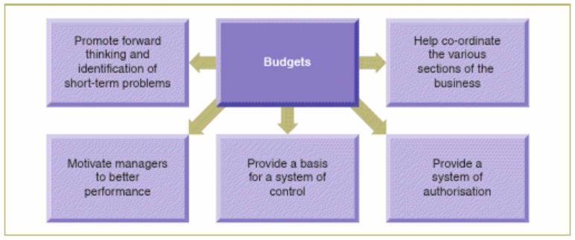
Why do businesses budget? - A business exist as a body with Core Strategic SMART Objectives, vision, mission and values
Planning - link to basic economic problem, company’s core strategic objectives – alignment to, Principal – Agent problem
Coordinating departments
Communicating
Motivate
Control – authorisation limits,
Evaluate performance

Slide 5
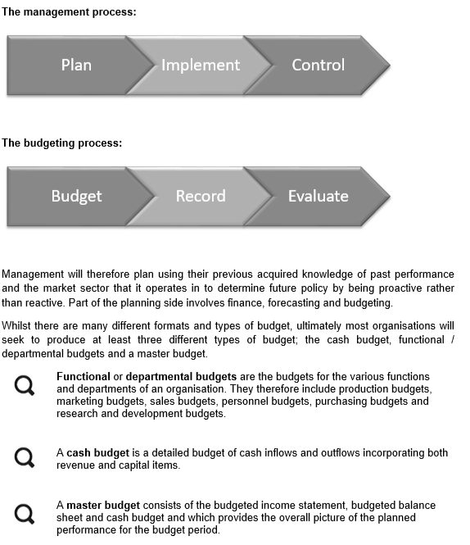

Slide 6
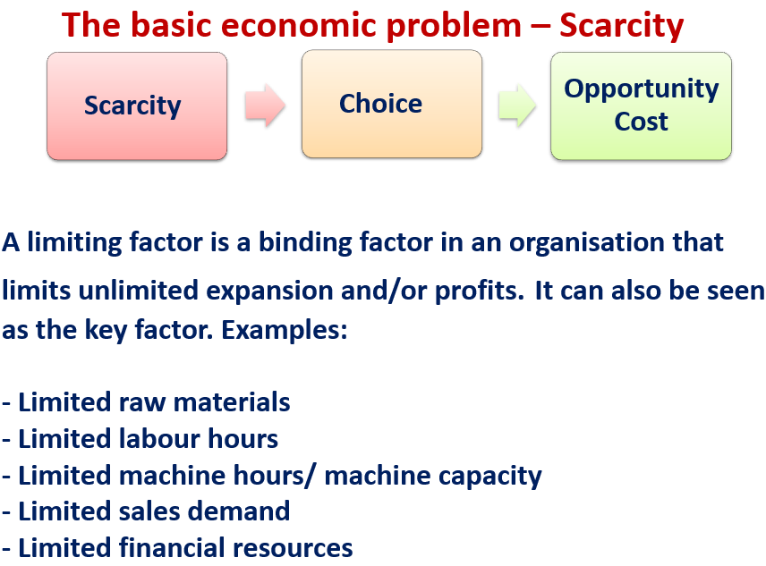
First step - Principal budget factor
A factor that limits the activities of functional budgets of an organisation.
Simply put – it is the driving factor behind all budgets e.g: how much can we sale, what is the maximum output capacity
Think of Limiting Factor

Slide 7
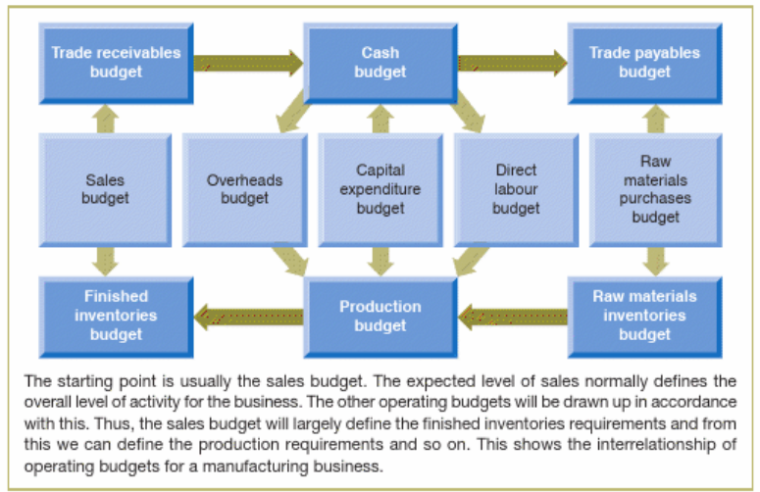
The Interrelationship of operating budgets
(Atrill, 2021, p204)

Slide 8
Budgeting approaches
Top-down budgeting
Bottom-up budgeting
Participatory Budgeting – both parties involved

Slide 9
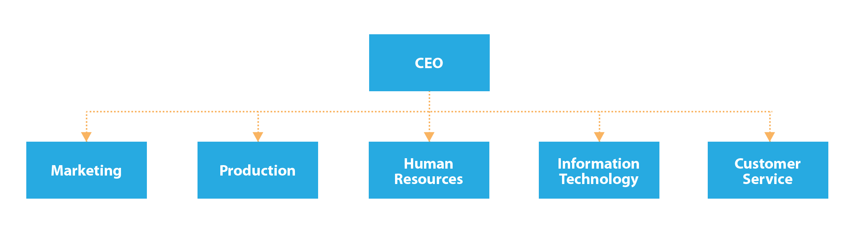
Functional Budgets
A financial or quantitative statement prepared for a function of an organization; it summarizes the policies and the level of performance expected to be achieved by that function for a budget period (Law, 2016).

Slide 10
End… any questions???

Slide 11
List of References
Atrill, P., 2021. Management accounting for decision makers. In: Management accounting for decision makers. Management accounting for decision makers: Pearson, p. 204.
Law, J., 2016. A Dictionary of Accounting. 5 ed. London: Oxford University Press.

