Slide 1

Artificial Intelligence and human collaboration.
By MORYOM QURESHI

Slide 2


Introduction: Artificial Intelligence in The UK Hotels (F&B).
  The UK hotel industyr is changing due to AI automation of common duties like inventory control, reporting, and buffet surveillance (Batat and Das, 2019).
  This enables employees to concentrate on personal service, engagement of the guests, and staff training.
  Balance may result in a lack of satisfaction, disengagement, and reputational risks (Costa & Costa, 2022).
  Case study: The Park Royal Hotel monitored breakfast and conference services to determine the AI-human collaboration.
  AI facilitates productivity, but it is not aimed at depriving human judgment in hospitality services.

Slide 3
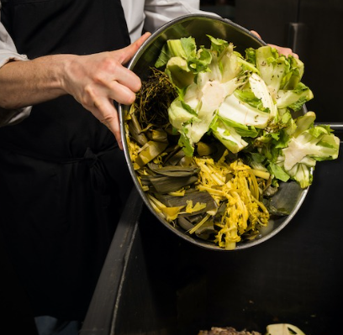
Operational Efficiency Literature Review
  Using AI increases efficiency in F&B in the form of predictive inventory, automated buffet control, and robot delivery (Cooper & Hall, 2023).
  The use of AI in IHG cut the number of food wastes by 10-15% and decreased the amount of energy used in refrigeration (WSHA, 2025).
  Inventory and portion control are the two types of AI used by Hyatt UK to reduce food waste by 39% (Orbisk, 2025).
  The artificial intelligence batch tracking in Radisson saved more than 58 million tonnes of food every year in Europe (EU, 2025).

Slide 4


Literature Review: Guest Experience
  Human touch will always be demanded; 80% of customers like hotel check-in with staff (Hotelier, 2020).
  Two-thirds of them prefer AI combined with human service in the F&B (Manos, 2024).
  The stakeholder theory emphasises the necessity of reconciliation between the satisfaction of guests, the welfare of staff and operational efficiency.
  AI does not replace the job of the staff, but complements it, improving decision-making.

Slide 5

F&B Sustainability Issues
  Hotel buffets add to 87 million tonnes of data yearly in the UK food waste (WRAP, 2023).
  The overproduction of food waste raises the cost of operation, emissions, and the brand image (Haldorai et al., 2022).
  Hyatt UK has decreased waste by 25-35% by using AI predictive portioning (Hyatt, 2023).
  The AI-powered inventory management helped IHG properties to save about 50% on their food waste (IHG, 2019).
  AI helps to optimise resources, and it needs to be controlled by people who adjust the diet and the portions.

Slide 6

Staff Shortages and Financial Pressures
  One quarter of the hotels in the UK state that staffing in F&B is an issue (ONS, 2022); 3 out of 4 suffer seasonally.
  AI minimises redundant activities, and the staff can work on tasks of high value (interaction with guests).
  Routine processes have been automated to enhance cost control.
  The agency theory advocates the strike between employee wellbeing, efficiency of the operations and the satisfaction of the guests.
  The Park Royal placement observations prove that AI tools with human supervision enhance interaction and trustworthiness.

Slide 7

Methodology
  Qualitative exploratory design applied to evaluate the AI-human collaboration during the UK hotel F&B operations (Dixit, 2020).
  Three sources of data were used: peer-reviewed journals, industry reports (UK Hospitality, WRAP), and placement experience at The Park Royal.
  Noticed breakfast, meeting, and bar services, employee workflow, and handwritten waste tags.
  The TBL model is used to evaluate the environmental, economic, and social performance.
  Driven by operational efficiency, employee functions, guest satisfaction and sustainability.

Slide 8

Environmental Sustainability
  The AI is helping to accurately predict the number of guests and minimise buffet overproduction.
  The IHG Green Engage program had a 50% lower food waste saved with the help of AI (IHG, 2019).
  Hyatt UK repurposes more than 58 million tonnes of food every year (EU, 2025).
  The AI batch monitoring by Radisson cut down on the perishables and energy use.

Slide 9
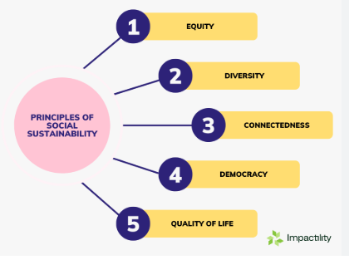
Social Sustainability and the role of the staff
  AI eliminates manual prediction and inventory calculations that were handled by employees (April, 2025).
  Employees will be able to concentrate on interaction with guests, allergies, and the quality of presentation.
  Enhances work quality and performance (Ye et al., 2022).
  Employees get reskilled, which enhances digital literacy and decision-making.
  The use of human-AI collaboration adds value to the experience of the guests without decreasing the quality of service.

Slide 10
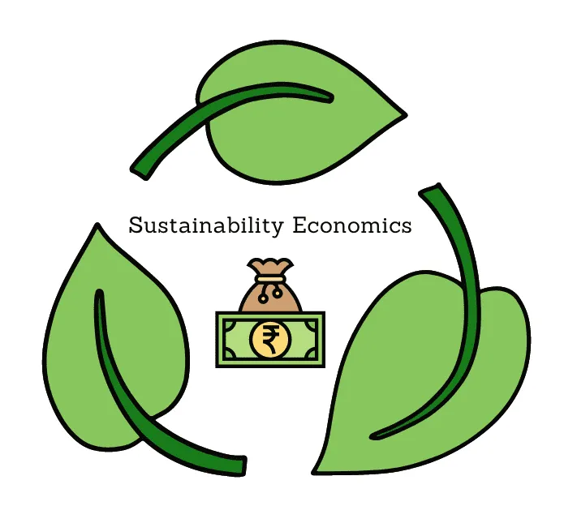
Economic Sustainability
  IHG had saved approximately 8% of its annual food costs on breakfast buffets with the help of AI.
  Hyatt UK also saved £350,000 a year in procurement and energy efficiency (Hyatt, 2023).
  Radisson also enhanced service delivery without necessarily recruiting more employees.
  AI makes operational costs low and efficient human resource allocation.

Slide 11

Human Touch and Guest Experience.
  Breakfast and conference services are still dependent on staff attention and the ability to solve problems.
  AI assists employees in the decision-making process but does not eliminate the need to make judgments in unpredictable situations.
  The stakeholder theory underscores the need to balance the needs of the guests, staff involvement, and financial objectives.
  The successful AI-human cooperation enhances the level of satisfaction among guests and stability.

Slide 12

Critical Perspectives
  AI enhances productivity, minimises waste and lowers expenses (Byline, 2025).
  Dependency has the risk of deskilling employees, loss of personal relationships, and discouraging employees.
  Carrying out AI is financially challenging for smaller hotels; manual work is still an option.
  The most appropriate results are achieved with integrated AI-human solutions, including predictive analytics and portioning under the control of the staff.
  There are trade-offs, which are combined to facilitate maximum efficiency, sustainability, and quality of services.

Slide 13

Conclusion and Recommendations
  Employ AI-statistical modelling under human control to decrease food waste and enhance efficiency (Dushkova et al., 2024).
  Ensure the consistency of human operational processes such as pre-peak huddles and checks on allergens (Quantum Black, 2024).
  Train the staff on AI literacy and sustainability practices.
  Trace and report ESG indicators in order to be seen as responsible and raise brand reputation (Freidberg, 2017).
  The sustainability of the environment, society, and economy through equal cooperation between AI and human beings means operational excellence.

Slide 14
References:
April, M. (2025) 16 companies using generative AI for business efficiency. Available at: https://indatalabs.com/blog/companies-using-generative-ai (Accessed: 19 February 2026).
Batat, W. and Das, D.K. (2019) Global trends, practices, and challenges in contemporary tourism and hospitality management. IGI Global. Available at: https://www.igi-global.com/book/global-trends-practices-challenges-contemporary/218146 (Accessed: 19 February 2026).
Byline (2025) How AI is transforming strategy development. Available at: https://www.mckinsey.com/capabilities/strategy-and-corporate-finance/our-insights/how-ai-is-transforming-strategy-development (Accessed: 19 February 2026).
Cooper, C. and Hall, C.M. (2023) Contemporary tourism: An international approach. Goodfellow Publishers. Available at: https://www.sciencedirect.com/book/monograph/9780750663502/contemporary-tourism (Accessed: 19 February 2026).
Costa, V. and Costa, C. (2022) Sustainability and competitiveness in the hospitality industry. Business Science Reference. Available at: https://www.igi-global.com/book/sustainability-competitiveness-hospitality-industry/277196 (Accessed: 20 February 2026).
Dixit, S.K. (2020) Managing hospitality organizations: Achieving excellence in the guest experience. Sage. Available at: https://www.tandfonline.com/doi/full/10.1080/11745398.2019.1653205 (Accessed: 20 February 2026).
Dushkova, Diana and Olga, I. (2024) 'Empowering communities to act for a change: A review of the community empowerment programs towards sustainability and resilience', Sustainability Available at: https://www.mdpi.com/2071-1050/16/19/8700 (Accessed: 20 February 2026).
EU, C. (2025) Food Waste. Available at: https://food.ec.europa.eu/food-safety/food-waste_en#:~:text=About%20Food%20Waste-,About%20Food%20Waste,SWD%20(2023)421). (Accessed: 19 February 2026).
Freidberg, S. (2017) 'Big food and little data: The slow harvest of corporate food supply chain sustainability initiatives', Ann. Am. Assoc. Geogr pp.1389–406.
Haldorai, K., Kim, W.G. and Garcia, R.F. (2022) 'Top management green commitment and green intellectual capital as enablers of hotel environmental performance: The mediating role of green human resource management', Tour. Manag. p.104431.
Hotelier, S. (2020) Report finds 80 percent of hotel guests would rather check in remotely. Available at: https://www.hoteliermiddleeast.com/news/report-finds-80-percent-of-hotel-guests-would-rather-check-in-remotely#:~:text=Subscribe,would%20rather%20check%20in%20remotely (Accessed: 20 February 2026).
Hyatt (2023) World of care highlights. Available at: https://about.hyatt.com/content/dam/hyatt/woc/2023WOCHighlights.pdf#:~:text=Waste%20and%20Circularity.%20Hyatt%20hotels%20are%20reducing,evaluating%20products%20purchased%20and%20improving%20waste%20sorting. (Accessed: 19 February 2026).
IHG (2019) Award-winning AI technology helps IHG hotels track, measure and reduce food waste. Available at: https://www.ihgplc.com/news-and-media/news-releases/2019/award-winning-ai-technology-helps-ihg-hotels-track-measure-and-reduce-food-waste (Accessed: 20 February 2026).
Manos, K. (2024) Balancing Automation and Human Touch in Guest Relations. Available at: https://medium.com/hotel-tech/balancing-automation-and-human-touch-in-guest-relations-76941ef005cc (Accessed: 20 February 2026).
ONS, O.f.N.S. (2021) Consumer price inflation, UK. Available at: https://www.ons.gov.uk/economy/inflationandpriceindices/bulletins/consumerpriceinflation/september2024? (Accessed: 20 February 2026).
Orbisk (2025) Using AI to reduce food waste at Hyatt Regency Aqaba Ayla Resort. Available at: https://orbisk.com/blog/using-ai-to-reduce-food-waste/ (Accessed: 20 February 2026).).
Quantum Black (2024) The state of AI in early 2024: Gen AI adoption spikes and starts to generate value. Available at: https://www.mckinsey.com/capabilities/quantumblack/our-insights/the-state-of-ai-2024 (Accessed: 20 February 2026).
WSHA (2025) 3 tips for hotels to reduce food waste in 2025. Available at: https://sustainablehospitalityalliance.org/reduce-food-waste-tips-winnow/ (Accessed: 20 February 2026).
Ye, H., Sun, X. and Lay, T. (2022) 'A review of robotic applications in hospitality and tourism research', Sustainability p.10827. Available at: https://www.mdpi.com/2071-1050/14/17/10827 (Accessed: 19 February 2026).

Slide 15
AI Acknowledgement:
I conﬁrm that I have not used any AI tools in the research and creation of this assignment. I conﬁrm that I have not presented any AI generated materials as my own work. I conﬁrm I have copies of my drafts, notes, and other resources I used, which I may be asked to provide in evidence.

