Slide 1
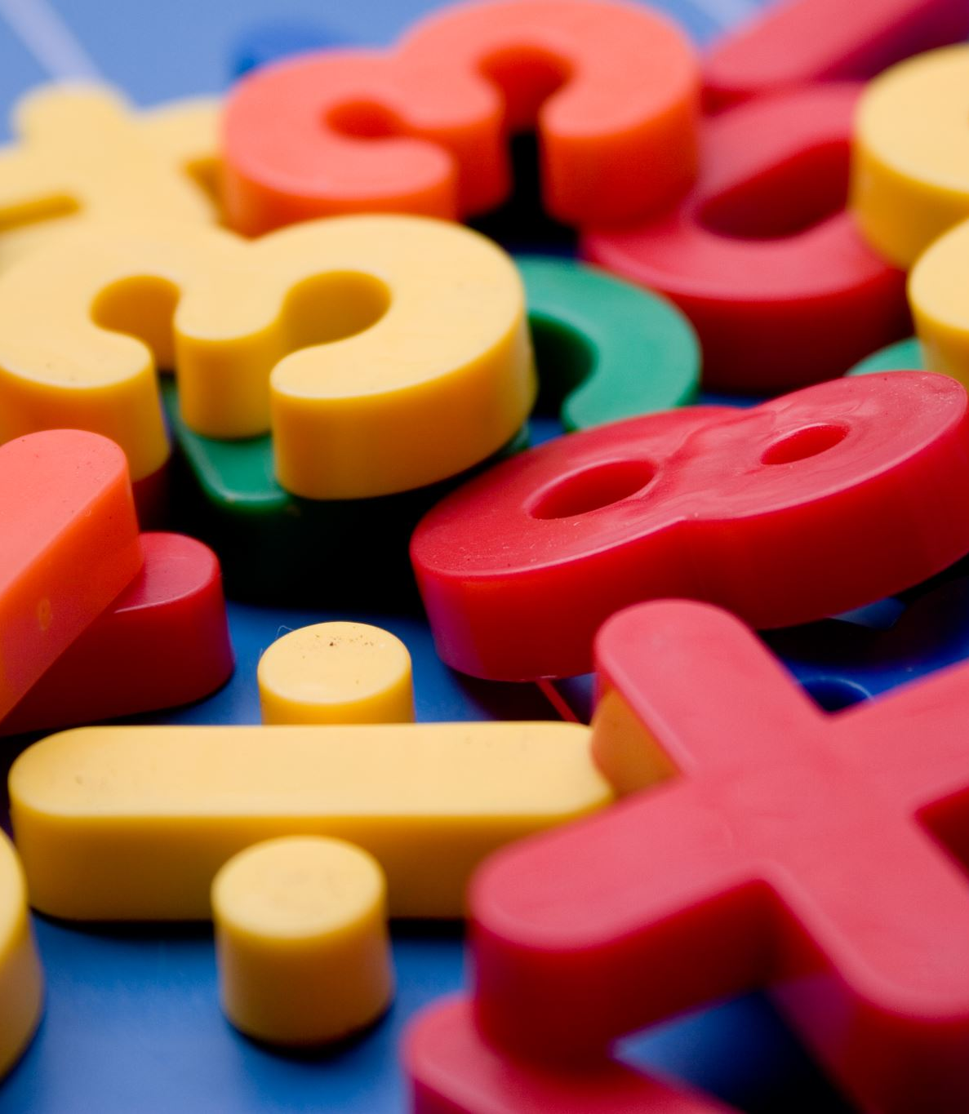
Numeracy across the Curriculum
ECAD 5012 Professional & Pedagogic Studies:
Leading the Learning: what, how and why am I teaching?
Mathematics and Numeracy
(2hours)

Slide 2
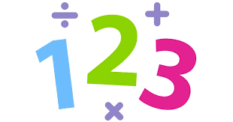
Aims of this lecture
The Numeracy Framework
Teaching Maths Cross-Curricular
Problem Solving
Good practice across Wales in Numeracy

Slide 3
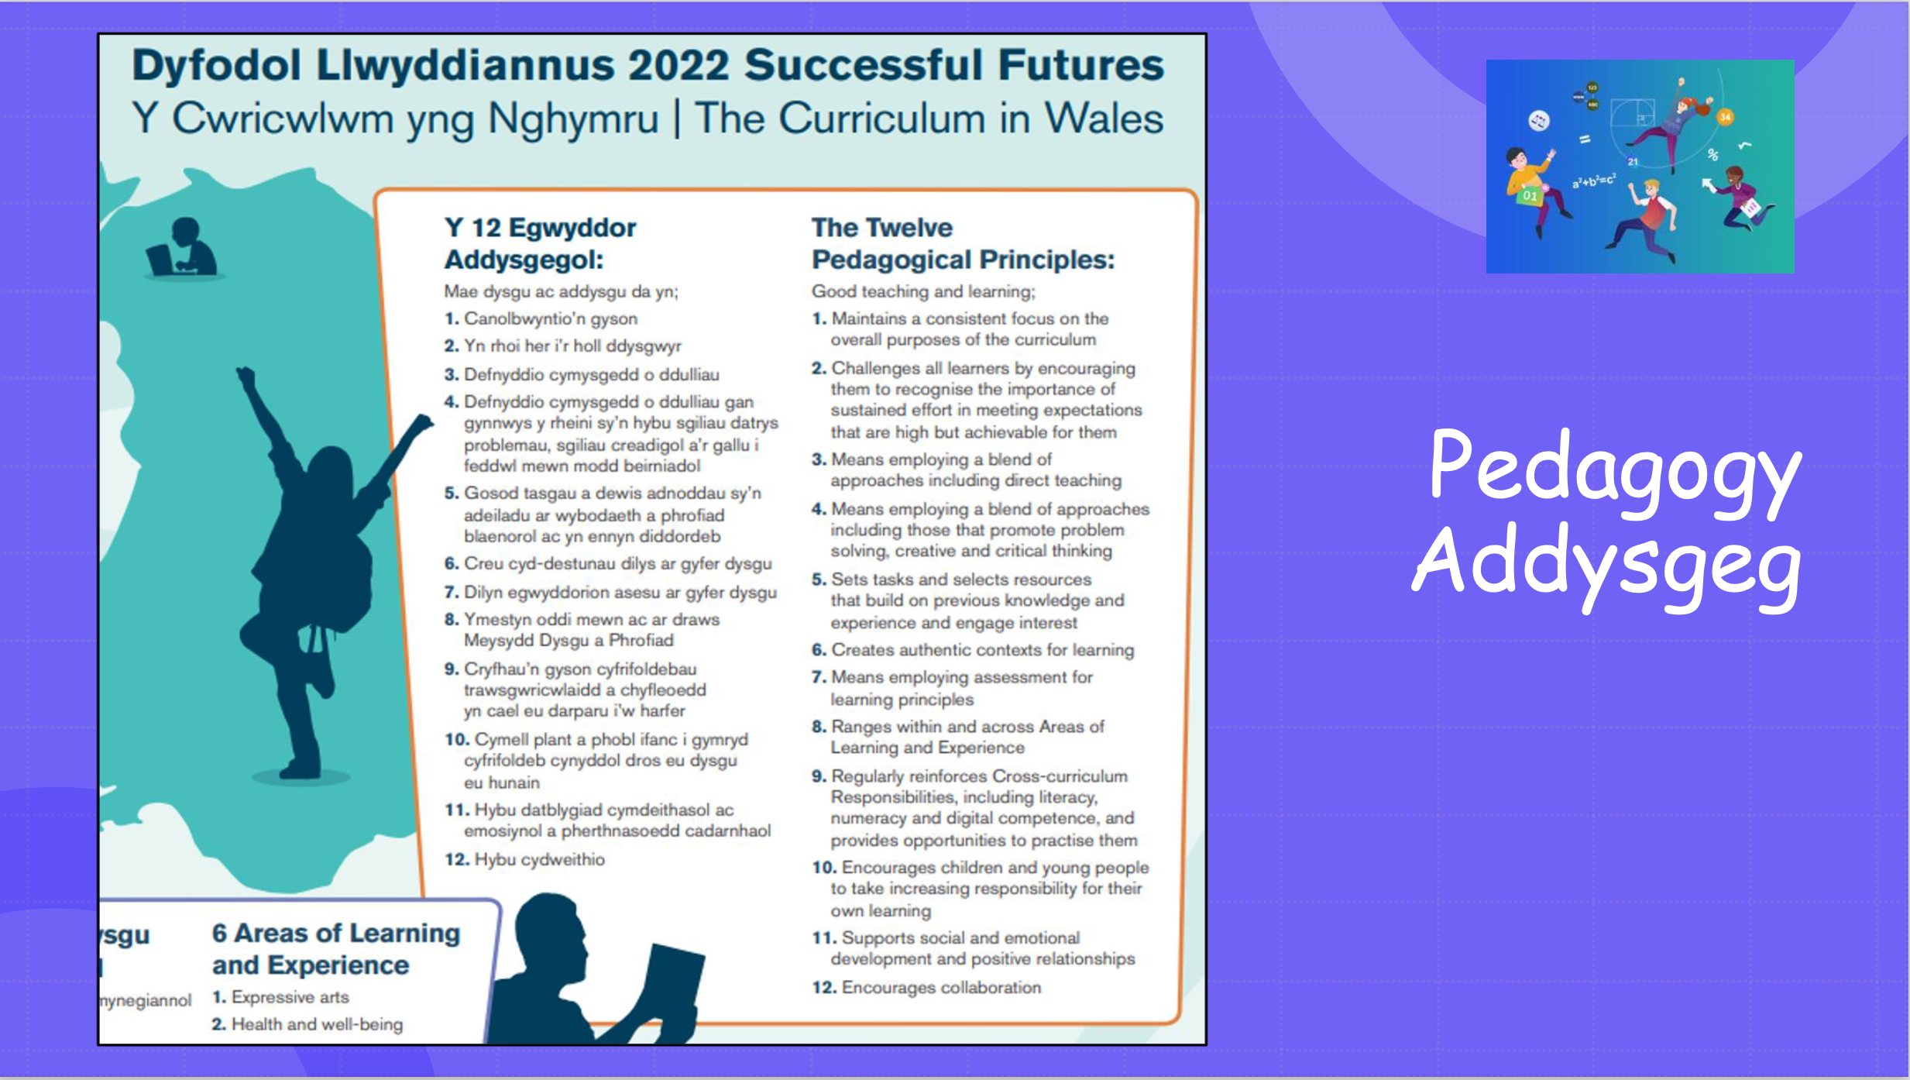

Slide 4

The Review therefore recommends that literacy, numeracy and digital competence should be Cross-curriculum Responsibilities for all teachers and people who work with children and young people. The curriculum structure needs to ensure that children and young people develop high levels of competence in these aspects and have frequent opportunities to develop, extend and apply them across the curriculum.
Successful Futures 2015

Slide 5
Similarly, numeracy, including arithmetical and data-handling skills, is deployed widely across the curriculum, and competence in numeracy is essential for independent living and work. Children and young people need regular opportunities to deepen their understanding of number and, as with literacy, to reinforce and use their numeracy skills in different contexts. It is important that all teachers and other staff who work with children and young people have an understanding of how best to reinforce these skills and take opportunities to consolidate learning appropriately. The numeracy component of the LNF provides guidance about a common approach to the reinforcement of such skills at different developmental stages.

Slide 6
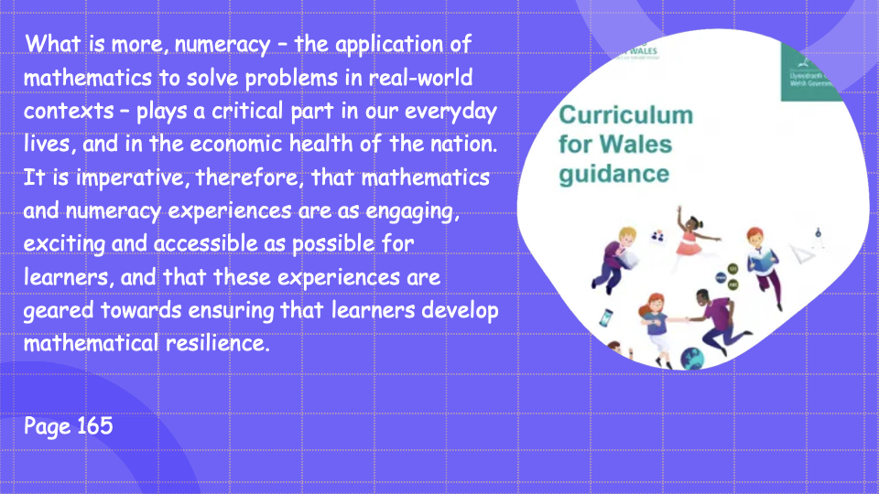

Slide 7
What is numeracy?
https://youtu.be/lR1t-Cn7Ui4

Slide 8
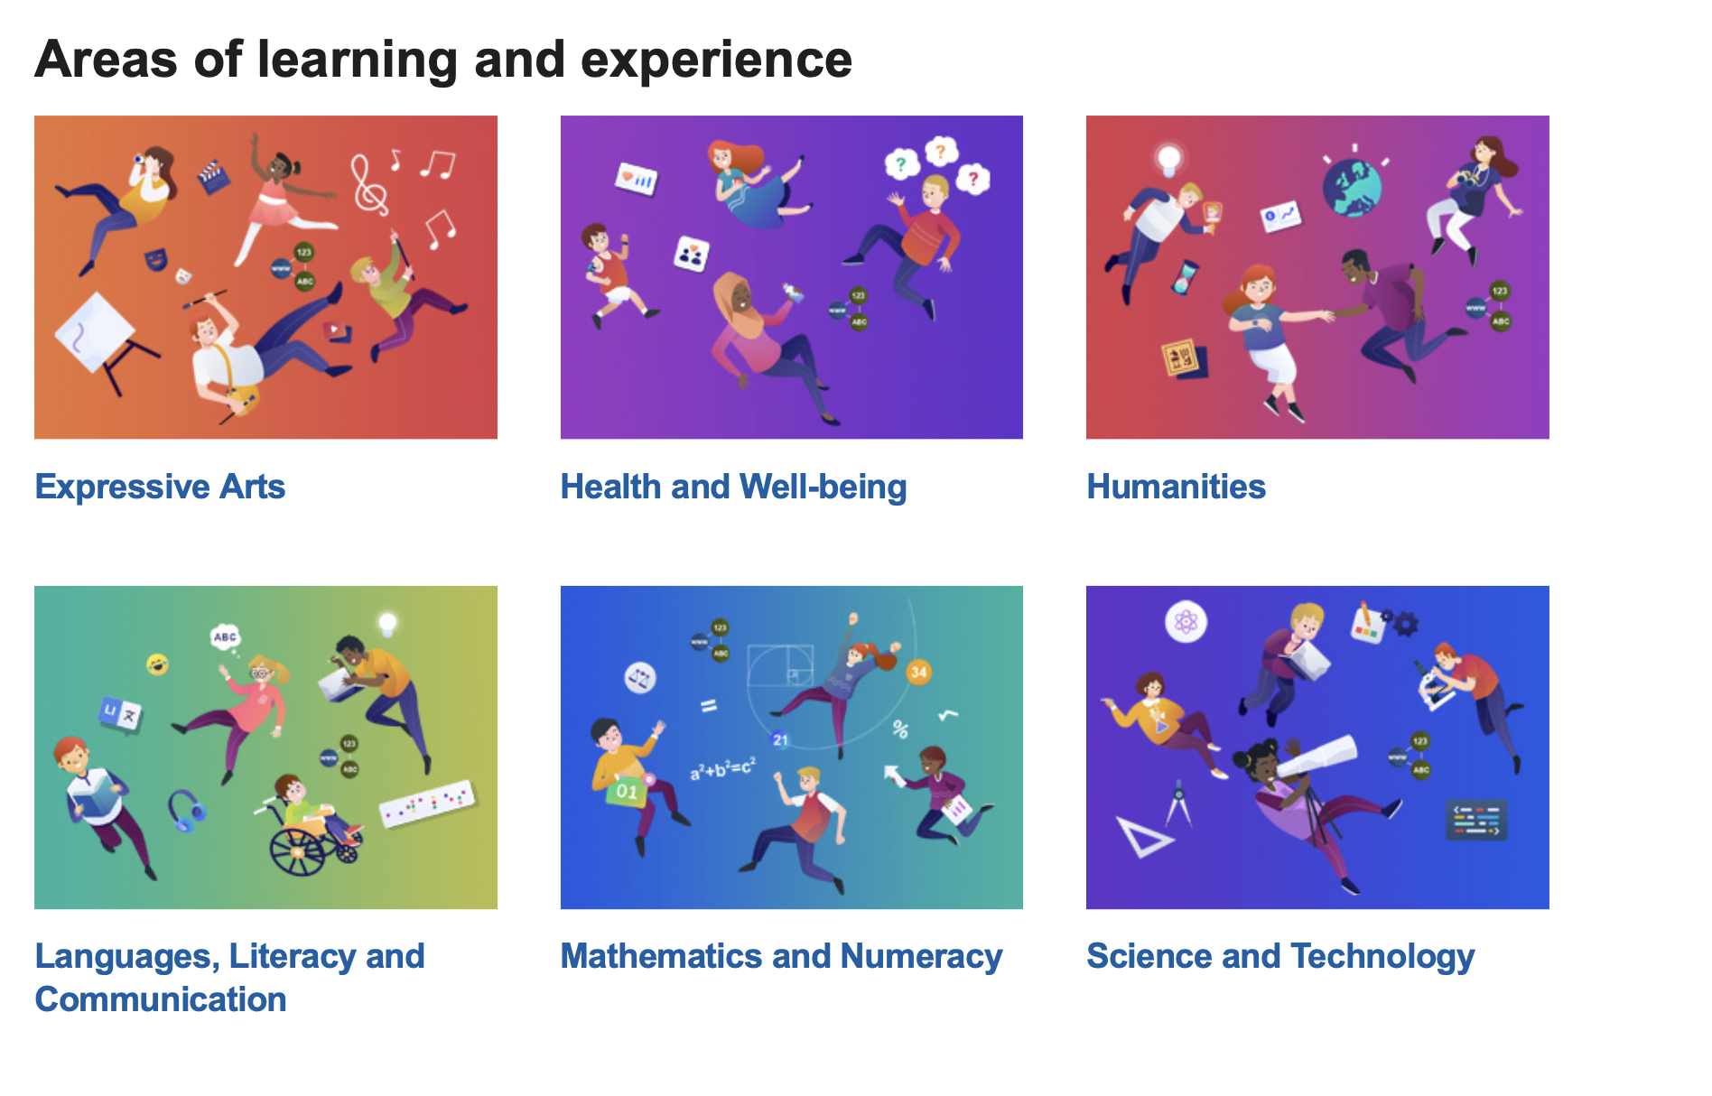

Slide 9
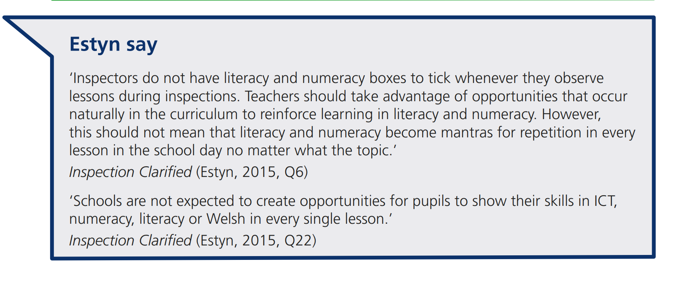
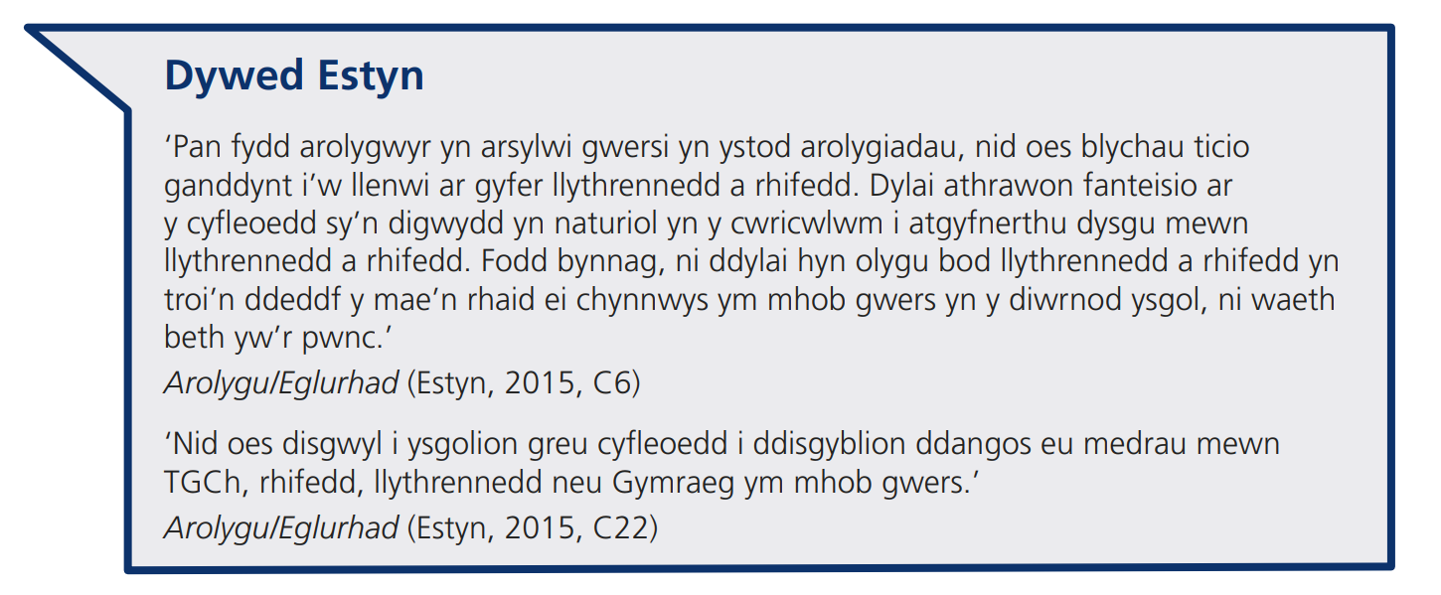

Slide 10
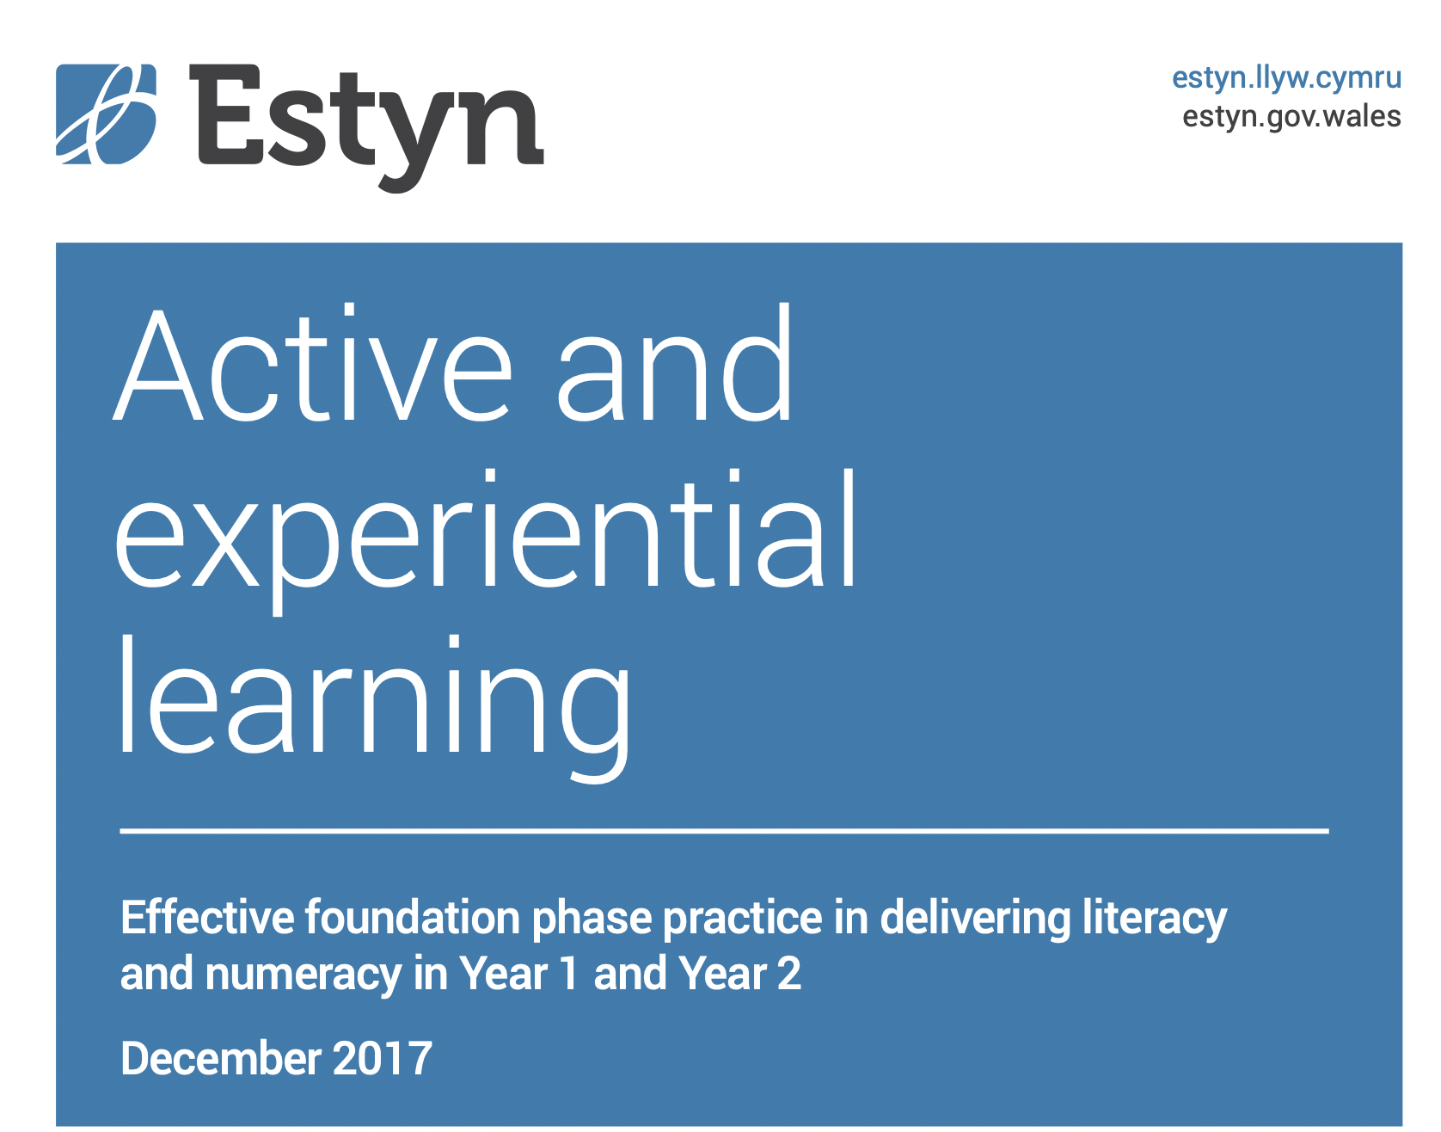
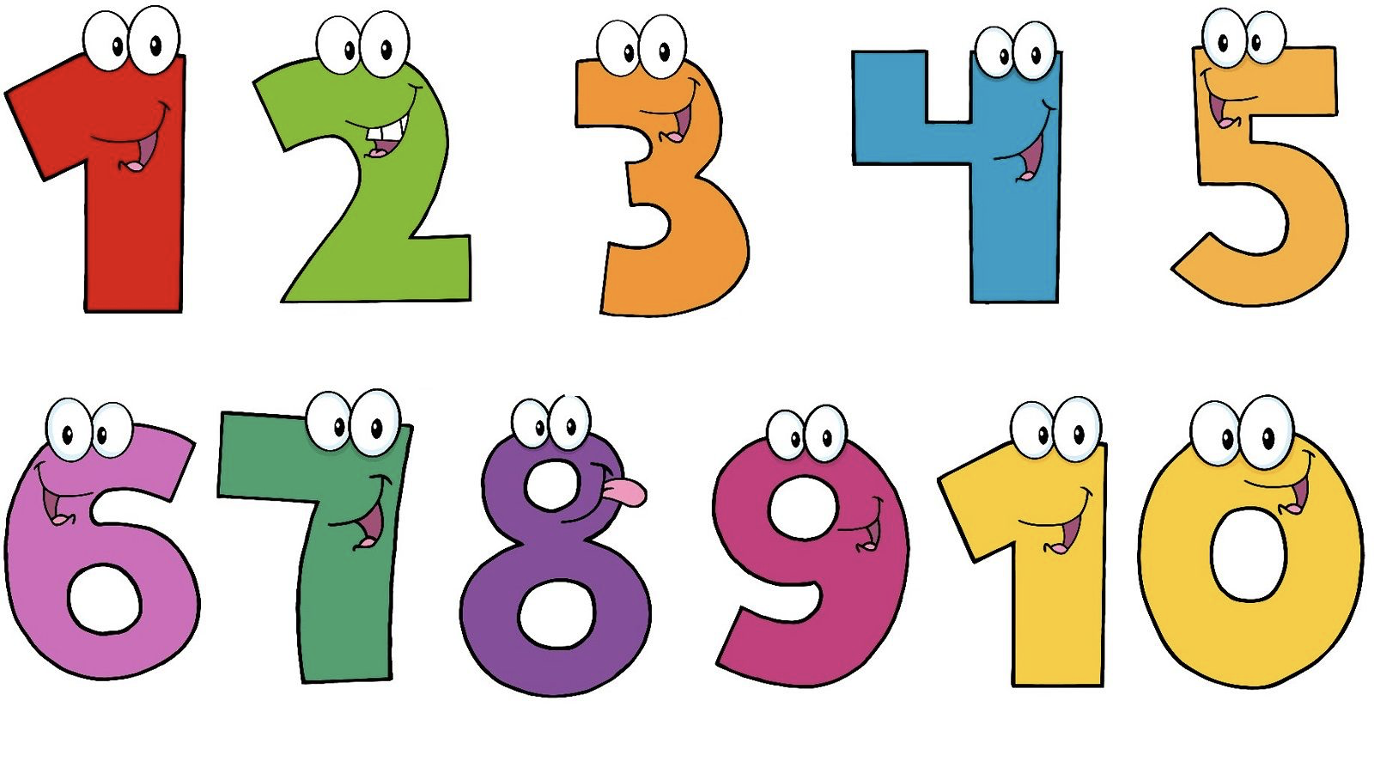
https://www.estyn.gov.wales/thematic-report/active-and-experiential-learning-effective-foundation-phase-practice-delivering

Slide 11
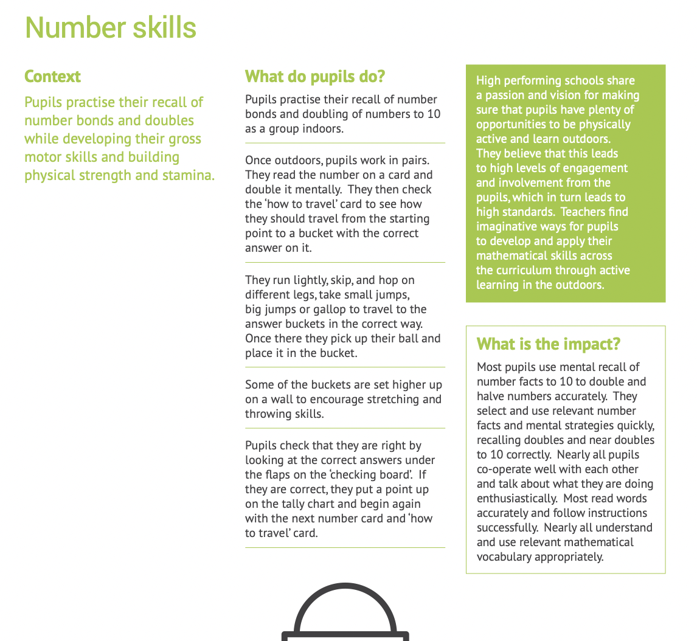
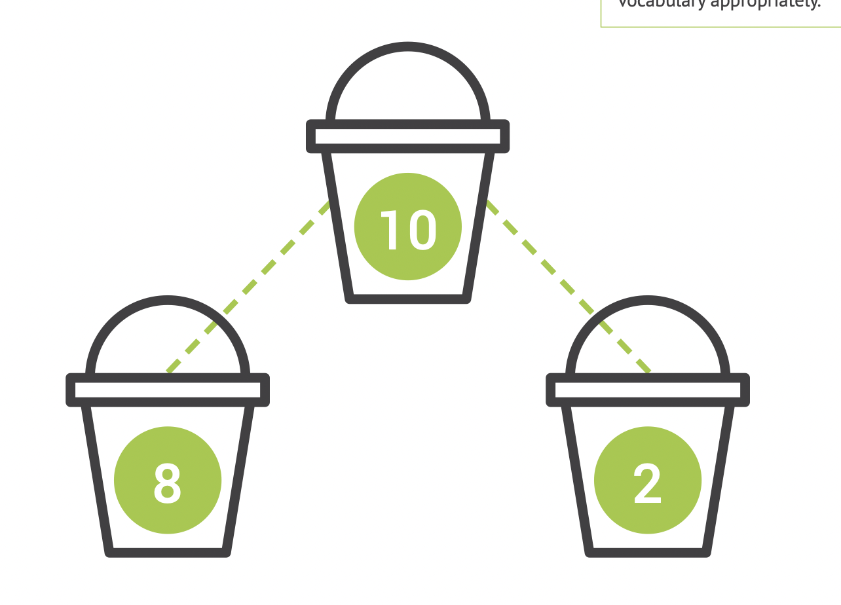

Slide 12
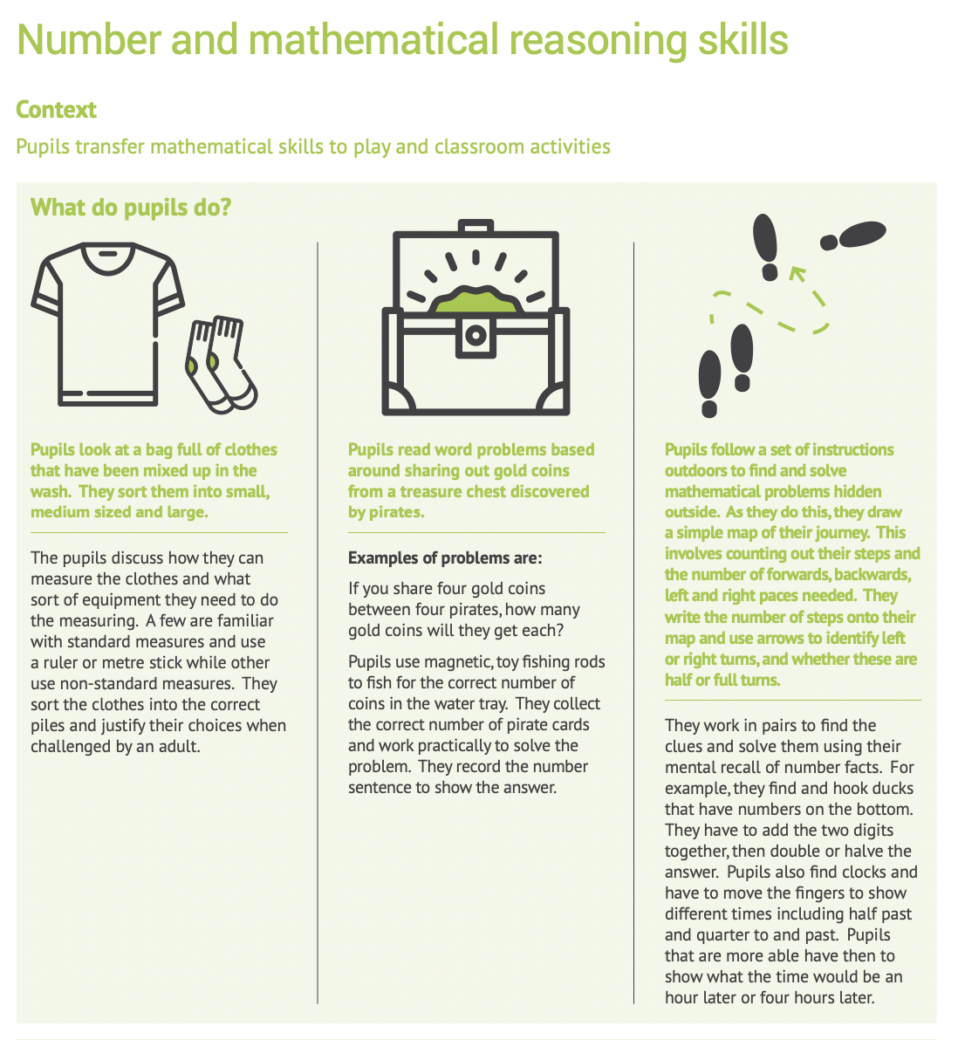
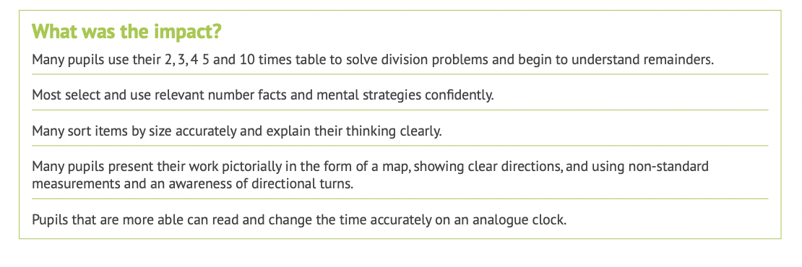

Slide 13
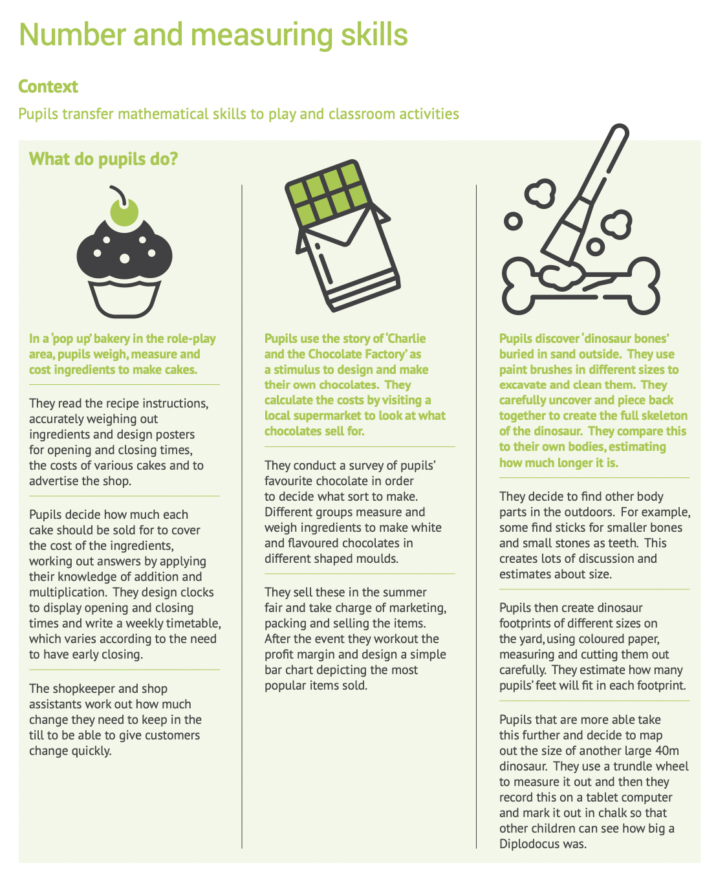
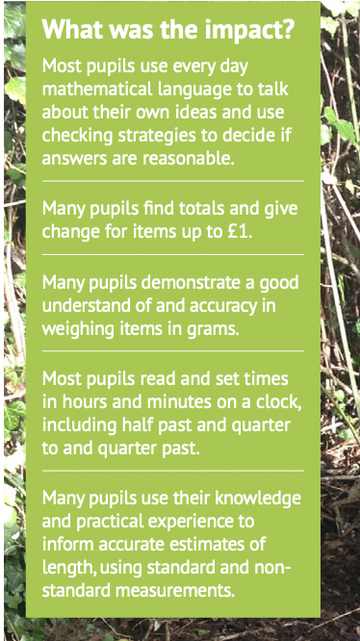

Slide 14
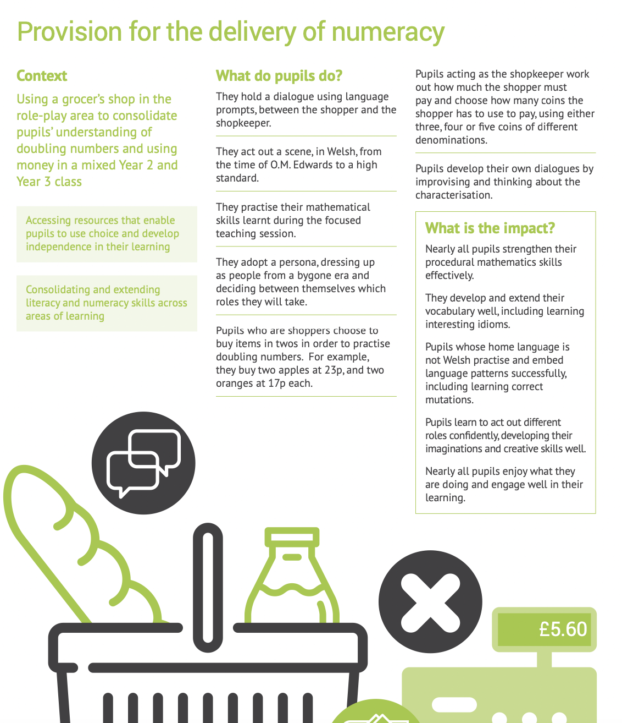

Slide 15
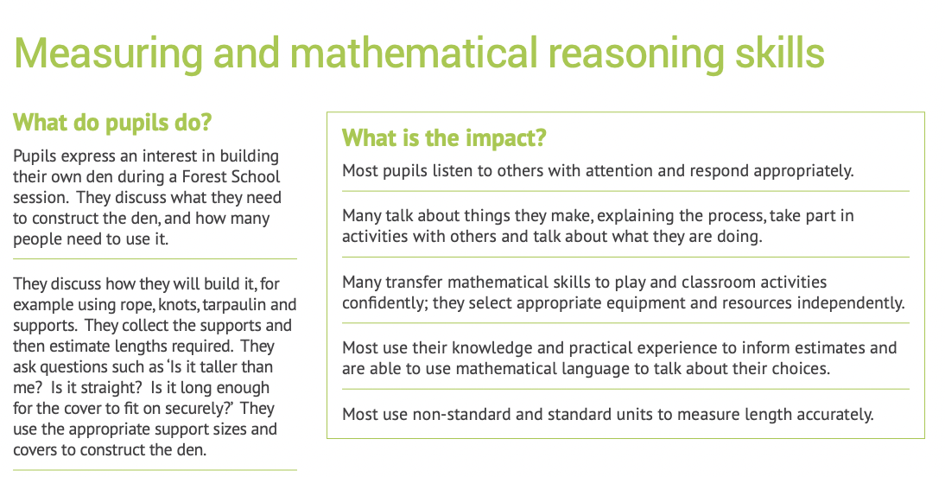

Slide 16
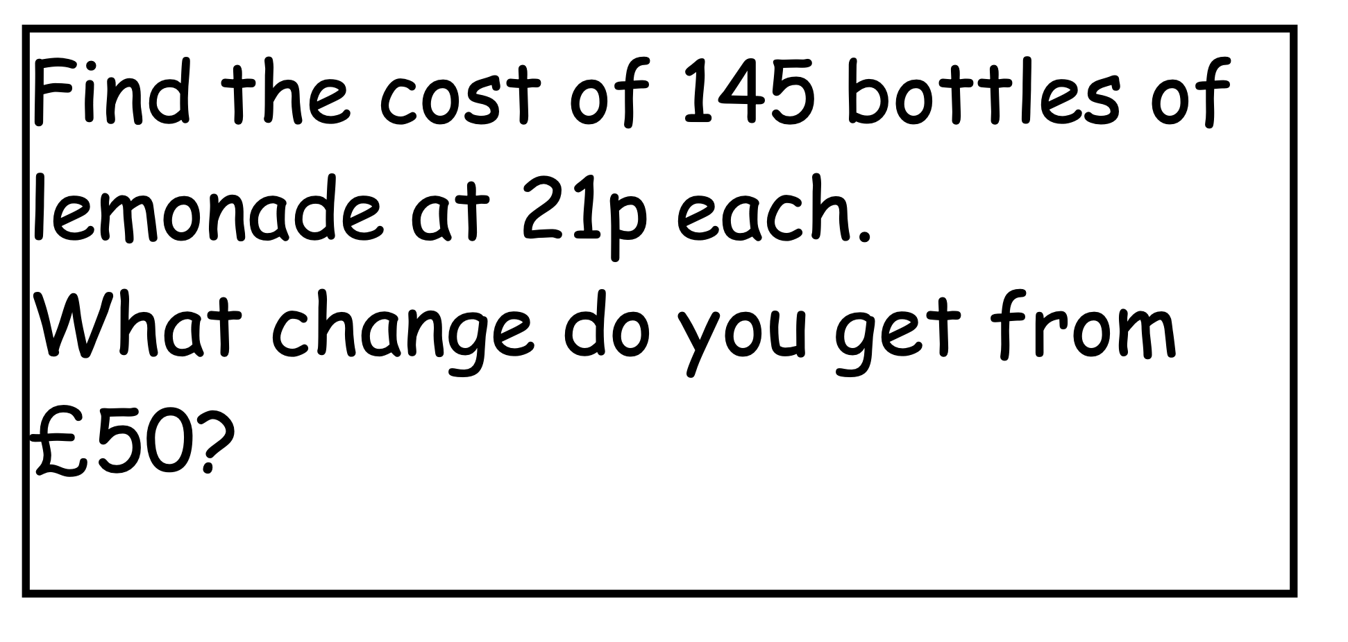
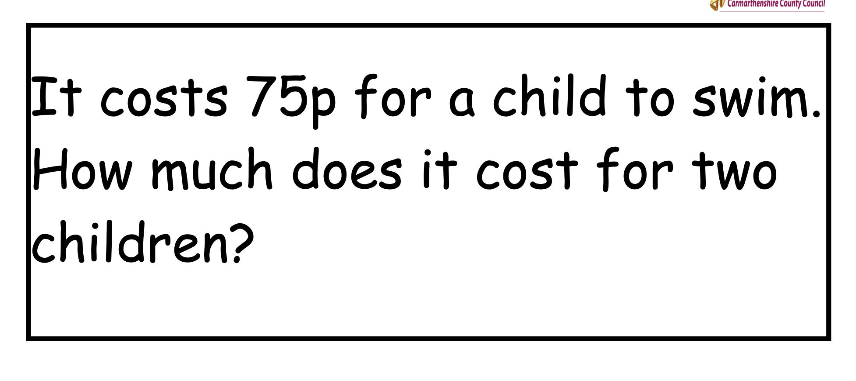
Real Life Problems - Solving Problems

Slide 17
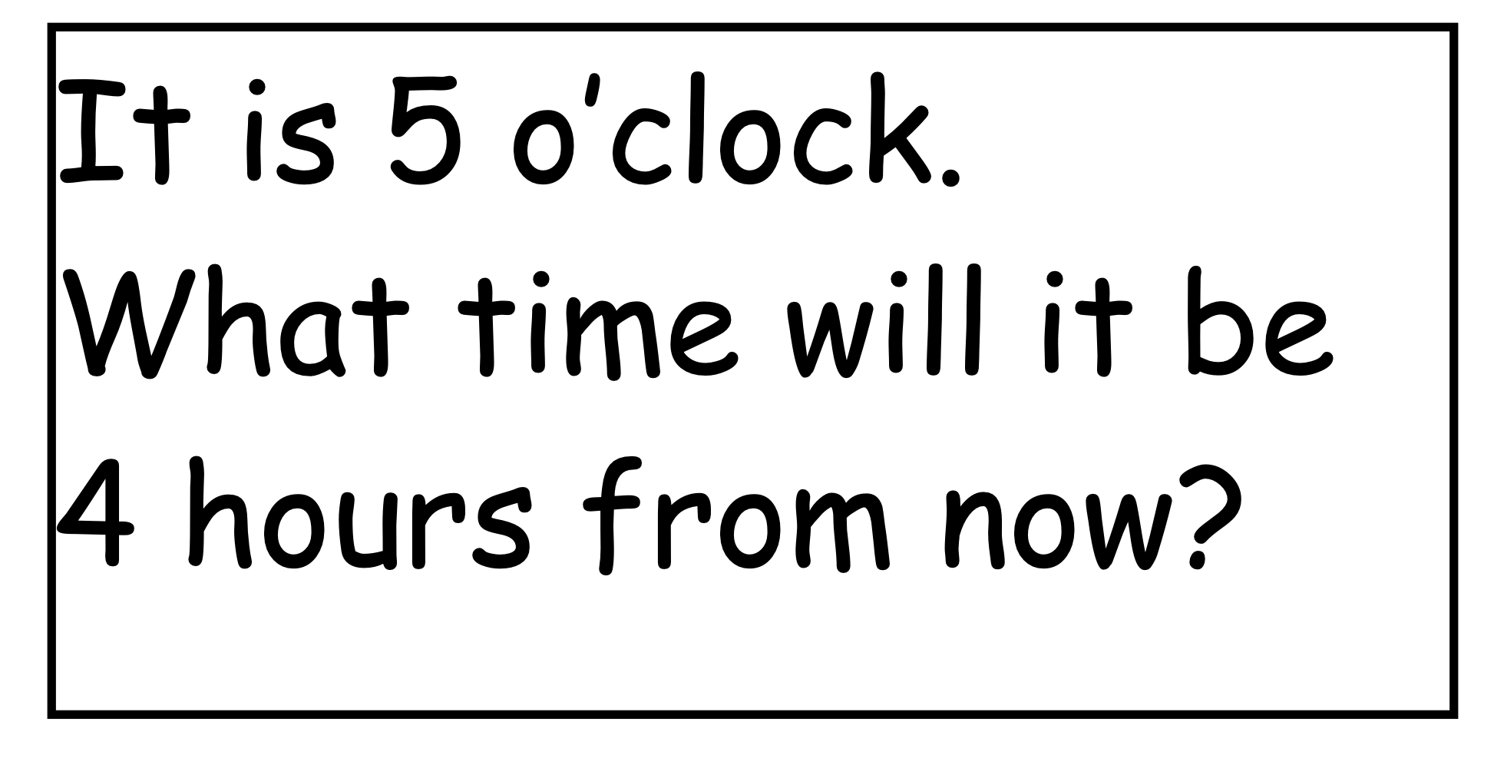
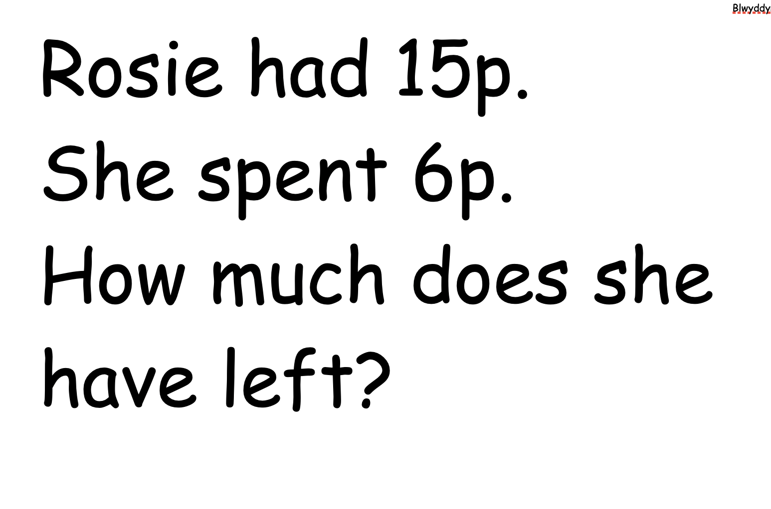
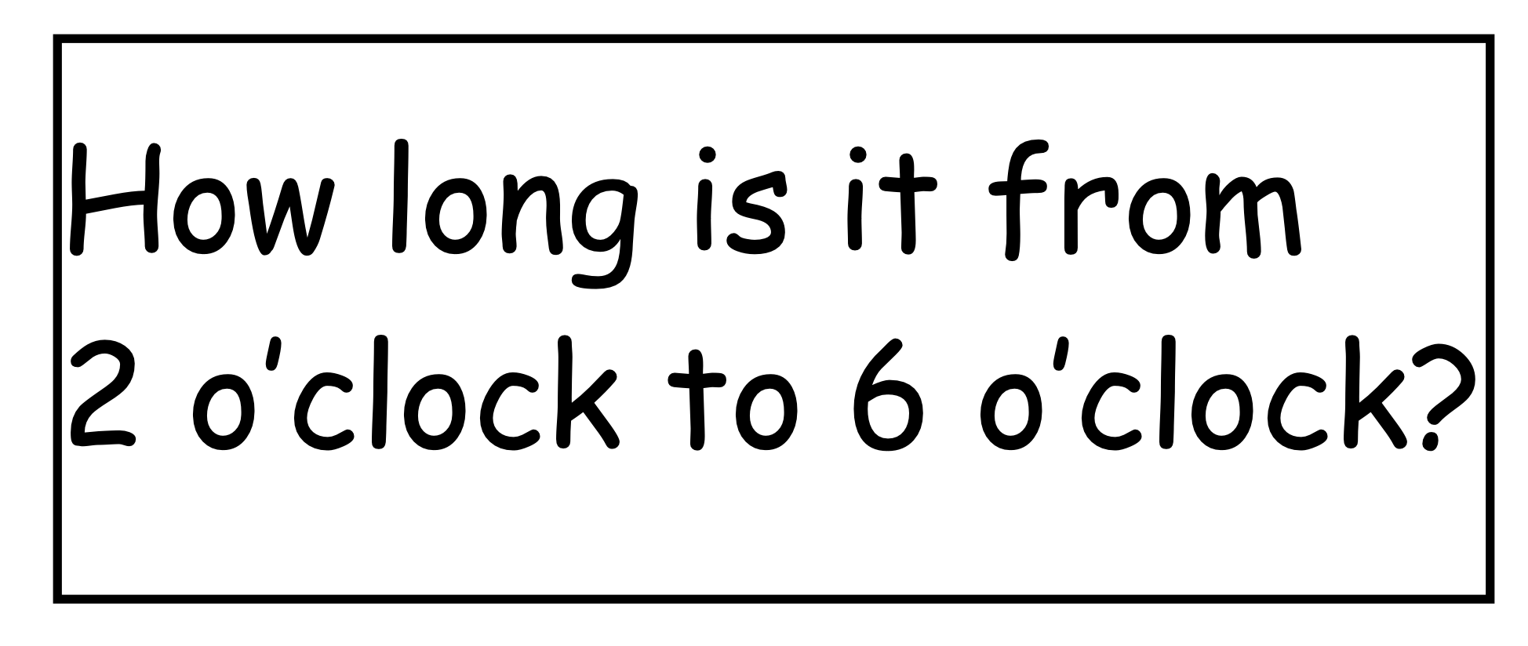

Slide 18

Link to LNF 2022
Numeracy Framework

Slide 19
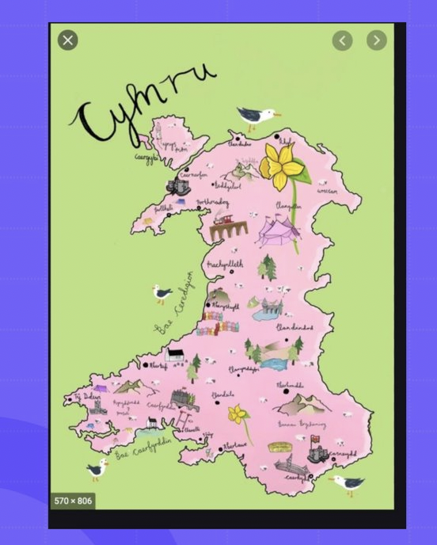
Cross-curricular themes
What would make a good cross-curricular theme for your different classes?

Slide 20
Task
1
2
3
In your groups choose 2/3 themes.
Think of as many mathematical activities as you can for each theme.
Be ready to share your ideas.

Slide 21


