Slide 1
Referencing & PLAgiarism

Slide 2

References vs. plagiarism

Slide 3
Referencing is…
A clear acknowledgement of where you have got any information, ideas, opinions, viewpoints etc.
Essentially, every piece of information, every opinion, every viewpoint, every picture and sketch needs to be referenced.

Slide 4

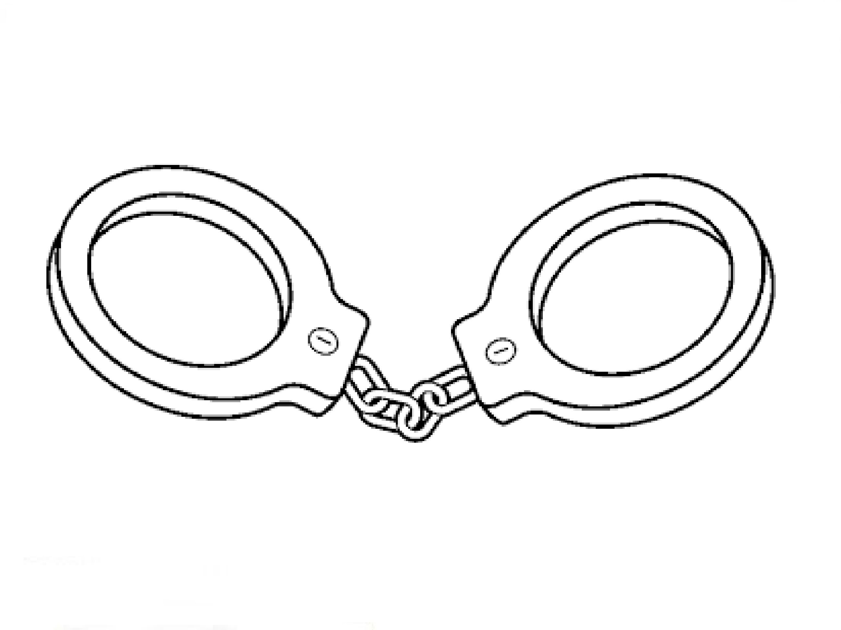
Plagiarism is…
Presenting the words, ideas, views and arguments of others as your own.
This is an academic crime and can cost you your degree.

Slide 5
Some basics
If you are quoting from a book, source or article, use inverted commas: “…”
NEVER COPY PASTE (not even in your own notes), unless you intend to use it as a quotation and it is clearly marked as such.
Read the Referencing Guide carefully. It will give you examples of how you should reference different material.
In Classics & Ancient History we use Harvard with the Classics Supplement.

Slide 6
Note-taking, Referencing and Plagiarism
Correct note-taking means you can reference well and you can avoid inadvertent plagiarism.
HOW TO TAKE GOOD NOTES:
Start every note with the exact reference you would use in your essay.
If you are quoting (i.e. copying down exactly what the author has written), then put the quotation in quotation marks “…”.

Slide 7
Types of unfair practice

Slide 8
Types of Unfair Practice in Coursework
Intentional Plagiarism
Inadvertent Plagiarism
Self-Plagiarism
Collusion

Slide 9
Intentional Plagiarism
This occurs if you simply copy chunks out of a textbook or from a website and pass them off as your own composition. There is nothing to be gained from this; it will always, if detected, count against you.

Slide 10
Inadvertent Plagiarism
This may occur if, in the course of note-taking, you copy substantial passages from a book or article into your own notes. After a lapse of some days, you may have forgotten that the notes were taken verbatim from another writer, and may use them in the composition of an essay. From the point of view of the tutor reading the essay, this is still plagiarism, even if unintentional.

Slide 11
Self-Plagiarism
Besides ensuring that all essays you submit are your own work, you must also avoid self-plagiarism. This means that you must not submit the same piece, or part of a piece, of work (with or without merely stylistic variation) in order to gain credit more than once. The same criteria apply to self-plagiarism as to other forms of plagiarism, and it is liable to incur the same penalty.

Slide 12
How to Avoid Plagiarism:
The GOLDEN RULE
ALWAYS ACKNOWLEDGE YOUR SOURCES!

Slide 13
Penalties
The higher your level of study, the harsher the penalties for Unfair Practice.
A second offence is treated more harshly than a first offence.
In determining the penalty, intention does not matter. So if you did it without realising it, that does not count AT ALL as a defence.
The penalties and regulations are available in the Academic Quality Handbook (you can see this on MyDay under Academic Office).

Slide 14
Remember
Plagiarism is committed every time you present the WORDS, IDEAS or VIEWS of others as your own.
This means that failing to reference adequately is a form of plagiarism (hence why poorly referenced pieces of work are penalised).

Slide 15
Recognising and avoiding unfair practice

Slide 16
Let’s try this out…
You should have one page with part of an academic article and a “mock” essay paragraph.
Read through both and decide what is plagiarism and what is not.
Mark yourself… (this is just for you, not official)

Slide 17
Unfair Practice?
Excavations in 1964 uncovered a building that is tentatively identified with the “Persian Stoa”.
YES
NO

Slide 18
Unfair Practice?
Excavations in 1964 uncovered a building that is tentatively identified with the “Persian Stoa”.
YES

Slide 19
Unfair Practice?
Excavations in 1964 uncovered a building that is tentatively identified with the “Persian Stoa”.
Why? No reference!
YES

Slide 20
Plagiarism?
The excavation uncovered a very important Roman statue made of bronze (Pikoula 2001:425).
YES
NO

Slide 21
Plagiarism?
The excavation uncovered a very important Roman statue made of bronze (Pikoula 2001:425).
NO

Slide 22
Plagiarism?
The excavation uncovered a very important Roman statue made of bronze (Pikoula 2001:425).
NO
Why?
Has reference
and there is no quotation.

Slide 23
Plagiarism?
Pikoula (2001:425) considers the appearance of the statue “odd”.
YES
NO

Slide 24
Plagiarism?
Pikoula (2001:425) considers the appearance of the statue “odd”.
NO

Slide 25
Plagiarism?
Pikoula (2001:425) considers the appearance of the statue “odd”.
NO
Why?
Has reference
and the quotation is marked.

Slide 26
Plagiarism?
According to Pikoula (2001:425) the individual features of the statue are discernible: thinly arched brows, big eyes with heavy upper eyelids, small fleshy mouth.
YES
NO

Slide 27
Plagiarism?
According to Pikoula (2001:425) the individual features of the statue are discernible: thinly arched brows, big eyes with heavy upper eyelids, small fleshy mouth.
YES

Slide 28
Plagiarism?
According to Pikoula (2001:425) the individual features of the statue are discernible: thinly arched brows, big eyes with heavy upper eyelids, small fleshy mouth.
Why?
Has reference
But NO quotation marks.
YES

Slide 29
Plagiarism?
Further the hair is rendered by incision and is parted in the centre.
YES
NO

Slide 30
Plagiarism?
Further the hair is rendered by incision and is parted in the centre.
YES

Slide 31
Plagiarism?
Further the hair is rendered by incision and is parted in the centre.
YES
Why?
No reference and no quotation marks

Slide 32
The tin report

Slide 33
What is TIN?
TIN, i.e. Turn-It-In, is a JISC text-matching software.
All essays, gobbets, PowerPoints, etc., are automatically submitted through TIN.
TIN does NOT detect unfair practice, but it is a very useful tool to start one’s detection of unfair practice.
Each piece of work is individually considered by the lecturer.
From this year, students can see their TIN reports in advance of the deadline (if you submit your work early enough) – this means that you can identify any inadvertent unfair practice and correct it (if you do it by the deadline).

Slide 34
How to read the TIN report
You need to read the TIN report carefully.
This is a blunt tool.
It will identify as “text-matching” anything it can find, including your name (from another essay), or a bibliographical item.
You need to learn to ignore these, and concentrate on what is important.

Slide 35
Working with examples
We will work with an example, so that you can see how the TIN report works.

