Slide 1

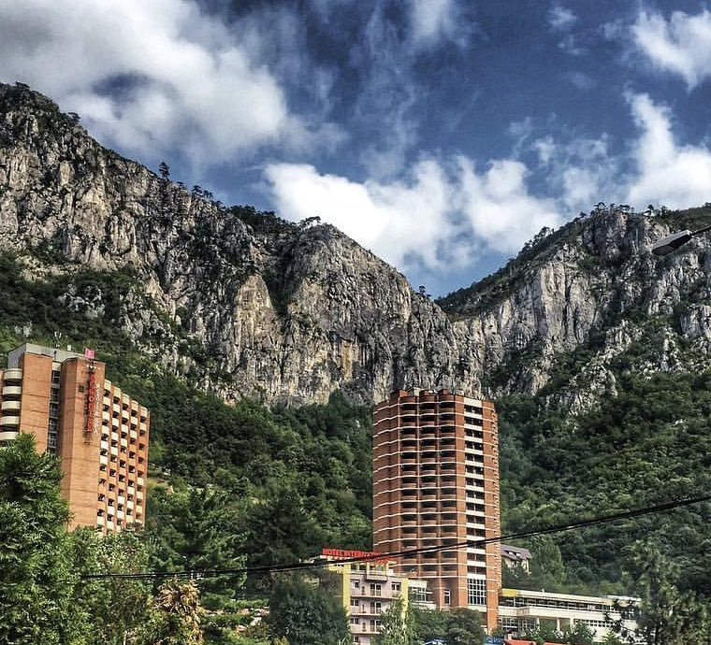
Hospitality and Guest Service Management
Presented by
Radu Grecu
1815250
Grand Hotel Minerva
Relaxation &Treatment base & SPA

Slide 2
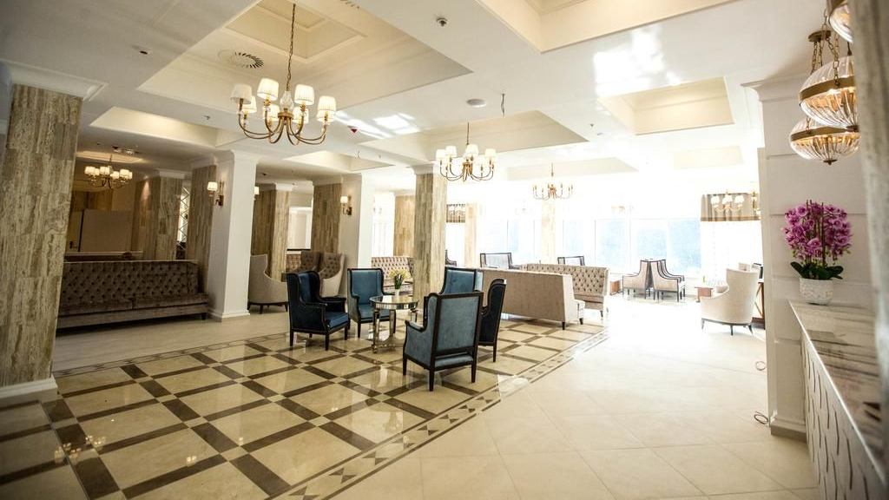
About us
Grand Hotel Minerva
Invites you to discover in Baile Herculane in the refinement, the hospitality and the comfort of a 4 star hotel, a special concept for one of the oldest balneo resorts in the world.

Slide 3
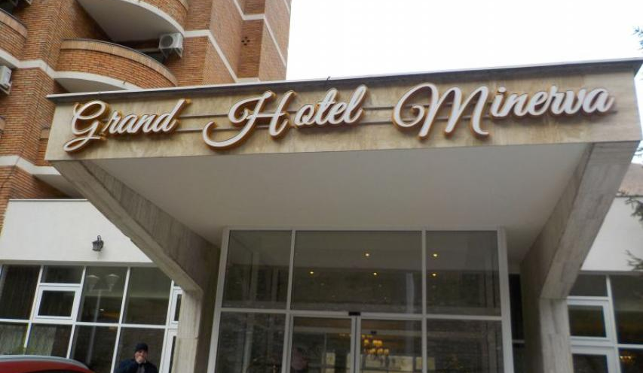
Overview
LANGUAGES SPOKEN BY STAFF
ENGLISH
FRENCH
GERMAN
ITALIAN
SPANISH
PET POLICY
WE WELCOME GUIDE DOGS
CAR PARKING
FREE CAR PARK FOR GUESTS
DISABILITY ACCES

Slide 4
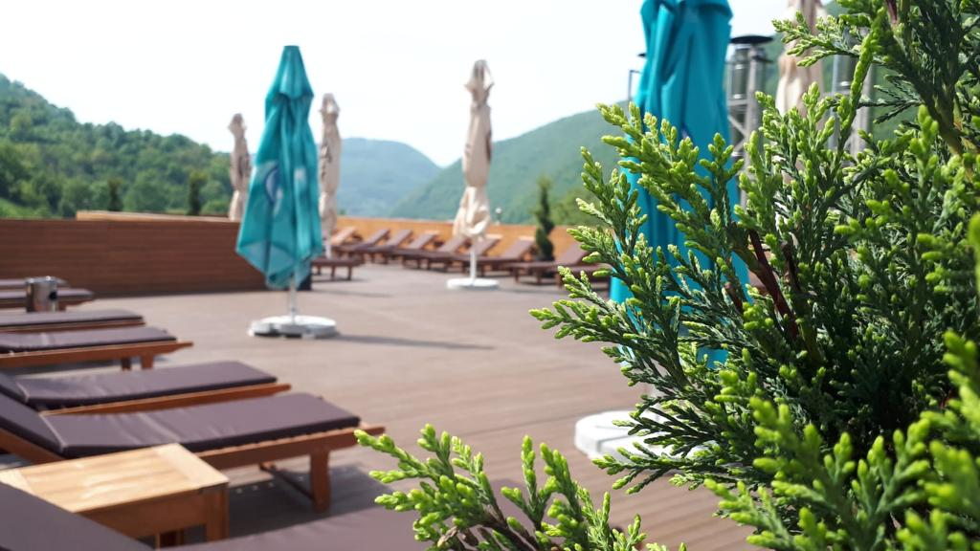
Facts about The Grand Hotel Minerva
Grand Hotel Minerva is situated in the centre of Baile Herculane resort in Romania
It is a 4-star hotel.
It is one of the oldest spa resorts in the world, famous for the miraculous thermal waters.
It offers 185 guest rooms.
Atmosphere, refinement and quality amenities will accompany you throughout the Grand Hotel Minerva experience.

Slide 5
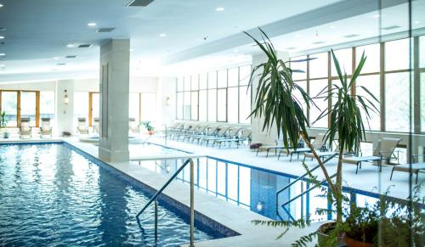
Services
We offer to our guest's medical treatment services in order to prevent any health injuries
There are specific procedures that can be performed on our treatment base: Laser, Ultrasound, Magnetotherapy, Radiofrequency Therapy, Paraffin, Streams, Sulphur Baths, CO2 Baths, Galvanic Baths, Underwater Shower, Aerosols, Physical Therapy, , mud packing.
Procedures with extra charge: zomotherapy, laser. relaxing massages, mud packs, thermal wrapping,
The procedures are established directly by the balneal doctor, they can be changed only at the request and under the approval of the balneal physician.
Guests will receive the referral from their family doctor or specialist doctor(recommendation for balneary treatment )
Treatments take place from Monday to Saturday inclusive
Free access to Harmony Spa
(swimming pools, fitness, Jacuzzi baths, 5 saunas.)
Guests receive dinner on check-in and breakfast on the check-out day

Slide 6
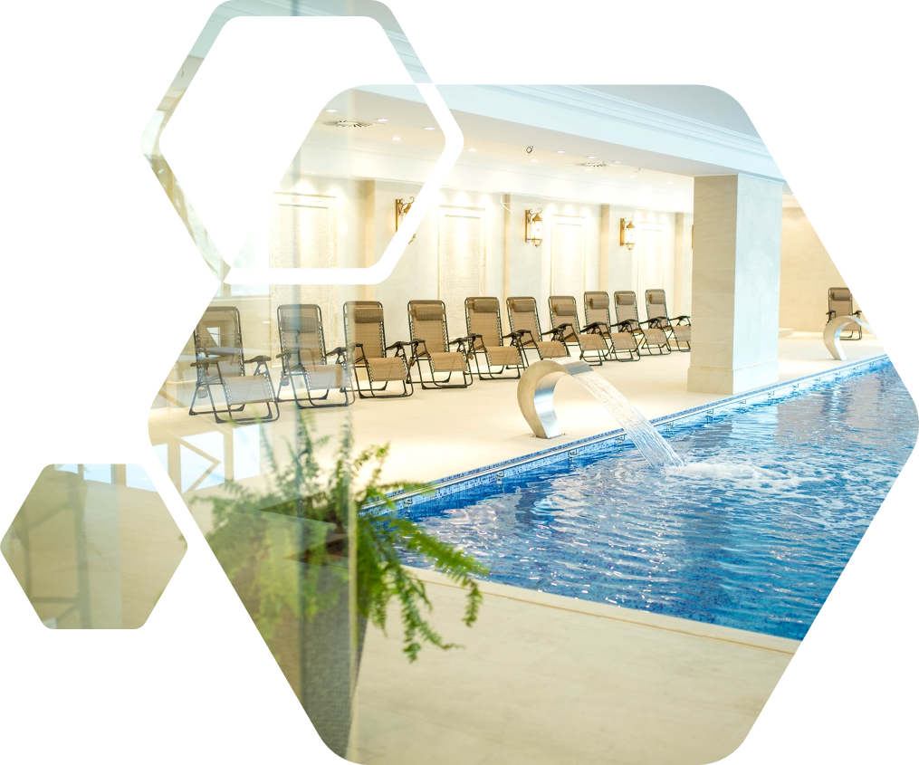
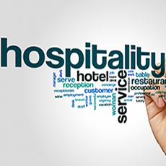
Services
In-room Services:
Whether you want to reward yourself at the end of an exhausting week, whether you are on holiday with your family or colleagues at teambuilding at Grand Hotel Minerva, you get rid of all the stress that drives you.
Classic Room ,Suite ,Apartments-including
LCD – TV cable
Minibar
Air conditioning
Hairdryer
Slippers
Dressing
Phone
Wi-Fi Internet
Other services:
Children Club-games and special terrace for parents and children
Lounge and bar near the sand
Parking

Slide 7
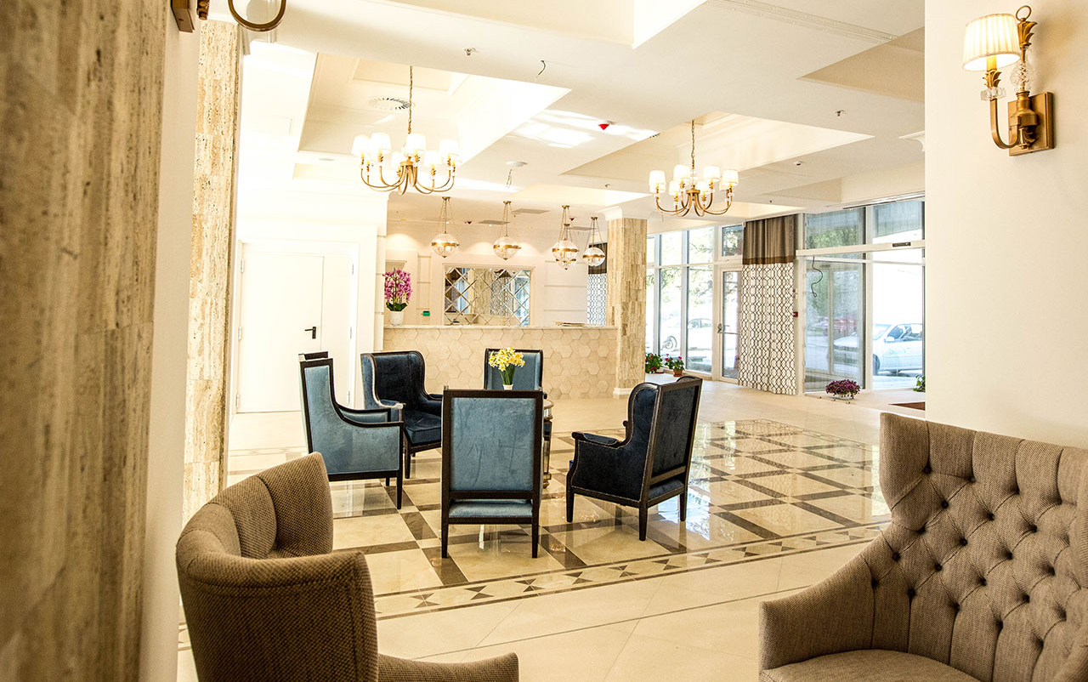
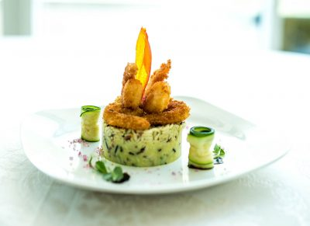
Products
We have for our guests more different types of accommodation:
13 GHM Apartments
114 Matrimonial Rooms
50 Twin Rooms
8 Suite
2 restaurants and 2 terraces

Slide 8

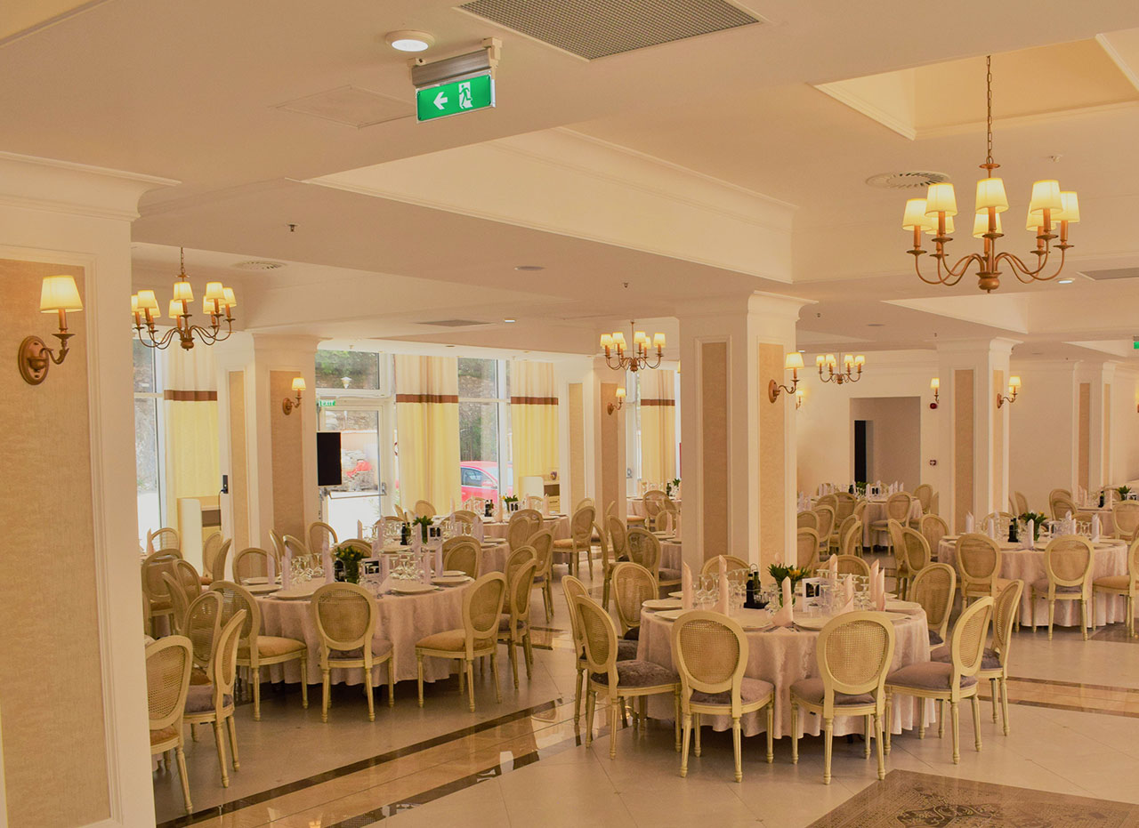
Unique Selling Point (USP)
https://www.istockphoto.com/de/grafiken/usp?sort=mostpopular&mediatype=illustration&assetfiletype=eps&phrase=usp
One of the unique selling point in the Grand Hotel Minerva is based on the foods it offers. This because they are making the guests admire the nice and appetising looking of the foods which are available for everyone.
But the most important unique selling points it is the treatment that the customers can do because the hotel has thermal water.
http://hotelminerva.ro/restaurante/

Slide 9
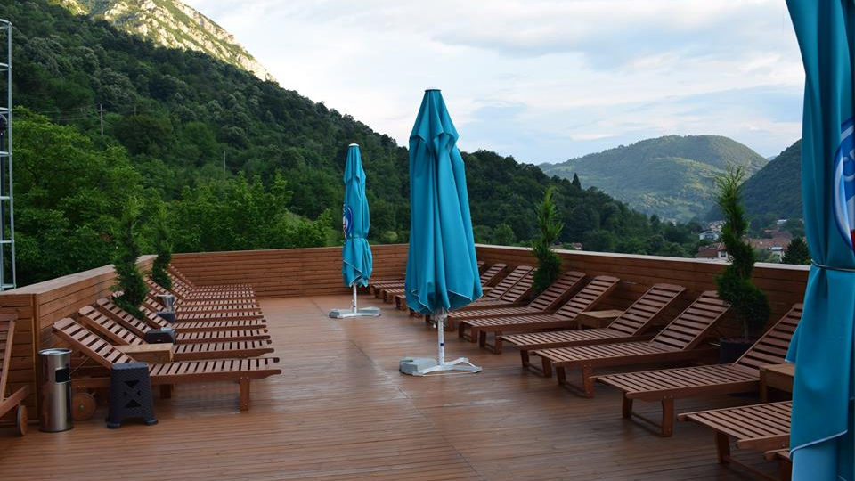
Guest Services
We welcome all guest
Help them with any information
Respect, patience
Data protection policy
Best treatment in the area
Healthy food

Slide 10
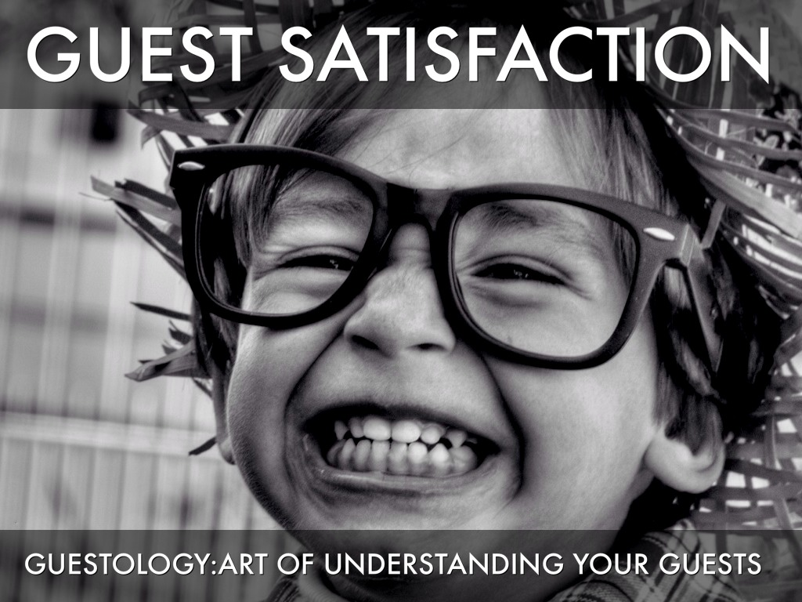
GUESTOLOGY
The guestology is adapted from the Walt Disney and it is considered as being a standard in the Service industry.
Next to that the concept of guestology is focused on the guest experience more than on the organisational efficiency of the hotel and this because the guests experiences are the ones contouring the standards of the hospitality industry.
The Guestology has two service models which are making the guests experiences very good. These being: ¬The Disney S.E.R.V.I.C.E model and the ¬GPOV model
1. The Disney SERVICE: smile, eye contact, respect, value the magic, initiate guest contact, creative solutions, end with a thank you.
2. GPOV- Listen to Guest Point Of View.

Slide 11
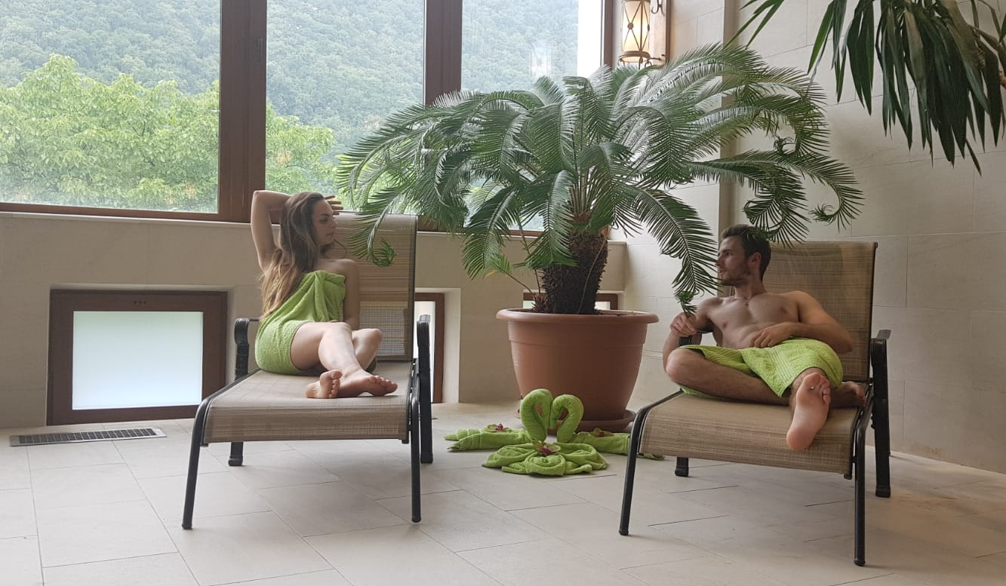
Guest Experiences
Everything was great! - meals (breakfast and dinner) served in buffet style. Although at first glance the options seemed limited, everything was delicious and fresh and you soon realized that no more needed. - the cleanliness was irreproachable, the linen was changed to two days, the towels daily. - Very clean and well-organized spa with massages and varied therapies. - very friendly and welcoming staff with children, even having a playground where they can spend their time.

Slide 12

SWOT ANALYSIS
Strengths: It has two restaurants with a big capacity
Weaknesses: The members of staff are not always showing interest
Opportunities: Look at international hotels and adapt some strategies from them
Threats: the economy of the hotel is not as big and permissive to changes.

Slide 13
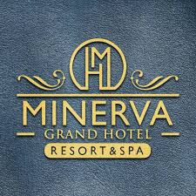
Conclusion:
This hotel is also rated for the best value in Băile Herculane! Guests are getting more for their money when compared to other properties in this city.
Also has one of the best-rated locations in Băile Herculane! Guests are happier about it compared to other properties in the area.

Slide 14
References:
Gerard De Manresa (2016), “Guestology is essential for success, your employees even more”, [online available on: https://www.linkedin.com/pulse/guestology-essential-success-taking-good-care-your-even-d-Manresa, accessed on: 19/02/2002]
Grand Hotel Minerva (2018), “About us” [Available on:http://hotelminerva.ro/en/about-us/, accessed on: 15/02/2020]
Juwaheer T.D. and Ross, D. L., (2003), “ A study of hotel guest perceptions” in Mauritius international journal of contemporary hospitality management Vol. 15, 2 [online available on: http://jthmnet.com/journals/jthm/Vol_2_No_1_June_2014/6.pdf, accessed on: 18/02/2020]
Ford , R.C., Heaton, C., P., and Brown, S. W. (2001) “Delivering excellent services. Lessons from the best firms”, in California Managements review , 44 (1): 39 – 56, [online available on:https://books.google.co.uk/books accessed on: 20/02/2020]
Kandampully, J., Mok, C. and Sparks, B. (n.d.). Service quality management in hospitality, tourism, and leisure.
Bonini, A. (2004). Guestology. Rimini: Trademark.

