Slide 1

SOFTWARE SOLUTIONS FOR BUSINESSES
BY KAMRAN KHAN
2221734

Slide 2

Index
E-COMMERCE HOW IT STARTED
2. AMAZON
3. YOUTUBE
4. FACEBOOK
5. REFERENCES

Slide 3

E-COMMERCE&HOW IT STARTED
The first online sale took place on August 11, 1994, when a man sold a CD by the band Sting to a friend via his website NetMarket, an American retail platform. This is the first instance of a consumer purchasing a product from a business via the World Wide Web, also known as "e-commerce" today. Since then, e-commerce has evolved to make products easier to discover and purchase through online retailers and marketplaces. Independent freelancers, small businesses, and large corporations have all benefited from ecommerce, which allows them to sell their goods and services on a scale that traditional offline retail does not allow.

Slide 4

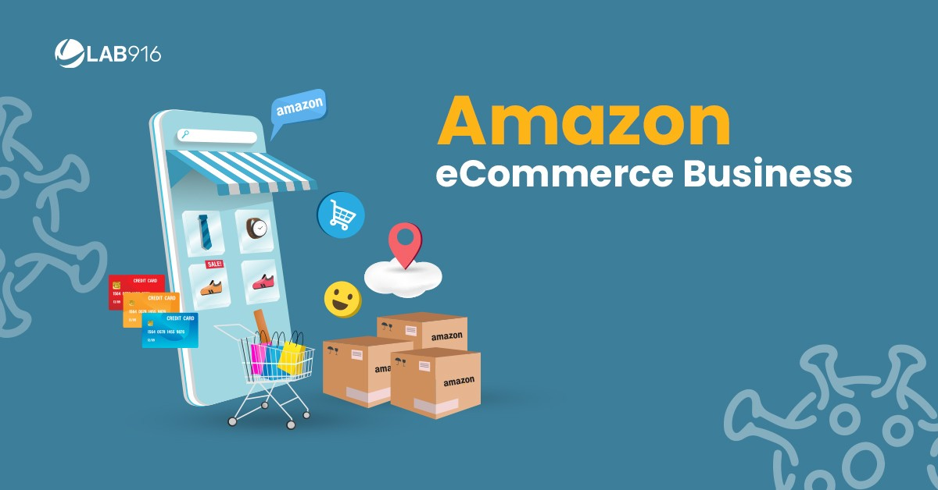
How it started
Amazon began as an online bookselling service and has since evolved into an internet-based business enterprise primarily focused on providing e-commerce, cloud computing, digital streaming, and artificial intelligence (AI) services. Amazon, headquartered in Seattle, operates a global network of websites, software development centres, customer service centres, data centres, and fulfilment centres.
It was founded by Jeff Bezos in his garage in Bellevue, Wash., on July 5, 1994 and has a current Revenue of 514 billion USD (2022)
Amazon Website

Slide 5

YouTube, Web site for sharing videos. It was registered on February 14, 2005, by Steve Chen, Chad Hurley, and Jawed Karim Google paid $1.65 billion for YouTube in October 2006. This expanded the site's business model, shifting it from generating revenue solely from advertisements to offering paid content such as movies and exclusive YouTube content. It also provides YouTube Premium, a paid subscription option for viewing content without advertisements.
While Amazon is a multinational technology company focused on e-commerce, Youtube is a global online video sharing and social media platform.
Youtube Website

Slide 6

Facebook is a website free to use wich allows users to create profiles, upload photos, join existing groups, and create new ones or can chat with each other, private messages or make video calls.The company makes the majority of its money from advertisements on the website With nearly three billion users ,Facebook became the world's largest social network, with roughly half of that number using it every day.
While Amazon is providing e-commerce services and Youtube is a site for sharing videos, Facebook is a website that allows users to connect with friends and not only.
Facebook Website

Slide 7

References
https://www.britannica.com/topic/YouTube
2. https://www.shopify.com/uk/blog/what-is-ecommerce
3. https://www.techtarget.com/whatis/definition/Amazon
4. https://www.britannica.com/topic/Facebook
5. https://images.google.com/

