Slide 1
Mark Huntly
m.huntly@uwtsd.ac.uk
ExpressJS

Slide 2
Express Characteristics
Express is a framework for NodeJS that allows the building of server-side JavaScript applications.
It is lightweight and unopinionated.
  Designed to be a minimal and flexible framework.
  Provides a robust set of features for web and mobile applications.
  Provides enough structure to handle HTTP requests and responses.
  Offers developers freedom in how applications are structured.
Notes:
Unlike opinionated frameworks that dictate specific patterns and architectures, Express provides just enough structure to handle HTTP requests and responses while letting you make architectural decisions.

Slide 3
Express Features
The Express framework is versatile.
It offers robust functionality for web applications including:
  Routing
  Middleware support
  Templating engine integration
  Error handling
  Request / response manipulation

Slide 4
Express Builds
Express is powerful enough to enable the creation of:
  Web servers
  Web services
  REST APIs
  Real-time applications
  Content Management Systems
  Single-page application backends
  Microservices
  Etc…
Notes:
The "web service or webserver" description is quite broad—Express can handle virtually any HTTP-based backend application.

Slide 5
Express Compatibility
Express is often used alongside other tools and technologies:
  Databases such as MongoDB or PostgreSQL
  Template engines such as EJS or Pug
  Frontend frameworks such as React, Vue or Angular
Provision to create complete full-stack applications.

Slide 6
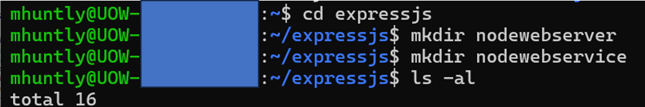
Exercise – Set up Express
Make a new directory called expressjs
Cd into expressjs
Create two new directories
  Nodewebserver
  Nodewebservice
Download three files from Moodle and place them in expressjs.
  .dockerignore
  docker-compose
  Dockerfile

Slide 7
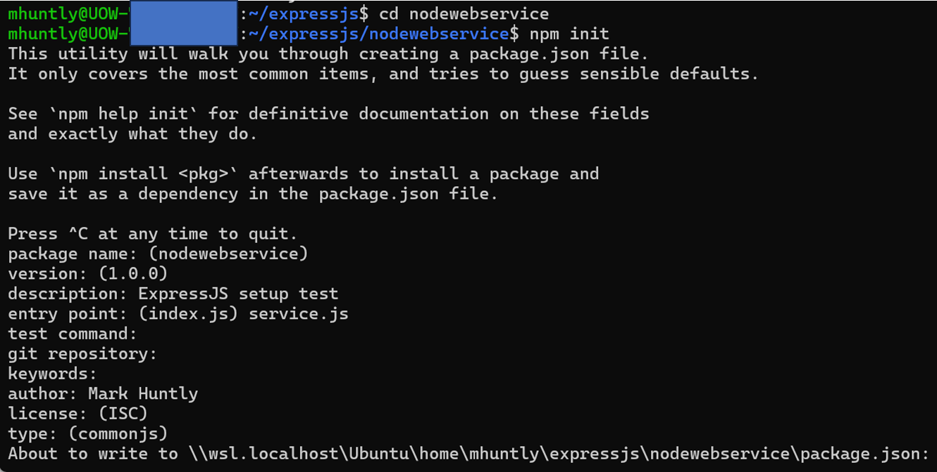
Exercise – Set up Express
Cd into the nodewebservice directory
Create a package.json file using npm init, answering the questions

Slide 8
Exercise – Set up Express
For this example we will use Express.js framework and a PostgreSQL database.
Whilst in nodewebservice directory, using npm install:
  express
  express-validator
  cors
  pg
  pg-format

Slide 9
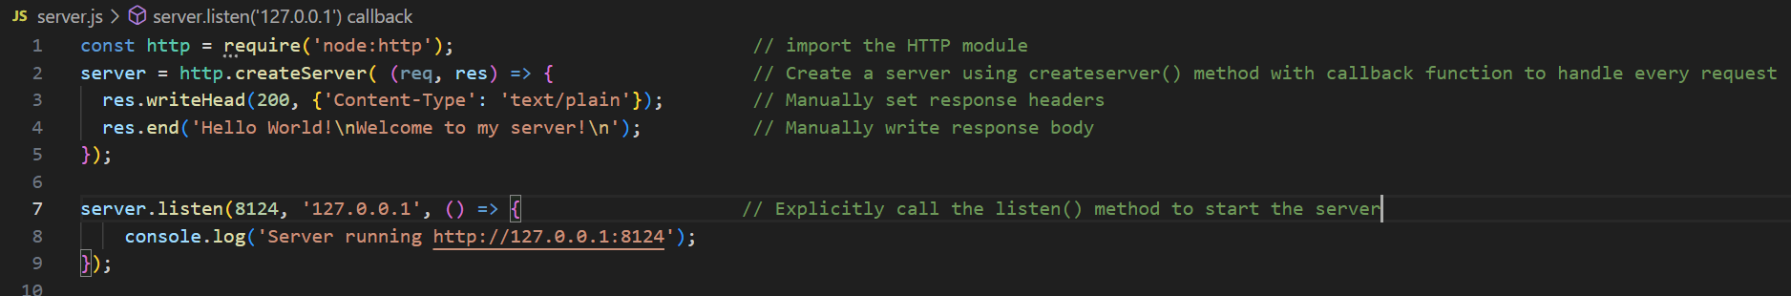
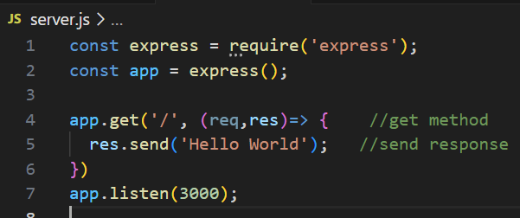
Node.js vs Express
Remember our Node.js code?
It can be simplified with Express
  Defines semantic routes
  Handles headers and response writing
Notes:
With NodeJS, even for a simple "Hello, World" application, you're writing boilerplate code that doesn't directly relate to your application logic.
Express abstracts away much of this complexity.
The Express version is significantly shorter and more readable.

Slide 10
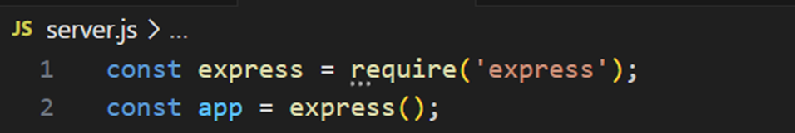
Express Object
To use Express we have to create an object that represents our server and contains a number of methods we can use.
  In particular, the routing methods.
The naming convention is common practice, using app as the object name, but the name isn’t important. You will see me call it service sometimes.

Slide 11
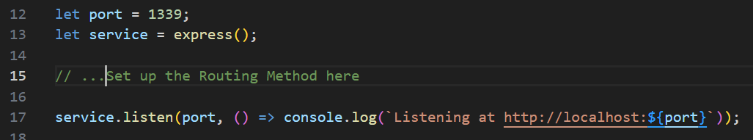
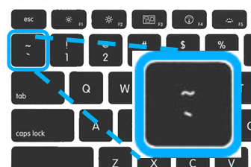
Start the Server / Service
Once the object is created, we can call its .listen() method with a port number to start the service (app).
Make sure you use the tilde

Slide 12
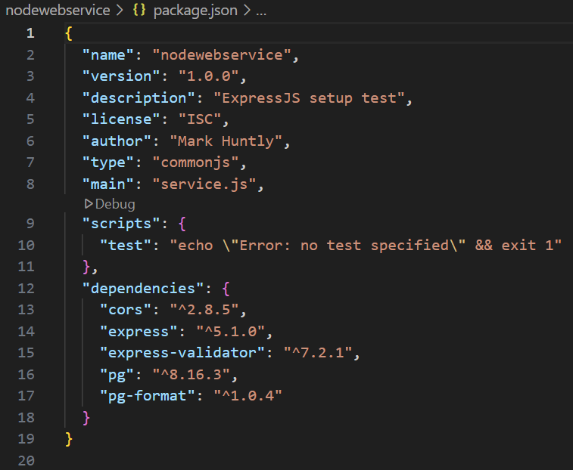

Exercise – Set up Express
Add some commands to the package.json file, replacing a line:
Replace this line with this:

Slide 13
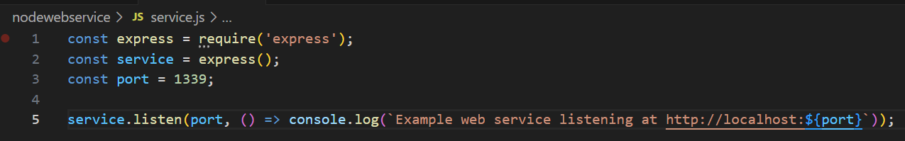
Exercise – Set up Express
Inside the nodewebservice folder, create a file called service.js
Compile and run the service with npm run-script start
  Or the short-hand npm run start
  This will run the “start” command script from package.json scripts object that was created.

Slide 14
Automatic Rebuild
You will notice that if you change the code, then you have to <Ctrl>+<C> and then restart the service by typing node service.js
We would really like the service to automatically restart when the code is changed. Nodemon is a module that allows us to monitor the code for changes to restart the service.
And to monitor the main.js file we use:
main.js represents the first file to execute…all its dependencies are automatically monitored

Slide 15
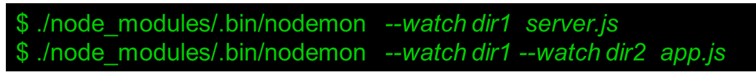
Automatic Rebuild
You can monitor a different directory using the --watch option (or even multiple directories, using multiple –watch
By default nodemon will traverse all sub-directories.

Slide 16
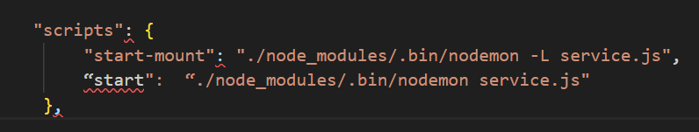
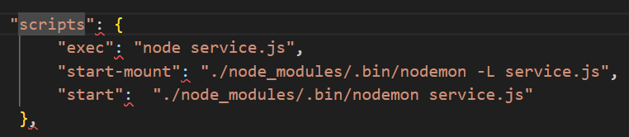
Exercise – Adding script
Install nodemon as a dev dependency.
We can add nodemon as a script
  EITHER like this: Use:
  $ npm run start
  OR $ npm start
OR like this if you also want to be able to run the script without the automatic build:
$ npm run exec
$ npm run start
$ npm start
FYI: The “start-mount” script is required to allow nodemon to read across a mounted drive when we use it docker-compose

Slide 17
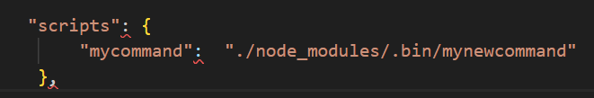
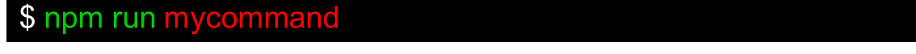
Alternative Way (FYI)
To use a locally installed package we used the scripts approach:
Execute the script:

Slide 18
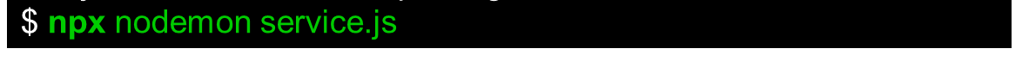
Alternative Way (FYI)
However, ordinarily a better approach is to use npx to run the local package because we would not need to manually edit package.json
For example, instead of adding the “start” script to package.json we can just run the nodemon package.
In our case, the argument “service.js” is included so we do not need to enter it each time. Which is why we are using this “script” approach.

