Slide 1

Intercultural Communication
Dr Caroline Jawad 2018

Slide 2
https://repositorio.iscte-iul.pt/bitstream/10071/12698/1/Final%20version%21%29%20Apply%20Hofstedes%20National%20Cultural%20Dimension%20Theory%20to%20Analyze%20Chinese%20Tourist%20Behaviors%20in%20Portugal%20Tourism--HuangXiaomei.pdf
It is known that national cultures have significant impact on determining what is important to tourists, how they make choices and what benefits they seek.

Slide 3
Managing people from different cultures
‘Differences in national culture may have a bearing on how organisations deal with each other and also on behaviour within organisations which comprise a mix of nationalities.’ Brooks
‘Managers must develop organisational systems that are flexible enough to take into account the meaning of work and the relative value of rewards within the range of cultures where they operate.’ Francesco and Gold
Mullins (2016:22)

Slide 4
Attributes does the global manager

Slide 5
Context: 10 Attributes of the Global Manager (French, 2011)
Be culturally sensitive and adaptable
Solve problems quickly and under different circumstances
Motivate and communicate well with people from different cultures
Understand different government and political systems
Manage and create a sustainable environment
Convey a positive attitude and enthusiasm when dealing with others
Manage in both traditional and virtual worlds environments
Manage the triple bottom line: society, economy and the environment

Slide 6
Understanding culture and management
Research on communication - Edward Hall
Research on different organisational functions - Nancy Adler
Research on organisational culture - Edgar Schein
Research on national culture- Geert Hofstede

Slide 7

Aim of today: find examples - Hofstede

Slide 8
Comparing countries
https://www.hofstede-insights.com/product/compare-countries/

Slide 9
Task
Look up the countries in your assignment
America
China
Dubai (UAE)

Slide 10
Other resources
https://geerthofstede.com/research-and-vsm/vsm-2013/

Slide 11
Factors affecting national culture -Brooks, 2006 p. 272)

Slide 12

Hofstede
Survey data about the values of people in over 50 countries around the world. These people worked in the local subsidiaries of one large multinational corporation – IBM.

Slide 13

Hofstede
A statistical analysis of the answers on questions about the values of similar IBM employees in different countries revealed common problems, but with solutions differing from country to country, in the following areas:
  Social inequality, including the relationship with authority;
  The relationship between the individual and the group;
  Concepts of masculinity and femininity: the social implications of having been born as a boy or a girl;
  Ways of dealing with uncertainty, relating to the control of aggression and the expression of emotions.

Slide 14

The four basic problem areas represent dimensions of cultures. A dimension is an aspect of a culture that can be measured relative to other cultures.

Slide 15
The basic problem areas correspond to dimensions which Hofstede named as
Power distance (from small to large )
Collectivism versus individualism
Femininity versus masculinity
Uncertainty avoidance (from weak to strong).

Slide 16
Together they form a four-dimensional (4-D) model of differences among national cultures. Each country in this model is characterized by a score on each of the four dimensions.

Slide 17
Also
A fifth dimension of differences among national cultures was identified, opposing a long-term orientation in life to a short-term orientation
(Cultural differences exist also according to region, religion, gender, generation, and class)

Slide 18
Power distance
Power distance can be defined as the extent to which the less powerful members of institutions and organizations within a country expect and accept that power is distributed unequally.
'Institutions' are the basic elements of society like the family, school, and the community; 'organizations' are the places where people work.
Notes:
Power distance can be defined as the extent to which the less powerful members of institutions and
organizations within a country expect and accept that power is distributed unequally.
'Institutions' are the basic elements of society like the family, school, and the community; 'organizations' are the places where people work.
Individualism pertains to societies in which the ties between individuals are loose: everyone is expected to look after himself or herself and his or her immediate family. Collectivism as its opposite pertains to societies in which people from birth onwards are integrated into strong, cohesive ingroups, which throughout people's lifetime continue to protect them in exchange for unquestioning loyalty.
Masculinity indicates the extent to which the dominant values of a society are "masculine" (e.g., assertive and competitive). Masculinity pertains to societies in which social gender roles are clearly distinct (i.e., men are supposed to be assertive, tough, and focused on material success whereas women are supposed to be more modest, tender, and concerned with the quality of life. Femininity pertains to societies in which social gender roles overlap i.e., both men and women are supposed to be modest, tender, and concerned with the quality of life.
Uncertainty avoidance can be defined as the extent to which the members of a culture feel threatened by uncertain or unknown situations and try to avoid such situations. This feeling is, among other things, expressed through nervous stress and in a need for predictability: a need for written and unwritten rules.

Slide 19
Continued
Power distance is a term that describes how people belonging to a specific culture view power relationships - superior/subordinate relationships - between people, including the degree that people not in power accept that power is spread unequally.
Individuals in cultures demonstrating a high power distance are very deferential to figures of authority and generally accept an unequal distribution of power, while individuals in cultures demonstrating a low power distance readily question authority and expect to participate in decisions that affect them.

Slide 20
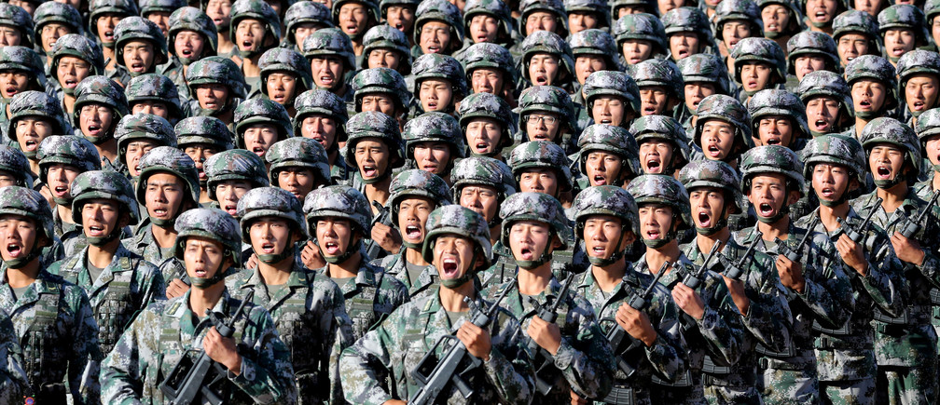

Slide 21


Slide 22
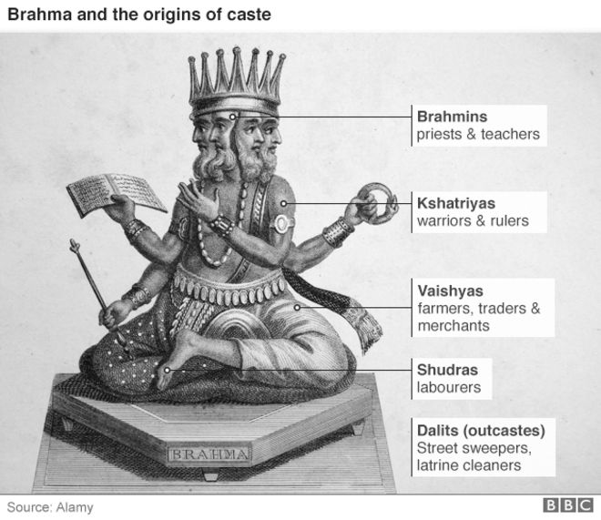
Example High power distance
India’s caste system is an example of high power
People are born into 1 or 5 caste levels or groups, each having a higher status than the one below it
Indian citizens belong to the caste they are born into and cannot aspire to enter another
From birth, their power is defined by the caste

Slide 23
Example Low power distance
Basically where everybody expects to get listened to

Slide 24
Scandinavia, New Zealand
Check !!

Slide 25
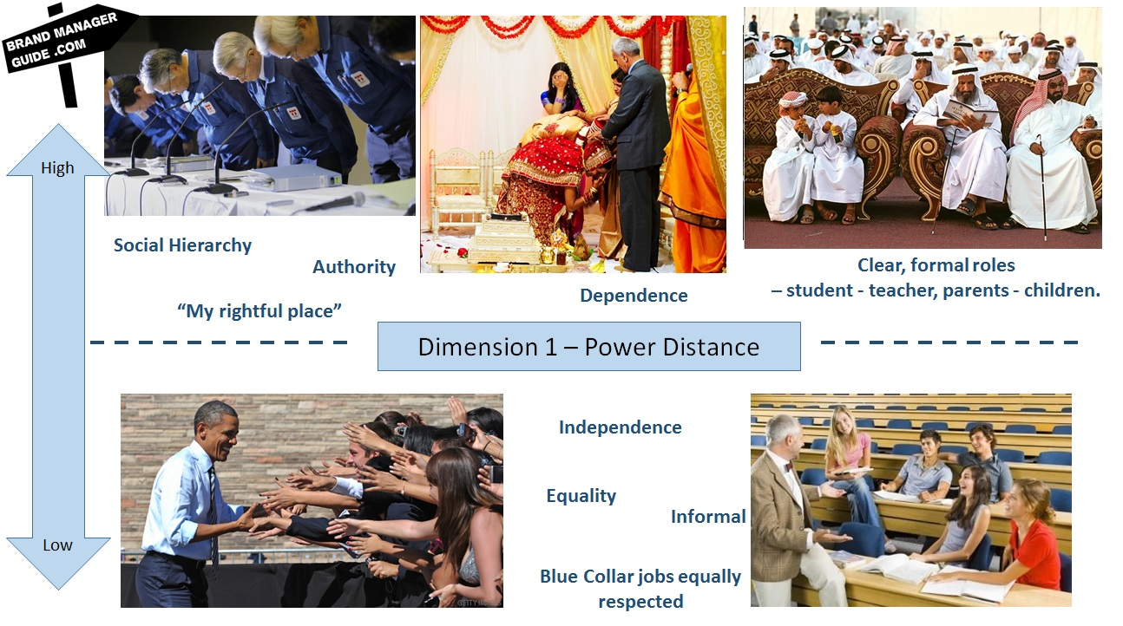

Slide 26
Individualism - Collectivism
Individualism pertains to societies in which the ties between individuals are loose: everyone is expected to look after himself or herself and his or her immediate family.
Collectivism as its opposite pertains to societies in which people from birth onwards are integrated into strong, cohesive ingroups, which throughout people's lifetime continue to protect them in exchange for unquestioning loyalty.

Slide 27
Continued
Highly individualistic cultures encourage each citizen to make personal choices and stand up for themselves
Collectivist cultures value the greater good and many members have their future prescribed by the government, family or church

Slide 28


High on Individualistic score
America – readily go to court against authority and each other to claim their rights
Managers/individuals do not have strong emotional bond with company – loyal for long as it suits their interests

Slide 29
Collectivism
Tightly knit social framework
Individuals expect their relatives, clan, in-groups to look after them in exchange for unquestioning loyalty
Children taught as we
Employer/employees treated the same
Hofstede found that wealthy countries had higher individualism scores and poorer countries had higher collectivism score. Countries like USA, Canada, Denmark and Sweden had high individualism and higher gross national product. Japan was an exception. Conversely, countries like Pakistan or those in Latin America had low individualism (high collectivism) and low gross national product.

Slide 30
Individualism vs Collectivism
Matthew
Shoji
A business associate in a financial firm in the US
Matthew is from a individualistic culture which utilizes low context communication. This means that he prefers to relay precise messages that are spoken in explicit terms, and really places value on verbal messages
Paired with Shoji, who is from a sister branch of the company in Japan
Shoji is from a collectivist culture which utilises high context communication.
This means that he employs implicit, non-verbal communication that is commonly very ambiguous

Slide 31
Problem
This fundamental difference aided in the first misunderstanding and attribution errors between Matthew and Shoji.
Matthew viewed Shoji as unwilling to contribute to the discussion, while Shoji was simply trying to respect Matthew’s opinion and not seem too outspoken.

Slide 32
Cultural Classification--Hall
Low-Context Cultures - What Is Said Is More Important Than How or Where It Is Said
  U.S.
  Germany
High-Context cultures - What Is Said and How or Where It is Said Are Significant
  Asia
  Latin America
  Middle East

Slide 33
Low-context in business
    Business before friendship
    Credibility through expertise & performance
    Agreements by legal contract
    Negotiations efficient

Slide 34
High-context in business
    No business without friendship
    Credibility through relationships
    Agreements founded on trust
    Negotiations slow & ritualistic

Slide 35
High and Low Context Cultures
Factors /Dimensions | High context | Low context
Lawyers | Less important | Very important
A person’s word | Is his or her bond | Get it in writing
Responsibility for organisational error | Taken by top level | Pushed to lowest level
Negotiations | Lengthy | Proceed quickly
Examples | Japan, Middle East | USA, Germany

Slide 36
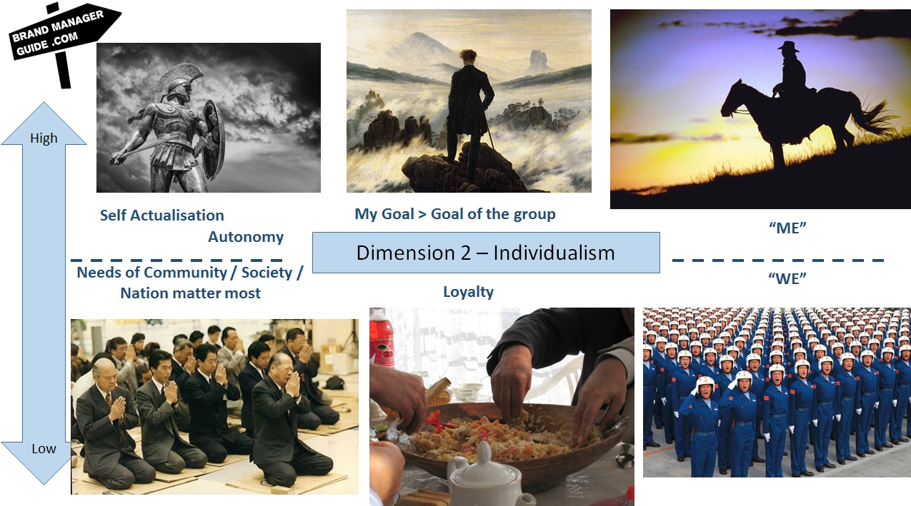

Slide 37
Masculinity
Femininity
Masculinity indicates the extent to which the dominant values of a society are "masculine" (e.g., assertive and competitive). Masculinity pertains to societies in which social gender roles are clearly distinct (i.e., men are supposed to be assertive, tough, and focused on material success whereas women are supposed to be more modest, tender, and concerned with the quality of life.
Femininity pertains to societies in which social gender roles overlap i.e., both men and women are supposed to be modest, tender, and concerned with the quality of life.

Slide 38
Masculinity-Femininity • This dimension refers to types of accomplishments valued by a particular culture. Different qualities have been attributed to two sexes
Toughness, competitiveness, aggression, perseverance, achievement and assertiveness have been attributed to men, where the dominant values in society are success, money, materials and ambition, etc.
Compassion, creativity, empathy, collaboration, harmoniousness, and aestheticism have been attributed to women, where the dominant values in society are cooperation, caring for others and quality of life. It is termed as ‘femininity.’

Slide 39
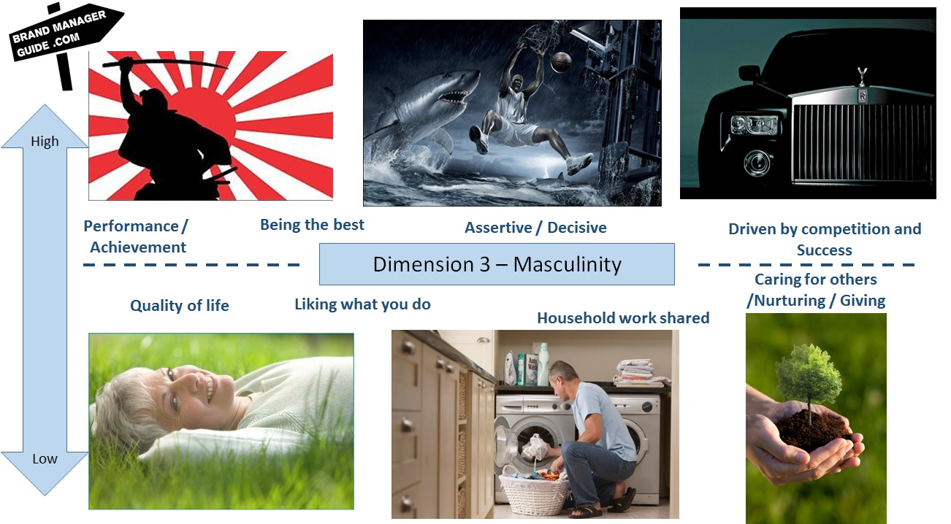

Slide 40
Societies where men are men …..
A society has a sexist orientation if it emphasizes differentiation on sex roles, allocating social roles according to such differences, expecting men to work in areas requiring masculine virtues and women to work in areas requiring feminine virtues.
In such societies, roles are largely determined by men and they impose masculine values in all roles. In such societies, there is premium on competitiveness and aggression, with empathy and collaboration being discounted. Such a culture is termed as ‘masculine’.
The examples of masculine cultures would include countries such as UK, Germany, South Africa & Italy.

Slide 41
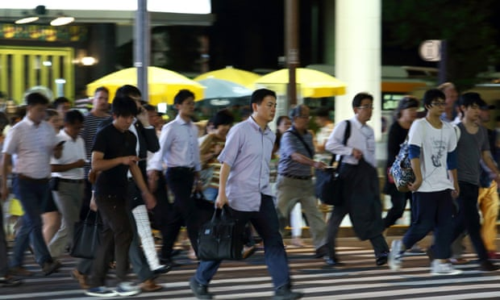
Japan
High masculinity index, place great importance on earnings, recognition, advancement and challenge.
Individuals are encouraged to be independent decision-makers, and achievement is defined in terms of wealth.
The workplace is characterised by high job stress and managers believe that their subordinates don’t like working, hence requiring some amount of control.
As stress levels and karoshi – deaths through overwork – increase, the Japanese government is planning a law to force workers to take paid holiday
Notes:
https://www.theguardian.com/world/2015/feb/22/japan-long-hours-work-culture-overwork-paid-holiday-law

Slide 42

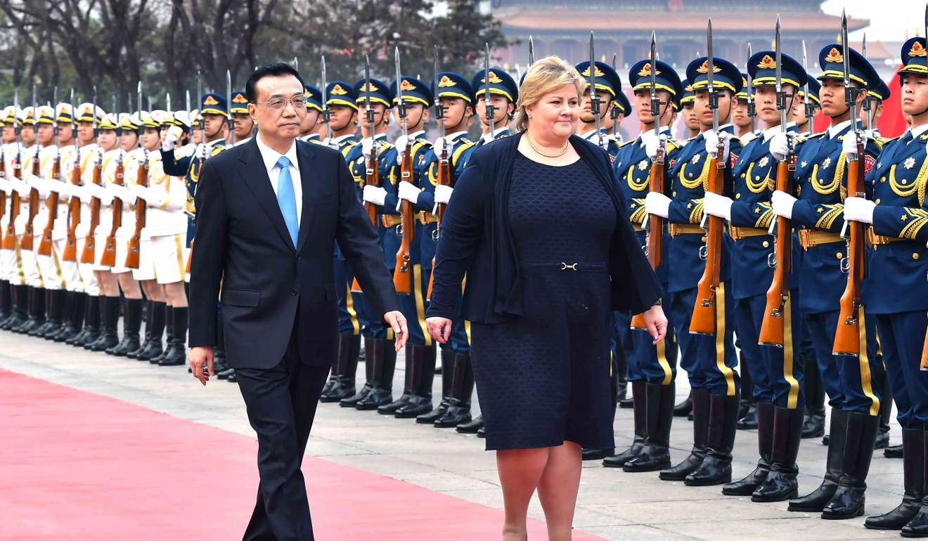
High femininity
Countries with high femininity tend to favour small–scale enterprises and place great importance on conservation of environment. The school system is designed to teach social adaptation. Many women hold higher-level jobs and they do not find it necessary to be assertive. Industrial conflict is less and workplace has less stress.
Notes:
Ema solberg

Slide 43
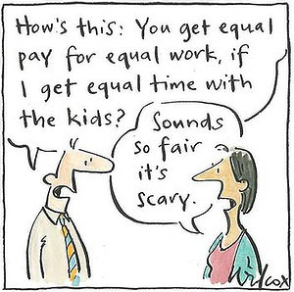
Norway
Low masculinity index tend to place great importance on cooperation, friendly atmosphere and employment security.
Individuals are encouraged to be group decision- makers and achievement is defined in terms of human contacts and living environment.
The workplace has a cordial atmosphere and managers give more credit to employees and freedom to act.

Slide 44
Uncertainty avoidance
Uncertainty avoidance can be defined as the extent to which the members of a culture feel threatened by uncertain or unknown situations and try to avoid such situations. This feeling is, among other things, expressed through nervous stress and in a need for predictability: a need for written and unwritten rules.

Slide 45
Continued
If members of a society feel uncomfortable with ambiguity and try to structure situations to avoid ambiguity, their tolerance for ambiguity is low or uncertainty avoidance is high.
Detailed and rigid structures, procedures, uniform behavior and belief in absolute truths help in avoiding ambiguity.
Unstructured, vague and unpredictable situations provide opportunities for using multiple approaches if members of a society feel comfortable with ambiguity.
Deviant behaviours and ideas are tolerated, and they are seen as sources of creativity.

Slide 46
Uncertainty avoidance
The extent to which people feel threatened by ambiguous situations, and have created beliefs and institutions that they try to avoid these.
This dimension measures how far cultures prepare or socialize their members into accepting ambiguous situations and tolerating uncertainty about the future.
High uncertainty–oriented nations tend to have a high need for security & a strong belief in experts & their knowledge. Examples include Germany, Spain & Japan. Members in such countries are more anxiety-prone & have high job stress.

Slide 47
Continued
Employees place high premium on job security, career planning, health insurance and retirement benefits.
Clear rules and regulations are welcomed and those managers who decide and give clear instructions are highly respected.
Countries with low uncertainty culture are more entrepreneurial and innovative and exhibit less emotional resistance to change. They are likely to feel more comfortable with ambiguity, uncertainty and unstructured situations.
Swedes, for instance, suppress emotions and in business they opt for the rational course rather than the emotional course.

Slide 48
Continued
Based on the varying levels of tolerance for uncertainty and ambiguity, different cultures have been given a ranking. A high ranking on this dimension indicates that that the country is more rule-oriented, and has low tolerance for uncertainty and ambiguity and vice-versa.
India has a ranking of 40 as against the world average of 65.
Examples of high uncertainty avoidance countries include Japan and Greece; and low uncertainty avoidance countries are United States, Canada and New Zealand, etc.

Slide 49
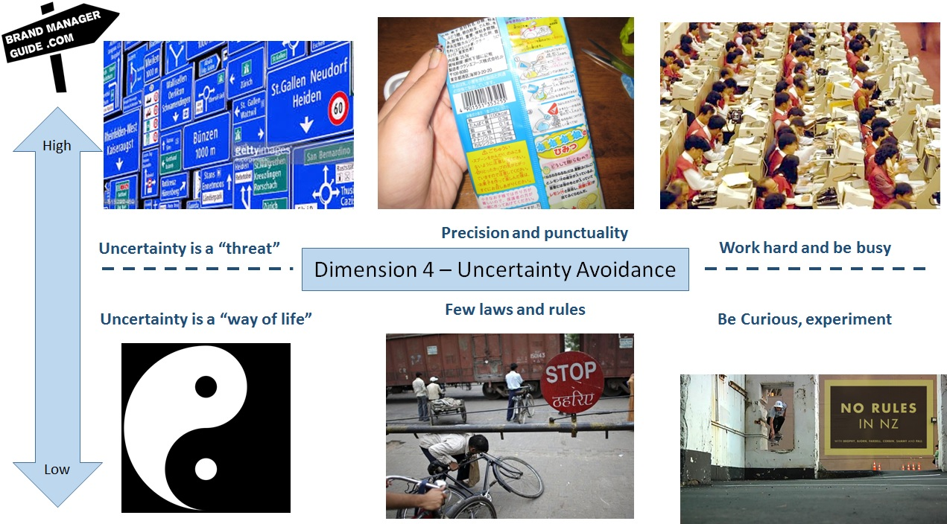

Slide 50
Long-term vs. short-term orientation in life
Added later: Confucian dynamism or long-term vs. short-term orientation in life
On the pole which could be labeled 'Long-term orientation' : persistence (perseverance ) ordering relationships by status and observing this order thrift
having a sense of shame
On the opposite pole 'Short-term orientation': personal steadiness and stability protecting your 'face’
Respect for tradition reciprocation of greetings, favors, and gifts

Slide 51
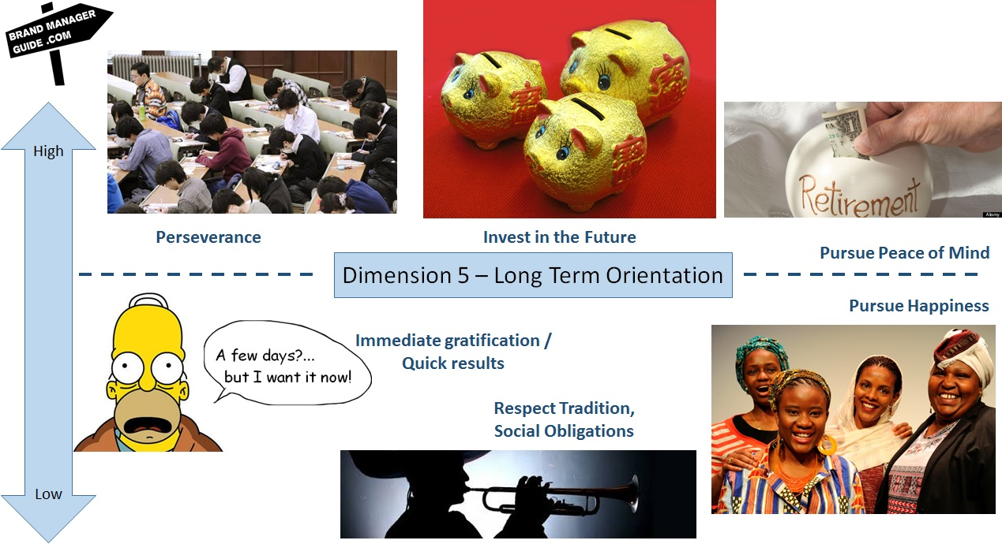

Slide 52
Hofstede and Bond (1984)
Link societal issues to four dimensions:
Power distance dimension is related to social inequality and the amount of authority of one person over others.
The uncertainty avoidance dimension is considered related to the way a society deals with conflicts and aggressions and as the last resort with life and death.
Individualism versus collectivism, is portrayed as being related to the individual’s dependence on the group; his or her self-concept as ‘I’ or ‘We’.
Masculinity versus femininity, is portrayed as being related to the choice of social sex roles and its effects on people’s self-concepts.

Slide 53
In each dimension, differences among countries manifest themselves at different levels: Child/family – School – workplace – citizen/state – ideas/philosophy

Slide 54
6 dimensions of national culture
The six dimensions of national culture are based on extensive research done by Professor Geert Hofstede, Gert Jan Hofstede, Michael Minkov and their research teams.
i. Power Distance Index (PDI)
ii. Individualism Vs. Collectivism (IDV)
iii. Masculinity Vs. Femininity (MAS)
iv. Uncertainty Avoidance Index (UAI)
v. Long Term Orientation Vs. Short Term Normative Orientation (LTO) Latest
vi. Indulgence Vs. Restraint (IND)

Slide 55
POWER DISTANCE INDEX (PDI)
This dimension expresses the degree to which the less powerful members of a society accept and expect that power is distributed unequally.
The fundamental issue here is how a society handles inequalities among people.
In societies with high Power Distance accept a hierarchical order in which everybody has a place and which needs no further justification.
In societies with low Power Distance, people strive to equalize the distribution of power and demand justification for inequalities of power.

Slide 56
COMPARISON
High Power Distance
Inequality is considered normal part of society.
Autocratic leadership.
Decide what is good & evil depending on who has power.
Child learn respect.
Low Power Distance
Inequality is considered wrong & it should be reduced if possible.
Democratic leadership.
Everyone (Top or Bottom) under the same rules of law.
Child learn independence.

Slide 57
COMPARISON
High Power Distance
Societies prefer centralization.
Subordinates do as they told.
Subordinates are blamed for mistakes.
More income inequality.
Mostly lower class people.
Low Power Distance
Societies prefer decentralization.
Subordinates expect to be consulted.
System is blamed for mistakes.
Less income inequality.
Mostly middle class people

Slide 58
Power distance
Hofstede’s data revealed four associations with this dimension:
Geographic latitude: higher latitudes are associated with lower power distance
Population: large populations are associated with high power distance
Wealth: national wealth is associated with low power distance
History: countries with a Romance language (Spanish, Portuguese, Italian, French) score medium to high, as do Confucian cultural inheritance countries; countries with a Germanic language (German, English, Dutch, Danish, Norwegian, Swedish) score low

Slide 59
INDIVIDUALISM VS. COLLECTIVISM
Individualism, can be defined as a preference for a loosely-knit social framework in which individuals are expected to take care of only themselves and their immediate families.
Collectivism, represents a preference for a tightly-knit framework in society in which individuals can expect their relatives or members of a particular in-group to look after them in exchange for unquestioning loyalty.

Slide 60
Comparison
Individualism I identity
Classified as individuals by their own particular characteristics.
Task comes first.
Low context communication.
Self-actualization is ultimate goal.
Wealthier countries tend to be more individualistic.
More press freedom.
Higher divorce rates.
Faster pace of life.
Collectivism We identity
Classified as in-group or out group.
Relationship comes first.
High context communication.
Harmony in society is ultimate goal.
Poorer countries tend to be more collectivist.
Less press freedom. Lower divorce rates
Slower pace of life.

Slide 61
Individualism Versus Collectivism
Hofstede’s data revealed four associations with this dimension:
Wealth: there is a strong relationship between a nation’s wealth and individualism
Geography: countries with moderate and cold climates tend to show more individualism
Birth rates: Countries with higher birth rates tend to be collectivist
History: Confucian countries are collectivist; regions heavily populated by European migrants (North America, Australia, and New Zealand) are individualist

Slide 62
MASCULINITY VS. FEMININITY (NOT SAME AS MALE & FEMALE)
The Masculinity side of this dimension represents a preference in society for achievement, heroism, assertiveness and material rewards for success. In Masculine cultures, difference between gender roles are more rigid. Its opposite,
Femininity, stands for a preference for cooperation, modesty, caring for the weak and quality of life. In Feminine cultures, difference between gender roles are less rigid.

Slide 63
Masculinity v Femininity
Hofstede’s data revealed two associations with this dimension:
Geography: feminine cultures are somewhat more likely in colder climates
Birth rates: in feminine cultures, the woman has a stronger say in the number of children; in masculine cultures, the man determines family size

Slide 64
Comparison
Masculinity
Tough, logical, aggressive, worldly and cruel.
People dizzy in the weak.
Girls cry but boys should not cry and boys fight but girls should not fight.
Sex is only concerned as man is a subject and woman is a object.
More illiteracy.
Many people live below poverty level.
Less aid consumption on poor.
Poverty is blamed on laziness.
Only men shop in market.
Salary is more important.
Tend to shorter vacations
Femininity
Gentle, emotional, calm, home-oriented and kind.
Have sympathy for the weak. B
oth boys and girls may cry but neither should fight.
Sex is concerned as a way for couple to make healthy relationship. Less illiteracy.
Many people live above poverty level.
More aid consumption on poor.
Poverty is blamed on bad luck.
Both men and women shop in market.
Leisure is more important.
Tend to longer vacations.

Slide 65
Uncertainty avoidance index
(not same as risk avoidance)
The Uncertainty Avoidance dimension expresses the degree to which the members of a society feel uncomfortable with uncertainty and ambiguity.
Countries exhibiting Strong UAI maintain rigid codes of belief and behavior and are intolerant of unorthodox behavior and ideas.
Weak UAI societies maintain a more relaxed attitude in which practice counts more than principles.

Slide 66
Comparison
Strong UAI (Uncertainty avoidance)
More stress and anxiety.
Feeling what is different is dangerous.
Need rules even if they are impractical or never practiced.
Believe in formalization.
Adopted innovations rather slowly or carefully.
People tend to stay in the same job as long as they can to avoid uncertainty.
Weak UAI (Uncertainty acceptance)
Less stress and anxiety. Feeling what is different is curious.
Don’t like rules or need fewer rules and may sometimes broke in case of necessity.
Believe in deregulation.
Taken less time to adopt.

Slide 67
Uncertainty Avoidance
This dimension refers to the extent to which people in a culture feel threatened by uncertain or unknown situations
Cultures strong in uncertainty avoidance are active, aggressive, emotional, compulsive, security seeking, intolerant
Cultures weak in uncertainty avoidance are contemplative, less aggressive, unemotional, relaxed, accepting of personal risks, and relatively tolerant
Associations with this dimension:
Religion: Orthodox, Roman Catholic Christian - high; Judaic, Muslim - medium; Protestant Christian, Eastern religion - low
History: history of Roman codified laws - high; Confucian tradition - lower

Slide 68
Comparison
Afraid of people who look or behave different or come from elsewhere.
People drive faster & more alcoholism
People always carry identity card.
Wealthy countries tend to be perceive more corrupt.
Cleanliness & purity are more important in marketing.
More tolerance towards people who are different.
People drive slower & less alcoholism.
Carry identity card is optional.
Wealthy countries tend to be perceive less corrupt.
Attracting consumers by convenience or easy products is more important in marketing.

Slide 69
LONG TERM ORIENTATION VS. SHORT TERM NORMATIVE ORIENTATION
Those with a culture which scores high (Long Term Orientation), on the other hand, take a more pragmatic approach: they encourage thrift and efforts in modern education as a way to prepare for the future.
Societies who score low on this dimension (Short Term Normative Orientation), for example, prefer to maintain time-honoured traditions and norms while viewing societal change with suspicion.

Slide 70
Comparison
Long Term Orientation
Perseverance in achieving results.
What is good and evil depends upon the circumstances.
Learn from other countries.
Traditions can be changed.
Short Term Orientation
Focus on achieving quick results.
What is good and evil depends upon the universal guidelines.
Proud to have our own country.
Traditions are sacrosanct.

Slide 71
Comparison
Important for resolving problem is common sense and certainly choosing the middle way.
Larger savings quote & funds available for investment.
Prefer family business and real estates.
Fast economically development of poor countries.
Important for resolving problem is fundamentalism (could be religious but also ideological/political fundamentalism)
Smaller savings quote & funds available for investment.
Prefer shares and mutual funds.
Slow or no economically development of poor countries.

Slide 72
Long-Term Versus Short-Term Orientation
In 1987, the Chinese Culture Connection, composed of Michael H. Bond and others, extended Hofstede’s work to include a new dimension
Countries high in Confucian work dynamism are Hong Kong, Taiwan, Japan, South Korea, and Singapore, popularly referred to as the Five Economic Dragons
Long-term orientation encourages thrift, savings, perseverance toward results, and a willingness to subordinate oneself for a purpose
Short-term orientation is consistent with spending to keep up with social pressure, less savings, preference for quick results, and a concern with face

Slide 73
INDULGENCE VS. RESTRAINT
Indulgence stands for a society that allows relatively free gratification of basic and natural human drives related to enjoying life and having fun.
Restraint stands for a society that suppresses gratification of needs and regulates it by means of strict social norms.

Slide 74
Comparison
Indulgence
More healthier & happier.
Societies have leisure ethic.
Optimistic.
Extroverted societies. (Prefer to being social)
Participate actively in sports.
Less moral disciplines. Higher crime rates but smaller police forces. Higher birth rates (in educated population). More obese(fat) people (in wealthier countries).
Restraint
Less healthier & happier.
Societies have work ethic.
Pessimistic.
Introverted societies. (Prefer to being alone)
Less active participation in sports.
Strict moral disciplines. Lower crime rates but larger police forces. Lower birth rates (in educated population). Less obese(fat) people (in wealthier countries).
Notes:
https://laofutze.files.wordpress.com/2011/01/hofstede.pdf

Slide 75
Indulgence v Self-restraint
Indulgent cultures: a higher percentage of very happy people, a higher importance placed on leisure, more extroverted personalities, lower death rate from cardiovascular diseases
•Restrained cultures: a lower percentage of very happy people, a perception of helplessness, more neurotic personalities, higher death rates from cardiovascular diseases
•Indulgence scores are highest in Latin America, parts of Africa, the Anglo world and Nordic Europe; restraint is mostly found in East Asia, Eastern Europe, and the Muslim world

Slide 76
Comparison
Less moral disciplines.
Higher crime rates but smaller police forces.
Higher birth rates (in educated population).
More obese(fat) people (in wealthier countries).
Strict moral disciplines.
Lower crime rates but larger police forces.
Lower birth rates (in educated population).
Less obese(fat) people (in wealthier countries).
Notes:
https://laofutze.files.wordpress.com/2011/01/hofstede.pdf

Slide 77
Criticisms of Hofstede
Nations are not the best units for studying cultures; counterargument: in a large global corporation, employees perceive their nation-states as the frame of reference or identity
Hofstede’s survey data are based on a small sample: 117,000 questionnaires from 40 countries (1968-1969 and 1970-1973), for only 6 countries the number of respondents exceeded 1,000, while for 15 countries the numbers were fewer than 200
Hofstede’s survey data are old and outdated, cultures do not stand still; Hofstede’s response (2002): the dimensions have centuries-old roots, recent replications show no changes, and the dimensions have been validated against other measures
Hofstede’s data are drawn from subsidiaries of only one company; Hofstede’s response (2002): using the IBM data provides unusually well-matched samples from a large number of countries

Slide 78
Hofstede’s Response
Research surveys are suitable, but should not be the only method used.
Nations are not always appropriate, but they are the only unit available.
IBM was homogeneous in nature: shared one organisational and occupational culture, so allowed allowed comparison of cultural values across subsidiaries.
Research was thorough and detailed (well-matched samples, correlations with other data); many replications.
If others can find more than ‘his’ five dimensions that are independent and can be validated – fine! ‘Candidates are welcome to apply’.

