Slide 1
MBA
Financial Management
Week 3
Capital Budgeting

Slide 2
Week Outline
Finding Profitable Projects
Capital-Budgeting Decision Criteria
  PBP
  ARR
  NPV

Slide 3
Finding Profitable Projects

Slide 4
Capital Budgeting
Meaning: The process of decision making with respect to investments in fixed assets—that is, whether a proposed project should be accepted or rejected.
It is easier to “evaluate” profitable projects than to “find them.”

Slide 5
Source of Ideas for Projects
R & D: Typically, a firm has a research and development (R & D) department that searches for ways of improving existing products or finding new projects.
Other sources: Employees, competition, suppliers, customers

Slide 6
Capital-Budgeting Decision Criteria

Slide 7
Capital-Budgeting Decision Criteria
The Payback Period
Accounting Rate of Return
Net Present Value
Profitability Index
Internal Rate of Return

Slide 8
The Payback Period
Meaning: Number of years needed to recover the initial cash outlay related to an investment
Decision Rule: Project is considered feasible or desirable if the payback period is less than or equal to the firm’s maximum desired payback period. In general, shorter payback period is preferred when comparing two projects.

Slide 9
Payback Period Example 1
Example: Project with an initial cash outlay of $10,000 with following free cash flows for 5 years.
Table 10.1 Payback Period Example
Blank | Project A | Project B
Initial cash outlay | −$ 10,000 | −$ 10,000
Annual free cash inflows | Blank | Blank
Year 1 | $ 6,000 | $ 5,000
2 | 4,000 | 5,000
3 | 3,000 | 0
4 | 2,000 | 0
5 | 1,000 | 0
Payback is 2 years.

Slide 10
Trade-Offs
Benefits
  Uses cash flows rather than accounting profits
  Easy to compute and understand
  Useful for firms that have capital constraints
Drawbacks
  Ignores the time value of money
  Does not consider cash flows beyond the payback period

Slide 11
Discounted Payback Period (1 of 2)
The discounted payback period is similar to the traditional payback period except that it uses discounted free cash flows rather than actual undiscounted cash flows.
The discounted payback period is defined as the number of years needed to recover the initial cash outlay from the discounted free cash flows.

Slide 12
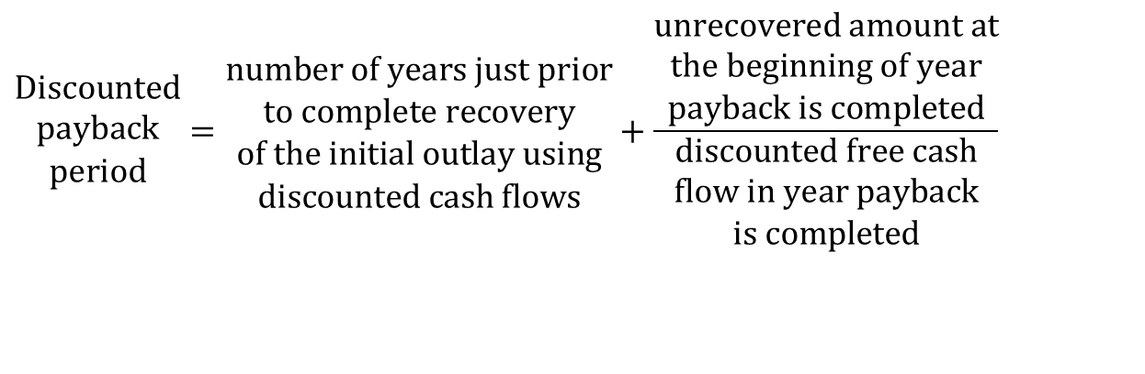
Discounted Payback Period (2 of 2)
$$\begin{matrix}Discounted \\ payback \\ period\end{matrix}=\begin{matrix}number of years just prior \\ to complete recovery \\ of the initial outlay using \\ discounted cash flows\end{matrix}+\frac{\begin{matrix}unrecovered amount at \\ the beginning of year \\ payback is completed\end{matrix}}{\begin{matrix}discounted free cash \\ flow in year payback \\ is completed\end{matrix}}$$

Slide 13
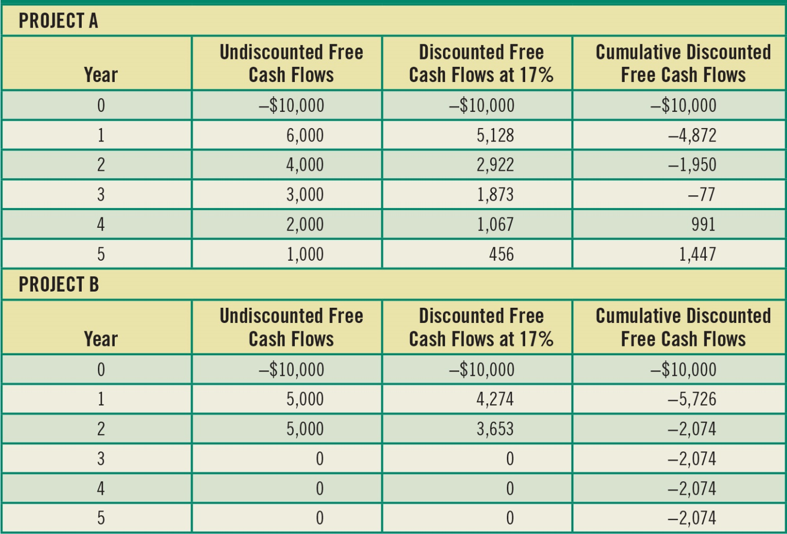
Table 10.2 Discounted Payback Period Example Using a 17 Percent Required Rate of Return

Slide 14

Payback Period Example 2
Table 10.2 shows the difference between traditional payback and discounted payback methods.
With undiscounted free cash flows, the payback period is only 2 years, while with discounted free cash flows (at 17 percent), the discounted payback period is 3.07 years.
$$Discounted payback period_{A}=3.0+\frac{\$77}{\$1,067}=3.07 years$$

Slide 15
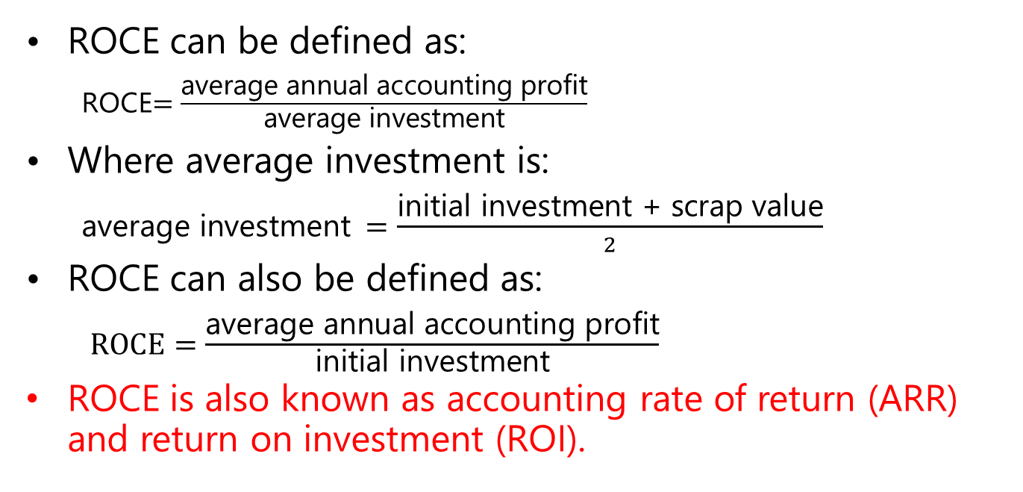
Return on capital employed
ROCE can be defined as:
  ROCE$=\frac{\text{average} \text{annual} \text{accounting} \text{profit}}{\text{average} \text{investment}}$
Where average investment is:
  $\text{average} \text{investment} =\frac{\text{initial} \text{investment}\text{ + }\text{scrap} \text{value}}{2}$
ROCE can also be defined as:
  $ROCE=\frac{\text{average} \text{annual} \text{accounting} \text{profit}}{\text{initial} \text{i}\text{nvestment}}$
ROCE is also known as accounting rate of return (ARR) and return on investment (ROI).

Slide 16
Return on capital employed (Continued)
Average annual accounting profit can be calculated from total project profits divided by number of years.
Accounting profit is not cash flow.
Simple decision rule: accept project if ROCE is equal to or greater than target value i.e. current company or division ROCE.
If projects are mutually exclusive, select project with highest ROCE.

Slide 17
Return on capital employed (Continued)
Example:
A machine costs £10 000
Useful economic life is 5 years
After 5 years, scrap value of £2000
Net cash inflows from the machine would be £3000 per year
Ignore taxation.

Slide 18
Return on capital employed (Continued)
Example:
Total cash inflows: 3,000*5 = £15,000
Total machine cost: 10,000-2,000 = £8,000
Total profit: 15,000 – 8,000 = £7,000
Average annual profit: 7,000/5= £1400

Slide 19
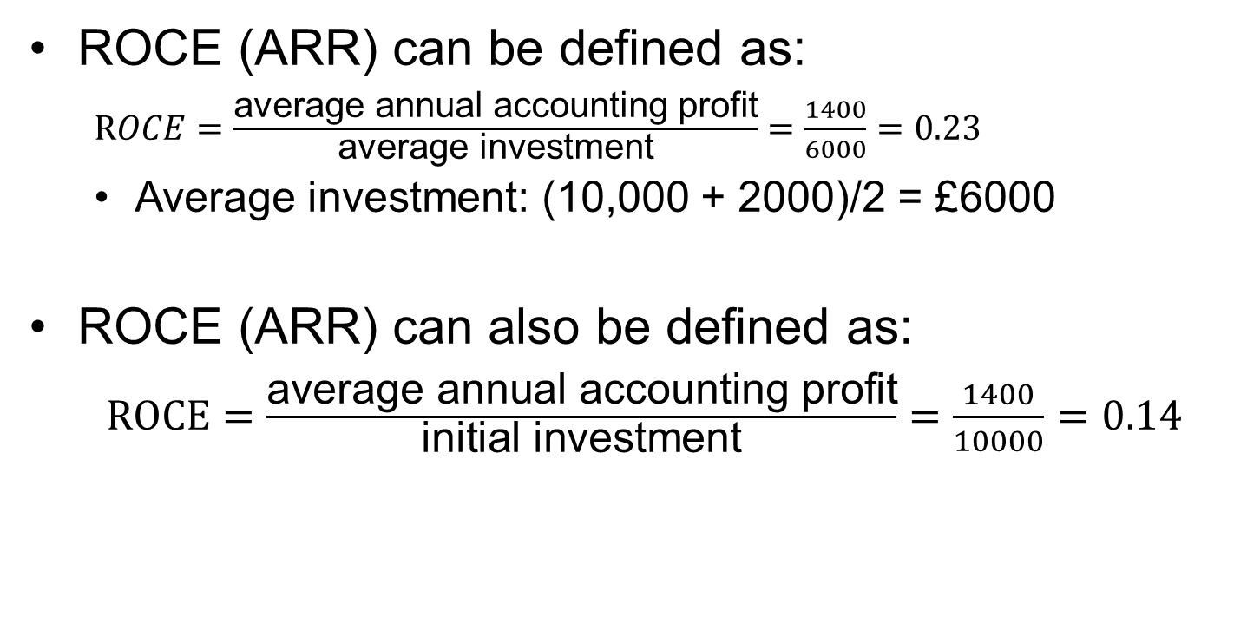
Return on capital employed (Continued)
ROCE (ARR) can be defined as:
  $ROCE=\frac{\text{average} \text{annual} \text{accounting} \text{profit}}{\text{average} \text{investment}}=\frac{1400}{6000}=0.23$
  Average investment: (10,000 + 2000)/2 = £6000
ROCE (ARR) can also be defined as:
  $ROCE=\frac{\text{average} \text{annual} \text{accounting} \text{profit}}{\text{initial} \text{i}\text{nvestment}}=\frac{1400}{10000}=0.14$

Slide 20
Return on capital employed (Continued)
Advantages of return on capital employed:
Gives value in familiar percentage terms
Can be compared with primary accounting ratio, ROCE
Relatively simple concept compared to DCF methods such as NPV and IRR
Can compare mutually exclusive projects
Considers whole of project, unlike payback.

Slide 21
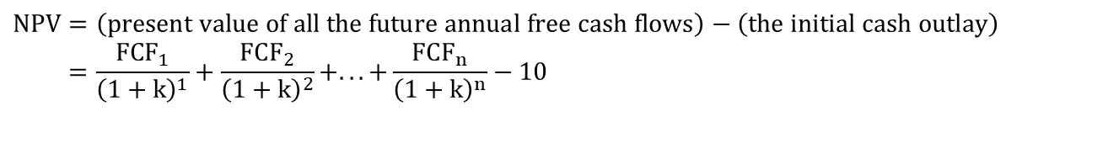
Net Present Value (N P V)
N P V is equal to the present value of all future free cash flows less the investment’s initial outlay. It measures the net value of a project in today’s dollars.
$$NPV=\left(present value of all the future annual free cash flows\right)−\left(the initial cash outlay\right) \\ =\frac{FCF_{1}}{{\left(1+k\right)}^{1}}+\frac{FCF_{2}}{{\left(1+k\right)}^{2}}+...+\frac{FCF_{n}}{{\left(1+k\right)}^{n}}−10$$

Slide 22
NPV Example (1 of 2)
Example: Project with an initial cash outlay of $40,000 with following free cash flows for 5 years and a required rate of return of 12 percent.
Table 10.3 Ski-Doo’s Investment in New Machinery and Its Associated Free Cash Flows
Blank | Free Cash Flow
Initial outlay | −$40,000
Inflow year 1 | 15,000
Inflow year 2 | 14,000
Inflow year 3 | 13,000
Inflow year 4 | 12,000
Inflow year 5 | 11,000

Slide 23
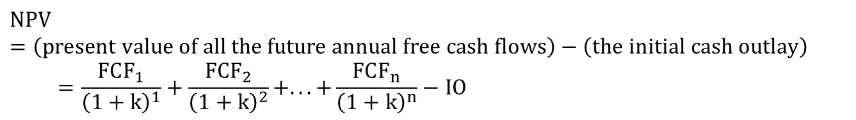
NPV Example (2 of 2)
$$NPV=\left(present value of all the future annual free cash flows\right)−\left(the initial cash outlay\right) \\ =\frac{FCF_{1}}{{\left(1+k\right)}^{1}}+\frac{FCF_{2}}{{\left(1+k\right)}^{2}}+...+\frac{FCF_{n}}{{\left(1+k\right)}^{n}}−IO$$
PV of FCF = $47,675
Subtracting the initial cash outlay of $40,000 leaves an N P V of $7,675.
Because N P V > 0, project is feasible.

Slide 24
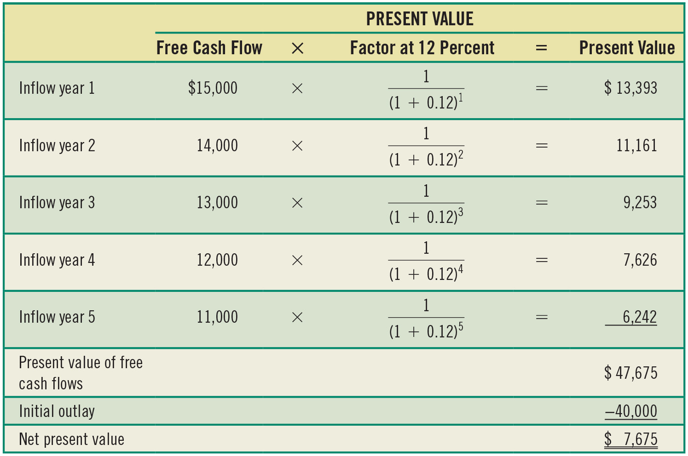
Table 10.4 Calculating the N P V of Ski-Doo’s Investment in New Machinery

Slide 25
N P V Trade-Offs
Benefits
  Considers all cash flows
  Recognizes time value of money
Drawbacks
  Requires detailed long-term forecast of cash flows
N P V is generally considered to be the most theoretically correct criterion for evaluating capital budgeting projects.

Slide 26
References and Reading List
Berk, J.B. and DeMarzo, P.M., Corporate finance. Pearson Education, Latest Edition.
Keown, A., Martin, J. and Petty, W. Foundation of Finance. 8th Edition, Pearson, London, Latest Edition.

