Slide 1
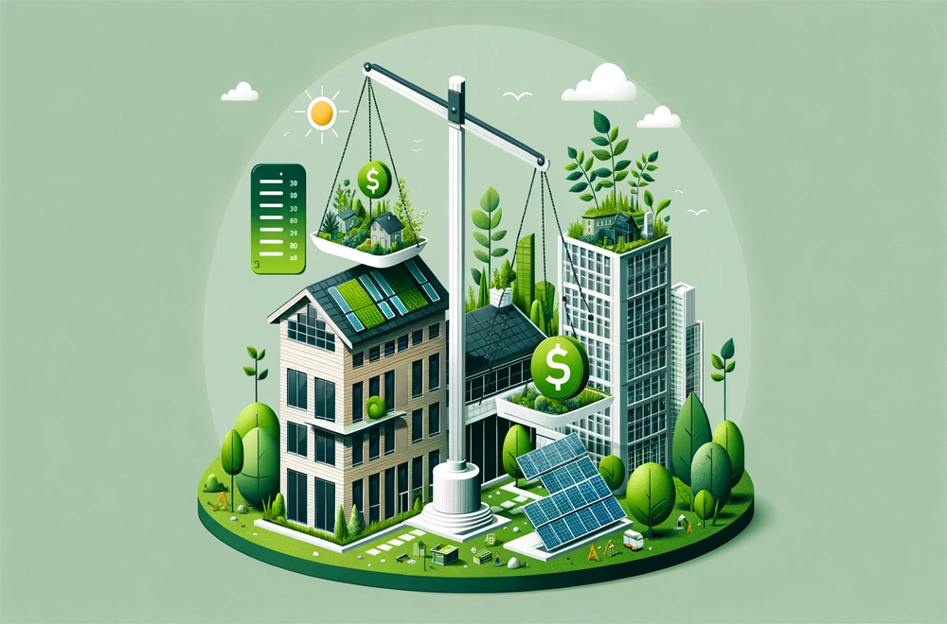
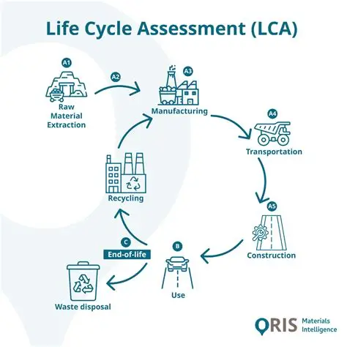
How much could sustainable building materials reduce the environmental impact of the construction sector while remaining economically and practically efficient?
🛣️Proposed Methodology
Literature Review
More Thorough
Lifecycle Analysis (LCA)
Through All Stages Of Life
Materials Comparison
Structural Performance, Durability & Availability
Cost & Practicality Evaluation
Cost Comparison (Initial, Maintenance, Future Defects Potential)
⁉️Why It Matters?
Carbon Contribution
Material Production
  Steel
  Concrete
Transportation
30% Increase (1994)
Low Carbon Alternatives
  Timber
  Recyclable
Long Term Improvement
Short Term Improvement
Expected Outcomes
✅Lower Carbon Emissions
Local Effect
Global Effects
✅Long-Term Cost Savings
Knowledge Betterment
Higher Initially, Future Betterment
All Stages Of Life
⚠️Supply Chain Adjustments
Industry Adjustments
Availability

