Slide 1
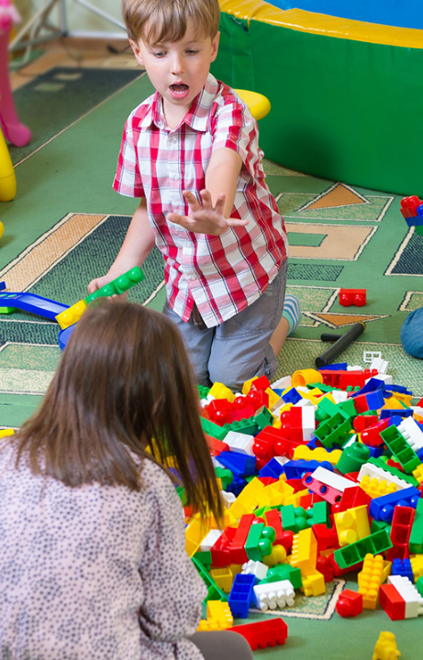
LCHS4010: PSYCHOLOGY IN HEALTH & CARE
Vygotsky’s Sociocultural Theory: Supporting Shona’s Development
A strategic case study applying ZPD, Scaffolding, and MKO guidance to support emotional regulation and social play.
Module Leader
Subject Profile
Setting
Neale Haddon
Shona (Age 3, Nursery)
London Children's Centre
Student Name
Student ID 2525295
Karan

Slide 2


SUBJECT ANALYSIS
Case Profile: Who is Shona?
Early Years Profile
Three-year-old child just started at nursery school (DfE, 2021).
Separation Anxiety
Cries a lot in the morning and finds it difficult to console himself (MacBlain, 2018).
Communication & Social Play
Non-verbal; likes to play on his own (MacBlain, 2018).

Slide 3

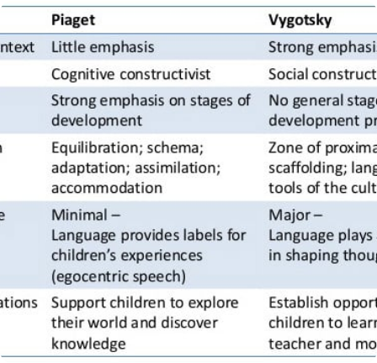
THEORETICAL FOUNDATION
Vygotsky’s Sociocultural Pillars
Social Constructivism
Learning is the activity that occurs because of interaction within the society and then internalized as individual learning (Fleer, 2018).
Zone of Proximal Development (ZPD)
Gap between actual independent problem solving and potential assisted problem solving (Schunk, 2020).
More Knowledgeable Other (MKO)
A person who knows more than you and your peers, hence creating the need for help which would enhance your capacity (Fleer, 2018).

Slide 4

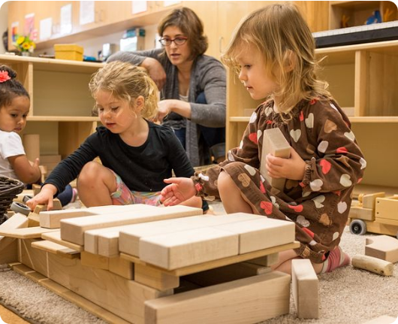
CASE APPLICATION
Applying Vygotsky’s Concepts to Shona
01
ZPD Identification
In this case, Shona is learning on her own while the concept of ZPD emphasizes the importance of collective tasks that concentrate on learning through cooperation facilitated by adults (Fleer, 2018).
02
Private Speech & Regulation
Inner speech helps to regulate children's emotions during drop-offs (Winsler, 2019).
03
Cultural & Social Tools
Visual story cards and objects act as mediators in the communication process of children (Oakley, 2019).

Slide 5


DEVELOPMENTAL DEBATE
Nature vs. Nurture: Interactionist View
Nature (Biological)
Nurture (Sociocultural)
Language Readiness: Biological potential for using language (MacBlain, 2018).
Quality Scaffolding: Help from the practitioner in the nursery environment (Fleer, 2018).
Temperament: The emotional response to stressful situations (Oakley, 2019).
Peer Environment: The manner of play (Rogoff, 2016).
Social Catalyst: Your experience allows you
Neurological Limits: The initial development potential that is genetically provided.

Slide 6


PRACTICAL STRATEGY
Action Plan: Scaffolding Shona’s Progress
PHASE 01
PHASE 02
Key Worker Attachment
Peer MKO Pairing
Apply a transition from the morning session that will help to alleviate the fears of Shona by using a one-to-one approach (Elfer et al., 2022).
Place Shona next to another child who is skilled at communicating in playtime (Fleer, 2018).
PHASE 03
PHASE 04
Language Scaffolding
Visual Schedules
Parallel talking and open-ended questions (Siraj & Kingston, 2015).
Visuals for routines to create expectations (DfE, 2021).

Slide 7


ACADEMIC CRITIQUE
Critical Evaluation of Vygotsky’s Model
Strengths & Pedagogy
EYFS Alignment: Perfectly compatible with EYFS regarding active scaffolding (DfE, 2021).
Social Practice: Promotes the role of practitioners and peers as key catalysts of learning process (Fleer, 2018).
Limitations & Gaps
Biological Oversight: Takes no account of innate temperamental traits (Oakley, 2019).
Measurement Challenge: Measurement problems may arise in relation to the ZPD boundaries (Schunk, 2020).

Slide 8

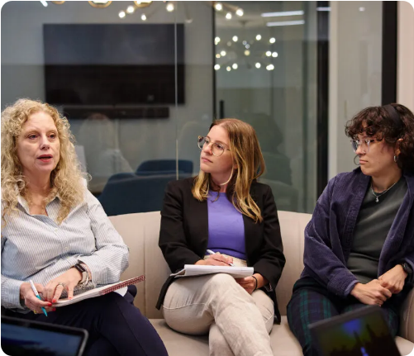
HOLISTIC PRACTICE
Multi-Agency Collaboration & Outcomes
Speech & Language Therapist (SLT)
Communication-based interventions and monitoring the development of communication stages (Siraj & Kingston, 2015).
Health Visitor & Parental Alignment
Ensuring that their activities are harmonized both within and outside the nursery (DfE, 2021).
Targeted Outcome
Minimizing the effects of separation anxiety, peer interactions, and language development.

Slide 9


ACADEMIC INTEGRITY
Conclusion & Reference List
Conclusion: Vygotsky's theory offers a structured framework to help Shona transition from solitary distress to group play through tailored scaffolding and peer MKO pairing.
• Department for Education (DfE) (2021) Statutory Framework for Early Years Foundation Stage. London: DfE.
• Elfer, P., Goldschmied, E. & Selleck, D. (2022) Key Persons in the Early Years. 3rd edn. London: Routledge.
• Fleer, M. (2018) Child Development in Educational Settings. Cambridge: Cambridge University Press.
• MacBlain, S. (2018) How Children Learn: Educational Theories Made Easy. London: SAGE.
• Oakley, L. (2019) Cognitive Development in Early Childhood. London: Routledge.
• Rogoff, B. (2016) The Cultural Nature of Human Development. New York: Oxford University Press.
• Schunk, D.H. (2020) Learning Theories: An Educational Perspective. 8th edn. New York: Pearson.
• Siraj, I. & Kingston, D. (2015) An Independent Review of the Early Years Foundation Phase in Wales.
• Vygotsky, L.S. (1978) Mind in Society. Cambridge, MA: Harvard University Press (Seminal Source).
• Winsler, A. (2019) Private Speech, Executive Function, and Emotion Regulation. New York: Springer.

