Slide 1

Week 9
Teamwork and Reflection in Health and Social Care

Slide 2
Why is teamwork important?
Group activity – discuss and report to the class:
The importance of teamwork in health and social care
Difficulties encountered in teamwork
Personal experiences of teamwork
How to overcome difficulties encountered in teamworking

Slide 3
Benefits of teamwork
Helps develop sense of connection
Source of mutual support
Can manage bigger tasks more efficiently
Reduces tension when facing challenges
Positive attitudes promote better well-being and patient care

Slide 4

Challenges of teamworking
Differences in opinion, values, or preferences
Friction between two or more team members
Reliance on others to complete tasks or to be present at certain times
Perception of inadequacies in the work performance of team members
Risk of feeling inadequate or left behind

Slide 5
Overcoming barriers to teamwork
Group activity – discuss and feedback to the class:
Strategies to manage individual challenges in teamworking
Strategies to resolve challenges with specific individual team members
Strategies to resolve challenges of a complete team that you are managing

Slide 6
The value of reflection
Increases self-awareness
Gives you greater control
Improves your communication
Better alignment with your values
Better decision making
Better personal accountability

Slide 7
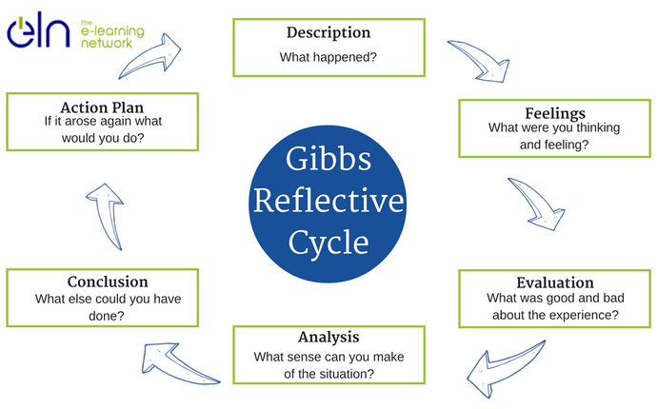
Gibbs (1988) model

Slide 8
Gibbs model components
Description – facts only. Describe the situation. What happened?
Feelings – feelings only. What feelings did you have before, during the event, after?
Evaluation – what went well? What did not? Positives and negatives of the situation only.

Slide 9
Gibbs model components cont.
Analysis – what factors influenced the situation in a positive way? what factors influenced the situation in a negative way?
Conclusion – what did you learn from the experience? What would you do differently next time?
Action plan – specific achievable actions for future experiences.

Slide 10
Activity
Consider a time when you worked as part of a team. Perhaps a group presentation at university. Spend 15 to 20 minutes writing about your experiences using Gibbs (1988) model.
Share your experiences with the class.

Slide 11
References
Gupta, S. (2023) Verywell Mind: The Importance of Self-Reflection: How Looking Inward Can Improve Your Mental Health. Available at: https://www.verywellmind.com/self-reflection-importance-benefits-and-strategies-7500858 (Accessed: 16 March 2025).
Mcloed, S. (2024) Simply Psychology: Gibbs Reflective Cycle. Available at: https://www.simplypsychology.org/gibbs-reflective-cycle.html (Accessed: 16 March 2025).

