Slide 1
Certificate of Higher Education
Business Skills for the Workplace
Academic Skills
(LCLM 4001)
Session 6- Paraphrasing and Using Turnitin

Slide 2
Last week’s recap
Last session we did the following:
Completed Task1
Discussed Developing Academic Paragraphs
TEEL AND PEEL methods for paragraph Structure

Slide 3

Today’s session
The session will be divided into 3 parts:
We will explore:
1- Paraphrasing in Academic Writing
2- Using Turnitin

Slide 4
Part 1
Paraphrasing

Slide 5
What is paraphrasing?
Paraphrasing is writing the ideas of another person in your own words. Paraphrasing is useful when you are using the work of others to support your own view.
When paraphrasing, you need to change the words and the structure but keep the meaning the same.
Please remember - even when you paraphrase someone's work, you must acknowledge it by providing a reference.

Slide 6
Why do we paraphrase?
To demonstrate understanding
To avoid plagiarism
To help clarify ideas
To contextualise quotes and paraphrases from other authors

Slide 7
Example 1
Source
It has long been known that Cairo is the most populous city on earth, but no-one knew exactly how populous it was until last month.
Paraphrase
Although Cairo has been the world's most heavily populated city for many years, the precise population was not known until four weeks ago.

Slide 8
Example 2
Direct quote: Brown (2004, p.72) argues that “ascertaining learning styles is essential to facilitate learning”.
Paraphrase:
  Brown (2004) is a keen advocate of learning styles.
  Learning styles are critical to reaching learners (Brown, 2004).
Note that the brackets depend upon whether the emphasis is on the author (a) or the information (b)
Note that in (b) the full stop comes after the citation – the citation is always part of the sentence. No page number is needed with a paraphrase.

Slide 9
Paraphrasing Techniques in Academic Context
Five Paraphrasing Techniques
Using Synonyms
Changing Word Order
Changing Word Form
Using Active / Passive voice
Using Positive / Negative

Slide 10
Paraphrasing Techniques Explained.
Watch the video below.
This video explains some useful techniques in paraphrasing

Slide 11

Activity 1
Following the paraphrasing examples you studied from the video, provide an additional sentence for every scenario in the slides that follow.
Notes:
.

Slide 12
1. Using Synonyms
Use Thesaurus.com/ a dictionary
Approximately 80% of low-income families will be assisted by the proposed ‘free lunch’ program. (Health Canada, 2015)
Suggested answer:
According to Health Canada (2015), roughly 80% of poor families will be helped by the suggested ‘free lunch’ campaign.
Note: do not use this technique on its own because if you just replace some words, the structure stays the same and you may be accused of plagiarism
Notes:
A Thesaurus is an important tool to use when paraphrasing.
Note – some words cannot / should not be paraphrased – names of people, cities, countries etc.

Slide 13
2. Changing word order
Approximately 80% of low-income families will be assisted by the proposed ‘free lunch’ program (Health Canada, 2015).
Suggested answer:
The suggested ‘free lunch’ campaign will assist roughly 80% of poor families according to Health Canada (2015).

Slide 14
BREAK

Slide 15
3. Changing word form
Approximately 80% of low-income families will be assisted by the proposed ‘free lunch’ program. (Health Canada, 2015)
Suggested answer:
According to Health Canada (2015), the suggested ‘free lunch’ campaign will provide assistance to roughly 80% of poor families.

Slide 16
4. Active / Passive voice
Approximately 80% of low-income families will be assisted by the proposed ‘free lunch’ program. (Health Canada, 2015)
Suggested answer:
According to Health Canada (2015), the suggested ‘free lunch’ campaign will assist / help roughly 80% of poor families.

Slide 17
5. Positive to negative
Approximately 80% of low-income families will be assisted by the proposed ‘free lunch’ program. (Health Canada, 2015)
Suggested answer:
According to Health Canada (2015), only roughly twenty percent of poor families will not benefit from the program.

Slide 18
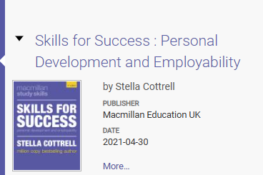
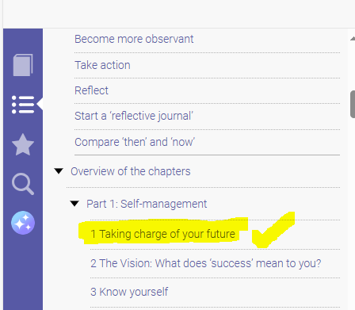
Activity 3
Students are invited to return to the Moodle page, to the online reading list (or click this link)
LCLM4001_BIRM: Online Reading List | Home
Find Go to this
section in yellow
And paraphrase all the sentences under the section Make it happen.
Notes:
.

Slide 19

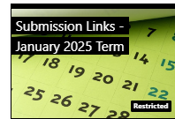
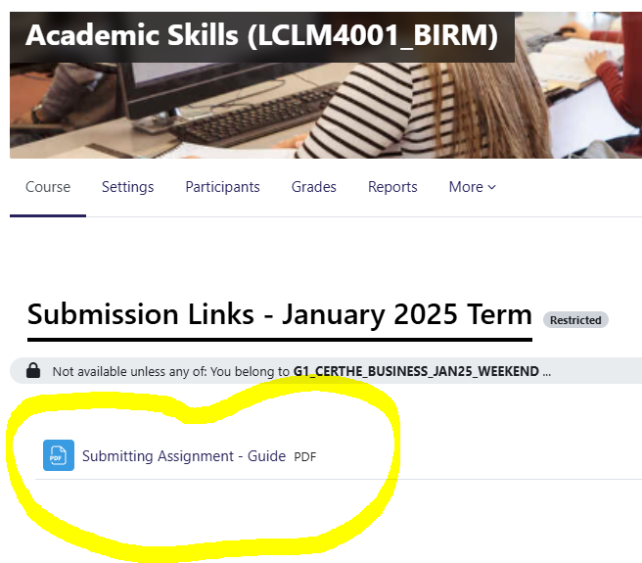

Steps in Locating and Using Turnitin
Step 1 > Locate this tile on Moodle
Step 2> Download this PDF file and read as we demonstrate in Class
Notes:
Support the students through this process- how to access Turnitin and submit their tasks to the right submission link

Slide 20
Activity 3
Students are invited to read and understand the steps involved in using Turnitin
Notes:
.

Slide 21

Activity 3 – 25 minutes
Individual task.
Give a detailed account of
  What happened in the class today
  What you learned today, and
  How can you apply this in the future?
Go to moodle page, download the file titled Documentation of Academic Skills Learning Experience Journey, and type the responses under Week 6.
Remember to save this document. We will return to it next week.

Slide 22

Next session…
We will Complete Task 2 – Academic Skills Practice – This task MUST be completed and submitted in class before the end of your session.
Learn about Constructing Academic Sentences
Don’t forget to revise

Slide 23

Summary
What is a summarising
Can you define paraphrasing?
Are you able to share some tips/techniques used in paraphrasing?
Can you confidently use Turnitin?

Slide 24
References
Oxford Brookes University, (2024) Academic Writing. Available at: https://www.brookes.ac.uk/students/academic-development/online-resources/academic-writing. Accessed 7/07/24.
Neuman, L. (2022) Taboo words – Words to avoid in your paper.
Available at https://www.bachelorprint.com/uk/academic-writing/taboo-words/ (Accessed: 06/07/24)
“Hints about Timethrift” by author unknown in Volume 1 No. 15 of The Leisure Hour magazine (8 th April 1852) and the full text of the article can be found online at https://hdl.handle.net/2027/uc1.a0006340913?urlappend=%3Bseq=243
Tripathy, M. (2018) ‘Building Quality Teamwork to Achieve Excellence in Business Organizations’, International Research Journal of Management, IT & Social Sciences. Available at https://sloap.org/journals/index.php/irjmis/ Vol. 5 No. 3, May 2018, pages: 1~7

