Slide 1

EFFECTIVE TEAM WORKING AND COMMUNICATION
CATALIN BOROSU
ID NUMBER:2115218

Slide 2

communication
Communication is an essential ability in any type of medium with human interaction. In any context, the ability to communicate effectively it is essential , especially in workplace where communication it is contributing to the company success. Communication it is easily the act of delivering and transmitting information from a person to another.(Ludow and Panton 1992)
The academic paper it has three essential sections that will discuss about: three models of communication that I learned in classes, the communication skills that I learned, the advantages and disadvantages of technology in communication.At the end of the paper , there will be provided different class exercices that I have performed during classes.

Slide 3
Models of communication
Explanation of Schramm’ model of communication
Another model of communication that has been deliver it is the Schramm’s model of communication which has been developed due to Shannon model , having the root in the Shannon model itself. This model was been founded in 1954. In this model, the information, model are not used until the message it is carefully and well developed into words and then it is possible to be conveyed to others. Here, encoding it has an essential role because it is the concept that initiate the whole communication process by transforming the though into a specific content. In that moment , when the information it is reached by the recipient his prime duty is to comprehend what the speaker actually intends to convey. In the moment the person understand what has been send, being able to decode the text in that moment it is said that the message has a role and can be used. Thus encoding and decoding are always the most essential aspects when it comes to effective communication without them information cannot be comprehend and can never flow effectively between different people.According to this model there are to principles of effective communication. One it is related to decoding and coding and the second it is about the fact that communication process is incomplete until the person who sent the message get a feedback from the second party who received the message.
( Duck and Mcmahan 2020)
Another model of communication is Berlo’s SMCR Model of Communication that has been founded by Berlo , David Berlo. This model has come also from Shannon Model of Communication. David Berlo in his model made a description of the aspects affecting the people components and ability in the communication and how to make the communication more better and efficient. This model it is concentrate on encoding and decoding, which it is actually happening before the sender it is able to sends the message and before the receive can get the specific message.Therefore, this model has actually four essential components that describe the process of communication such as sender, channel, message and also receive . However, each of them can be affected by also other aspects and factors( Berlo 1960)

Slide 4
Models of communication
1.The three models of communication taught in class:
The first model of communication that I learned about it is the Shannon Weaver model that was developed in 1948 when its founder , who is Claude Shannon created wrote an article. Shannon was a mathematician and developed this model that it is known also as “mothers of all models “ being more technological that other models that are more linear. ( Maud et.al 2017)
Explanation of Shannon Weaver Model
According to Shannon model, the sender it is the one that encodes the text and sends to the receiver using a technological channel such as phone or telegraph. The, the sender it is converting the message into different codes that are comprehended to the machines. Therefore, the text is sent in codes through a specific medium. The receiver needs to decode this message before interpreting or comprending it. However, in some cases the machine it is acting like a decoder, as the channel has noise and the receive it is not always capable to decode which can leads to communication issues in the communication process. For instance, the sender it is our brain, while the encoder it is our mouth understand the language and air it is the channeler, while here the receptor is another individual’ear and also the decoder it is the brain of that person.
(Stanton 2009)

Slide 5
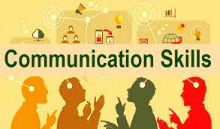
Communication skills
2. THE COMMUNICATION SKILLS:
Human communication it has a lot of issues and difficulties.Sometimes people can say something but not always to make people understand what they say. Communication skills can be divided into verbal (oral and written) and non verbal communication such as facial expressions, eye contact, signs and gestures, eye contact, body language et.al ,listening (active and empahitc) The first one it comes with different qualities in order to exist an effective communication: the verbal communication should have clarity, use the language that people understand, should be loudly so all people can understand.People should have emphaty , to be friendly and be able to put themselves in other people’s situation.( Stndon 2009)
Also,at verbal communication people should be able to engage with eye contact .
Moving forward to written verbal communication that reffers to the communication that it is written here people should use formal language , not. “ street one” and respct the rules of writing.

Slide 6
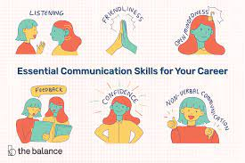
Communication skills
At non verbal communication , here people should be able to engage with body language, facial expression, should pe able to express what they need without words.
Listing it is also a communication process it is known as “neglected skills” because people are learned hoew to read, write and communication but not to how to liste effectively. This it is why after we listen we cannot remember more than 50%.
Listening skill it is essential when it comes to communication :” Unless somebody listens to the message and understands it, there is no communication, only noise.’ (STANTON, 2009)
People should be aware of communication barriers that exists that can minimise their ability to communicate good such as: differences in perception,stereotype, lack of knowledge et.al
Also, the module learned me different types of written communication such as remots, letters , memos et.al Learning the format of each of the above

Slide 7

Technology in communication
3) TECHNOLOGY IN COMMUNICATION:
ADVANTAGE AND DISADVATAGES:
Technology in communication it is about the transfer of the message, information among individuals or machine through the use of effective new technology “This processing of information can help people make decisions, solve problems, and control machines.”(Duck and Mcmahan 2020)
New innovation in terms of technological one has reinvented the way individuals are communicate as simple devices have progresses enable to people to use them in order to communication through different communication channeles, ways that build
connections worldwide. There are at least four types of communication technology that change the way of sending a text:telephone, radio, television, and internet.
(Morgan 2017)
Technology in communication has facilitated good communication among people or also companies, as it is ensuring different alternatives and ways that resulted to effective communication. Through their smartphones, laptop, computers and the other channel that the technology has created people can deliver their message and get the feedback , being able to call, email , text , message et.al

Slide 8

advantages
Advantages of technology in communication:
-the documentation and archiving of communication quick and easy, with the simple use of storage , database, people can deliver and save email and other details and can query them as needed for future use.
-with technology in communication people can deliver their messages more easily, being able communicate with people all around the world, to send their easily, to call easily et.al
For companies, advantages of technology in communication are also multiple such as:
Low cost of ownership: low ways to communication, as technology has improved the message are more easily to be send and more efficient, workers can communicate now free and easily through facebook, mail et.al The cost of communication with technology has decline in compare with traditional ways of communication such as letters et.al
-technology in communication has enable a communication process that is
“Instantaneous and Efficient”
When communicating with technology, people can deliver their text to people anywhere. When they need somone they can call them through whatsapp, telegram et.al not being forced to wait until that person come to the office. Also technology in communication has enabled better video cameras, better quality of communication and also the ability of people to get in real time the message even if the sender and receiver are not in the same location.
.”(Duck and Mcmahan 2020)
Other advantage it is in terms of quick and easy. With the use of technology in communication, communication process it is more easy and more faster. For instance comparing with filling paper to just making a rapid phone call.
A Bunch of Other Advantages

Slide 9

disadvatages
With technology in communication, people can havelive video conversations with others in multiple countries using just the app of webcams and a teleconference service, which are optios that are so efficient and less expensive than going to that countries and travel all the world.
So, advantages are the following : more efficient process of communication, more faster method of communication, with technology people are able to communicate from anywhere in the world, with technology in communication , communication it is
.”(Duck and Mcmahan 2020)
Some of disadvatages of technology in communication are related to the fact people have become so dependable of phones, Facebook and other methods of communication,forgetting how they can communicate one to one, one to one interaction. So, technology has made communication imperson :” The very nature of how technology works inhibits personal communication in that it is short and instant and in no way meant to express feelings and emotion compared to face to face communication.” People have become distracted by technology, forgetting to communicate in other ways rather than just using their phone et.al
Technology in communication has made the message to be distorted ,damaging its clarity .Other disadvantages are related to social isolation and loneliness as people are having less physical interaction, proffering to communicate just online, losing their ability to communicate in real life.
Also, technology in communication has build a range of opportunities for individual who are not focused about moral and ethical principles. The use of Internet has started to be in different unfair practices, many people facing different bullies from other.
(Ludlow and Panton 1992)
Poor communication often emerge when it is exists a “discrepancy between what is said and what is heard. For instance, when I am at work and I am communicate with a person from another country and I am using a term that has multiple meanings then the misunderstanding it is happening, as understanding is no longer mutual. .”(Duck and Mcmahan 2020)

Slide 10
conclusion
In conclusion, as has been suggested there are different models of communication that different and have different elements but there are essential in terms of proving a systematic representation of the communication process which helps people in comprehending how communication works and how this can be achieves. How it was seen there are at least five communication skills that are necessary to have an effective communication in both private and personal life such as : listening, straight talking , non-verbal communication, stress management and emotional control. In term of technology in communication , as it was seen technology has enabled a better communication process, transforming and challenging the traditional communication process to a new one that comes with a lot of benefits for those that engage within and for companies too.
So, communication it is an employable skills that it is essential in all the human environments, without it people not being able to communicate and receive new informations. Technology in innovation has comes with different opportunities for both people and companies.

Slide 11
references
REFERENCES:
Ludlow, R. and Panton. F. (1992) The Essence of Effective Communication. New York. Prentice Hall.
Maund, A.,Schriek M. and Tinkler, P. (2017) Certificate in Higher Education: Skills for the Workplace. London; Sage Publications.
Morgan, P. (2017) The Business Student’s Guide to Study and Employability. London. Sage
Stanton, N. (2009). ‘Mastering Communication.’ Basingstoke: Palgrave Macmillan
Quintanilla, K.M. and Wahl, S.T. (2014). Business and professional communication: keys for workplace excellence. Thousand Oaks, Calif: Sage.
Duck, S. and Mcmahan, D.T. (2020). Communication in everyday life: a survey of communication. 4th ed. Thousand Oaks, Calif: Sage Publications, Inc.

Slide 12
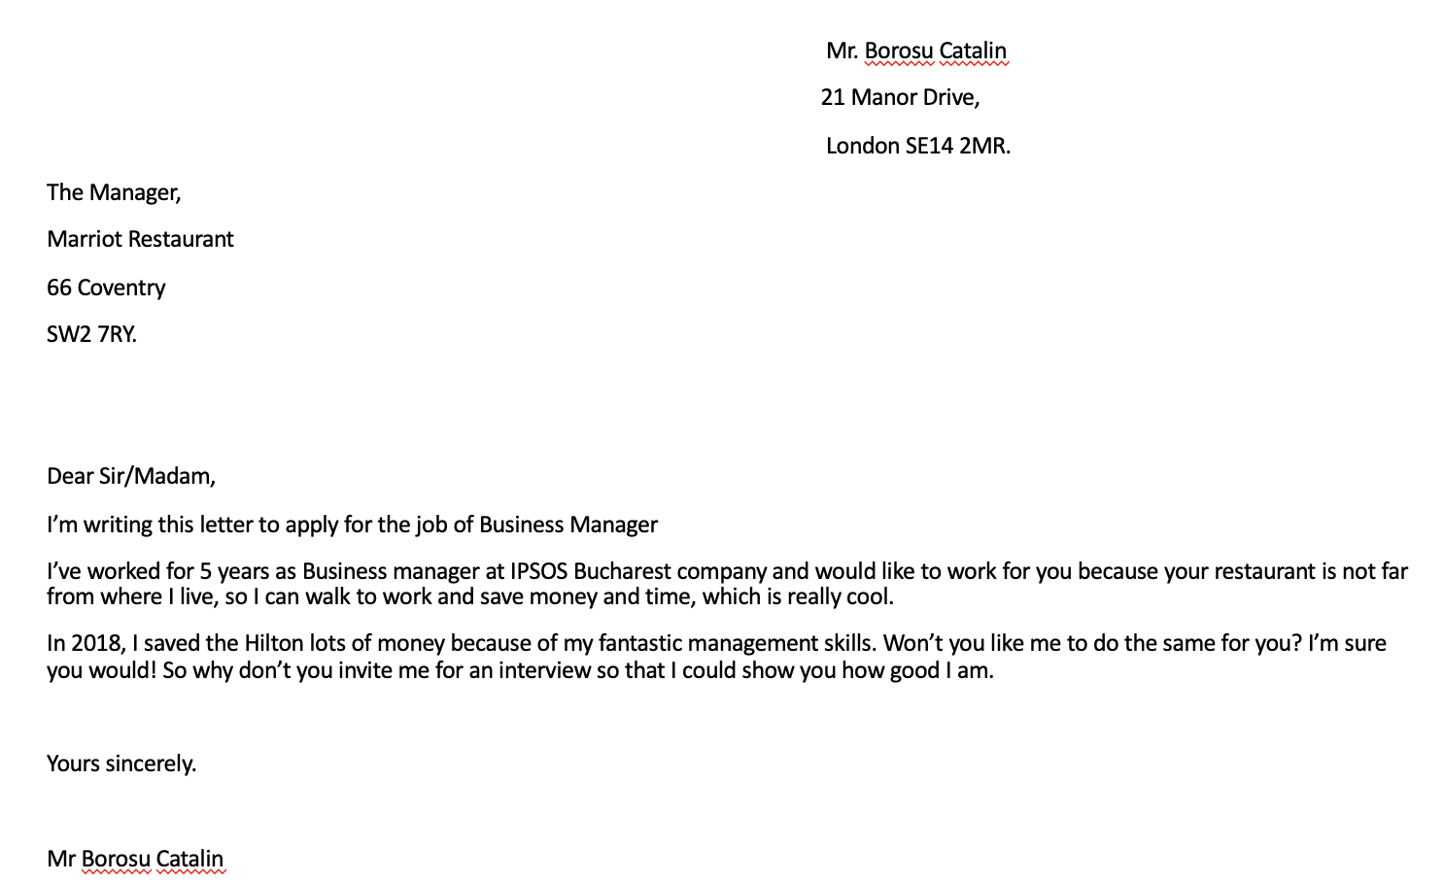
APPENDIX

