Slide 1


Design of Wireless Neural Networks in the Finance Industry to Improve Performance, Security, and Efficiency

Slide 2
Anthony Ekperechi 2318045
1st July 2026

Slide 3
Introduction
Applications of Neural Networks in Wireless Communications in Finance
The rise of mobile applications and smart devices has significantly expanded the use of wireless networks and the extent of human interaction within the system. Moreover, the implementation of IoT, mobile edge computing, and caching technologies improves how data is collected, processed, analysed, and used for various sensing and purposes, such as authentication and transaction processing.

Slide 4
Tech Requirements
Introduction
Artificial intelligence neurons are used for inference, prediction, intelligence, and predictive data analysis. In the network, the machine learning algorithm enables neurons to learn from datasets generated by the environment, users, and devices. This can therefore be used to predict users’ behaviours, content requests, mobility patterns, time, frequency and files that can be cached across the network.

Slide 5
Moreover, the inferences and predictions are the primary enablers of the emerging smart devices, IoT paradigms and sensors that will generate huge datasets of resource usage to understand the network operation, delivery services, monitor failures, and intelligent transmissions. The neural network has the capability of processing massive data volumes and parsing helpful information from the dataset as a precursor to delivering a quality customer experience. For example, secure and real-time transactions. The intelligent system can obtain from different subsystems for training and ensure quality services.

Slide 6
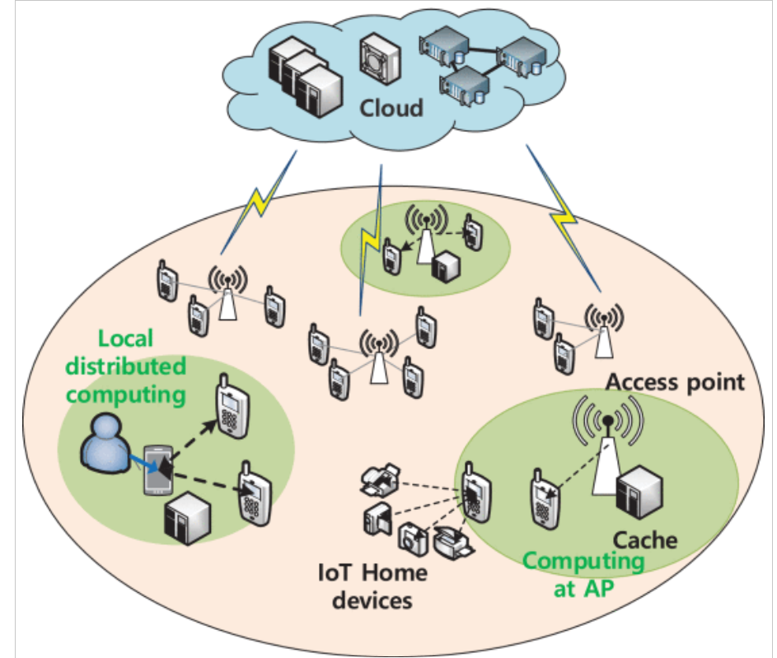

Competitive Landscape

Slide 7
Contribute to knowledge and understanding.
Why this project and my aim
Worked in finance and trained in technology.

Slide 8
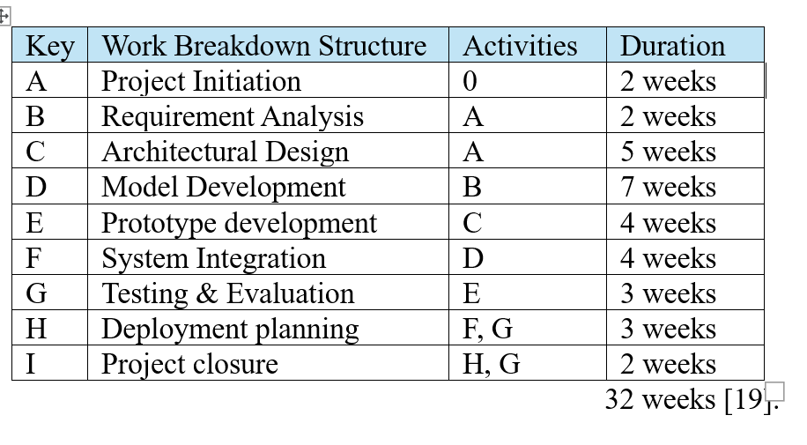
Completion process

Slide 9
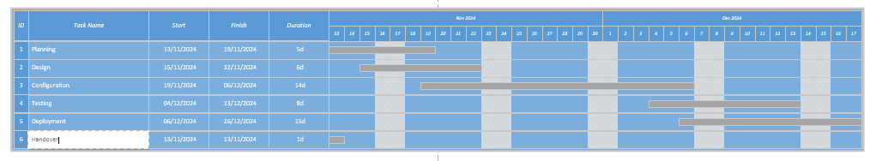
Gant Chart

Slide 10
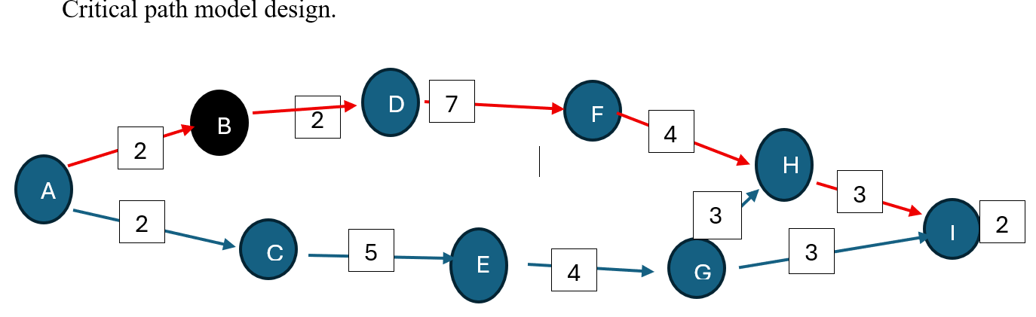
Critical Path design

Slide 11
Aims and Objectives
Research Aim
To design and evaluate a wireless neural network architecture for financial systems that improves system performance, cybersecurity, and computational efficiency
Research Objectives
The objectives of this research are:
Analyse existing digital financial infrastructure and identify limitations in current centralised AI and networking architectures [6].
Design a wireless neural network architecture integrating edge computing and distributed machine learning [6].
Develop secure data transmission protocols for financial transactions over wireless networks [6].
Implement a neural network model for fraud detection and risk prediction within the proposed architecture [6].
To research and design a system appropriate to the financial institutions [6].

Slide 12
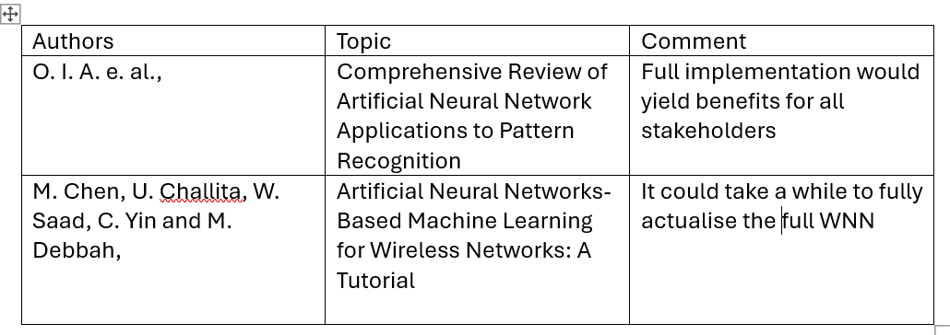
Literature reviews

Slide 13
Literature reviews understanding
Introduced new ideas of knowledge and
understand and what to expect and contribute.

Slide 14
Methodologies
Primary research
Python simulation
Secondary sources: Undertaking research of other works done.

Slide 15
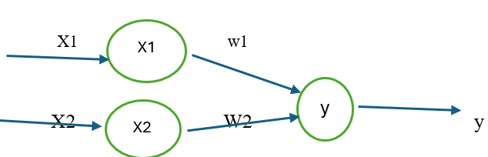
Project Design – Neural Network

Slide 16
Conclusion
The integration of wireless communication networks with neural network architectures offers a transformative opportunity for the financial sector. By enabling distributed intelligence, enhanced security, and real-time analytics, wireless neural networks that significantly improve the performance and efficiency of modern FinTech systems.

Slide 17
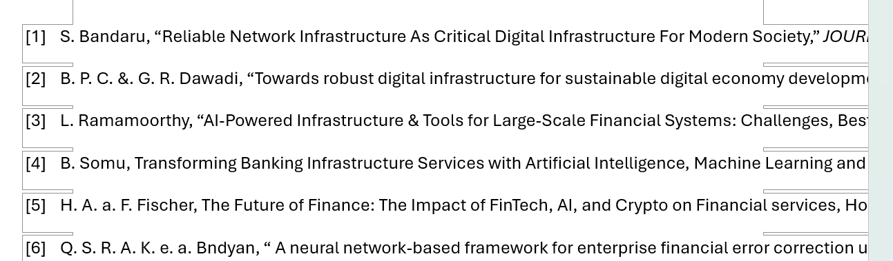
References

Slide 18

Digital Communications
Cloud
Local
Hybrid

Slide 19

Thank you
someone@example.com

