Slide 1
Developing Innovation and
Creativity for Business Advantage
Week 7
Digital Revolution

Slide 2
Recap
Week 1: Introduction; Creativity, Innovation & Entrepreneurship.
Week 2: Concepts & techniques of innovation & creativity.
Week 3: New-Product Development and Product Life-Cycle Strategies.
Week 4: (1) Differentiating between critical and creative thinking; (2) The challenge of adding value to Innovation and Creativity
Week 5: (1) Innovation, Growth & Competition; (2) Open and Closed Innovation
Week 6: Disruptive innovation; Innovation impulses
This week (our final week): Digital revolution

Slide 3

4 Key Concepts in the Digital Age Mindset
Ecosystems
Co-Opetition
Co-Creation
New Work Culture

Slide 4

Key CONCEPTS: Ecosystem

Slide 5
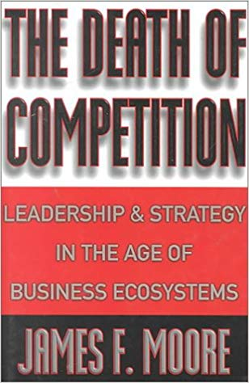
Ecosystems
Concept: The concept of business ecosystems has been gaining currency lately and is now widely used to describe a business’s or organization’s wider network (everybody that effects the business somehow, including customers, suppliers, partners, service providers, competitors, governmental and non-governmental actors, the public, the media, etc.)
The idea behind ecosystems strategy is that in the interconnected digital age, companies no longer compete only for industry leadership or product superiority – what matters more now is system leadership.

Slide 6
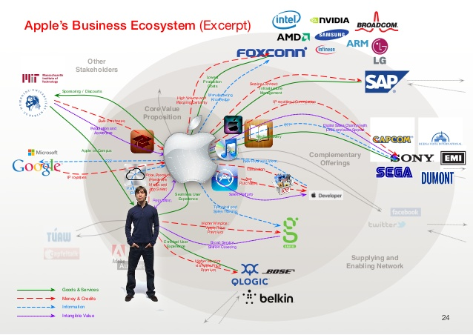

Slide 7
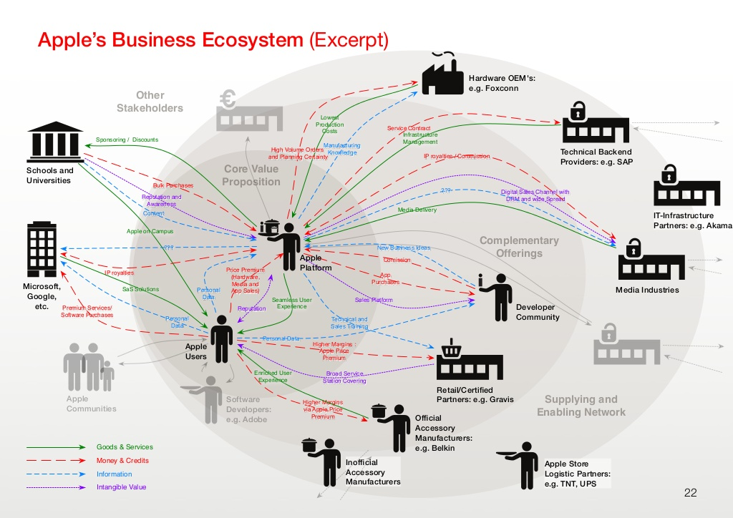

Slide 8
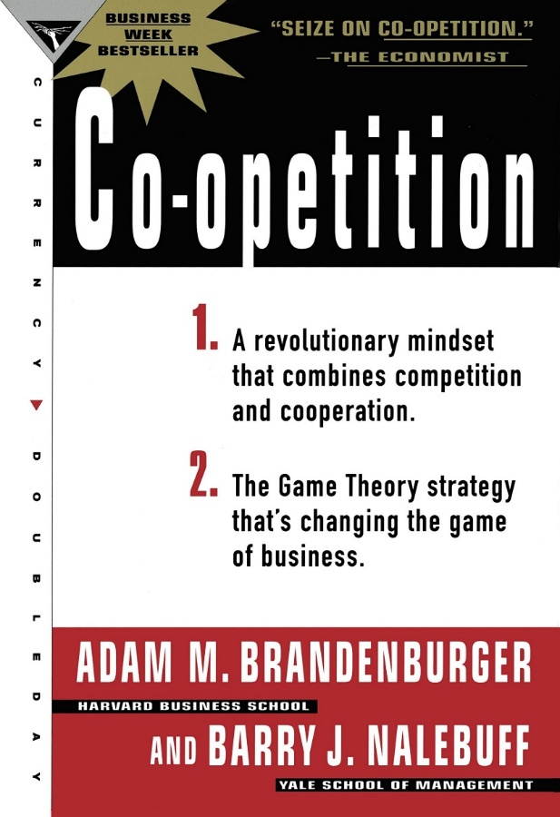
Co-Opetition
Concept: In a networked ecosystem, value creation is no longer a zero-sum game. Companies create value together with competitors who are at the same time collaborators in other regards.
Companies should see other players in their ecosystem as co-opetition because their own success also partly depends on the flourishing of the entire ecosystem. If you outcompete everybody, you might just kill the ecosystem.
See Brandenburger & Nabelbuff (2013)

Slide 9
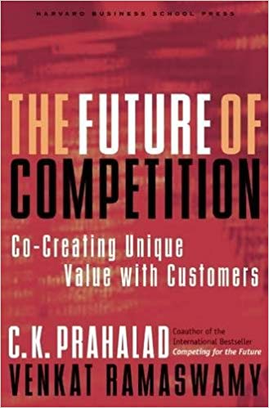
Co-Creation
Concept: In business ecosystems, value is co-created instead of being created within a firm only and then received and passively consumed by customers.
Companies should open the design of their products and services and their innovation process to other stakeholders (mainly customers) in their ecosystem to create more value for everyone involved.
See Prahalad & Ramaswamy (2013)

Slide 10

Co-Creation Examples
58% of businesses are now fielding co-creation initiatives (Hitachi Europe Report)
See 10 Examples of Co-Creation here:
https://www.braineet.com/blog/co-creation-examples/
Is UWTSD also co-creating its offerings and services?

Slide 11
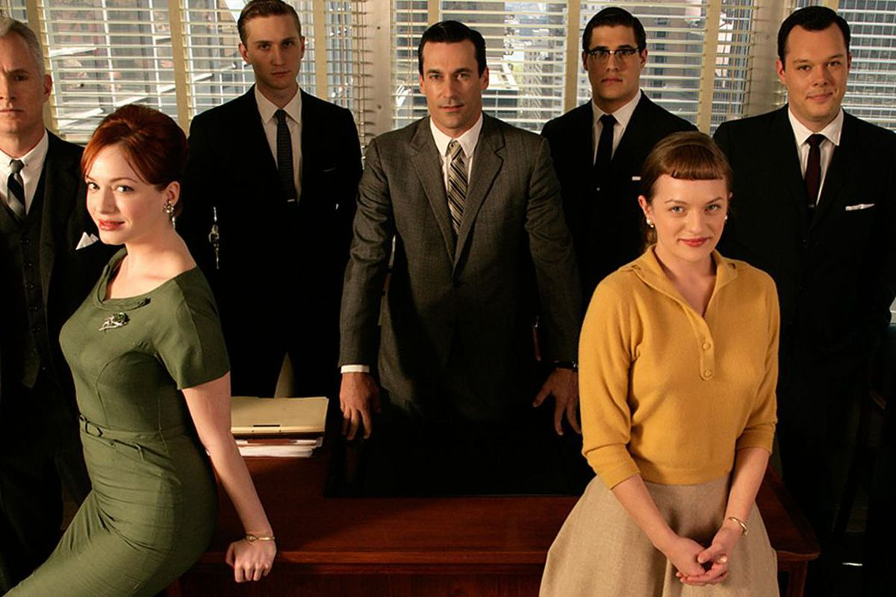

Traditional vs new work culture

Slide 12
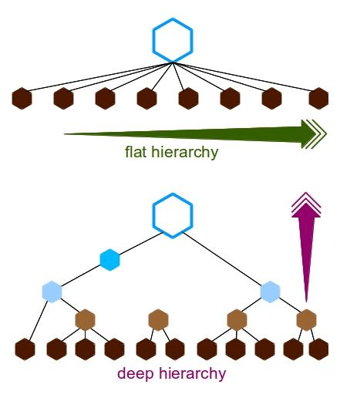
New Work Culture
Work cultures are changing rapidly in all industries. This has to do with changing cultural attitudes, but also with network effects and evolved mindsets of digital native generations (Millennials, Gen Z).
New work cultures are generally agile, flexible, and collaborative, and deploy flat hierarchies as opposed to traditional work cultures which are top-down and silo based (departments don’t talk to each other, employees do what they are told, creativity is not expected or rewarded).

Slide 13
New Work Culture Principles
Actual human input from collaborators is more important than official/established work processes
Documentation does not have to be extensive when processes are showing desired results
Collaboration is more important than contractual or hierarchical relations between parties
Genuine desire to find innovative responses and effective solutions is more important than following a plan or prescriptive work process

Slide 14
5 Spheres of Digital Transformation
Business Models
Cultures & Processes
Brand & Customer Experience
Data Management
Innovation

Slide 15
1) Business Models
How do businesses create value? How do they produce and sell their goods or services?
Traditional | Digital

Slide 16
2) Brand & Customer Experience
How do businesses present themselves to the public (what type of advertising and messaging) and how do they involve the customer or make the customer feel when dealing with them?
Traditional | Digital

Slide 17
3) Culture & Process
What is the company culture and how do businesses handle work processes (such as collaboration, customer management, etc.)? How do they involve customers and other stakeholders?
Traditional | Digital

Slide 18
4) Data Management
How do businesses treat customer data? What uses do they make of it?
Traditional | Digital

Slide 19
5) Innovation
How do businesses innovate? Which new technologies do they use to upgrade existing services and products?
Traditional | Digital

Slide 20
Innovative eBusiness

Slide 21
eBusiness Models
There are three types of marketplaces:
Controlled by Sellers
Controlled by Buyers
Neutral Marketplaces

Slide 22
Seller Controlled Markets
Set up by single vendor seeking many buyers
Main aim
to retain value and power in any transaction

Slide 23
Buyer Controlled Markets
Set up by or for one or more buyers
Main aim
to shift value and power in marketplace on the buyer’s side
Buyer intermediaries can also be there
…act as agents

Slide 24
Neutral Markets
Set up by third party intermediaries to match many buyers to many sellers
Matches buyers to sellers at an auction
Commission based

Slide 25
Choosing a Marketplace Model
Choosing a marketplace depends on four factors:
Are there transactions or benefits to be realized ?
Is electronic market for product developing quickly ?
Does company have substantial market share or buying power ?
Would a neutral intermediary be beneficiary ?

Slide 26
Class Exercise (30 mins)
Choose an organisation you are familiar with and then identify the 5 Spheres of Digital Transformation

