Slide 1
BLACK RED WHITE
Expansion to the United Kingdom
Opportunities of the international expansion and associated risk

Slide 2
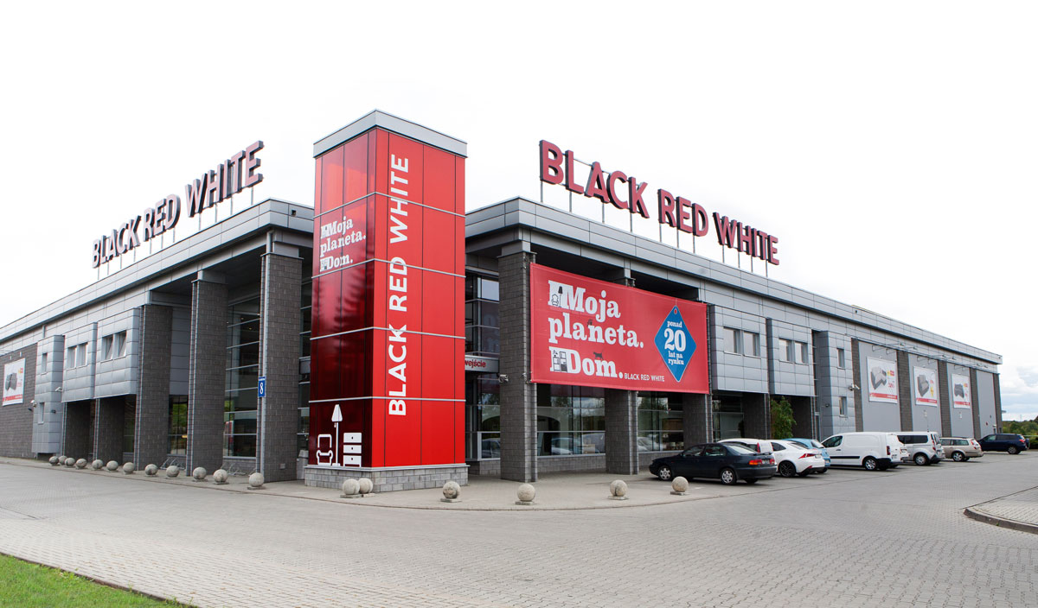

Slide 3
BRW
Large Polish furniture producer, established in 1993 and well managed international company, but with the relatively small and undeveloped international brand existence (currently Eastern European market)
Large scale manufacturing
Good supply chain
Easy to distribute
Space saving – IKEA style packed products
2nd largest known furniture producer in Eastern Europe and biggest in Poland
Good price and good quality
Online sales
Home delivery and fitting option
Notes:
Black Red White is a large Polish furniture producer, established in 1993. ell managed international company, but with lack of the wider international expansion.
There is a large scale manufacturing with the well organised supply chain. Biggest in Poland and 2nd largest in Europe.
Offering good quality and good price, online sales, home delivery and fittings.
Easy to distribute across the Poland.
Prodcuts are space saving, as offered in cartoon boxes – same as offered by IKEA.

Slide 4
Current situation
Biggest furniture producer in Poland and 2nd in Europe
Turnover approximately £400,000,000 (2016)
Employment 8000 + 3000 contractors
Restructuring the management (introducing new people with the specialists experience)
Aim to double turnover to 800,000,000 by 2019, through the further international expansion.
Notes:
Black Red white is currently the biggest furniture producer in Poland and 2nd in Europe.
Reported turnover is £400M in 2016.
In order for further expansion company recently employed a group of specialists with the different background and experience and different fields of business.
The aim of the restructured company is to double its turnover to £800M by 2019.

Slide 5
United Kingdom
Is the 6ht largest economy in the world and 2nd in Europe
Population 65.64 million (Poland 38.422million)
GDP per capita $38.847 (Poland $15.050)
Over a 1 million Polish residents in the UK
Well established Polish food suppliers; rising interest of Polish food and products in the UK; almost every big grocery offers Polish products
The need for diversification in the furniture market – IKEA vs. expensive furniture producers (John Lewis), or low quality (Argos)
Notes:
United Kingdom is the 6th largest economy in the world and 2nd in Europe.
It’s population is 65.64 million, which is nearly double of the population in Poland.
There is over a 1 million Polish residents living in the UK.
Since Poland joined European Union, there is a rising demand for Polish food in the Uk, and there are well established Polish food suppliers across United Kingdom. Polish shops are in most of the cities and towns. Big chains offer Polish products (Tesco, Asda, Sainsbury).
There is a need for diversification in the furniture market, as there is a main affordable furniture producer – IKEA; therefore either expensive, well made products, or cheap and low quality (Argos).

Slide 6
Identifying customer needs
Average salary in the UK - £27,600 (2016)
Need for affordable, well made furniture with the modern design
Available showrooms
Available online sale
Delivery and fitting services available
Notes:
Average salary in the UK is £27,600 (in 2016.)
There is a need for affordable, well made furniture with the modern design.
Customers prefer to see before they buy – can measure and see how the product looks like, its practicality, etc., therefore showrooms are needed.
There is a rising online sales – therefore online sales, must be available.
Delivery and fitting option should be available, as busy customers prefer goods to be delivered and fitted by someone who knows how to do it quickly and efficiently.

Slide 7
COMPETITORS
No direct competitors as such, producing in large scale, offering wide range, good quality of products in good price
Only 1 similar direct competitor - IKEA - targeting the same customers
Notes:
There is no direct competitor offering wide range, good quality products in good price.
There is one similar competitor – IKEA, which compete in Poland, and the showrooms of the both companies are often located close to each other.

Slide 8
Direct competitor - IKEA
First shop opened in the UK in 1987
But only 20 stores across United Kingdom
In the UK there is 52 main cities with population of 100,000 or over ; customers complaints about lack of shops in their area
Well established distribution
Notes:
IKEA opened its 1st showroom in 1987, but lacked in expansion, as there is only 20 stores across the country.
There is 52 main cities in the UK, and there are complaints that IKEA is lacking its existence in most.
IKEA has well established distribution in the UK.

Slide 9
Rationale for expansion to the UK
Market for relatively low priced, good quality, well designed and functional furniture
Low manufacturing cost in Poland
Earning in GBP (BRITISH POUND), with the exchange rate 1 GBP = 4,71 PLN (as on 01/03/2018)
Lack of the direct competitors on the UK market
Extensive plans to build large number of houses across the United Kingdom
Notes:
There is a market for BRW products, as for relatively low priced, good quality, well designed and functional products.
There are low manufacturing costs of production in plants in Poland.
National currency is British Pound (GBP), with the current exchange rate 1 GBP = 4,71 PLN (as on 01/03/2018).
There is a lack of direct competitors on the UK market.
There are extensive plans to build large number of houses across the United Kingdom – lack of houses for people.

Slide 10
Potential risk in the UK
High rent property prices
A new unknown brand in the UK market
Competing with the worldwide known brand – IKEA, but already competing in Poland
Exchange rates: GBP –PLN
Growing online sales
Costs of transport
Notes:
High prices of the properties to rent.
A new, unknown brand on the market.
Directly competing with well known and known in the UK since 1987 brand – IKEA., what is also a competitor in Poland.
Changes in exchange rates GBP/PLN
Growing need of the online sales.
Transport costs – Poland – UK, about 1100 miles +, depends on the location in the UK.

Slide 11
Uncertainty because of Brexit negotiations
UK citizens voted to leave European Union
Uncertainty over free movement of goods and people
Breaking free trade agreement causing additional expenses and costs
Additional trade barriers, taxes
Notes:
There is a uncertainty after the Brexit vote – UK citizens decided to leave European Union.
Possibility of the limitation of free movement of goods and people, breaking free trade agreements may cause additional costs and expenses.

Slide 12
For expansion
New entrant with new, contemporary design and solutions
Good quality products but cheaper than direct competitor - IKEA
Wide range of products : home, office, kitchen, accessories
Similar to IKEA strategy as regard to organising showrooms
Online sales
Company’s aim to expand internationally to double its turnover
Notes:
As a new entrant company will offer good quality, low priced, wide range of furniture products with the contemporary design and practical solutions.
Cheaper than IKEA, but better made.
Offering wide range of products: home, office, kitchen, specialist (BRW Medica), accessories.
Company aim and is ready for further international expansion to double its turnover.
Offers online sales, home delivery and fitting.
Plans to expand internationally.

Slide 13
Possibility of cooperation with the local suppliers
Notes:
There is also possibility of work with the local suppliers, meeting company standards.

Slide 14
The proposed way to entry UK market
Showrooms in cities where IKEA lacked its existence
Showrooms in cities where IKEA has its shops already
Online sales with the home delivery and fitting options
Cooperation with building companies operating in the UK – possibility of fitting furniture to newly build houses
Cooperation with the government organisation – opportunity of furnishing council houses (local government funded accommodations)
Cooperation with the UK’s universities – furnishing student accommodations, and universities with office furniture
BRW Medica – professional furniture for the specialist medical organisations
Providing free 3D projects available to download for architects and designers, and the estate agencies across the Uk.
Notes:
Showrooms where IKEA lacked its existence.
Showrooms where IKEA already has own shops.
Online sales with the home delivery and fittings option.
Cooperation with the building companies that operate in the United Kingdom – opportunity to furnish newly build houses.
Cooperation with the local government organisations – opportunity to furnish council houses – local government build and funded accommodations.
Cooperation with Uk universities – furnishing student’s accommodations, and universities with the office furniture.
Black red White Medica – professional furniture for the specialist medical organisations.
Providing 3D projects available to download for architects, designers and estate agencies across the Uk.

Slide 15
Barriers to entry
European Union Free Trade Agreement – no current trade barriers
Well developed transport infrastructure – motorways, ferries between UK and France
Language – English language
GBP – British Pound – local currency
Notes:
European Union Free Trade Agreement – no current trade barriers.
Well developed transport infrastructure across the Europe and in the UK – motorways. Ferries available between France and United Kingdom.
Language – English – widely spoken internationally language.
National currency – GBP – British Pound. There will be exchange rates involved.

Slide 16
Legal and regulatory
Easy to establish new company or subsidiary company in the United Kingdom
Part of the European Custom Union - free market – no restrictions or taxes on imported or exported goods within the Union
Financial requirements
Employees rights
Well developed consumer rights and protection, customers statutory rights
Notes:
Easy to enter market, establish new company or subsidiary company in the United Kingdom.
Part of the European Custom Union – free market, no restrictions or taxes on imported or exported good within the EU.
UK financial requirements – but very transparent and everything can be provided online to the appropriate regulatory organisations.
Well established employment rights with wide employees protection.
Well developed consumer rights and consumer protection, customer statutory right, wide range of the rights to return, change, exchange of goods.

Slide 17
References
https://www.ons.gov.uk/peoplepopulationandcommunity/populationandmigration/internationalmigration/bulletins/ukpopulationbycountryofbirthandnationality/2016
http://www.dailymail.co.uk/news/article-3085585/One-ten-eat-Polish-cuisine.html
https://www.pb.pl/wielkie-przemeblowanie-w-black-red-white-829813
https://universitybusiness.co.uk/Article/lack-of-university-accommodation-could-affect-students

Slide 18
https://magazine.startus.cc/average-wage-uk-salary-earning-age/

