Slide 1

The Importance of Emotional Intelligence at the Workplace
By
Nargas Ahmadzai ( 2106756)
Module_ Developing Intelligence Skills for the Workplace
Module Code_ BMSW 6106_BIRM Lectures By _ Essa Bah

Slide 2

Outlines
Leadership Impacts Employee’s Emotions
What is Emotional Intelligence
The Importance of Emotional Intelligence in the Work Environment
The Models of Emotional Intelligence
The Goleman Model
Conclusion
References

Slide 3


Leadership impacts employees’ emotions
Stress /Anxiety
Motivation /Happiness
Performance/Confidence

Slide 4
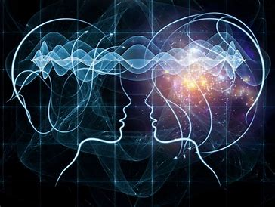
What is emotional intelligence
Self-awareness
Self- Management
Social-awareness
Relationship-management
Source Kanesan and Fauzan, 2019.

Slide 5
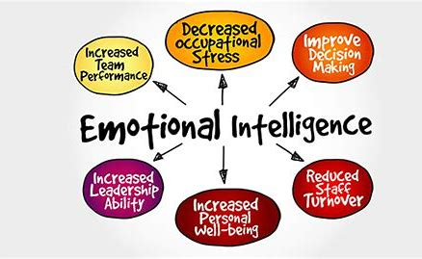
The importance of emotional intelligence in the work environment
Source: (Staff,2019)

Slide 6

The models of
EI
(Emotional Intelligence)
1. Ability Model
The Mayor- Salovey
2. Mixed Models
The Goleman Model
The Bar- On Model
3. Trait Model
The Trait EI Model
Source: (Camille ,2023)

Slide 7
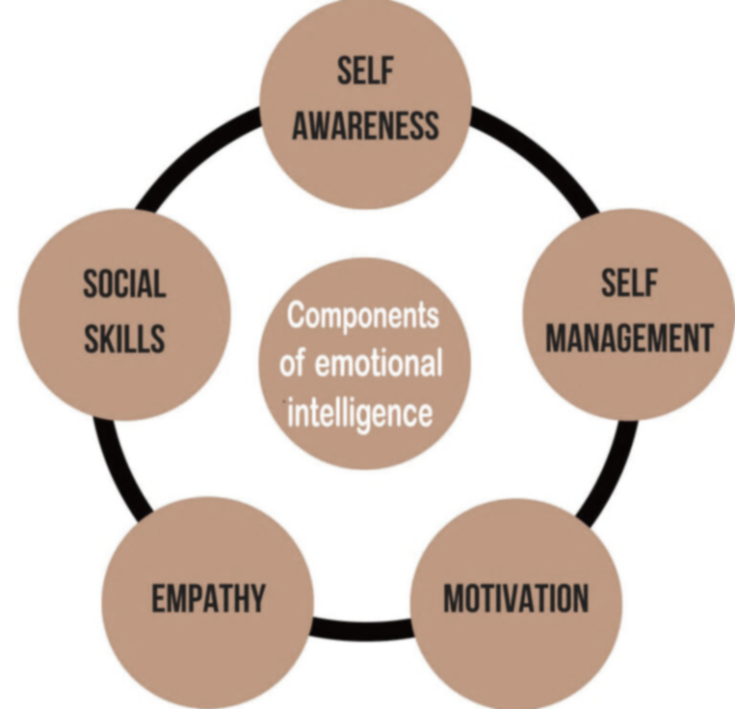
The Goleman model by Daniel Goleman introduced in 1997
Source: (Global intelligentsia, 2020)

Slide 8

conclusion
Emotional intelligence is not just emotions it is the capability to organize and supervise your emotions and understand others' emotions. Organisations need people with high emotional intelligence abilities therefore to enhance these skills they need to focus providing on opportunities and training sessions for employees to avoid conflict and unproductivity.

Slide 9
References
Globalintelligentsia.Com (2020.). Component s of emotional intelligence – Daniel Goleman’s leadership of eq. [Online] available at: https://globalintelligentsia.Com/components-of-emotional-intelligence/.
Kanesan, P. And Fauzan, N., (2019). Models of emotional intelligence: A review. E-BANGI journal, 16(7).
‌
Staff, W. (2019). Five ways to use emotional intelligence at work. [Online] human resources online. Available at: https://www.Humanresourcesonline.Net/five-ways-to-use-emotional-intelligence-at-work [accessed 27 June. 2024].
Camille (2023). What Are The Three Models Of Emotional Intelligence? [online] Creed Branson. Available at: https://creedbranson.com/what-are-the-three-models-of-emotional-intelligence/ [Accessed 10 Jul. 2024].
‌

Slide 10


Thank you any questions

