Slide 1
Psychology for health and social care
(BMHP4003_BIRM)
Student name : Poly Begum (2116759)
Lecturer name: Neale Haddon
Why is psychology important when working as Health Visitor?

Slide 2
Contents
Introduction - 3
Health visitor roll - 4
Erik Erikson’s theory - 5
About Erikson’s theory - 6
Erikson theory picture - 7
Conclusion - 8
References - 9

Slide 3
Introduction
Today I will be talking about why psychology is very important when someone is working as a Health Visitor.
What is psychology: Psychology came from two Greek words.
Psych- meaning mind, soul or spirit and
Logos- meaning knowledge, discourse or study.
Psychology is the scientific study of mind and behavior. Psychologists are actively involved in studying and understanding mental processes, brain functions and behavior.

Slide 4
Health Visitor Role
Health Visitors are specialist community public health nurses. They specialise in working with families with a child aged 0 to 5 to identify health needs as early as possible and improve health and wellbeing. A Health Visitor will have many duties, including establishing relationships with families, assessing children’s health needs, providing information, support and advice to parents, working with other professionals to protect and safeguard children and organizing clinics.

Slide 5
Erik Erikson theory
Erikson had an 8 stage theory.
He believed that personality developed in (8) stages
Each stage is linked to social experiences across the lifespan
At each stage, the person must successfully or unsuccessfully cope
  Success: acquire strengths needed for next developmental stage
  Unsuccessful: less likely to be able to adapt to later problems
Stage 1:Basic trust vs mistrust.
Stage 2:Atonomy vs shame and doubt.
Stage 3: Initiative vs guilt.
Stage 4:Industriousness vs inferiority
Stage 5: Identity vs confusion.
Stage 6: Intimacy vs Isolation.
Stage 7: Generativity vs Stagnation.
Stage 8 : Ego Integrity vs Despair.

Slide 6
About Erikson’s theory
Stage one is about 0 – 1 years age of child life about trust.
Stage two is about 1 – 3 years age of child life about will and slowly becoming confident.
Stage three is about 3 - 5 years age of child life about taking part in little activities.
Stage four is about 6 - 11 years age of child life about completing tasks, developing skills.
Stage five is about 12 - 18 years of age about self image.
Stage six is about 18 - 35 years of age about personal relationships.
Stage seven is about 35 - 55 years of age about building successful careers.
Stage eight is 55+ and about wisdom and knowledge.
A health visitor can apply Erikson’s theory on her job.

Slide 7
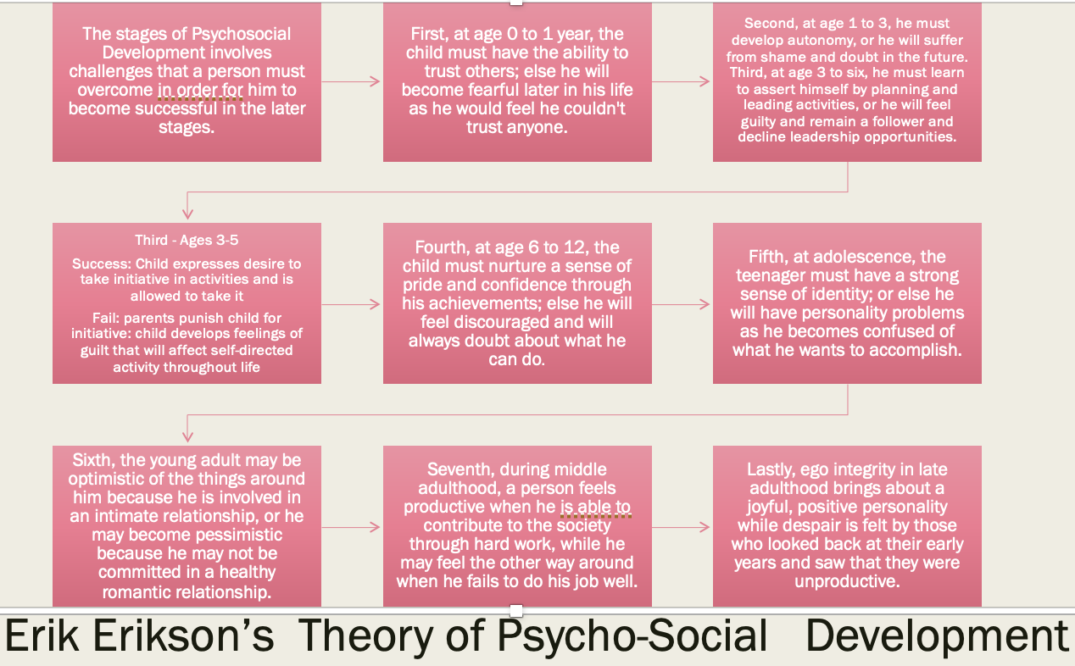
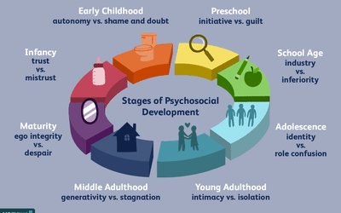
Erik Erikson theory: Erikson has 8 stages of theory.

Slide 8
Conclusion
In conclusion, it is important for a health visitor to know a lot about psychology and the importance of it as it can show the reasons for why someone's health is bad e.g stress or anxiety. If a health visitor worker has psychological knowledge she could do her job easily, more confidently and more professionally.

Slide 9
References
Gross, R, D., (2015), Psychology: The Science of Mind and Behaviour 7th edn, Hodder Education Group, EBSCO Publishing : eBook Collection (EBSCOhost)
Griggs, R, A., (2012), Psychology: A concise introduction 3rd edn, Publishing: worth
Val, M., (2016), An introduction to health psychology 4th edn, Publishing: Pearson Education Limited
Linda, P., (c2009), How children learn (electronic resource).3, contemporary thinking and theorists. London: Andrews UK Publishing: eBook.
Eysenck, M, W., (2017), Simply Psychology, Taylor & Francis Group: ProQuest Ebook Central
Hogg, M. and Vaughan, G., (2017), Social Psychology, 8th edition, Harlow, Pearson Education.

