Slide 1
Llangatwg Community school Tennis session for 7-11 year olds
Sam Mawer

Slide 2
Llangatwg Community School background
Llangatwg is a Community school in Cadoxton which is a village just outside of Neath
700 pupils ranging from the ages of 11-16
School facilities used by the wider community by various groups and organisations on a weekly basis.
Open to the community during evenings, weekends and school holidays.
School website - http://www.llangatwg.org.uk/

Slide 3
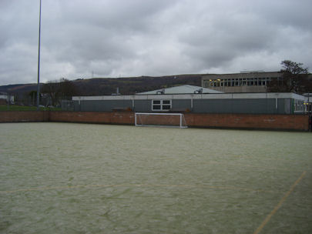
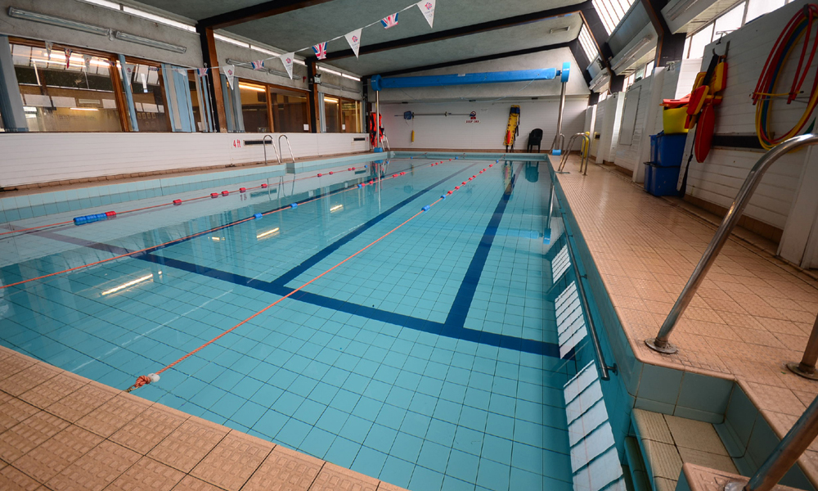
Facilities
Astro turf pitch which can be hired out by the public on weekday evenings.
Changing rooms and shower facilities available.
Swimming Pool which is hired out to local community.
Gym – used for p.e lessons
Two outdoor netball courts
Fitness suite
Sports hall with basketball hoops
Youth wing
2 Grass rugby pitches
Tennis courts

Slide 4
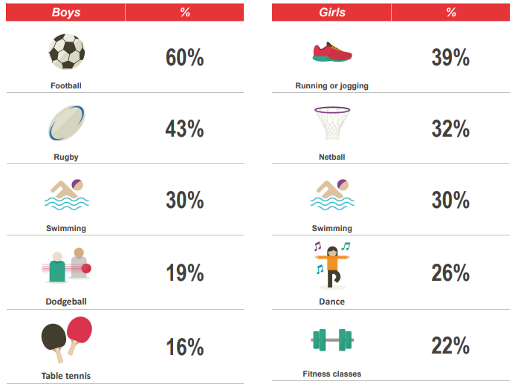
Data
Popular community club activities that Llangatwg Community School pupils take part in:

Slide 5
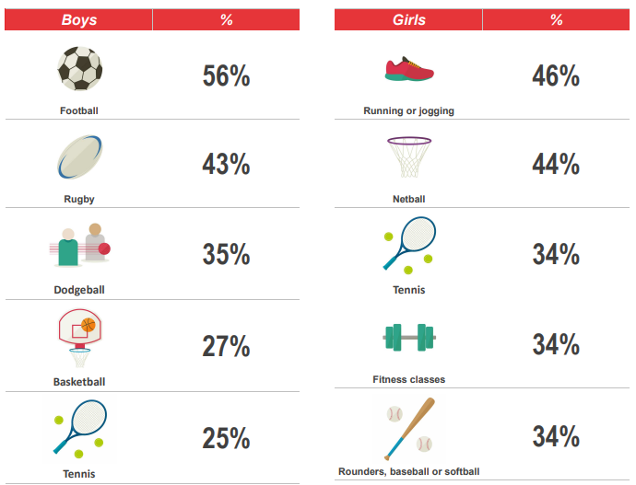
Data Continued…
Activities that pupils from Llangatwg Community School want to take part in:

Slide 6

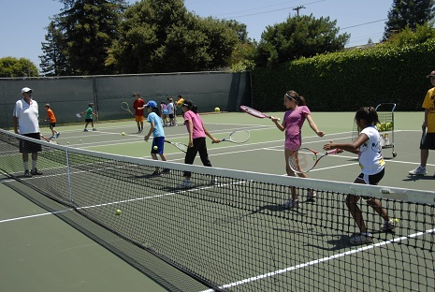
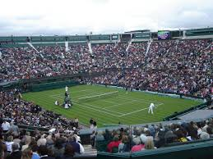
Chosen Session - Tennis
Results from the 2015 Llangatwg sports survey show both boys and girls would like to take part in tennis which they are not currently.
Tennis courts on site but no funding to get the courts resurfaced.
Tennis sets that will be used can be set up on the netball courts or AstroTurf depending on which is deemed more suitable for the number of attendants.
1 night a week for 1 hour between 6-7pm.

Slide 7
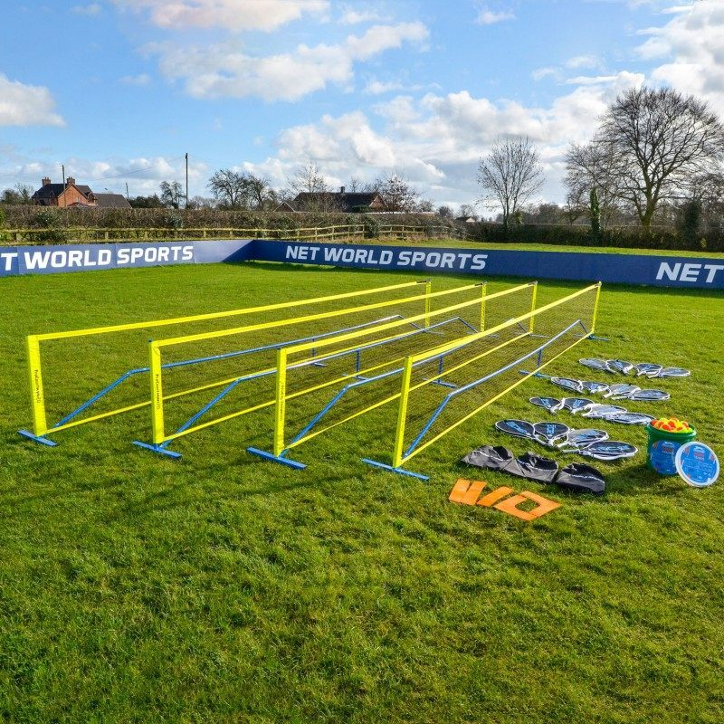
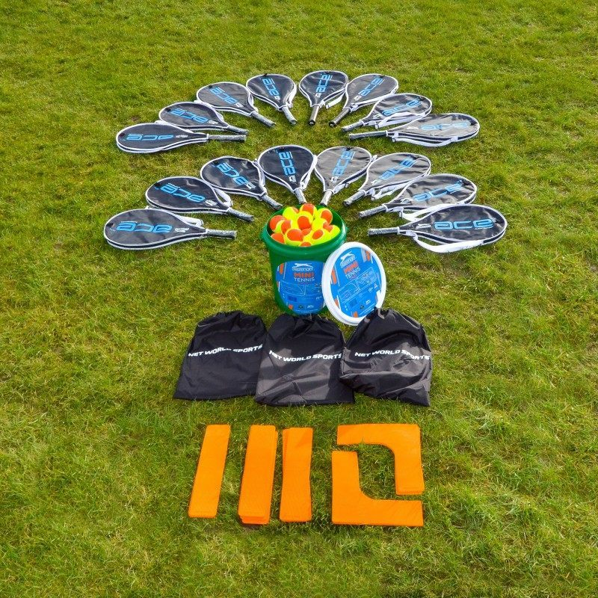
Costs
Vermont Pro Court Mini Tennis Set Schools edition -£499.90
Includes – 4 x 20ft (6m) mini tennis net with posts
16 x 24in Junior tennis rackets (Tri coloured)
60 x Slazenger mini tennis balls
4 x tennis court lines
4 x carrier bag

Slide 8
Continued…
2 coaches at £15 an hour each = £30 a week.
Fee of £3 per session for participants.
Based on 16 participants a week it would take 10 weeks to cover cost of the tennis set.
Second set can be bought after the first few sessions if there is demand for it.
Costs can be covered through community chest grant funding through either Swansea council or Neath Port Talbot P.A.S.S. if granted, the fee paid by participants can be reduced to £1 to help pay the coaches costs if not covered by the grant.

Slide 9


Funding
Swansea council/NPT P.A.S.S community chest scheme offers up to £1500 of funding per sports club and community group.
Community Chest is a Sport Wales grant aid scheme which is funded by the national lottery.
Aim is to offer funding that will help individuals, clubs, teams or organisations create a more active Wales.
Can apply online at: https://grants.sportwales.org.uk/en/login?ReturnUrl=%2f

Slide 10
How the session can be developed/Engaging the group
Coaches to include two or more drills then a game in each session to engage the group and to make it fun.
Changing the activities and drills each week to keep the sessions interesting as might not want to repeat the same sessions week after week which will encourage the participants to return each week.
At the end of each month the coaches can organise a tournament between the participants to see the progress that has been made and award prizes.
Loyalty cards can be given out and points rewarded for each time you attend which can earn you rewards such as a free session after attending 5 sessions or a voucher to use at a local tennis store.

