Slide 1
Heat Exchangers
Lecture 2
Rob Goodson

Slide 2
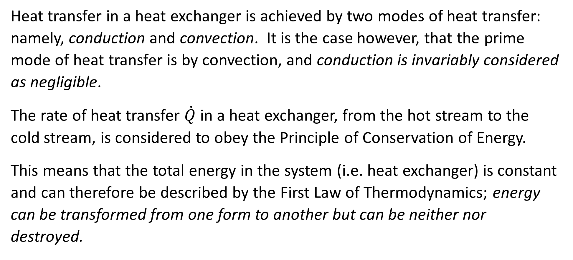
Calculation of Heat Transfer Rate
Heat transfer in a heat exchanger is achieved by two modes of heat transfer: namely, conduction and convection. It is the case however, that the prime mode of heat transfer is by convection, and conduction is invariably considered as negligible.
The rate of heat transfer $\dot{Q}$ in a heat exchanger, from the hot stream to the cold stream, is considered to obey the Principle of Conservation of Energy.
This means that the total energy in the system (i.e. heat exchanger) is constant and can therefore be described by the First Law of Thermodynamics; energy can be transformed from one form to another but can be neither nor destroyed.

Slide 3
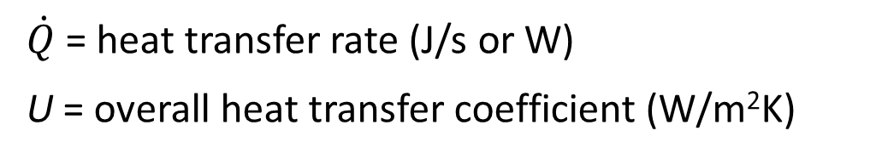
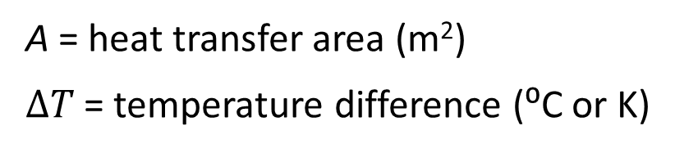
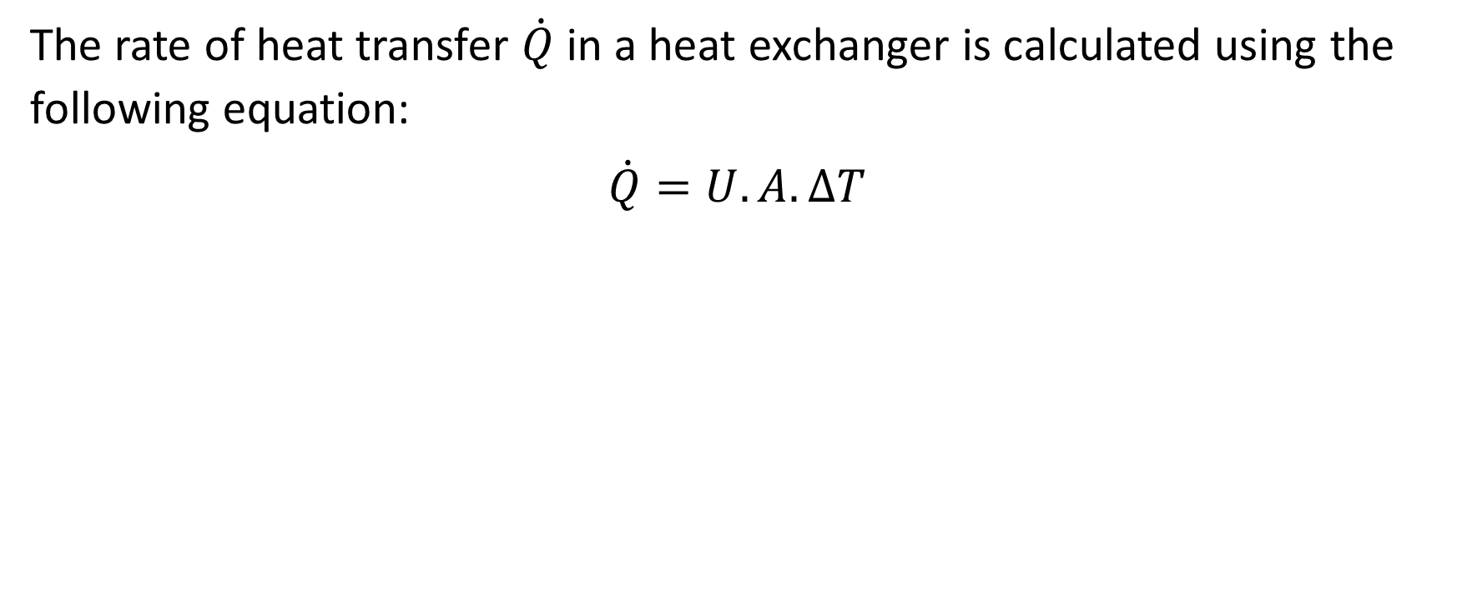
Calculation of Heat Transfer Rate
The rate of heat transfer $\dot{Q}$ in a heat exchanger is calculated using the following equation:
$$\dot{Q}=U.A.∆T$$

Slide 4
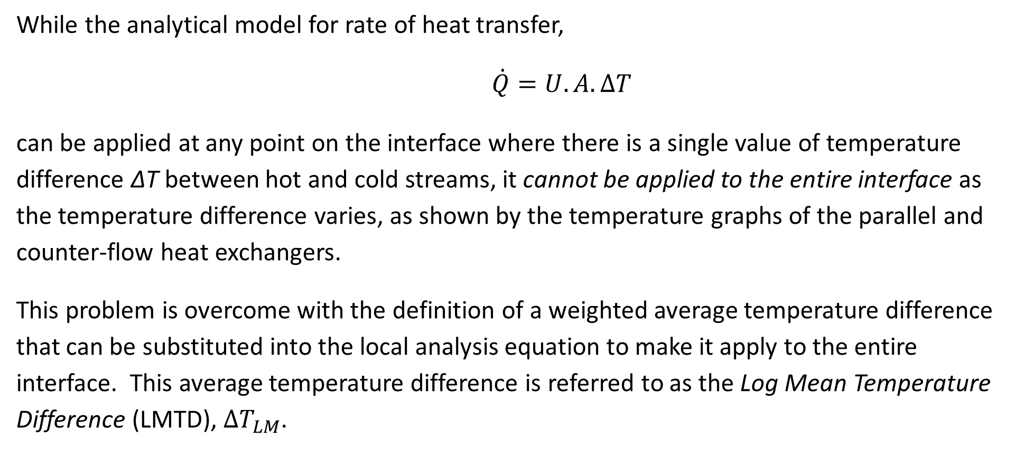
A weighted temperature difference - LMTD
While the analytical model for rate of heat transfer,
$\dot{Q}=U.A.∆T$
can be applied at any point on the interface where there is a single value of temperature difference ΔT between hot and cold streams, it cannot be applied to the entire interface as the temperature difference varies, as shown by the temperature graphs of the parallel and counter-flow heat exchangers.
This problem is overcome with the definition of a weighted average temperature difference that can be substituted into the local analysis equation to make it apply to the entire interface. This average temperature difference is referred to as the Log Mean Temperature Difference (LMTD), $∆T_{LM}$.

Slide 5
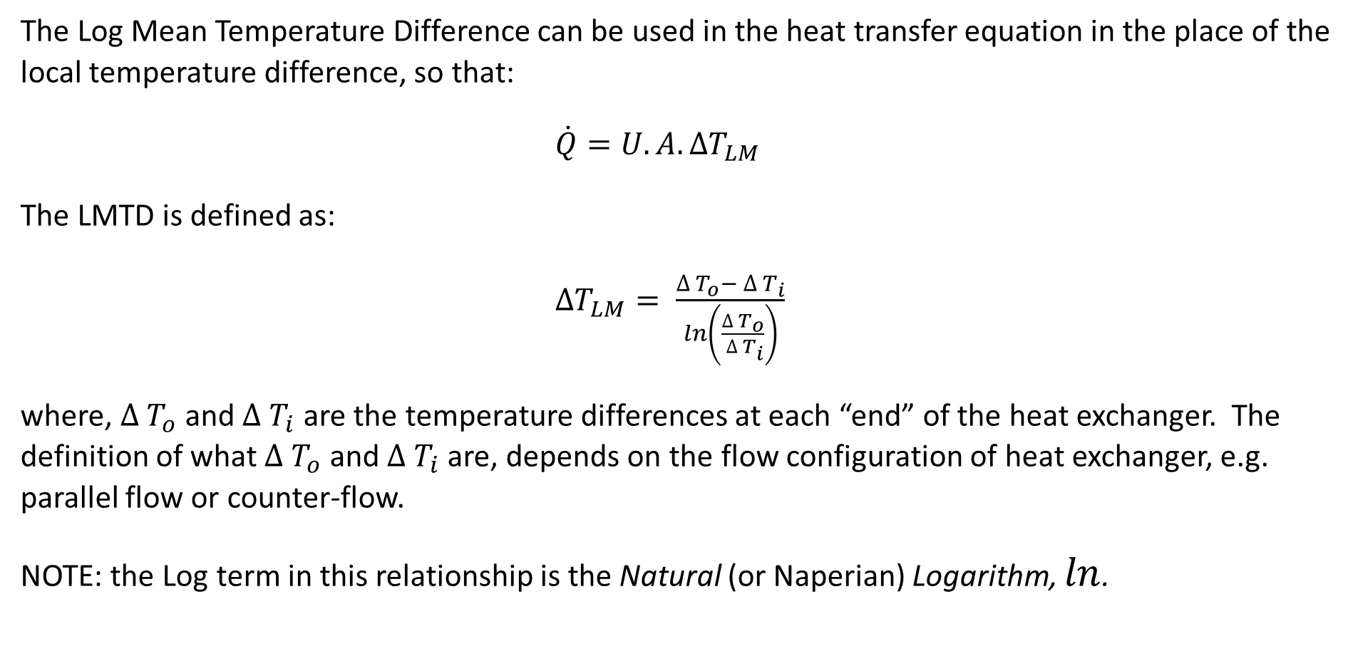

Log Mean Temperature Difference - $∆T_{LM}$
The Log Mean Temperature Difference can be used in the heat transfer equation in the place of the local temperature difference, so that:
$\dot{Q}=U.A.∆T_{LM}$
The LMTD is defined as:
$∆T_{LM}= \frac{∆ T_{o}− ∆ T_{i}}{ln\left(\frac{∆ T_{o}}{ ∆ T_{i}}\right)}$
where, $∆ T_{o}$ and $∆ T_{i}$ are the temperature differences at each “end” of the heat exchanger. The definition of what $∆ T_{o}$ and $∆ T_{i}$ are, depends on the flow configuration of heat exchanger, e.g. parallel flow or counter-flow.
NOTE: the Log term in this relationship is the Natural (or Naperian) Logarithm, $ln$.

Slide 6
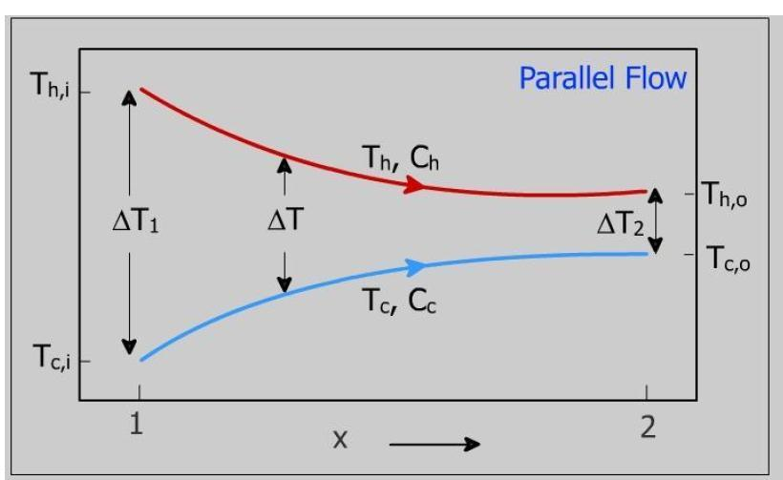
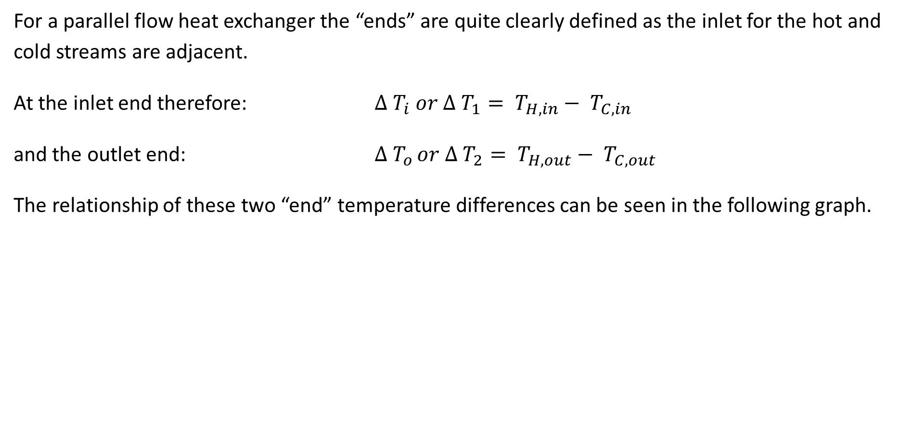

$∆ T_{i}$ and $∆ T_{o}$ for Parallel Flow
For a parallel flow heat exchanger the “ends” are quite clearly defined as the inlet for the hot and cold streams are adjacent.
At the inlet end therefore: $∆ T_{i} or ∆ T_{1}= T_{H,in}− T_{C,in}$
and the outlet end: $∆ T_{o }or ∆ T_{2}= T_{H,out}− T_{C,out}$
The relationship of these two “end” temperature differences can be seen in the following graph.

Slide 7
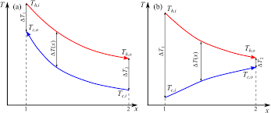

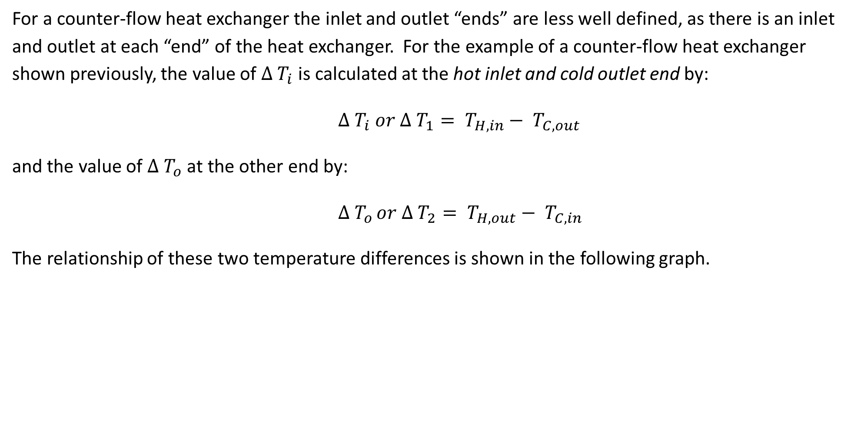
$∆ T_{i}$ and $∆ T_{o}$ for Counter-Flow
For a counter-flow heat exchanger the inlet and outlet “ends” are less well defined, as there is an inlet and outlet at each “end” of the heat exchanger. For the example of a counter-flow heat exchanger shown previously, the value of $∆ T_{i}$ is calculated at the hot inlet and cold outlet end by:
$∆ T_{i} or ∆ T_{1}= T_{H,in}− T_{C,out}$
and the value of $∆ T_{o}$ at the other end by:
$∆ T_{o }or ∆ T_{2}= T_{H,out}− T_{C,in}$
The relationship of these two temperature differences is shown in the following graph.

Slide 8

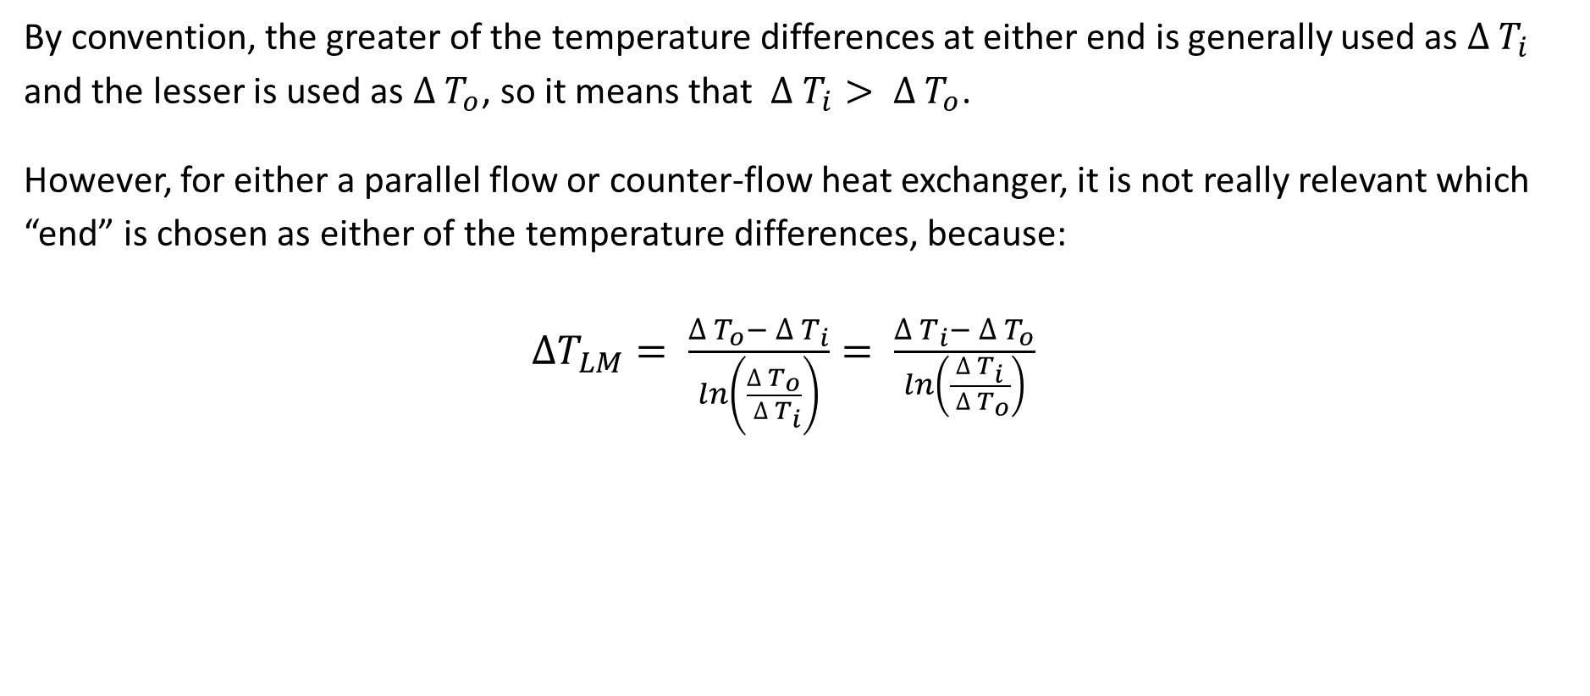
$∆ T_{i}$ and $∆ T_{o}$ are Interchangeable
By convention, the greater of the temperature differences at either end is generally used as $∆ T_{i}$ and the lesser is used as $∆ T_{o}$, so it means that $∆ T_{i}> ∆ T_{o}$.
However, for either a parallel flow or counter-flow heat exchanger, it is not really relevant which “end” is chosen as either of the temperature differences, because:
$∆T_{LM}= \frac{∆ T_{o}− ∆ T_{i}}{ln\left(\frac{∆ T_{o}}{ ∆ T_{i}}\right)}= \frac{∆ T_{i}− ∆ T_{o}}{ln\left(\frac{∆ T_{i}}{ ∆ T_{o}}\right)}$

Slide 9
LMTD - Problem
Consider a simple water-to-water heat exchanger. Water enters one side of the heat exchanger with a mass flow rate of 24 kg/s at a temperature of 80 °C, and exits at a temperature of 30 °C. Water enters the other side of the heat exchanger at 20 °C and exits at 60 °C. The overall heat transfer coefficient of the heat exchanger is 240 W/m²K.
Determine which is the hot stream and which is the cold stream.
Determine the rate of heat transfer from the hot to the cold stream.
Determine if this is a parallel flow or a counter flow heat exchanger.
Sketch a graph of the temperature profile of the hot and cold streams against the distance along the length of the heat exchanger.
Calculate the Log Mean Temperature Difference.
Determine the mass flow rate of the cold stream.
Calculate the required surface area between the hot and cold streams.
If the simple heat exchanger design was a concentric tube configuration, and the inner tube was the hot stream of external diameter 100 mm, what would be the required length?

Slide 10
Notes

Slide 11
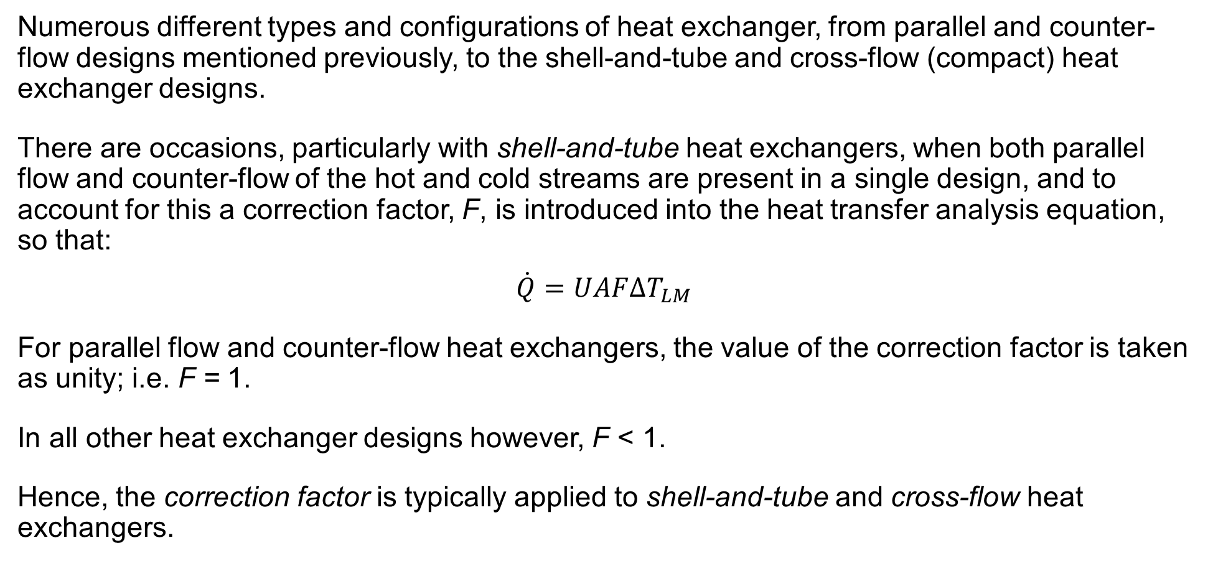
Shell & Tube and Cross-flow heat exchangers
Numerous different types and configurations of heat exchanger, from parallel and counter-flow designs mentioned previously, to the shell-and-tube and cross-flow (compact) heat exchanger designs.
There are occasions, particularly with shell-and-tube heat exchangers, when both parallel flow and counter-flow of the hot and cold streams are present in a single design, and to account for this a correction factor, F, is introduced into the heat transfer analysis equation, so that:
$$\dot{Q}=UAF∆T_{LM}$$
For parallel flow and counter-flow heat exchangers, the value of the correction factor is taken as unity; i.e. F = 1.
In all other heat exchanger designs however, F < 1.
Hence, the correction factor is typically applied to shell-and-tube and cross-flow heat exchangers.

Slide 12
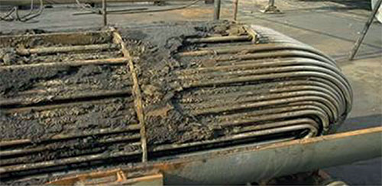
Industrial importance of Shell & Tube heat exchangers
Estimated that 35-40% of heat exchangers employed in global heat transfer processes are of the shell and tube type of heat exchangers.
Primarily due to the robust construction geometry as well as ease of maintenance and upgrades possible with the shell and tube heat exchangers.
In a shell and tube heat exchanger, conventional segment bafﬂe geometry is largely responsible for higher fouling rates. This is typically caused by uneven velocity proﬁles, regurgitation and eddies generated on the shellside of these segmentally-bafﬂed heat exchangers. Results in shorter run times between periodic cleaning and maintenance of tube bundles.

Slide 13
Shellside fouling of Shell & Tube HX
The principal mechanisms of fouling are generally considered as follows:
• Particulate matter in ﬂows
• Crystallisation
• Chemical reaction
• Corrosion processes
• Biological mass accumulation
As a case study the impact of shellside fouling on the thermal performance and economics of shell and tube heat exchangers employed in the reﬁnery and petrochemical plant processes will be discussed.
Recent design improvements in shell and tube heat exchangers will highlight a means of mitigating fouling, and hence improving thermal performance.

Slide 14
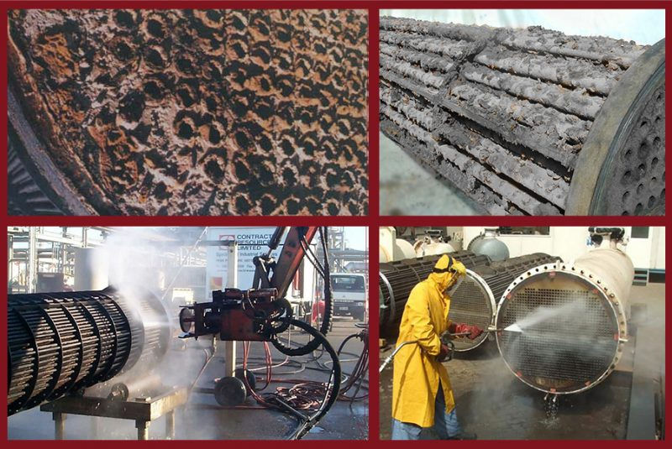
Refinery applications
Majority of the heat energy input in a refinery takes place in the Crude Unit, where crude oil is preheated in banks of heat exchangers before further heating to high temperature (370 - 400°C) in a fired heater (furnace).
Preheat exchanger performance is vital in reducing the fuel consumption in the downstream furnace and supplying the uniform crude flow to the furnace over production operations. However, fouling generally occurs in the crude preheat systems, hence affecting their performance characteristics.
It is found that fouling in preheat exchangers contribute significantly to reduction of the heat transfer coefﬁcient (U), often by 25-30% in 3 months and as low as 50% in 6 months after operation of new plant installation.

Slide 15
Refinery applications
A direct consequence of fouling is increased fuel costs in the downstream furnace and added to maintenance and cleaning costs of heat exchangers, could signiﬁcantly affect the overall plant operating costs.
Anti-fouling agents are often added to the process streams to reduce the fouling tendencies and improve the plant economics.
As mentioned previously, conventional segmented-baffles are found to promote higher rates of fouling on the shellside.
Total fouling-related expenses in the major reﬁning plants in the USA alone is estimated to be about US$ 1.4 billion per annum (£ 1076 million). Total fouling-related costs for major industrialised nations is estimated to exceed US$ 4.4 billion annually (£ 3382 million).

Slide 16
Fouling reduction
Research by Ebert and Panchal (1997) presented a fouling model that is expressed as the average (linear) fouling rate under given conditions as a result of two opposing terms; a deposition term and a mitigation term.
The model points to the possibility of identifying combinations of temperature and velocity below which the fouling rates will be negligible; known as the ‘threshold condition’.
Model also suggests that the heat exchanger geometry can be designed to effectively maintain the fouling-related conditions below the ‘threshold condition’.
This geometric design consideration can be seen in the HELIXCHANGER®.

Slide 17
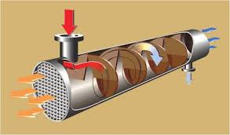
Helical shell & tube heat exchanger
The HELIXCHANGER® heat exchanger uses Lummus Technology's solutions for common issues such as shell-side fouling, high-pressure drop and vibration.
The design incorporates quadrant shaped baffle plates are placed at an angle to the tube axis in a sequential arrangement to create a helical flow pattern.

Slide 18
Helical shell & tube heat exchanger
Optimum design of a HELIXCHANGER® heat exchanger are shown to offer the following improved operational characteristics:
• Uniform flow velocities through the tube bundle offering uniform temperature distribution.
• Elimination of regurgitation and eddies
• Shellside flow tends to turbulent flow conditions improving the temperature driving force (ΔT).
• Higher flow velocities are achieved with correspondingly lower pressure drops, hence improving shear stress at the heat transfer surface.
• Reduced shell size achieved with the HELIXCHANGER® design, offers higher tubeside velocities as a secondary beneﬁt and reducing the tubeside fouling rates as well.
The above characteristics achieved in a HELIXCHANGER® heat exchanger contribute significantly in lowering the fouling rates and maintain higher performance during longer operating times as compared to conventional shall and tube heat exchangers.

Slide 19
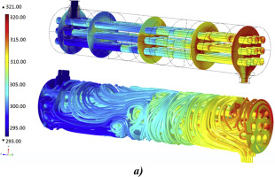
Helical shell & tube heat exchanger
It is known that fouling is costly for industry both in terms of capital costs of heat exchangers as well as the operation and maintenance costs associated with it.
The HELIXCHANGER® has proven very effective in reducing fouling rates signiﬁcantly, whereby 3 to 4 times longer operation periods are achieved between bundle cleaning operations.
The helical baffle design offers greater flexibility in selecting optimum helix angles to maintain desired flow velocities and temperature profiles to keep the conditions below the “fouling thresholds”.

