Slide 1
Introduction to Physiology
BMPH 5023
The Skeletal System
G Weaver – Module Lead

Slide 2
Classroom expectations
Respect is the key
Respect the lecturer
Respect others’ right to learn
Respect each other’s views
General classroom expectations are the same for
all students and are in the student contract
spect is the key
Respect the lecturer
Respect others’ right to learn
Respect each other’s views
General classroom expectations are the same for all students and are on the VLE

Slide 3
Body systems
Circulatory
Circulatory
Digestive
Respiratory
Endocrine
Digestive
Respiratory
Endocrine
Urinary
Urinary
Nervous
Skeletal
Muscular

Slide 4
Assessment
You will be assessed through
A written assignment (Component 1)
A practical assignment (Component 2)

Slide 5
Employability
An understanding of the functions of the cell is essential
in scientific and laboratory work.
Roles that involve an understanding of cell structure,
body metabolism and management of metabolic
disorders include:
Laboratory technician
Haematology / phlebotomy technician
Dietician
Nurse specialists in diabetes, urology, cardiology

Slide 6
Aims for the session:
By the end of this session you should:
Know how a bone is formed
Be able to describe the structure of different types of bone tissue
Understand the functions of bone tissue in the body

Slide 7
Bones
Key facts:
Bones are living structures that are continuously being
regenerated.
There are different types of bones, classified as
long irregular
short flat
sesamoid

Slide 8
Bones
Types | Examples
Long bones consist of a shaft and 2 extremities are longer than they are wide | Femur Tibia Fibula
Short, irregular, flat and sesamoid bones have no shafts or extremities are diverse in shape and size | Short bones carpals (wrist) Irregular bones – vertebrae, some skull bones Flat bones – sternum, ribs and most skull bones Sesamoid bones – patella (knee cap)

Slide 9
Long bones
Long bones have a shaft (called the diaphysis) and 2
extremities ( - the epiphyses).
The shaft is composed of compact bone with a
central canal, containing fatty yellow bone marrow.
The extremities have an outer covering of compact bone
with spongy (cancellous) bone inside.

Slide 10
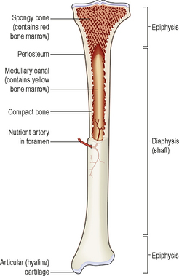
Long bones
Long bones are covered by a vascular
membrane, the periosteum, which
has two layers. An outer layer that is
tough and fibrous and protects the
bone underneath.
An inner layer that contains cells that
are responsible for
production and breakdown
repair and regeneration
of bone tissue

Slide 11
Blood supply to bones
Blood supply to the shaft of the bone is provided by one or more
arteries.
The epiphyses have their own blood supply, connected by their
internal capillary networks.
The sensory (nerve) supply usually enters the bone at the same
site as the artery, and branches throughout the bone.
Therefore bone injuries are often very painful.

Slide 12
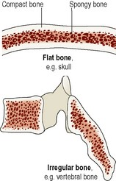
Structure of short, irregular, flat and sesamoid bones
These have a thin outer layer of compact bone with spongy bone inside containing red bone marrow.
They are enclosed by periosteum (except in the inner layer of the skull where it is replaced by the outer covering of the brain, the dura mater).

Slide 13
Microscopic structure of bone
Bone is strong and durable connective tissue.
65% of bone is a mixture of calcium salts, mainly calcium
phosphate. This gives bone great hardness, but on its own
would be brittle and prone to shattering.
The remaining third (35%) is organic material, called
osteoid, which is mainly collagen. Collagen is very strong
and gives bone some flexibility.

Slide 14
Bone cells
The cells responsible for bone formation are called
osteoblasts, which later mature into osteocytes.
Osteoblasts and chondrocytes (cartilage-forming
cells) develop from the same basic fibrous tissue cells
Osteoclasts break down bone.
They are large cells made from the fusion of up to 20
monocytes.

Slide 15
Bone types
Compact (cortical) bone
Compact bone makes up about 80% of the body bone mass.
It comprises a large number of parallel tube-shaped structures
called osteons.
See diagram on next slide:

Slide 16
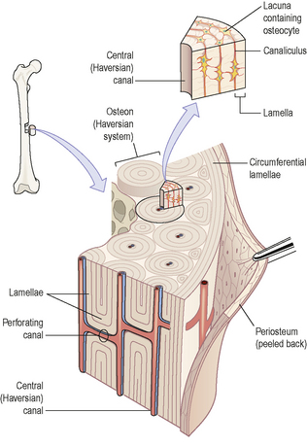
Cortical bone
Each osteon is made up of a
central canal surrounded by a
series of expanding rings, similar
to the growth rings of a tree (see
diagram).
Osteons tend to be aligned to
provide maximum strength for the
bone. For example, in the femur
(thigh bone), they run from one
epiphysis to the other. This gives the
bone great strength.

Slide 17
Cortical bone structure
The central canal of the bone contains nerves,
lymphatics and blood vessels, and each central
canal is linked with neighbouring canals by
tunnels running at right angles between them,
called perforating canals.
A further series of tiny channels in the bone structure
allows the circulation of interstitial fluid through the
bone.

Slide 18
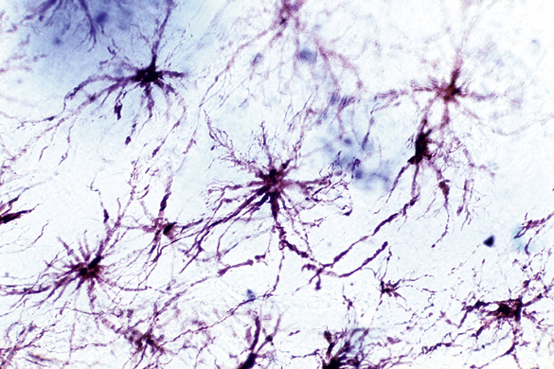
Microscopic structure of compact bone
This image shows the light micrograph of osteocytes, showing the multiple fine processes that extend through bone structure and allow each cell to communicate directly with its neighbours.

Slide 19
Spongy bone
Spongy bone looks like a honeycomb.
Under the microscopic there is a framework consisting of few lamellae (small plates of bone) and osteocytes interconnected by canaliculi(small canals).
Osteocytes are nourished by interstitial fluid seeping into the bone through the tiny canaliculi.

Slide 20
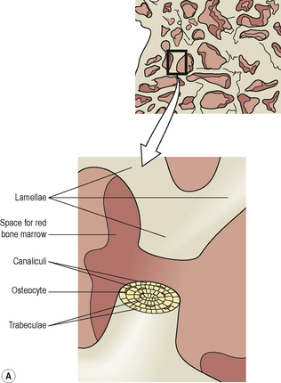
Spongy bone
Spongy bone is lighter than compact bone, reducing the weight of the skeleton.
The structure also contains red bone marrow.

Slide 21
Activity – 30 minutes
In small groups:
Describe the process of ossification
Describe the growth of a long bone
Give examples of these types of bones:
a) long bones
b) flat bones
c) Irregular bones
Feedback in the class

Slide 22
Bone development
During bone development, osteoblasts become calcified,
gradually changing into osteocytes as the bone matures.
Bones lengthen during childhood, although this process
slows down as a result of hormonal influences towards the
end of puberty.
Once all the bone has hardened through the process of
ossification, no further growth is possible.

Slide 23
Exercise and bone
Bone growth lengthways permanently ceases once ossification
has occurred but thickening of bone is possible throughout life.
This involves the laying down of new osteons at the periphery of the bone.
Weight-bearing exercise stimulates thickening of bone,
strengthening it and making it less liable to fracture.
Lack of exercise reverses these changes, leading to lighter,
weaker bones.

Slide 24
Diet and bone
Healthy bone tissue requires adequate dietary calcium and
vitamins A, C and D.
Calcium, and smaller amounts of other minerals such as
phosphate, iron and manganese, are essential for adequate
mineralisation of bone.
Vitamin A is needed for osteoblast activity.
Vitamin C is used in collagen synthesis
Vitamin D is required for calcium and phosphate
absorption from the intestinal tract.. .

Slide 25

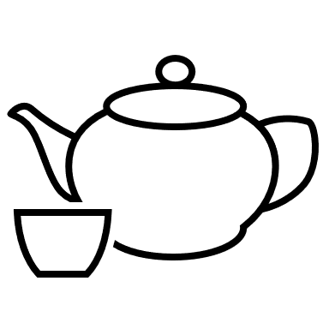
Break

Slide 26
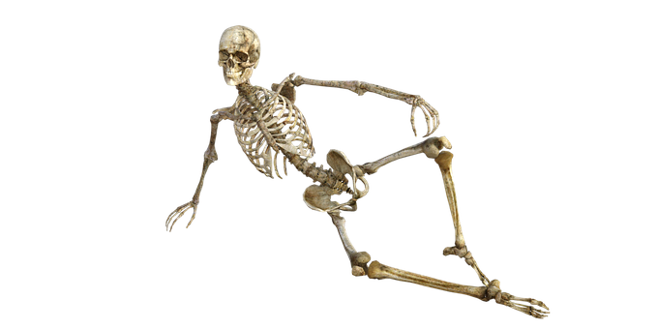
The skeleton

Slide 27
The bones of the skeleton are divided into two groups:
The axial skeleton
(the central system)
The axial skeleton consists of
the skull
vertebral column
ribs
sternum
Together these bone structures
constitute the central bony core of the body, the axis.
The appendicular skeleton
(the appendages)
The appendicular skeleton consists
of
the shoulder girdle
the upper limbs
the pelvic girdle
the lower limbs

Slide 28
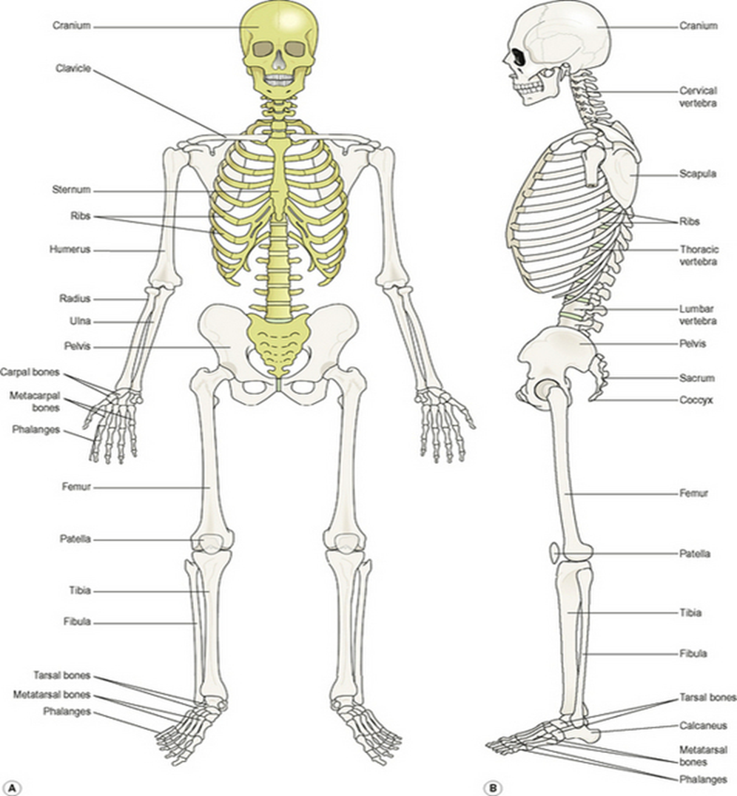
Notes:
Axial skeleton in yellow, appendicular skeleton in cream in diagram A
A = Anterior view
B = Lateral view

Slide 29
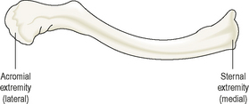
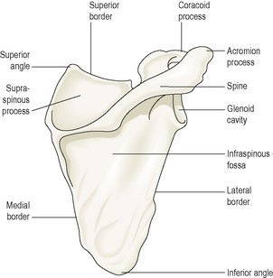
The Appendicular Skeleton
The shoulder girdle
The shoulder girdle consists of two
scapulae (shoulder blades) and two
clavicles.
The clavicle provides the only bony
link between the upper limbs and the
axial skeleton.
The clavicle is pictured opposite (above)
The shoulder blade is pictured opposite (below)

Slide 30
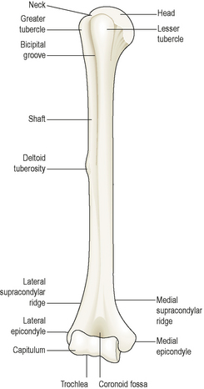
The Humerus – upper arm bone
This is the bone of the upper arm
(pictured opposite).
The head sits in the outside
socket of the scapula (shoulder
blade), forming the shoulder joint.
At the lower end the humerus
connects with the lower arm
bones, the radius and ulna, at
the elbow joint.

Slide 31
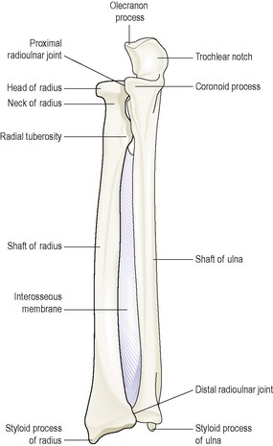
The Radius and the Ulna
These are the two bones of the
forearm.
They articulate (connect) with the
humerus at the elbow joint, the
carpal bones at the wrist joint and
with each other at the ends of the
bones.
A membrane connects the bones
along their shafts to stabilise
them and maintain their positions.

Slide 32
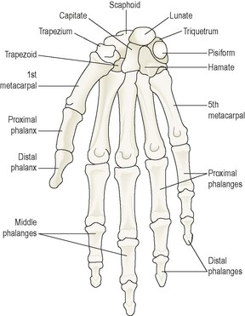
Bones of the wrist and hand
There are eight carpal (wrist) bones
arranged in two rows of four.
Tendons of muscles lying in the
forearm cross the wrist and are
and are held close to the bones by
fibrous bands called retinacula.
There are 14 phalanges, (finger
bones) three in each finger and two
in the thumb. They articulate (link
to) the metacarpal bones by hinge
joints.

Slide 33
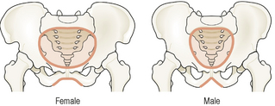
The male and female pelves
The lower limbs form joints with the
trunk at the pelvic girdle which is
formed from the two innominate (hip)
bones.
The pelvis is formed by the pelvic
girdle and the sacrum. The shape of
the female pelvis allows for the
passage of the baby during childbirth.
The female pelvis has lighter
bones, is more shallow and rounded
and is roomier comparison the male.

Slide 34
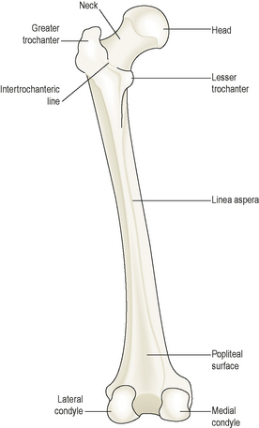
The lower limbs
Femur (thigh bone)
The femur is the longest and heaviest
bone of the body. Its function is to
transmit the weight of the body
through the bones below the knee to
the foot.
The head of the femur is rounded and fits
into the acetabulum of the hip bone to
form the hip joint.
The neck of the femur extends outwards
and downwards from the head to the shaft.

Slide 35
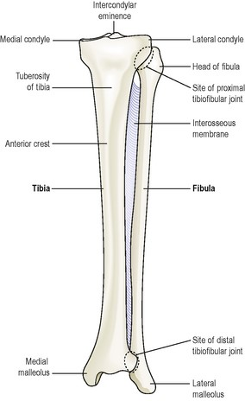
The Tibia and Fibula
Fibula
The fibula is the long slender
lateral bone in the leg. The head of the
fibula articulates with the tibia, forming
the tibiofibular joint.
The lower part of the fibula
articulates with the tibia, and projects
beyond it to stabilise the ankle.
The distal extremity of the tibia forms
the ankle joint.

Slide 36
The Tibia and Fibula
Fibula
The fibula is the long slender
lateral bone in the leg. The head of the
fibula articulates with the tibia, forming
the tibiofibular joint.
The lower part of the fibula
articulates with the tibia, and projects
beyond it to stabilise the ankle.
The distal extremity of the tibia forms
the ankle joint.

Slide 37
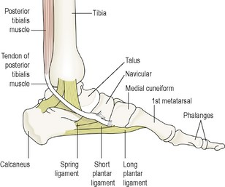
Bones of the lower leg and foot
Other bones in the lower leg include
the patella (knee cap)
tarsal (ankle bones)
the metatarsals (foot bones
Bones in the foot are supported by
ligaments and the actions of
associated muscles. This gives the
sole of the foot an arched or
curved shape.
The diagram opposite shows the position of the ankle
and foot bones.

Slide 38

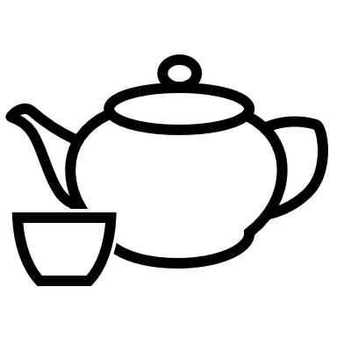
Break time

Slide 39
Joints
A joint is the point at which any two or more bones come
together (articulate). Joints allow flexibility and movement of
the skeleton and allow attachment between bones.
There are two main types of joints - fibrous and cartilaginous.
Cartilaginous joints are subdivided into more specialised
categories in line with their particular structure.

Slide 40
Fibrous joints
The bones forming these joints are linked with tough, fibrous
material. This often means that no movement is possible.
E.g. the joints between the skull bones, the sutures, are
completely immovable.
Sometimes limited movement is possible, for example
the tibia and fibula in the leg are held together along their shafts by
a sheet of fibrous tissue or membrane. This is a fibrous joint that
allows a limited amount of movement and stabilises the
alignment of the bones.

Slide 41
Cartilaginous joints
These joints are formed by fibrocartilage, a tough material that
acts as a shock absorber.
The joint may be immovable although sometimes a limited
degree of movement can occur-
E.g. between the vertebrae, which are separated by the
intervertebral discs, or
at the symphysis pubis, to allow for childbirth.

Slide 42
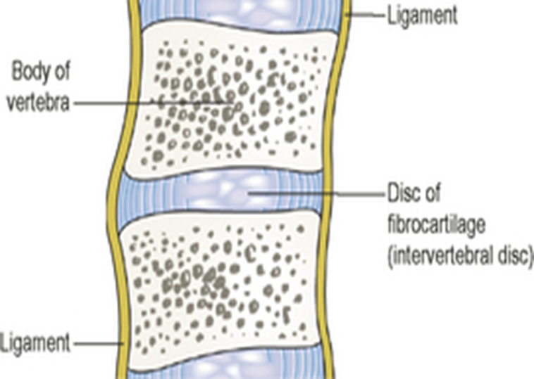
Cartilaginous joint
These joints are formed by fibrocartilage, a tough material that acts as a shock absorber.
The joint may be immovable although sometimes a limited degree of movement can occur
– eg, between the vertebrae, which are separated by the intervertebral discs, or at the symphysis pubis, to allow for childbirth.

Slide 43
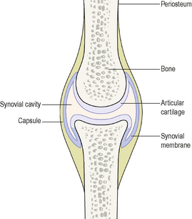
Synovial joints
Synovial joints have a synovial membrane - a sleeve of fibrous tissue holding the ends of the bones together and lubricated with a small amount of synovial fluid.
Most synovial joints permit a range of movement.

Slide 44
Synovial fluid - a thick sticky fluid, of egg-white consistency, which fills the synovial cavity
Synovial fluid:
nourishes the structures within
the joint cavity
- contains phagocytes to remove
cell debris
- acts as a lubricant
- maintains joint stability
prevents the ends of the bones
from being separated
Sacs of synovial fluid or
bursae are present in some
joints, e.g. the knee.
They act as cushions to
prevent friction between a
bone and a ligament or
tendon, or skin where a
bone in a joint is near the
surface.

Slide 45
Other joint structures
Ligaments that provide additional stability at most joints.
Muscles or their tendons also provide stability and stretch
across the joints they move.
When the muscle contracts it shortens, pulling one bone
towards the other.

Slide 46
Types of synovial joints
Type of Joint | Location | Movement
Ball and socket | Shoulder, hip | Flexion, extension, abduction, adduction, rotation
Hinge | Elbow, knee, ankle | Flexion, extension
Gliding | Between the clavicles and: shoulder blade (back), sternum (front) | Expansion/relaxation of the chest cavity (breathing)
Pivot | Skull, spinal vertebrae | Head movement
Condyloid | Wrist, jaw, fingers, toes | Wrist flexion, up and down movement

Slide 47
Joint movement is facilitated by the actions of muscles, attached to the bones by ligaments.
Major muscle groups | Location
Biceps/triceps | Upper arm
Pronator/supinator | Forearm
Deltoid | Shoulder
Quadriceps/ gluteal/hamstring | Thigh (upper leg)
Gastrocnemius | Calf (lower leg)

Slide 48
Activity - 30 minutes
In small groups
Answer the following questions:
Which type of joint permits the most movement?
Use examples to compare a hinge joint and a ball and
socket joint
Class discussion

Slide 49
Health focus - osteoporosis
Causes and Features
All adults experience a ‘loss of bone
Mass’ after the age of 35. This is
because bone tissue is reabsorbed
faster than it is being produced in the
body.
Lower oestrogen levels after the
menopause can increase the rate of
bone loss in women, meaning that
bone density in women is less
than in men of the same age from this
point.
Skeletal deformity – gradual loss of
height with age, caused by
compression of vertebrae
bone pain
fractures –e.g. the hip (neck of femur),
wrist (Colles’ fracture) and vertebrae.
Notes:
Environmental factors and diseases are also associated with
decreased bone mass and can sometimes be influenced by
changes in lifestyle. Immobility also causes osteoporosis, but
this can be reversed with exercise and weight bearing activities.
Exercise and calcium intake during early life thought to affect
the bone mass of an individual, and therefore influence the risk
of osteoporosis in later life. Osteoporosis therefore increases
the risk of fractures in older individuals.

Slide 50
Osteoarthritis (osteoarthrosis, OA)
a degenerative non-inflammatory disease that results in
pain and restricted movement of affected joints – mainly
the hips, knees and joints of the cervical and lower
lumbar spine. The damage caused by osteoarthritis results
in inflammation and fluid collect in the joint. This causes
causes pain and reduced joint mobility.
In most cases, the cause of OA is unknown (primary OA),
but risk factors include excessive repetitive use of the
affected joints, female gender, increasing age, obesity and
heredity.

Slide 51
Sprains, strains and dislocations
These damage the soft tissues, tendons and ligaments round
the joint without penetrating the joint capsule.
In dislocations there may be additional damage to
intracapsular structures by stretching-
e.g. to the long head of the biceps muscle in the shoulder joint.
If repair is incomplete there may be some loss of stability,
which increases the risk of repeated injury.

Slide 52
Bone Fractures
Bones may fracture (break) in different ways.
The table shows the common classifications of bone fractures
Classification | Description
Hairline fracture | A fine fracture that does not completely break the bone
Simple/closed fracture | A complete break of the bone that does not puncture the skin
Spiral fracture | The bone is fractured along part of its length (sometimes the result of an indirect impact injury)
Comminuted fracture | Bone is fragmented or splintered
Compound fracture | The bone penetrates the skin (higher risk of infection)

Slide 53
ACTIVITY – read the case study below
A 76 year old female visits the GP for an annual check-up.
Her history shows that she smokes 20 cigarettes a day and is a
heavy coffee drinker. She has had several fractured bones in
the last 5 years that required medical attention. On
examination she has lost 2.5cm in height over the past year.
She has also lost several kilos but says that she still wears the
same size clothes.

Slide 54
Questions – answer the questions based on the information in the case study
1. What bone disease is she exhibiting?
2. Describe the bone changes in this condition on a macro and micro
cellular level
3. Suggest some treatments/lifestyle changes that she could make to
address her current health situation?
(Attributed to Ankey J, Colbert B, Dingle M, Lee K, Steggall M - Anatomy and Physiology for Nursing and Health Professionals 2009, Pearson Education).

Slide 55
Conclusion
This session has provided you with information about the main bone formations of the skeleton.
You now know how the skeleton provides structural support, and have information about how the bones contribute to maintaining health.

Slide 56
References
Ross J, Wilson KJ, – Foundations of Anatomy and Physiology
13th Edition Churchill Livingstone 2018
Watson R Anatomy and Physiology for Nurses
14th Edition 2018 Balliere and Tindall (Elsever)
Ankey J, Colbert B, Dingle M, Lee K, Steggall M – Anatomy and Physiology for Nursing and Health Professionals UK/USA 2012 Pearson Publications

