Slide 1
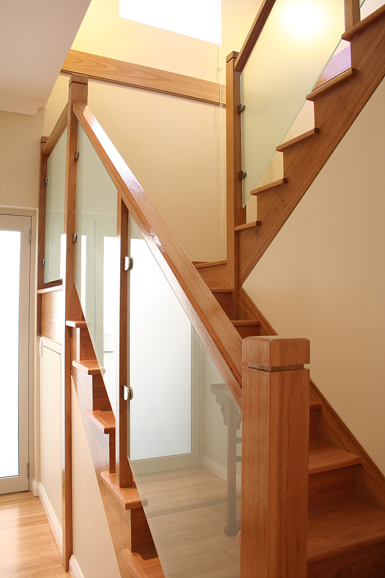
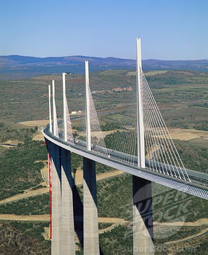
Built Environment Portfolio
Technology III
Modern Methods of Construction
Notes:
New Building Regulations Standards are putting increased pressure on architects and designers to provide energy saving solutions within the new build sector.
With the increasing lack of tradesmen and rising costs of traditional methods of construction (which are unlikely to meet the demands for future developments), more and more clients and industry decision makers are recognising the significant benefits of modern methods of construction (MMC).
Modern methods of construction are about better products and processes. They aim to improve business efficiency, quality, customer satisfaction, environmental performance, sustainability and the predictability of delivery timescales.

Slide 2
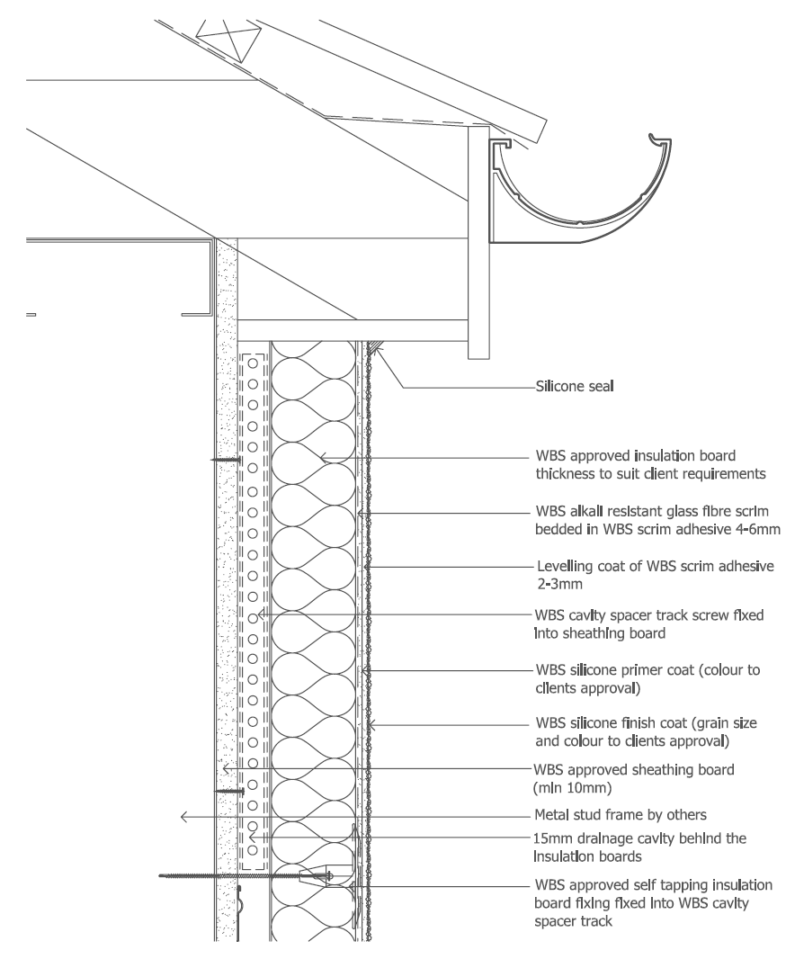
Modern Methods of Construction
...about better processes and products
Better management
Better effectiveness and efficiency
Better quality
Better environmental performance
Better customer satisfaction
Better procurement
  Not always about changing technology!
Source: wetherby
Notes:
Modern Methods of Construction (MMC) building systems include timber-frame, steel-frame, Pre-Cast concrete-frame, structural insulated panel systems (SIPS) and, Modular and Volumetric, Panelised and Hybrid semi-volumetric systems that combines both the volumetric and panelised approaches, or on -site MMC innovative building techniques and structural system technologies such as Insulated Concrete Form (ICF), "TunnelForm" or "Thin Joint Blocks" that fall outside the off-site categories.
In particular MMC is about reducing waste!

Slide 3
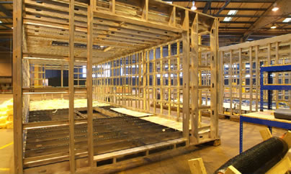
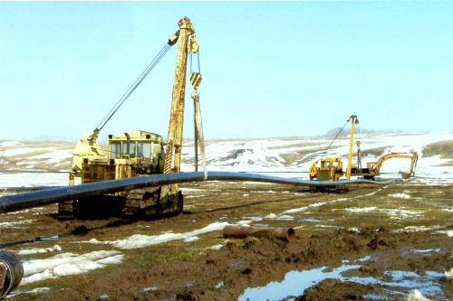
Modern Methods of Construction
Types of MMC..
  Hybrids and pods
  Non off-site methods
  Panellised
  Volumetric
Notes:
Modern Methods of Construction (MMC) building systems are used to construct buildings more quickly to deliver high-quality, well-designed homes and properties, efficiently and economically. They are increasingly regarded as a means of improving quality, customer satisfaction, environmental performance, sustainability and the predictability of delivery timescales, reducing time spent on site, improving on-site safety and overcoming skills shortages in construction.
MMC embraces a range of building system technologies and processes involving various forms of supply chain specifications, prefabrication and off-site assembly and, can include On -site MMC innovative building techniques and structural system technologies such as "TunnelForm" or "Thin Joint Blocks" that fall outside the off-site categories.
Whether you are using a Volumetric, Panelised or Hybrid semi-volumetric system that combines both the volumetric and panelised approaches, or on -site MMC innovative building techniques the building can be designed to include a large amount of flexible space which can be adapted to meet the varying needs of different building users throughout the lifetime of the building.

Slide 4
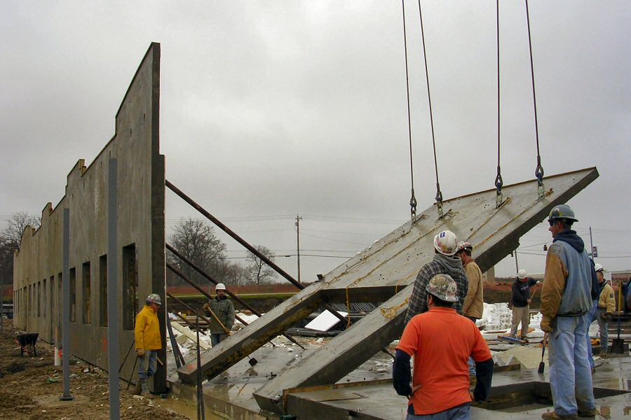
Modern Methods of Construction
Cost - extremely competitive
Speed - fast start, fast build, pre-planning…
Ease of construction - factory process on site
Durability - compare favourably with metal system failures and accidental damage
Security - used for prisons and security walls
Fire resistance - 2+ hours inherent resistance
Panellised system
Tilt up
Notes:
Off-site manufactured - panellised
(flat panel units built in a factory and transported to
site for assembly into a three-dimensional structure
or to fit within an existing structure).

Slide 5
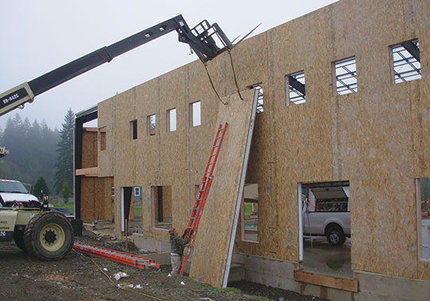
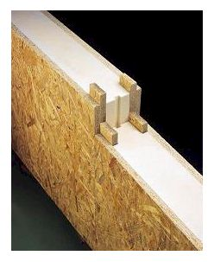
Modern Methods of Construction
Panellised systems
SIPS
  Structural
  Aesthetics
  Insulation
  Design flexibility
  Tight high-performance
  Speed
Notes:
Structural insulated panels are used to construct the floors, walls, and roofs in buildings ranging in size from family homes to convention centres. The panels are made by sandwiching a core of rigid foam plastic insulation between two very strong structural skins of oriented strand board (OSB). Other skin material like steel or aluminium are sometimes used for specific applications.
Why SIPS
Speed
SIPS is erected on site within a short space of time and a typical house will be SIPS Completed in under a week. Internal and external trades can carry on at the same time which can potentially halve the build time.
Simplicity
Detailing is simple allowing construction to move forward at a rapid rate and follow on trades can operate more efficiently – for instance wiring is face fixed meaning no more chases, plastering is square and plumb.
Thermal Properties
The SIPS System produces very high thermal qualities putting SIPS in Pole position to meet future Code for Sustainable Housing standards in 2013 (Code 5) and 2016 (Code 6).
Air Tightness
The unique fixing methods for SIPS Panels mean that problematic air tightness test need not be a worry, as they never fail on the structure unlike most other methods.
Cleanliness
It is said “For every three houses built one is buried as a result of waste”. As the majority of a SIPS build is made off site this greatly reduces the waste factor.
Strength
At six times the strength of Timber frame SIPS Panels can save vital space by eliminating the need for strengthening timbers in roof and walls. SIPS Panels are often used alongside Glulam or Versalam Beams, which make an attractive feature to any building.

Slide 6
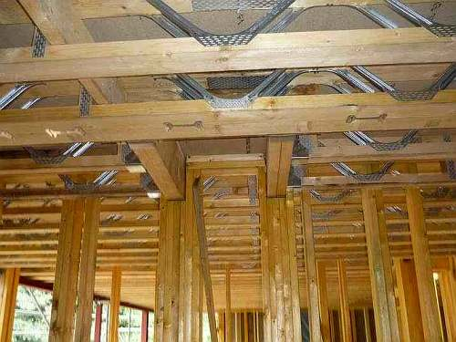
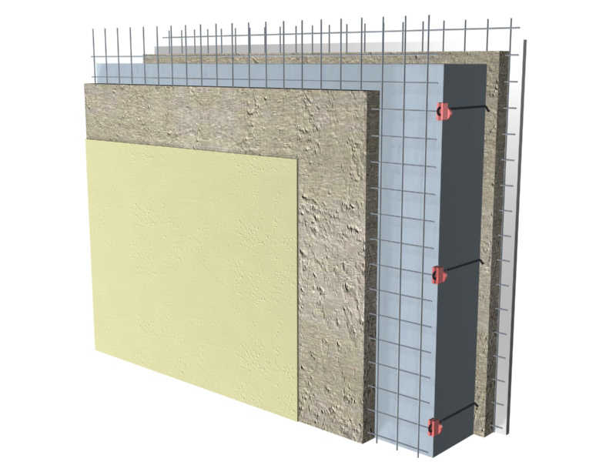
Modern Methods of Construction

Slide 7
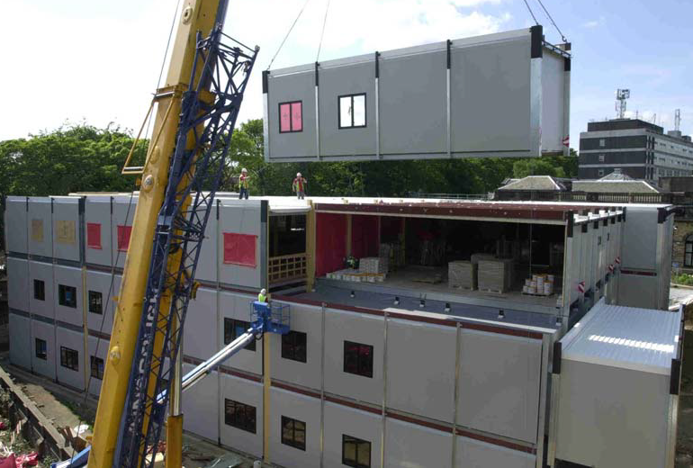
Modern Methods of Construction
Volumetric
Volumetric offsite construction can help reduce the production of waste to as little as1.8%
Allows for efficient design and continuous process improvement
Involvement of the supply chain as well as procurement strategies helps achieve time and cost savings
Notes:
Off-site manufactured - volumetric
(three-dimensional units produced in a factory, fully fitted out before being transported to site and stacked onto prepared foundations to form dwellings).

Slide 8
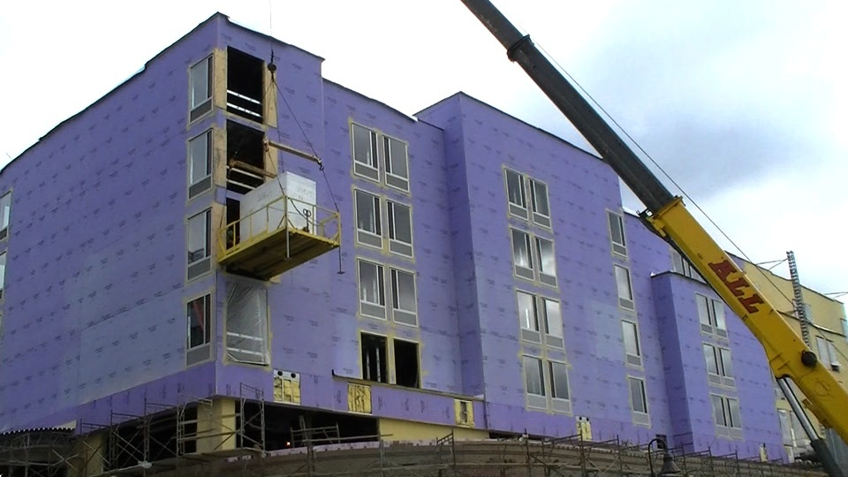
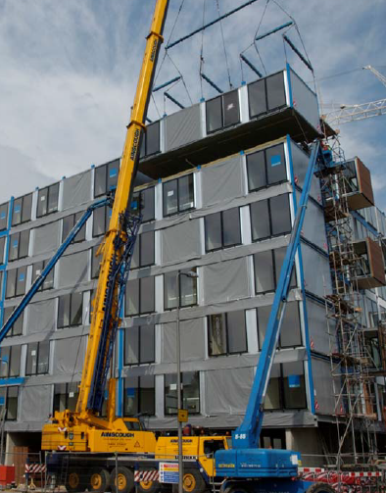
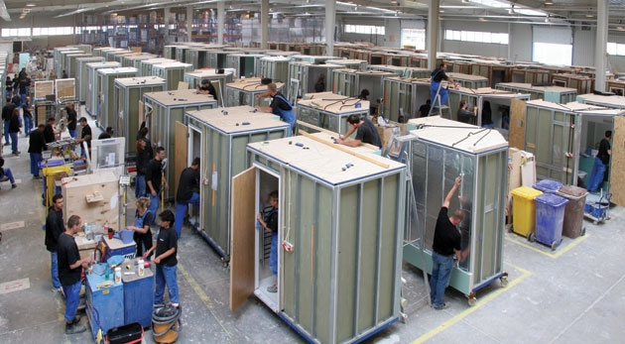
Modern Methods of Construction

Slide 9
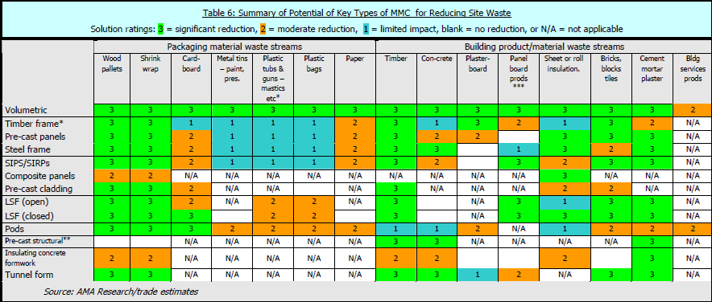
Modern Methods of Construction
Source: WRAP 2007

Slide 10
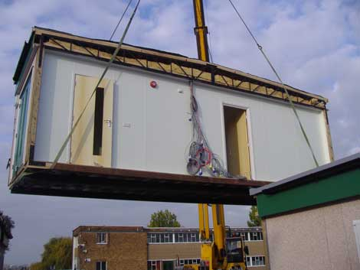
Modern Methods of Construction
National Audit Office Findings
Labour and time savings
Cost reductions
Quality improvements
Effective risk management
Notes:
Labour and time
Our research showed that, compared to more traditional techniques, modern methods of construction can reduce on-site labour requirements to less than a quarter and on-site time to less than a half. These reductions are not magic: they result from some work taking place off-site. They bring real benefits because off‑site work involves different labour that is not as stretched as the on-site workforce [Footnote 2] and off-site work can be taken off the overall critical path providing it is planned properly. Modern methods of construction can therefore make better use of scarce labour and reduce total development time.
Benefits can be lost if project planning does not take account of the construction technique. We heard of one development where the superstructure all went up in 2 weeks. Then nothing happened for 8 weeks because nobody had told the following trades that the process was different and they would have to start earlier. Poor planning and communication failure wasted much of the benefit in using modern methods of construction.
More generally, our research shows that design and manufacture of off-site elements must start as soon as outline planning permission is obtained. This has two important implications. First, supply chain management, in particular the interface with planning authorities and with manufacturers, is vital. Second, early design freeze is critical because design changes after manufacture has started will be expensive.
Cost
Our analysis confirmed that modern methods of construction can be cost‑competitive in the right circumstances but hybrid and volumetric techniques are more expensive on average than other techniques. A range of circumstances, such as poor soil conditions and restricted working space, favour modern methods of construction but other factors, including late design changes and late contractor appointment, have the opposite impact. All these conditions affect the relative cost‑effectiveness of different construction methods.
Some financial benefits of modern methods of construction can be overlooked. Two come from faster completion (earlier rent receipts and a shorter borrowing period) and two come from the quality control in off-site manufacture (less snagging and less on-site inspection). These benefits close about a third of the average cost gap between modern methods of construction and more established techniques.
Quality
We found that modern methods of construction can deliver at least as good quality as more established techniques providing they are specified appropriately. We considered quality under the headings of durability (will the building last as long?), whole life costs (will it cost the same to maintain?) and performance (will it operate as well?).
Risk management
Modern methods of construction substantially change the risk profiles of home building projects, with risks migrating from later stages to earlier stages. Our report includes a detailed table illustrating how risk management changes when using modern methods of construction.

Slide 11
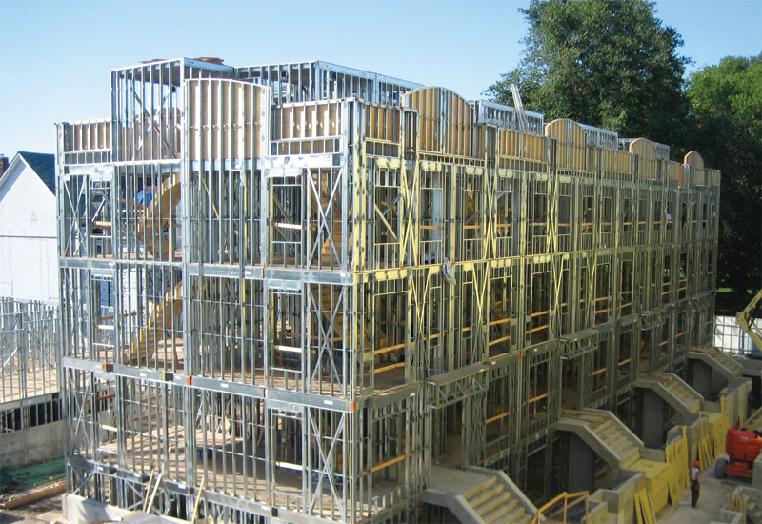
Modern Methods of Construction
Steel frame
Notes:
The typical challenges faced by contractors in the Gulf region include building green, on time and within budget. Contrary to popular belief, there are certain technologies and techniques which can help with all these issues.
Steel framework is one of them. While the technique itself is not new, it has, like all other technologies in the construction industry, developed over the years. Revolutionised by software, it is now able to offer more.
Steel framework, and particularly light-gauge steel framing, is used for a variety of projects, from schools, villas and labour accommodation, to offices and high-rises. It can also be used for partitions within buildings and for framing interior walls. As an engineered product (often manufactured and assembled in a factory before being delivered to site), it is gaining popularity due to a lack of application limits.

Slide 12
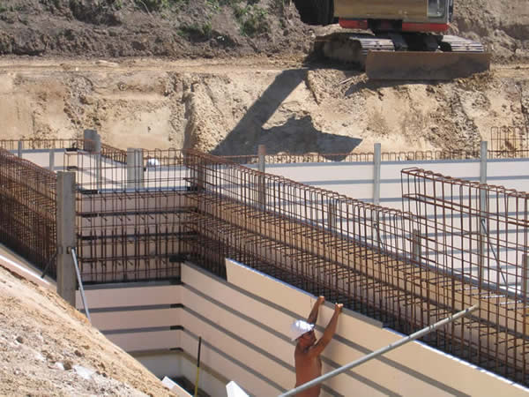
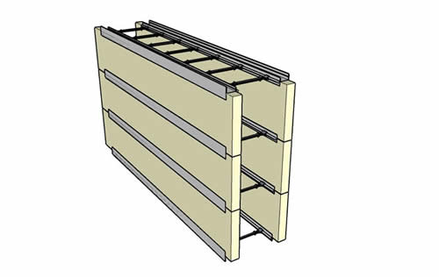
Modern Methods of Construction
Innovative methods
Insulating concrete formwork
Speed
Strength
Efficiency
Concrete curing
Reduces thermal shrinkage
Notes:
Polarwall , Insulating Concrete Formwork (ICF), is a simple construction, using a plastic framework to hold polystsyrene in place . The two sides of the wall are held parallel at designed widths, depending on which size crosstie is being used. Engineering & Structural Design
Polarwall offers real advantages to the structural design and the curing strengths of the concrete. Unlike traditional block construction, or timber frame, Polarwall is much stronger and can therefore withstand greater loadings.
The benefits of using Polarwall are:
Steel reinforcement within the main body of the wall for above ground construction can be eliminated, providing huge cost savings
For basements, steel mesh is preferred to provide a quicker build speed
Permanently incasing the concrete with insulation provides the perfect environment for concrete to cure and gain maximum strength Insulating the concrete as it is poured can reduce thermal shrinkage
Open plan space can be easily used as the walls will offer greater loading capabilities
A structural design of the building is required to satisfy the requirements of the local Building Control. This will need to be carried out by a qualified structural engineer. Polarwall Ltd has links with a number of structural engineering firms throughout the UK. They have acquired the necessary experience to offer the most appropriate and economical design

Slide 13
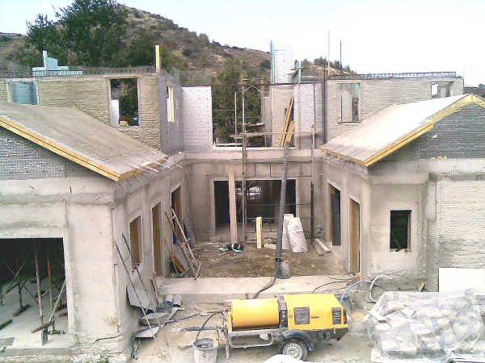
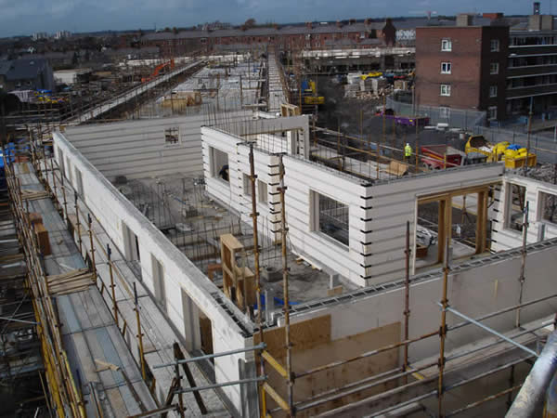
Modern Methods of Construction

Slide 14
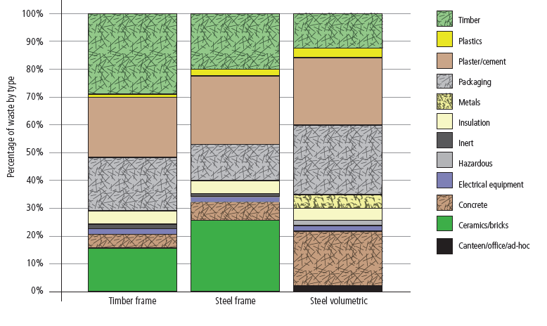
Composition of waste in different MMC projects
Source: www.beaware.org.uk
Notes:
The amount of waste generated by the MMC sector in 2006 is estimated at almost 21,000 tonnes. Of this waste, 63% is from timber frame, 29% is from volumetric and 8% is from light gauge steel frame and SIPs. If no action is taken, these waste arisings could increase to 68,000 tonnes by 2020, owing to the expected take-up of MMC products7.
It is easier to manage waste in a factory environment than on a construction site which benefits the MMC sector. This is mainly due to having better control within a manufacturing process, allowing more effective segregation which in turn, results in less contamination and greater levels of recycling7.
The Waste and Resource Action Programme (WRAP), have a number of case studies on their website8 demonstrating the benefits and waste savings achieved from using different forms of MMC construction compared with traditional construction methods. For example, BRE waste measurement studies on the SMARTLife project (carried out on behalf of WRAP) show a 22% waste reduction using light steel frame construction and 11% for timber frame, compared to traditional methods.
The three SMARTLife studies recorded total waste arisings on-site and in the factory for different systems of MMC, using an environmental performance indicator of volume of waste
generated per 100m2 of construction floor area. The following waste arisings were identified:
Timber frame (wall panels and floor cassettes): 19.16m3 of waste generated per 100m2 of floor area
Volumetric steel (modular): 5.51m3 of waste generated per 100m2 of floor area
Steel frame (walls and floor cassettes): 16.84m3 of waste generated per 100m2 of floor area.
The studies show that the top three waste streams for each system were plaster/cement (largely comprising plasterboard), timber and packaging. Figure 1 shows a breakdown of the
types of waste arising from the three SMARTLife studies.

Slide 15
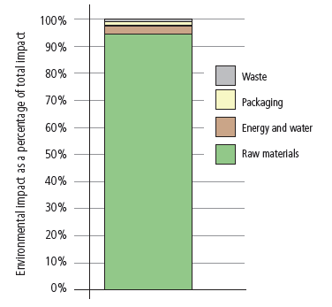
Modern Methods of Construction
Greatest impact is in the raw materials
Mainly from packaging
  Polythene sheet/wrap
  Cardboard
  Metal
  Plastic
  Timber
  Paper sacks
Average MMC Environmental Impact
Source: www.beaware.org.uk
Notes:
Figure shows that the greatest overall environmental impact for the MMC systems studied is from raw materials, responsible for 94% of the impact. This is followed by energy/water at 3%, and packaging and waste, both at just over 1%. On average, transportation accounts for 12% of the raw materials impact. It is important to note that the following results are based on incomplete datasets and as such, are only indicative.
Issue:
A variety of packaging is used on raw materials supplied for the manufacture of MMC systems such as polythene
sheet/wrap, cardboard, metal and plastic banding, timber pallets and bearers, plastic containers (from adhesive and paint) and paper sacks.
This makes up a large proportion of the waste stream from manufacturing (up to 50% by weight) and not all of it is being recovered effectively. Some of this packaging may be reduced if it is used in an optimal manner, for example by using corner edges rather than full packaging on furniture.
Action:
Work closely with the supply chain to understand packaging types and any specific reasons why they are used, then aim for optimal packaging solutions and take back schemes. Specify that packaging on raw materials is either reusable or recyclable and clearly identifiable.
What next:
Identify the top 50% of raw material suppliers to MMC manufacturers in terms of sales and devise a joint action plan for tackling packaging.
Who to take it forward:
Modular and Portable Building Association (MPBA), Construction Products Association, Build Offsite, UK Timber Frame Association (UKTFA) and British Precast Concrete Federation (BPCF) with support from BRE and other appropriate business support organisations.

Slide 16
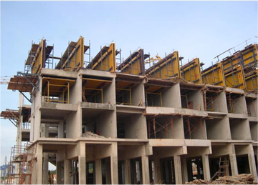
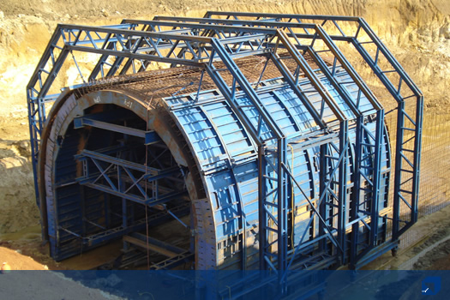
Modern Methods of Construction
Non off-site methods
Tunnel forms

Slide 17
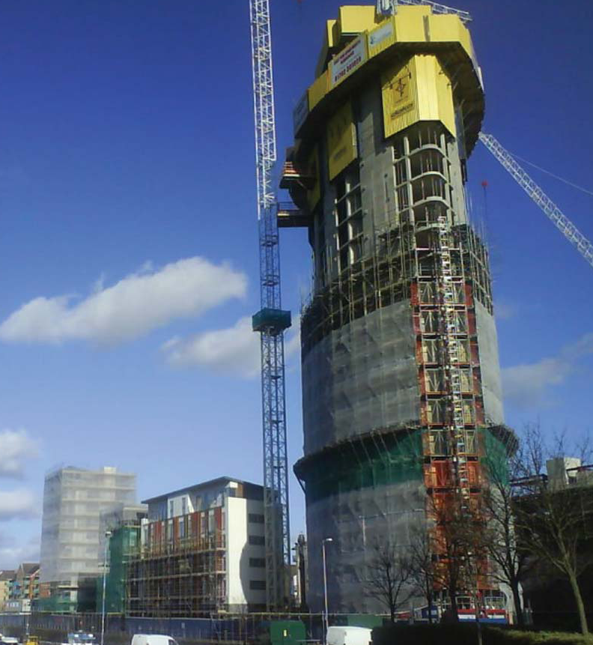
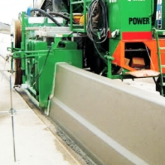
Modern Methods of Construction
Non off-site methods
Slip forming
Notes:
Slip Forming, used to construct a variety of concrete elements and structures, is the technique of moving formwork to allow for the simultaneous extrusion and finishing of concrete. It is a continuous process which can provide significant time savings in a variety of construction projects. As concrete is placed, the formwork may be moved either vertically or horizontally. It can be moved vertically to form chimneys, walls, tanks, silos, and multi-story buildings, and usually provides uniform cross-sections from the bottom of the structure to the top. The formwork can also be moved horizontally to produce even layers of concrete for highways, driveways, curb and gutter combinations, and median barriers.

Slide 18
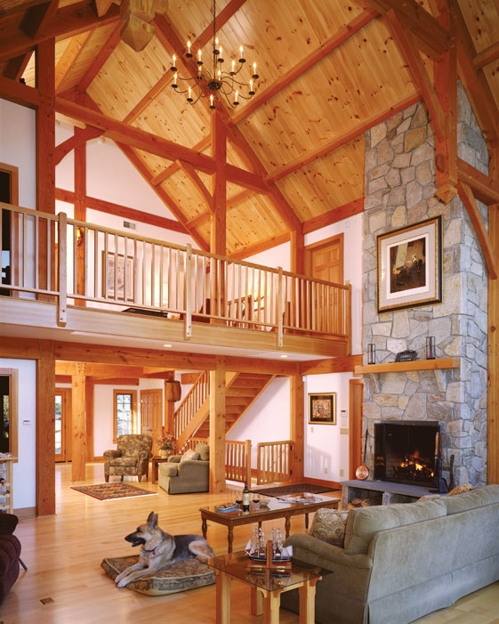
Modern Methods of Construction
Timber frame
  Renewable material
  Flexibility
  Thermal
  Dry construction
  Speed
  Complete package

Slide 19
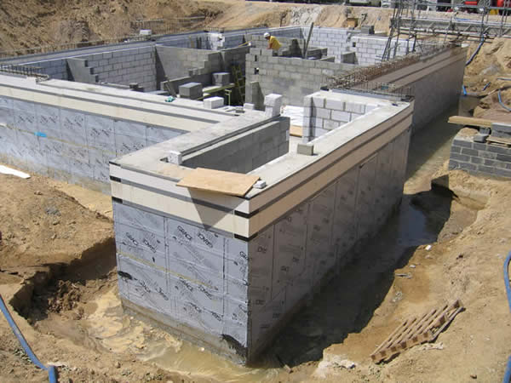
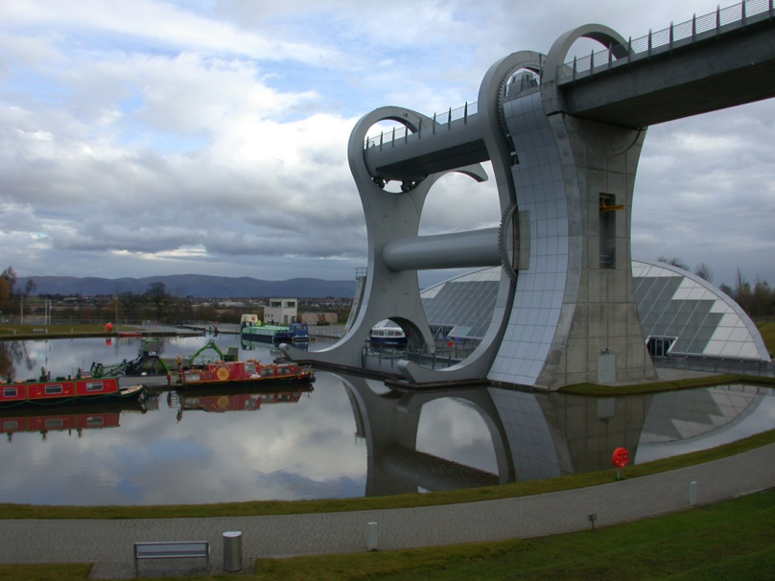
Modern Methods of Construction
Why MMC?
Reduction in embodied energy used in construction
Reduction in energy consumption;
Reduction in water consumption;
Reduction in construction waste;
Reduction in defects;
Can include facilities for recycling and the ability to make use of alternative renewable energy sources
Notes:
Materials with improved characteristics will be used that will make the bridge construction safe, durable, and reliable. Materials like high-performance concretes, polymer concretes, and plastics will be utilized. As the fiber reinforced composites are becoming more tolerant towards temperature, they will be used extensively for bridge construction. Use of larger steel fibers will be used in the tensioned members. The economics of future bridge construction will implement a simple design, with an increased interface between design, erection, and maintenance. Progressive study in modern superior materials and management techniques will facilitate the construction of durable structures that do not require extensive maintenance.

Slide 20
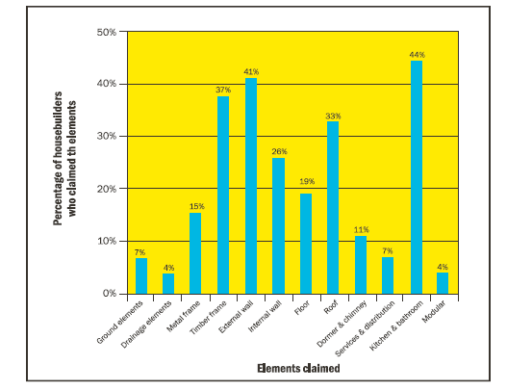
Modern Methods of Construction
Good environmental design which can add value
Fits well into BREEAM, CSH etc
Innovative use of volume and space
Flexibility and adaptability
Can provide good acoustic insulation
Can provide good thermal insulation
Others!
Elements which offer greatest potential for offsite MMC
Notes:
The increasing demand for housing, coupled with wide concerns over the need to improve performance, has created a powerful case for use of offsite technologies. However, to date, the industry has been slow to innovate and adopt offsite technologies, which has inhibited achieving a step improvement in productivity and quality of housing supply. This study forms part of a three-year research project on the applications of innovative building technologies in housing construction. It reports the findings of a survey of the top 100 housebuilding firms regarding the use of Offsite Modern Methods of Construction (Offsite-MMC). The respondent firms together contribute more than 30% to the total housing unit
completions in the industry.
THIS CHART
The aspects of housing with the greatest potential growth for Offsite-MMC applications were considered to be kitchen and bathroom pods (44%), external wall (41%), timber frame (37%) and roofs (33%)
(Figure 4). The housebuilders did not generally see great potential for complete modular buildings. The analysis of comments revealed that housebuilders assessed the potential for Offsite-MMC applications
against a wide range of factors including technical requirements, cost, time, site integration, customers’ choices, sales, mortgage issues and site specifics.

Slide 21
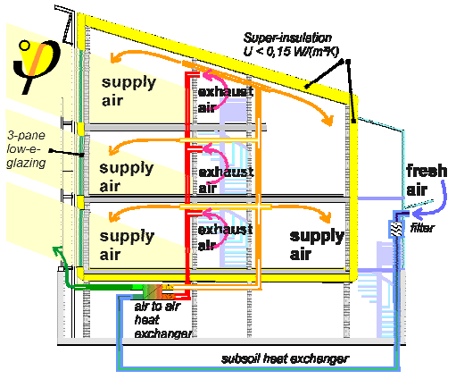
Innovative methods
Modern Methods of Construction
Passive design
Native landscape
Attention to power
Water conservation
Reduction of emissions
Design for operation and maintenance
Materials efficiency
Design for recycling
Perhaps an intelligent approach!
Source: Passive House Institute
Notes:
In January 2008, the European Parliament called on the Commission to propose a binding requirement that all new buildings needing to be heated and/or cooled are constructed to PassivHaus or equivalent non-residential standards from 2011, and a requirement to use passive heating and cooling solutions from 2008.
Passivhaus is a construction standard which applies to new build dwellings. There is also a Passivhaus
refurbishment standard, which sets standards beyond the Energy Saving Trust’s best practice in
refurbishment standard. However, achieving the Passivhaus refurbishment standard may not be feasible or
cost effective in many cases, and therefore it is recommended for flagship refurbishments or one off projects.
The PassivHaus Planning Package (PHPP) is a design tool produced by the PassivHaus Intitut Germany for use by building architects and designers.
PHPP contains a series of tools for:
calculating energy balances
designing comfortable ventilation
calculating the heat load
summer comfort calculations
and many other useful tools for reliable design of PassivHaus dwellings

Slide 22
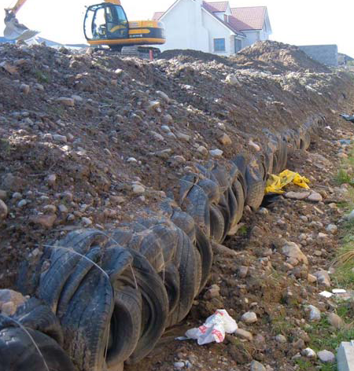
Tyre bale use in embankments
Modern Methods of Construction
First UK use
Alternative to concrete
Improved drainage and slope stabilisation
Environmental impact reduced
Cost and environmental benefits
Notes:
First use of tyre bales in house building in Great Britain.
Tyre bales were used as an alternative to concrete and brick retaining walls in the construction of an embankment to support new residential housing. Improved drainage and slope stabilisation were achieved.
Costs savings of up to £25,000 were estimated.
A 100 metre embankment utilised approximately 21,000 used car and light commercial vehicle tyres, weighing 160 tonnes.
Environmental impact was reduced through the displacement of virgin aggregates and energy intensive cement and bricks, and through reduced emissions from the transportation of materials.
The application also assists the creation of markets for recycled tyres which can no longer be disposed of to landfill in the UK.
Cost and environmental benefits for the use of tyre bales in civil engineering projects are likely to be greater in the Highlands of Scotland, the location of this project, due to the limited availability of lightweight aggregates and the greater transportation distances.

Slide 23
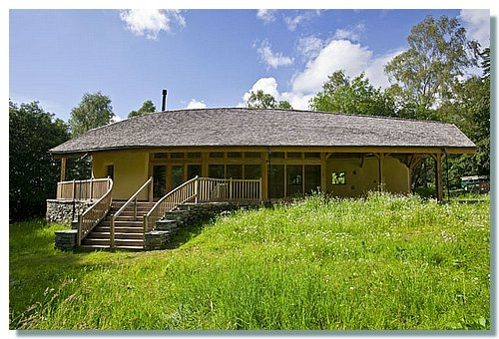
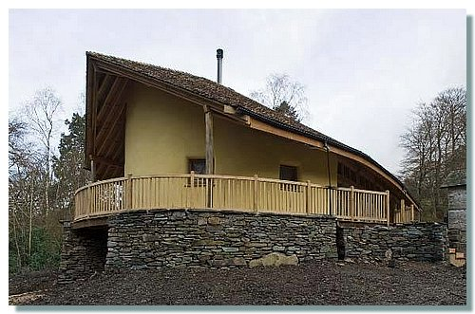
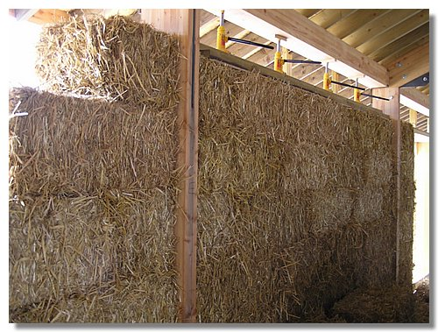
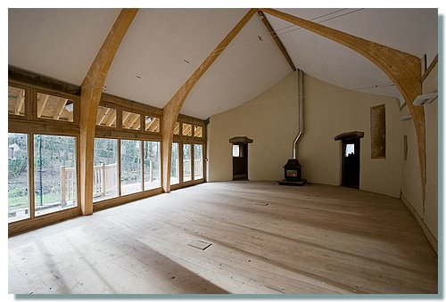
Notes:
The Footprint is the first straw bale building in Cumbria, and the first for the National Trust.
Thanks to the choice of alternative building materials such as straw walls, used car tyre foundations, sheep's wool insulation, timber frames, floors and walkways, an oak shingle roof, this beautiful and inspiring building has a low environmental impact.
The National Trust used a conventional building company (lambert-gill from Carlisle) for the majority of the construction and overseeing the process. Opportunities for skills development, training and hands on involvement were created through practical courses, most of which were led by amazonails.
The most complete record of the Footprint Project construction is the time-lapse movie that we assembled from some of the 43,000+ images shot from the dedicated camera overlooking the site.

Slide 24
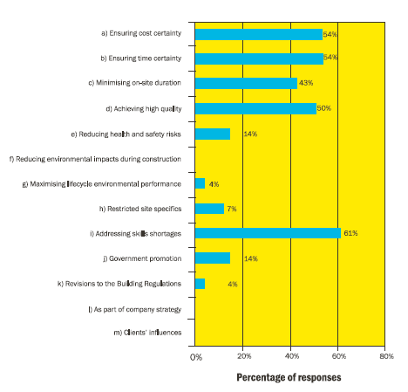
Modern Methods of Construction
Housing market
Most important industry-wide drivers for using Offsite-MMC – the top100’s view
Notes:
The most important industry-wide drivers for housebuilders to use Offsite-MMC were addressing skills
shortages (61%), then ensuring time and cost certainty (54%), then achieving high quality (50%) and then minimising on-site duration (43%) (Figure 5). The time and quality drivers were also highlighted in the studies of Goodier and Gibb (2004), Venables, et al. (2004) and Parry et al. (2003). Analysis of housebuilders’ comments made along with their quantitative answers reveals that the conventional drivers of time, cost and quality are still strongly influencing the industry in deciding whether to use innovative building technologies. Factors such as health and safety, sustainability and clients’
influences appear to be largely overlooked.
The top 100 housebuilders’ drivers for using Offsite-MMC in their projects were consistent with those
applying to the industry as a whole. However, achieving high quality was indicated as most important
and the issues of health and safety and sustainability were taken into account to a greater extent.
Various comments, provided by the respondents in explaining their answers, indicated a broad
spectrum of housebuilders’ understanding on Offsite-MMC.

Slide 25
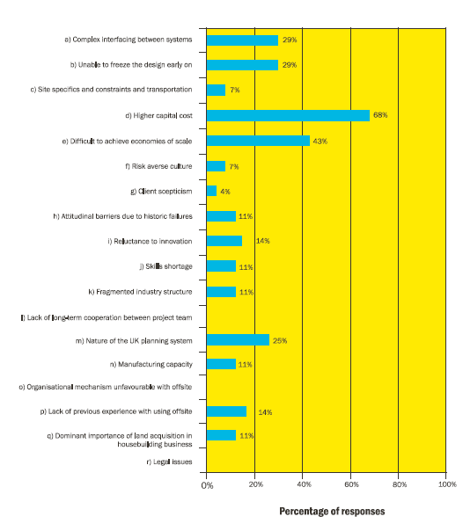
Modern Methods of Construction
Housing market
Most significant industry-wide barriers against the use of Offsite-MMC – the top 100’s view
Notes:
The most significant barriers restricting the use of Offsite-MMC in the industry as a whole were considered to be higher capital cost (68%), the difficulty in achieving economies of scale (43%), complex interfacing between systems (29%), the inability to freeze the design early on (29%) and the nature of the UK planning system (25%) (Figure 6). Goodier and Gibb (2004, p.4) also concluded that “the belief that using ‘offsite’ is more expensive when compared with traditional construction is clearly the main barrier to the increased use of offsite in the UK”. They further argued that the longer lead-in times for offsite were also a significant barrier, particularly to contractors. The risk averse culture, attitudinal barriers, fragmented industry structure, manufacturing capacity were also indicated by a few housebuilders (less than 15%). The concerns of mortgage lenders and insurers with non-traditional buildings were also raised.
Barriers against the top 100 housebuilders’ using Offsite-MMC in their own project were consistent with those applying to the industry as a whole and were mainly related to technical, economic and process issues. Other factors related to procurement, risk averse culture and institutional concerns, however, were not considered relevant.

Slide 26
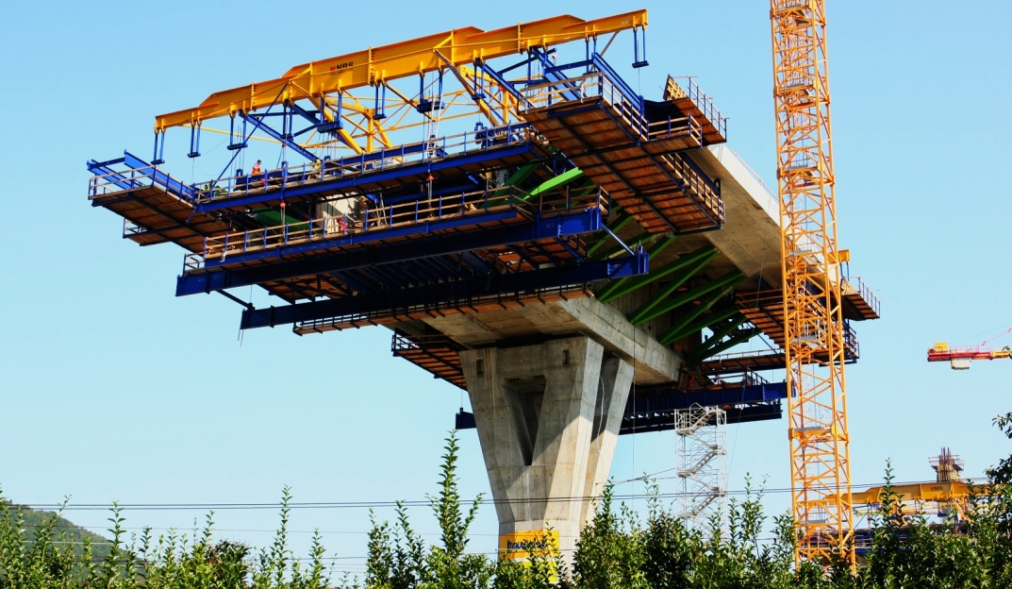
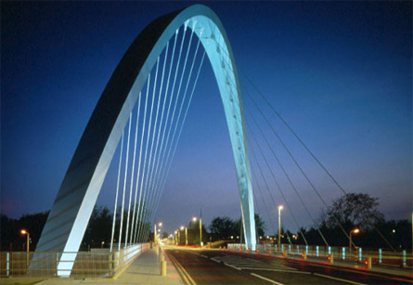
Modern Methods of Construction
Civil engineering
Design with innovation in mind
Sustainability credentials
Meeting the needs of client and society
Life cycle analysis
Buildability
Cost benefit analysis

Slide 27
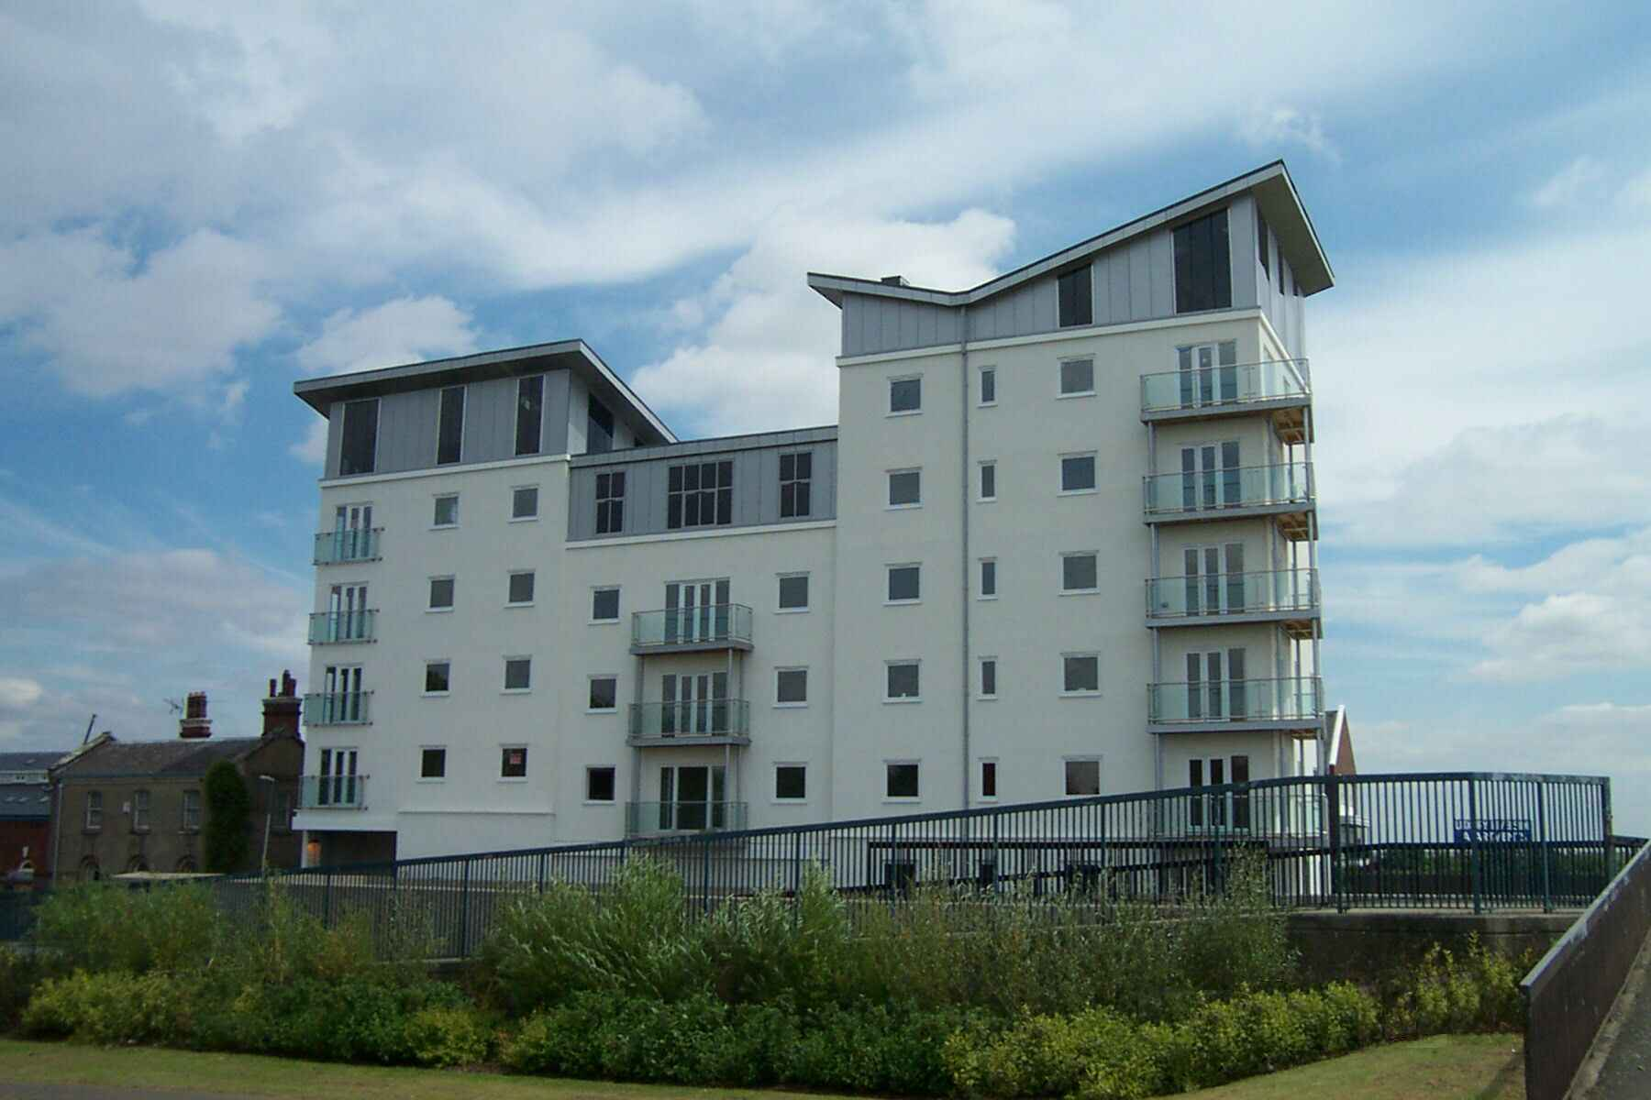
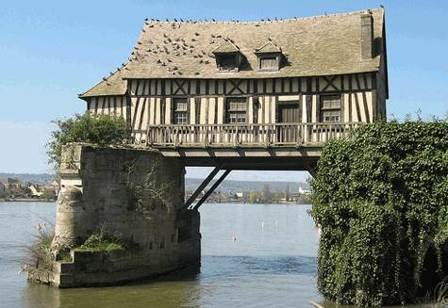
Modern Methods of Construction
Workshop
Examine the key factors that will affect MMC’s role to minimise construction site waste.
Research other modern methods of construction and evaluate the challenges such methods will have on their integration with management and other technologies.

Slide 28
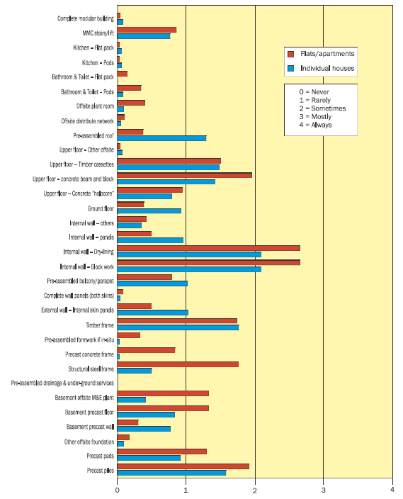

Slide 29
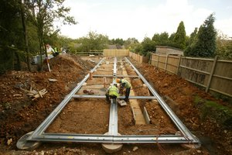
Modern Methods of Construction
There are five categories used by the Housing
Corporation to classify an MMC (housing)
construction system3:
n Off-site manufactured - volumetric
(three-dimensional units produced in a factory,
fully fitted out before being transported to site
and stacked onto prepared foundations to form
dwellings).
n Off-site manufactured - panellised
(flat panel units built in a factory and transported to
site for assembly into a three-dimensional structure
or to fit within an existing structure).
n Off-site manufactured - hybrid
(volumetric units integrated with panellised systems).
n Off-site manufactured -
sub-assemblies and components
(larger components that can be incorporated into
either conventionally built or MMC dwellings).
n Non-off-site manufactured MMC
(innovative methods of construction used on-site
and the use of conventional components in an
innovative way).
Notes:
Delivery to site of over 50 lightweight galvanised steel foundation beams followed, and a pair of operatives placed 20 different lengths of the ‘SystemFirst Homes’ foundation by hand. Each beam spans between a pair of pile caps and is shot fired to each cap to provide a secure connection. The longest span was 3.3m and the shortest was 0.9m.
Clear labelling on each beam avoided the potential for confusion over which section belonged where. “This is one of the first projects on which we have installed the galvanised steel version of the SystemFirst Homes foundation,” says RBL’s Paul Emblin. “It is cheaper to manufacture and proved to be lighter and quicker to install than a previous version of the foundation made from stainless steel.”
Additional steel cross members – known as ‘ladder racks’ – were installed between the main foundation beams to provide added support, before square panels of polystyrene were dropped into place to offer insulation. The bungalow’s floor was completed with the installation of underfloor heating and a 100mm thick concrete screed.
Each main beam features a pair of troughs to receive a pour of concrete and the completed foundations support a single course of 365mm thick ‘Ziegel’ blocks, which form the perimeter and internal walls of the bungalow.

Slide 30
Modern Methods of Construction
References
Wei Pan, Alistair Gibb and Andrew Dainty, (2005) Offsite Modern Methods of Construction
in Housebuilding, Perspectives and Practices of Leading UK Housebuilders, Loughborough University
Google images on MMC, accessed 7th March 2013
WRAP (2007) MMC
Passive House Institute
www.beaware.org.uk, accessed 5th march 2012

