Slide 1
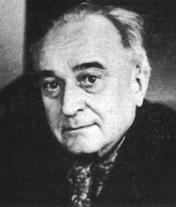
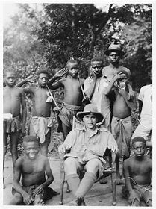
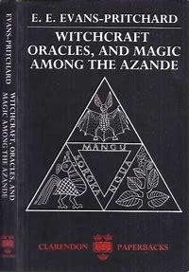
Sir Edward Evan Evans-Pritchard
21 September 1902-11 September 1973
In his book Witchcraft ,oracles and magic among the Azande (1976)
Evans-Pritchard mainly focuses on :
Witchcraft
Witch-Doctors
Oracles
Magic
One of Evans-Pritchard’s most notable pieces of research was his fieldwork and book on Witchcraft, oracles and magic among the Azande . The Azande are of a group of people in Sudan, Africa. Evans-Pritchard’s main aims were to study how the Azande build their social constructs around the ideas of magic and witchcraft and yet how they place blame on witches and their ideology for any misfortune. The Azande see witches, sorcery, oracles and witch-doctors as a means for active change within their social climate , to the extent that it shapes their social norms.
In this book Evans-Pritchard considers and makes links to the western perspective on witchcraft and demonstrates how this social framework can be seen from his own Westernised point of view. From early on in the book it is apparent that although beliefs in witchcraft seem irrational from the western point of view, the Azande people have developed these ideas from a whole different perspective after experping the world in a different way to ourselves.
Primary criticisms of Evans-Pritchard’s work with Azande :
Gender and Mysticism: Throughout the book he makes references to the relationship of men and women, which shows women as having reduced status and he notes
how comparatively, women hold more mystical beliefs, although these are not elaborated upon.
Ghosts:
Although the Azande beliefs in ghosts is mentioned,
it is not fully dealt with in the book.
When one applies mystic theory :
It is not clarified for the reader when, where and by
Whom (under what circumstances) magic is allowed
to be used within the group.
https://en.wikipedia.org/wiki/E._E._Evans-Pritchard
Evans-Pritchard was a British anthropologist who played a key role in the development of social anthropology, especially through his research into witchcraft and magic. Born in east Sussex he was the son of an Anglican clergyman but he later converted to Roman Catholicism. In Africa, where most of his books are based and more specifically when looking into witchcraft, he was influenced by his Western perspective and used this as a comparative in his field work.
E.E. Evans-Pritchard. 1937 (1976). Witchcraft Oracles, and Magic among the Azande. Oxford University Press, New York. 1976.

