Slide 1

Digital technologies
Gabriela Ciuba
1806307
Supervisor: Mark Huntly

Slide 2


IT experience at the beginning of the Module
Interest in mathematics and science
Education at the BTEC level at an Economics and IT school in Poland
Professional work as a team leader, problem solver and auditor
The use of digital technology in everyday professional work

Slide 3
personal development
Focus on continuous personal development
Courses and trainings in applications and software used in business
Interest in programming languages and database analysis and willingness to develop in this direction
In the era of very rapid technological development, I want to expand my skills constantly

Slide 4
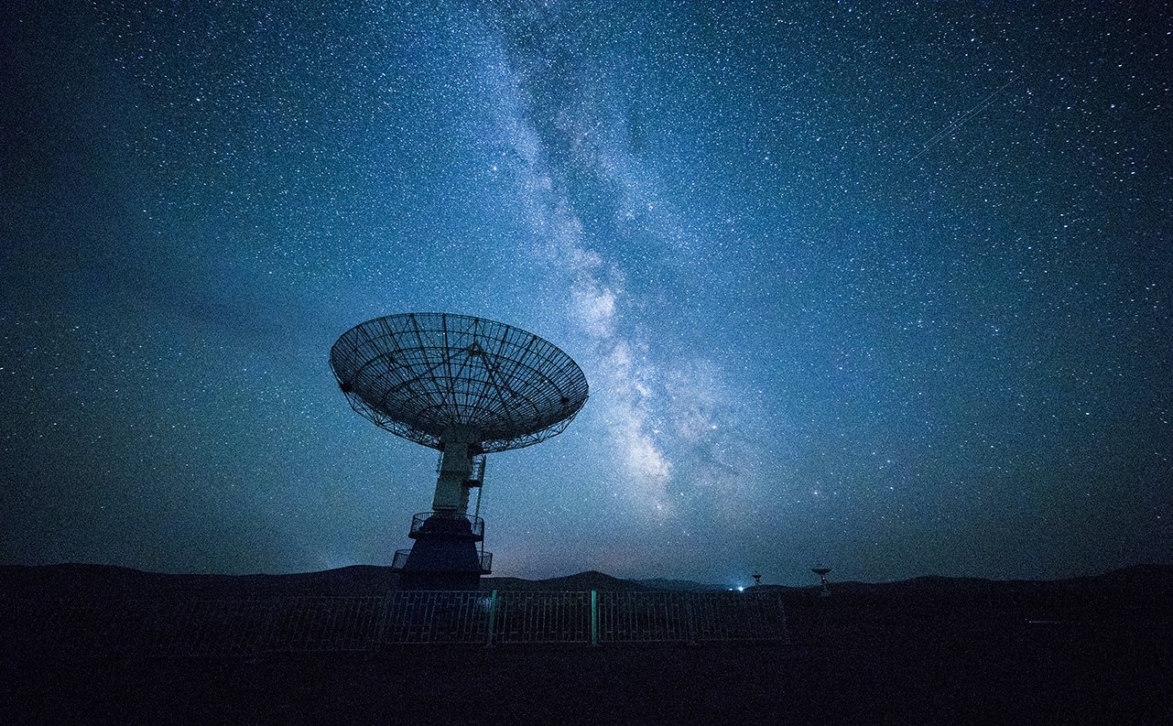
Digital technologies module
Understanding digital technologies that support effective and efficient workflow
Acquiring knowledge
and practical skills
in various industries
Office software products

Slide 5
Digital technologies module
Cloud technologies
Data analysis
Data storage
Internet history
Internet components
Computer Software
System Software
Application software
Artificial
Inteligence

Slide 6
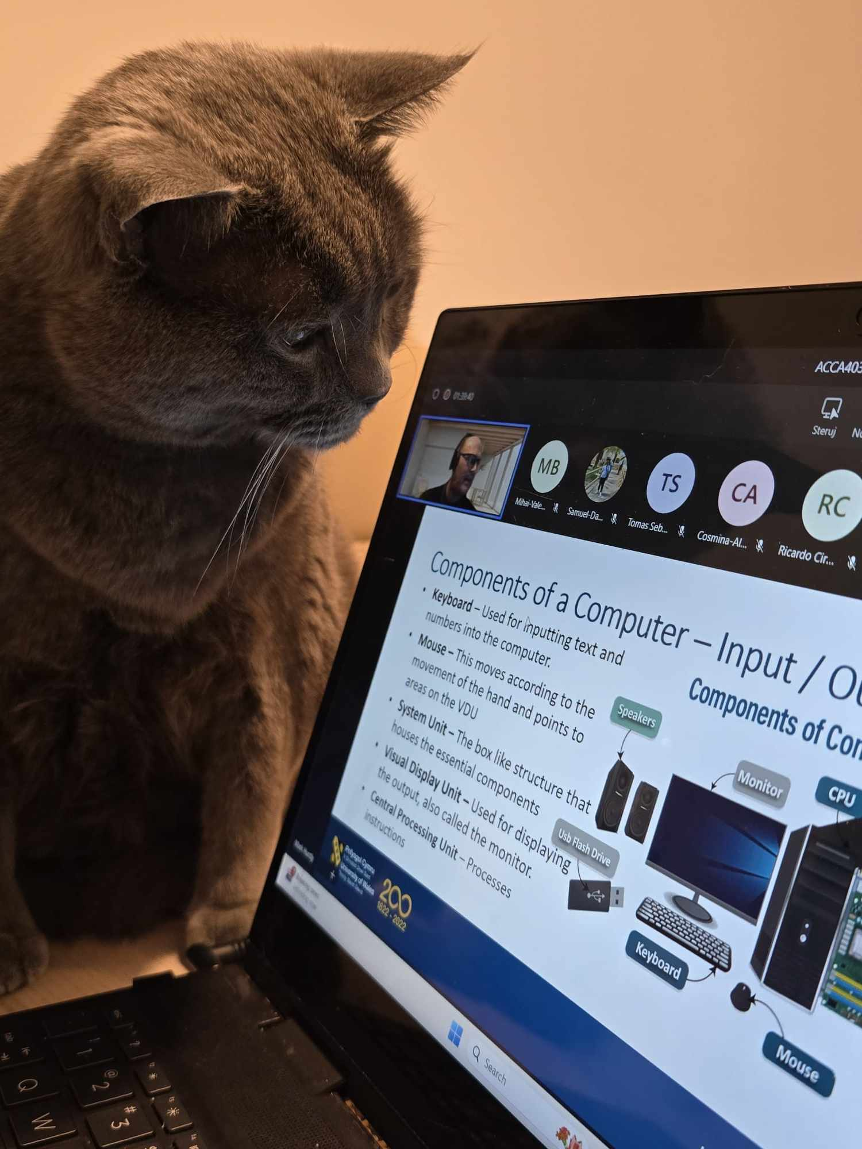
Digital technologies module
A huge amount of knowledge and practical application
Online and on-campus classes conducted in an interesting way
Online classes conducted using the MS Teams communication tool
Support and help at every stage of learning
Engaging students to participate in practical classes
Even my cats love these online classes

Slide 7
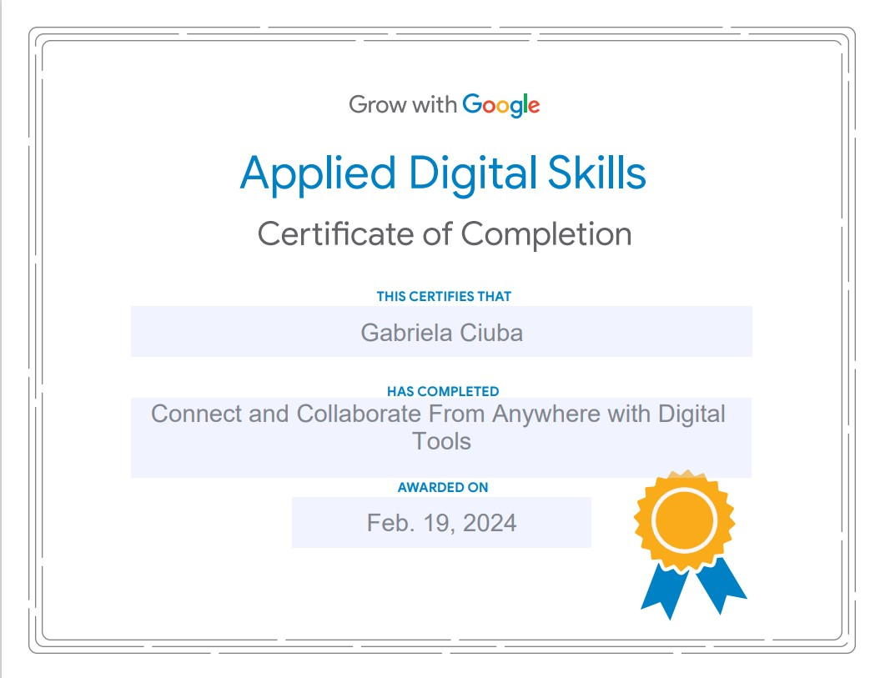
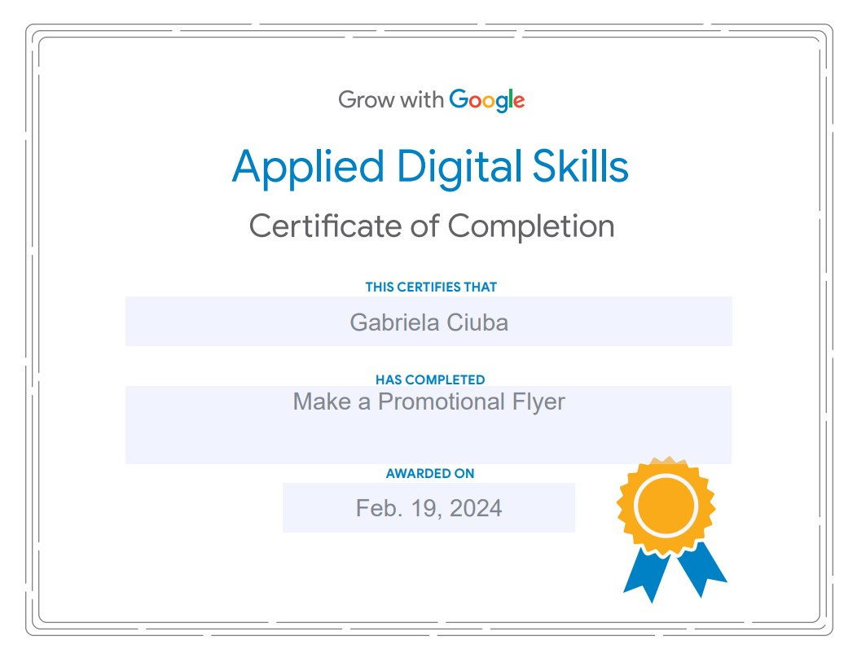
Expanding knowledge and skills by participating in classes on the Google platform

Slide 8
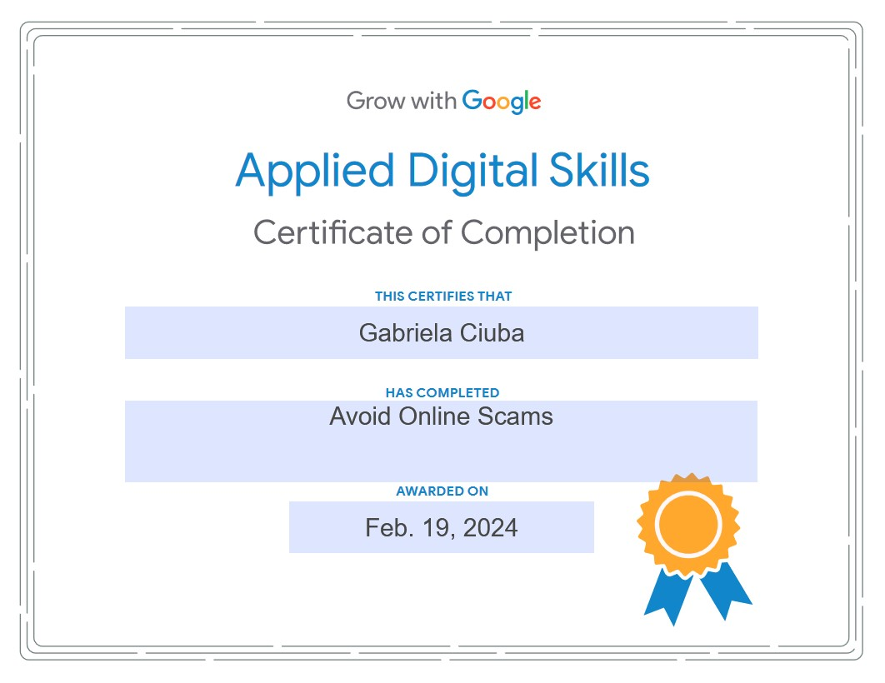
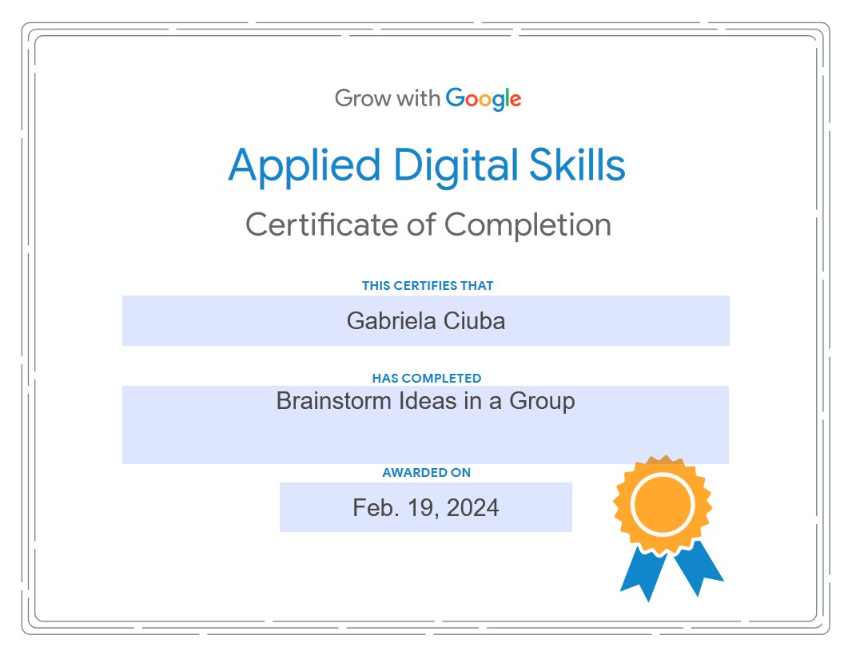
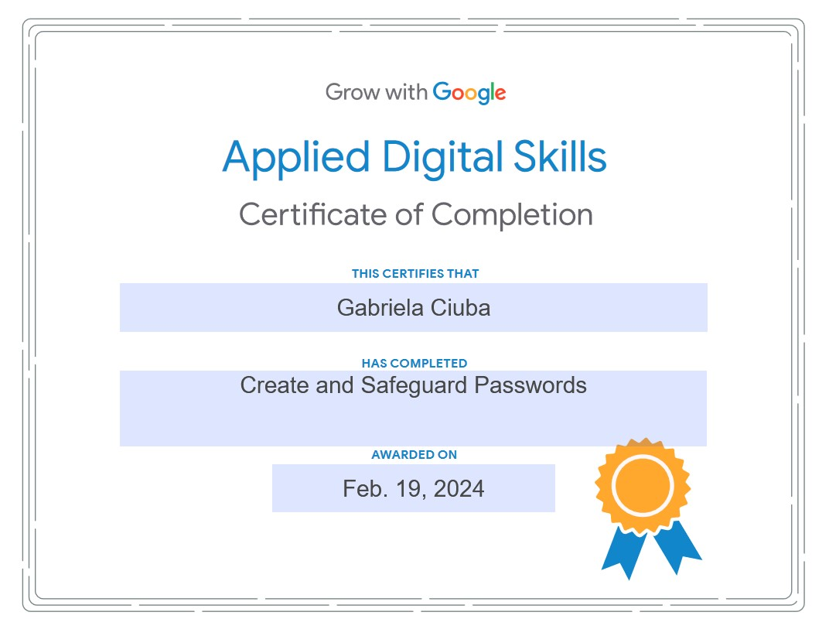
Expanding knowledge and skills by participating in classes on the Google platform

Slide 9

Thank you!
I look forward to the next module

