Slide 1
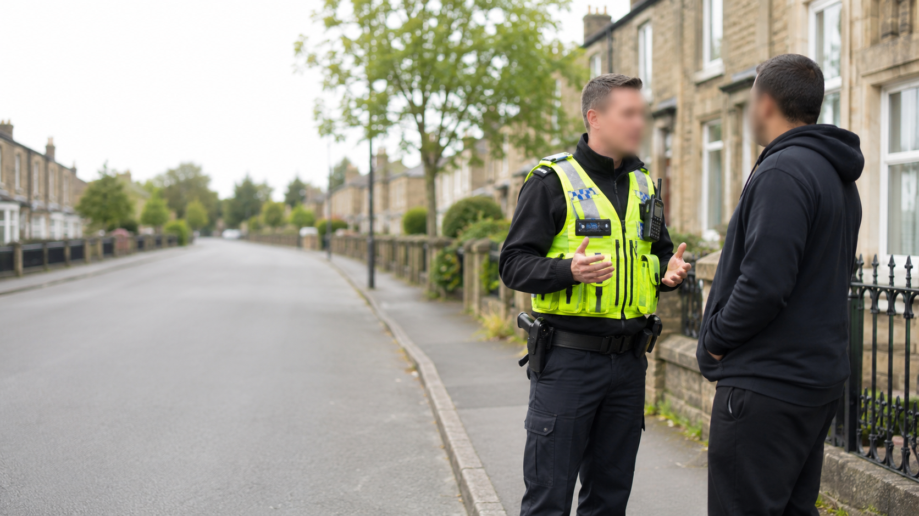
Student-facing session pack
The role of the
response police officer
BMLC6000 Conducting Investigations · Week 2
Focus: response policing, ethical judgement, qualities, skills and competencies

Slide 2
Today’s three-hour session
Two short input blocks, two breaks and a lot of application.
09:00
Role and reality of response policing
09:25
Group exercise: qualities, skills and competencies
10:00
Break 1 — 15 minutes
10:15
Code of Ethics: what good looks like
10:45
Ethical scenario decisions
11:00
Break 2 — 15 minutes
11:15
Initial attendance: judgement under pressure
11:45
Assessment link, reflection and preparation
Learning rhythm: brief concept → activity → feedback → assessment link.

Slide 3
By the end of this session, you should be able to…
1
Explain the core role of a response officer at an incident
Keep asking:
What matters first?
Who is affected?
What am I assuming?
What must I record?
What would I justify later?
2
Identify the qualities, skills and competencies needed for effective response policing
3
Apply the Code of Ethics to practical decision-making
4
Connect ethical response policing to investigation, victims, witnesses and evidence

Slide 4
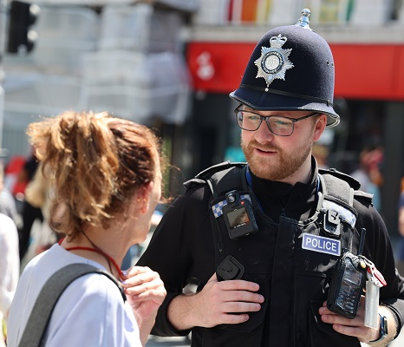
Response policing: the first professional contact
The response officer often shapes the whole investigation before anyone else arrives.
At the first attendance, the officer may need to:
make people safe
identify victims, witnesses and suspects
preserve scenes and evidence
communicate calmly and lawfully
make early decisions with incomplete information
record actions and rationale

Slide 6
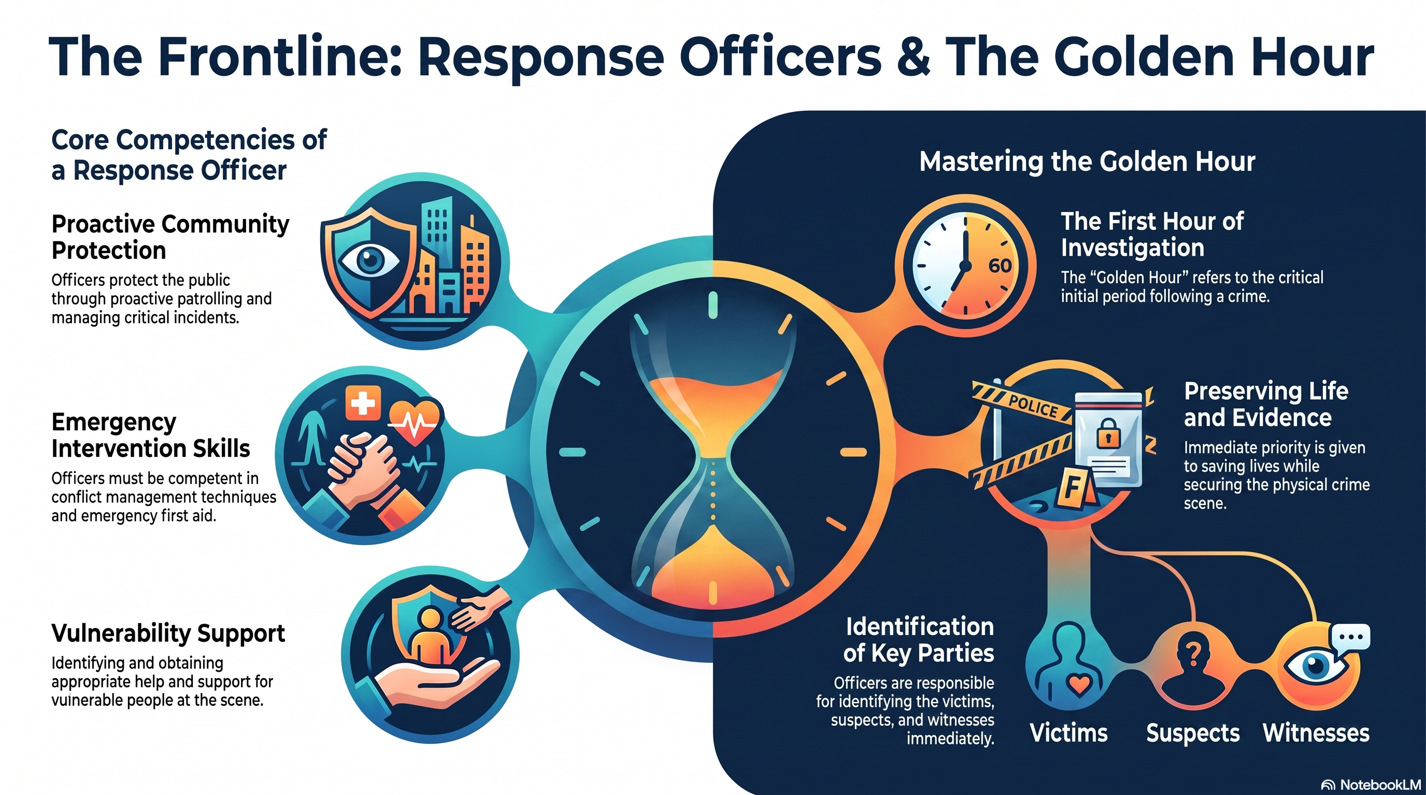

Slide 7
Safety
preserve life and prevent further harm
Legality
use powers fairly, proportionately and accountably
People
listen, communicate and recognise vulnerability
Evidence
protect what may later matter in court
Trust
act in a way that maintains legitimacy
Good response policing = practical action + ethical judgement + defensible recording.

Slide 8

Group exercise: what makes a good response police officer?
Work in groups. Think beyond “brave” and “fit”.
Your task
List the qualities, skills and competencies needed.
Sort them into categories.
Choose your top five.
Be ready to defend one difficult choice.
10 minutes group work + 10 minutes feedback

Slide 9
Use this structure for your group answer
Qualities are not the same as skills or competencies.
Qualities
Skills
Competencies
Who you are
and how you show up
What you can do
through practice
What you can apply
reliably in context
integrity
resilience
patience
empathy
communication
de-escalation
note-taking
questioning
decision-making
risk assessment
evidence awareness
teamworking
Notes:
Display this while groups work or immediately before feedback. The purpose is to stop the discussion becoming a list of generic virtues. Ask each group to identify one quality, one skill and one competency that they think is most important for the Week 8 role play.

Slide 10
Debrief: what did your group prioritise?
The strongest answers usually link personal conduct to investigative outcomes.
Share one priority from each column:
Critical-friend challenge
one quality
one skill
one competency
one area where a poor response officer could damage an investigation
Would your top five still work if the officer was tired, under pressure, being filmed, and dealing with a distressed victim?
If not, revise them.

Slide 11
Break 1
15 minutes · return ready to apply the Code of Ethics
Prompt for the break: what ethical pressure is most likely to affect a response officer?
Notes:
Break for 15 minutes. Ask students to return on time. leave the prompt on screen during the break.

Slide 12
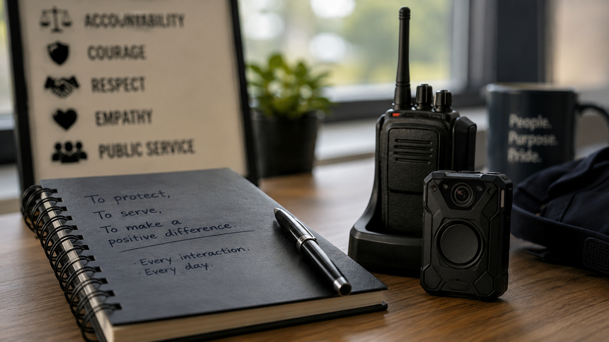
Code of Ethics: a practical decision-making anchor
The 2024 Code is built around three ethical policing principles.
Courage
Do what is right, communicate honestly, and be accountable.
Respect and empathy
Listen, understand, act without prejudice, and recognise vulnerability.
Public service
Act in the public interest and build trust and confidence.
Not just “nice values” — a way to test decisions before, during and after an incident.
Notes:
Source: College of Policing Code of Ethics, 2024. The principles are courage, respect and empathy, and public service.

Slide 13
A simple test for response policing
Good decisions need to stand up later — not only feel right in the moment.
Right thing
Is the aim legitimate and necessary?
Right way
Is the action lawful, fair and proportionate?
Right reasons
Could you explain it honestly to the victim, supervisor, court or public?
Ethics should sharpen decision-making, not slow it down.
Notes:
This slide translates the Code into a practical test. Use it as a bridge to scenario work. Ask students for one example of a decision that could be lawful but still undermine public trust if handled badly.

Slide 14
Ethical scenario decisions
In pairs: choose a response, then justify it using the Code of Ethics.
SCENARIO 1
SCENARIO 2
SCENARIO 3
A distressed victim is angry, shouting and filming you.
A colleague makes a dismissive comment about a repeat caller.
You are under time pressure and tempted to skip full notes.
What does respect and empathy require?
What does courage require?
What does public service require?
Output: one defensible sentence beginning “I would…” and one beginning “Because…”.

Slide 15
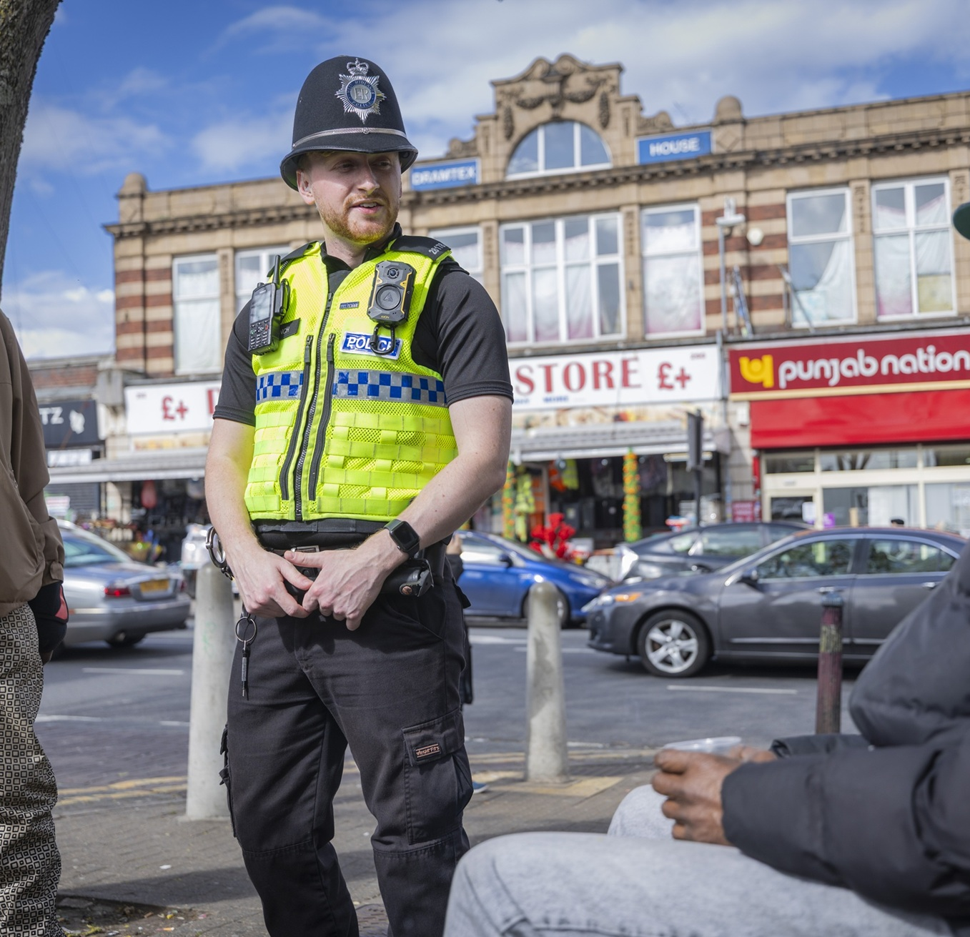
Where ethics usually gets tested
Pressure does not remove ethical responsibility — it reveals it.
Common pressure points:
time pressure and incomplete information
distressed, angry or vulnerable people
assumptions about credibility or lifestyle
bystanders filming or challenging police action
working culture and peer behaviour
fatigue, stress and emotional labour
Key question: how do we keep good judgement when conditions are poor?

Slide 16
Break 2
15 minutes · then we apply everything to initial attendance
When you return, sit in your groups.
Notes:
Second 15-minute break. Keep the slide visible.

Slide 17
Initial attendance: what matters first?
A response officer cannot do everything at once. Prioritisation is part of professionalism.
1
Preserve life
immediate safety, medical needs, ongoing threats
2
Protect the scene
avoid contamination, identify boundaries, control access
3
Care for people
victims, witnesses, vulnerability and reassurance
4
Preserve evidence
physical, digital, testimonial and contextual evidence
5
Record and communicate
actions, rationale, updates and escalation
Use this as a checklist — but always adapt it to the facts in front of you.

Slide 18
Applied group scenario: first 10 minutes
You are first on scene. Decide what you do, say and record.
Dispatch summary
A neighbour reports shouting, broken glass and a frightened woman outside a house. A male has left the address before police arrival. The caller says there may be children inside.
Immediate risks
People
Evidence
What could go wrong in the next 10 minutes?
Who needs care, control, separation or support?
What could be lost if you do nothing?
Ethics
Record
Which Code of Ethics principle is most tested?
What decisions need a rationale?
Output: a short first-attendance plan in no more than 8 bullet points.

Slide 19
How this links to the Week 8 role play
The role play assesses practical application, not acting ability.
People
victim/witness care, communication and vulnerability
Scene
preservation, safety and investigative awareness
Evidence
recognising physical, digital and testimonial opportunities
Judgement
prioritising, deciding and explaining your rationale
Professionalism
ethical conduct, calmness and accountability
Preparation task: write a 150-word personal reflection — “What do I need to improve before the role play?”

Slide 20
Key takeaways
A good response officer is not defined by speed alone.
1. Response officers set the tone for the whole investigation.
2. Ethics are practical: they shape what you do, say and record.
3. Good response policing balances safety, people, evidence and accountability.
4. The best decisions are those you can justify later.
Next week: Monday 12th – 0900. Digital and Cybercrime Guest speaker

Slide 21
Sources and preparation
For further reading before Week 3.
Core sources used in this session
College of Policing. Code of Ethics: Ethical Policing Principles. 2024.
College of Policing. Code of Practice for Ethical Policing. 2023.
College of Policing Authorised Professional Practice: Investigation.
Preparation for Week 3
Bring one example of evidence that could be lost, contaminated or overlooked during the first 10 minutes of police attendance.
Notes:
Do not spend long on this slide. It provides a clean student-facing source list and a specific preparation task. Remind students that scholarly, professional and legal sources all have a place, but they need to understand how to use them appropriately.

