Slide 1

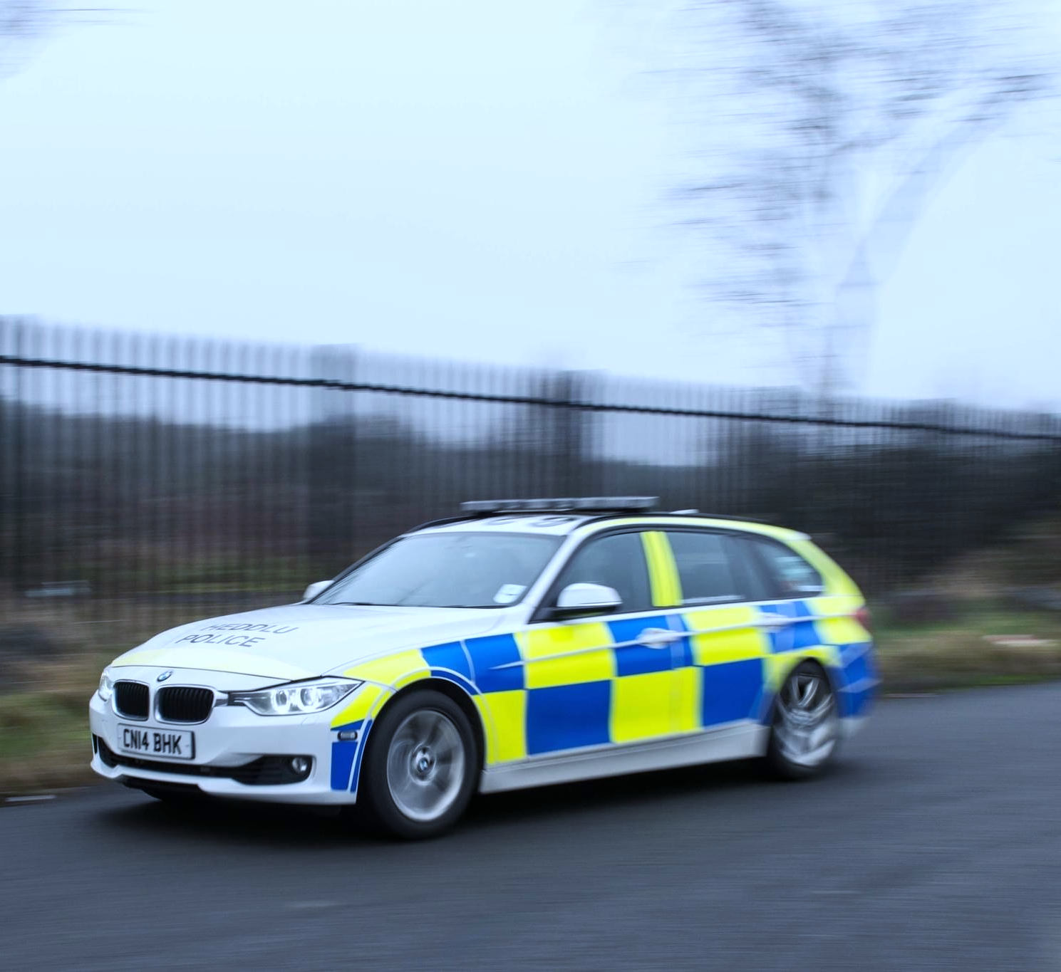
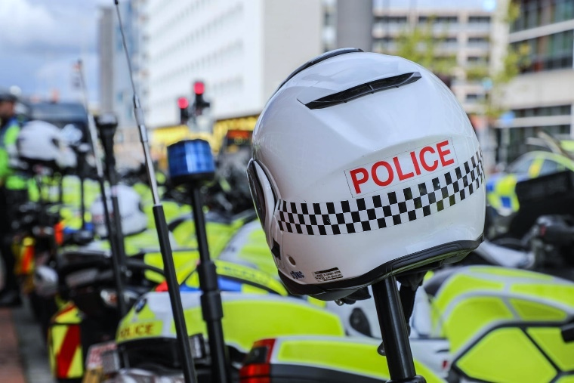
Introduction to
Policing the Roads
Part 1
V2
Notes:
By the end of this lesson you will be able to:
Identify the principal roads policing functions.
Describe what the 5 year Roads Policing Strategy according to the National Police Chiefs Council for 2011 – 2015 means to them as Police Officers.
Describe the 4 elements of the 5 Year Roads Policing Strategy according to the National Police Chiefs Council (NPCC) for 2015 – 2020 and the 4 elements of of the new NPCC Roads Policing strategy for 2022 – 2025
Explain how the strategic objectives of the National Police Chiefs Council (NPCC) roads policing strategy can be implemented into local roads policing

Slide 2
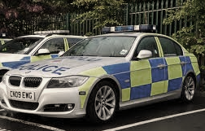



What do you think the principal roads policing functions are?
Notes:
Trainer to pose the question
Q. “What do you think the principal roads policing functions are?”
Trainer to ask for answers and write them on the white board
Once this has been completed trainer to reveal Slide 3.

Slide 3
Principal Roads Policing Functions
Identify road-related health & safety issues & mitigate those issues where possible
Set a professional example when driving, using the road or responding to incidents
Develop relationships in a community leading to the gathering of information & intelligence that will help in disrupting criminality & reducing crime
Recognise the offences in relation to drivers & vehicles & the legislation & the policies to deal with them
Notes:
This and the following slide outline the principal RPU functions as stated in
‘The NPCC (2015) Policing the Roads in Partnership – 5 Year Strategy 2015 – 2020’ / 3 year strategy 2022-2025.
Trainer to compare the students answers with the answers on slides 3 & 4 and discuss.

Slide 4
Principle Roads Policing Functions
Stop & seize (where appropriate) vehicles that have been or are suspected to be involved in crime
Attend & manage incidents where there may be death or injury &/or damage to vehicles & the road infrastructure
Take every opportunity to intervene & address driver behaviour be educations, advice & enforcement
Investigate & dispose of offences committed in the roads environment

Slide 5

ACPO Policing the Roads 5 Year Strategy
(2011 – 2015)
Focused harm reduction that saves lives & prevents crime
Enforcement based on professional judgement & discretion
A visible roads policing presence on the Strategic Road Network
Intelligence-led resources
Enforcement, Education & Engineering to affect & influence driver behaviour
Notes:
The ACPO Policing the Roads – 5 Year Strategy 2011-2015 prioritised and set out how effective and visible policing of the roads helped to create a safe and secure environment for all road users.
The strategy achieved this by implementing five key objectives:
Focused harm reduction that saves lives and prevents crime
Enforcement based on professional judgement and discretion
A visible roads policing presence on the Strategic Road Network
Intelligence-led resources
Enforcement, Education and Engineering to affect and influence driver behaviour.

Slide 6
ACPO Policing the Roads 5 Year Strategy
(2011 – 2015)
Key Areas
Reducing Road Casualties
Disrupting Criminality
Counter Terrorism
Patrolling the Roads
Combatting anti-social road use
Implementing the strategy
Notes:
1.4.1 Reducing Road Casualties
Each casualty on the road represents an avoidable personal trauma and, if fatal, costs the public purse a large amount of money. The main causes of road death and injury are accidents and incidents involving alcohol, drugs or excess speed, singularly or in combination. Two groups of road users continue to be highly represented in road accident statistics:
Young people (between 16 and 24 years), mainly due to speed and careless behaviour
Motorcyclists, mainly due to the use of excessive speed.
The strategy proposes an approach of enforcement and education that aims to ensure that drunk and drug impaired drivers and those who use excessive speed, are identified and brought to justice.
1.4.2 Disrupting Criminality
Many criminals use the road network in the planning and commission of their crimes, including drug smuggling, counterfeit goods and stolen vehicles and parts; this can be reduced by proactively policing the roads environment.
A visible police presence, coupled with the use of effective information and intelligence gathering, can be used to focus enforcement activity in order to detect, disrupt and challenge criminal use of the roads in all its forms.
1.4.3 Countering Terrorism
International and domestic extremist groups continue to pose a significant threat to the security and safety of the United Kingdom (UK). The strategic road network is used to facilitate the planning and execution of their campaigns and is itself a potential target. A visible policing presence on the roads can assist in deterring, disrupting and ultimately arresting offenders.
1.4.4 Patrolling the Roads
Effective patrolling, both on foot and mobile, is vital in detecting and reducing crime and for bringing about public reassurance. The presence on the roads of patrols aids the reduction of poor and illegal driving which cannot be detected by remote enforcement alone.
1.4.5 Combating anti-social road use
Communities routinely identify poor and aggressive driver behaviour and speeding traffic as a greater problem than all other anti-social behaviour. The Police Service has at its disposal a number of tools to combat anti-social road use, e.g. the power to seize vehicles and issue Fixed Penalty Notices (FPN) for offences including no insurance, no driving licence, no tax, and causing harassment, alarm or distress whilst driving carelessly. There are also educational programmes, aimed at drivers who unthinkingly or inadvertently break the law, that are alternatives to prosecution.
1.4.6 Implementing the strategy
Implementation of the 2011-2015 strategy is achieved by working with partners and stakeholders to create a shift in public attitude and behaviour to one of habitual compliance with the laws and conventions of the road. The focus is on harm reduction that saves lives and prevents crime by concentrating on road users who pose the highest threat of harm, whilst in turn responding appropriately to those who have shown a momentary lapse of judgement or care.

Slide 7
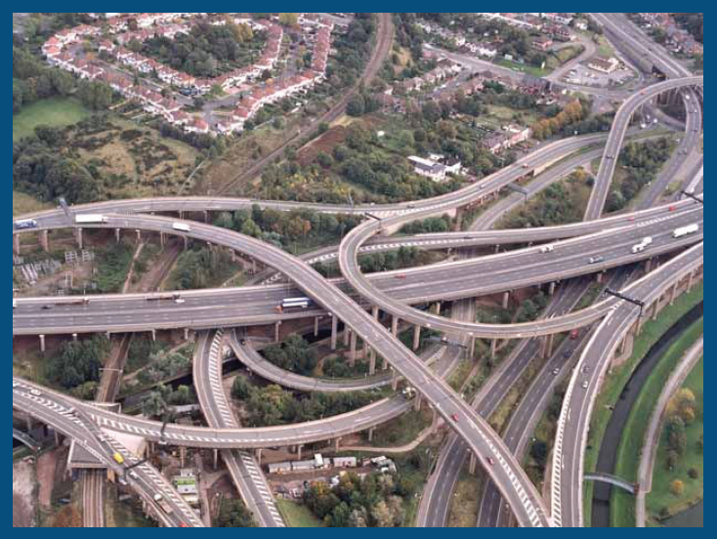
Roads Policing
The National Police Chiefs Council (NPCC)
Roads Policing Strategy
Notes:
Trainer to use introduce the NPCC Roads Policing Strategy 2015 – 2020.
The current strategy is built on the original hence the need to discuss both

Slide 8
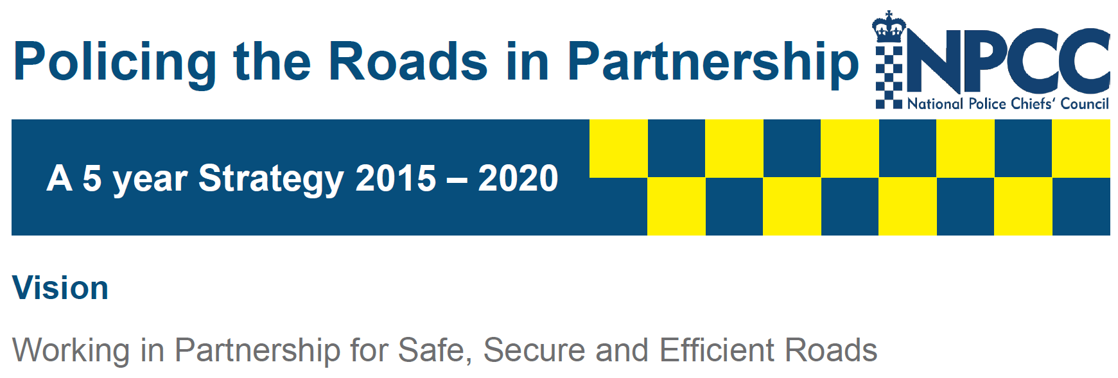
What does this mean for you?
Notes:
Detailed explanation of the 2015 -2020 strategy – trainer to discuss with learners. Trainer to emphasise that this is the NPCC strategic view – how do we implement this on the ground?

Slide 9
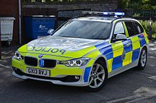
NPCC Policing the Roads in Partnership 5 Year Strategy (2015 – 2020)
Builds on 2011-2015 strategy
Commitment to reduce fatal/serious injury collisions
Combat organised crime & terrorism
Enforcement based on intelligence, professional judgement & discretion
The ‘Fatal Four’
Notes:
Detailed explanation of the 2015 -2020 strategy – trainer to discuss with learners. Trainer to emphasise that this is the NPCC strategic view –
Q. How do we implement this on the ground?

Slide 10
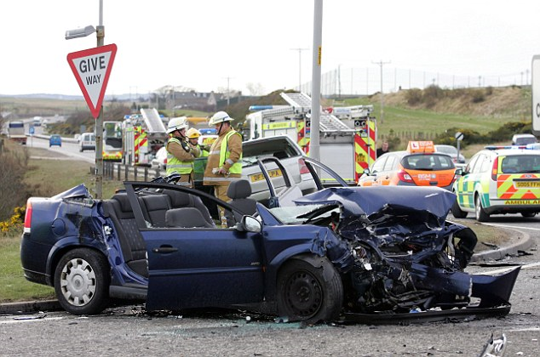
NPCC Policing the Roads in Partnership
5 Year Strategy (2015 – 2020)
Drink & drug driving
Non-wearing of seatbelts
Excessive speed
Driving whilst distracted
The ‘Fatal’ Four
Notes:
Detailed explanation of the 2015 -2020 strategy – trainer to discuss with learners. Trainer to emphasise that this is the NPCC strategic view – how do we implement this on the ground?

Slide 11
NPCC Policing the Roads in Partnership
5 Year Strategy (2015 – 2020)
Safe
Secure
Effective
Efficient
Notes:
Trainer to reveal this slide point by point, and outline that these are the four strategic objectives of the NPCC roads policing strategy.
Group work.
Trainer to split the class to split into four.
Each group will select one objective each and consider how this strategic objective can be implemented practically into local roads policing.
Ten minutes for the task.
Each group to report their findings back to the class in turn using flipcharts.

Slide 12
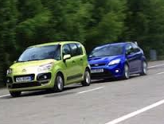
Safe
Working in partnership to achieve safe roads, free from harm.
We will work with partners to adopt a balanced & joined up approach to enforcement & education activities utilising appropriate technology to reduce the numbers of persons killed or seriously injured on UK roads, especially amongst vulnerable groups including younger people, cyclists, motorcyclists & pedestrians
Notes:
Trainer to reveal these slides to consolidate the learning. These slides are the direct definition of these terms from the NPCC strategy document. Trainer to compare and discuss the learners answers.

Slide 13
Secure
Working together to establish secure roads free from the threat of serious organised crime & terrorism.
We will continue to share information between partners to promote joint enforcement & the use of automatic number plate recognition (ANPR) to detect & disrupt those criminals who use the road.
Notes:
Trainer to reveal these slides to consolidate the learning. These slides are the direct definition of these terms from the NPCC strategy document. Trainer to compare and discuss the learners answers.

Slide 14
Effective
Through effective, data led patrolling & engagements with partnerships to deliver a safer & more secure “network road” approach throughout the UK.
Effective policing is an important & visible element of the Services commitment to protecting the public.
Notes:
Trainer to reveal these slides to consolidate the learning. These slides are the direct definition of these terms from the NPCC strategy document. Trainer to compare and discuss the learners answers.

Slide 15
Efficient
Working together to promote efficient roads that promote public confidence & satisfaction through safety.
We will be innovative & flexible in our approach, using effective communications to help deliver cost effective solutions to harm reduction that works & enjoys public support & legitimacy over the next 5 years.
Notes:
Trainer to reveal these slides to consolidate the learning. These slides are the direct definition of these terms from the NPCC strategy document. Trainer to compare and discuss the learners answers.

Slide 16
NPCC National Roads Policing Strategy (2022 - 2025
Prevent harm & save lives
Tackle crime on our road
Explore the challenges & benefits of new technology
Influence public behaviour to ensure road safety
.
Ethically and procedurally sound
Preventing Harm & Saving Lives
Evidentially based approach
Policing Our Roads Together
Changing Minds
Tackling Crime
Driving Technology & Innovation
Environmentally & Economically informed
Achieved through the 5 E’s
Notes:
The current strategy is built on the original hence the need to discuss them all
Trainer to put the students back into there groups and each group given one topic consider how this strategic objective can be implemented practically into local roads policing.
Ten minutes for the task.
Each group to report their findings back to the class in turn using flipcharts or PowerPoints.
Trainer to discuss the students responses.
Prevent Harm and Save Lives
On average five people are killed on our roads every day. Many more suffer life changing
injuries. The fatality figure has remained stubbornly high for a decade. We think this should no
longer be tolerated by anyone: the police and our partners, the public, business, the media and
policy makers.
Traumatic, unexpected and often preventable deaths on our roads devastate victims, their families and our communities. Our service to those involved in, and bereaved by, serious and
fatal collisions will be driven by empathy and professionalism. Our full support to those in the frontline dealing with these tragic incidents will also be a priority.
Preventing harm and saving lives is a core mission of policing. We will work with our partners across a range of agencies and organisations to achieve it. Policing our roads together can
prevent both social and economic harm to our society from a range of threats and criminal activity. Preventing harm includes preventing offending, we will work together to find ways to
reduce and prevent offending in the first place.
Everyone should be able to use our roads in a safe and healthy way. We will educate where appropriate to prevent re-offending and explain where there’s an opportunity to encourage
safer use of our roads. We will also use our enforcement powers to prosecute in accordance with the law where necessary, in order to prevent harm and save lives.
Tackling Crime
Policing our roads plays a major part in disrupting criminals who abuse our road network for criminal gain. Differentiating between ‘traffic’ offences and other crime risks undervaluing the contribution that policing our roads together makes in tackling crime in our communities.
It is entirely appropriate, legitimate and necessary that policing our roads means tackling drivers who break the law by engaging in behaviours that cause harm. This means addressing those crimes that cause death and serious injury on our roads - offences that range from speeding to failing to wear a seatbelt, from distracted driving to impaired driving, from careless to dangerous driving, and any other behaviour that causes harm on our roads.
By targeting those causing the most harm on our roads, there will be opportunities to enable the detection and prosecution of the most serious crime. This will involve the use of technology, such as ANPR, or intelligence from our partners and the public and the regulatory and coercive powers of other agencies.
Working with our partners, we will tackle crime and the enablers of crime and take every opportunity to intelligently target those who create the most harm in our communities using our enforcement powers, proportionately, robustly and ethically.
Driving Technology and Innovation
New technology presents us with policing challenges such as dealing with electric vehicles and alternative mobility (e-scooters, e-bikes), but also opportunities to prevent death and injury on our
roads.
Vehicles that can be limited to certain speeds, or that can communicate with each other in order to avoid collisions, or reduce congestion, are becoming increasingly common on our road network, along with vehicles and technologies that limit their impact on the environment. We also face a future where vehicles offer to do more for us as we use them on our road network and in our shared spaces.
We will work with local and strategic partners to understand these challenges and to ensure we maximize the benefit of new technological opportunities to prevent harm to all road users. We will work to positively influence or prevent technological developments that may undermine safety or promote offending.
We will continue to draw on academic insight and work in ways that are informed by the best available evidence, seeking out new and innovative opportunities to police our roads together and
save lives. We will use research to drive our activity and we will learn, from every opportunity, what works to promote safe and healthy roads for everyone to use.
Changing Minds
Personal responsibility is the starting point for safer roads. Abiding by the laws of the road, which are designed first and foremost to protect life, reduces the chances of being killed or seriously injured in a collision or causing a fatal or serious collision.
The way in which we use our roads and public space is changing. Active travel is welcome and necessary and it will mean that we must become used to sharing space with other travel modes and become more tolerant and more understanding through respecting the needs of others with whom we share space.
We invite all those who use roads and public spaces to consider how they will contribute to the policing of our roads to save lives. This includes employers and others with a duty of care towards those using our roads for commercial activity.
We will be consistent and resolute, leading by example, to challenge some long-held problematic beliefs and behaviours in our society, for example around the acceptability of speeding. We want to encourage everyone to play their part in saving lives by behaving in a way which keeps everyone safe.
Unlike any other crime, road users are both potential victims and potential offenders every day. We will continue to try and change minds and in doing so, positively change and save lives.

Slide 17
Legislation that allows us to Police the Roads
Highways Act 1835
Highways Act 1980
Road Traffic Regulation Act 1984
Road Traffic Act 1988
Notes:
Legislation for our roads go back a long way, although some have been amalgamated or replaced all four of these acts are still currently in use. As officers you will be mainly concerned with the RTA 1988 and in the coming lessons you will see how this act supports us in making our roads safer.
The other acts you will no necessary think you use day to day but have their part to play. For example the Highways Act 1980 defines what a carriage way is, which is highly important when it comes to offences on our roads.
Group Activity
Trainer to split class into three groups. Each group to be given either: HA 1835, HA 1980 or RTR 1984. Groups then to briefly look into these and report to the class what these acts are.
Highways Act 1835
This is a very old act but is still very active and although it has some powers/offences that do not make sense in modern life such as:
Riding upon the cart, or upon any horse drawing it, and not having some other person to guide it, unless there be some person driving it.
Quitting his cart, or leaving control of the horses, or leaving the cart so as to be an obstruction on the highway.
Not having the owner's name painted up.
The playing of football on public highways, with a maximum penalty of forty shillings. (Repealed)
It still has offences we can use today such as:
Section 72: "If any person shall wilfully ride upon any footpath or causeway by the side of any road made or set apart for the use or accommodation of foot passengers; or shall wilfully lead or drive any horse, ass, sheep, mule, swine, or cattle or carriage of any description, or any truck or sledge, upon any such footpath or causeway; or shall tether any horse, ass, mule, swine, or cattle, on any highway, so as to suffer or permit the tethered animal to be thereon.“
This is directly reference in the current Highway Code (Rule 64)
You MUST NOT cycle on a pavement. HA 1835 sect 72
Highways Act 1980
This act mainly deals with the management and operation of the road network in England and Wales. But has several powers and offences within it which can be beneficial to Police Officers such as:
131(2) If a person without lawful authority or excuse pulls down or obliterates a traffic sign placed on or over a highway, or a milestone or direction post (not being a traffic sign) so placed, he is guilty of an offence; but it is a defence in any proceedings under this subsection to show that the traffic sign, milestone or post was not lawfully so placed.
137 Penalty for wilful obstruction. (1)If a person, without lawful authority or excuse, in any way wilfully obstructs the free passage along a highway he is guilty of an offence and liable to [imprisonment for a term not exceeding 51 weeks or] a fine [or both].
161Penalties for causing certain kinds of danger or annoyance.
(1)If a person, without lawful authority or excuse, deposits any thing whatsoever on a highway in consequence of which a user of the highway is injured or endangered, that person is guilty of an offence and liable to a fine not exceeding [level 3 on the standard scale].
(2)If a person without lawful authority or excuse—
(a)lights any fire on or over a highway which consists of or comprises a carriageway; or
(b)discharges any firearm or firework within 50 feet of the centre of such a highway,
and in consequence a user of the highway is injured, interrupted or endangered, that person is guilty of an offence and liable to a fine not exceeding level 3 on the standard scale.]
(3)If a person plays at football or any other game on a highway to the annoyance of a user of the highway he is guilty of an offence and liable to a fine not exceeding
(4)If a person, without lawful authority or excuse, allows any filth, dirt, lime or other offensive matter or thing to run or flow on to a highway from any adjoining premises, he is guilty of an offence and liable to a fine not exceeding [level 1 on the standard scale].
Road Traffic Regulation Act 1984
This act provides powers to regulate or restrict traffic on UK roads, in the interest of safety. Such powers / offences include:
67 Emergencies and temporary obstructions.
(1)A constable, or a person acting under the instructions (whether general or specific) of the chief officer of police, may place on a road, or on any structure on a road, traffic signs (of any size, colour and type prescribed or authorised under section 64 of this Act), indicating prohibitions, restrictions or requirements relating to vehicular traffic, as may be necessary or expedient to prevent or mitigate congestion or obstruction of traffic, or danger to or from traffic, in consequence of extraordinary circumstances; and the power to place signs conferred by this subsection shall include power to maintain a sign for a period of 7 days or less from the time when it was placed, but no longer.
81 General speed limit for restricted roads.
(1)It shall not be lawful for a person to drive a motor vehicle on a restricted road at a speed exceeding 30 miles per hour.
(2)The [national authority] may by order... increase or reduce the rate of speed fixed by subsection (1) above, either as originally enacted or as var
84 Speed limits on roads other than restricted roads.
(1)An order made under this subsection as respects any road may prohibit—
(a)the driving of motor vehicles on that road at a speed exceeding that specified in the order,
(b)the driving of motor vehicles on that road at a speed exceeding that specified in the order during periods specified in the order, or
(c)the driving of motor vehicles on that road at a speed exceeding the speed for the time being indicated by traffic signs in accordance with the order.
112 Information as to identity of driver or rider.
(1)This section applies to any offence under any of the foregoing provisions of this Act except—
(a)sections 43, 52, 88(7), 104, 105 and 108;
(b)the provisions of subsection (2) or (3) of section 108 as modified by subsections (2) and (3) of section 109; and
(c)section [F135A(5)] in its application to England and Wales.
(2)Where the driver of a vehicle is alleged to be guilty of an offence to which this section applies—
(a)the person keeping the vehicle shall give such information as to the identity of the driver as he may be required to give—
(i)by or on behalf of a chief officer of police, or
(ii)in the case of an offence under section [F235A(1)] or against section 47 of this Act, by or on behalf of a chief officer of police or, in writing, by or on behalf of the local authority for the parking place in question; and
(b)any other person shall, if required as mentioned in paragraph (a) above, give any information which it is in his power to give and which may lead to the identification of the driver.

Slide 18

Notes:
Group work.
Trainer to split the class to split into four.
Each group will select one objective each and consider how this strategic objective can be implemented practically into local roads policing.
Ten minutes for the task.
Each group to report their findings back to the class in turn using flipcharts.

