Slide 1

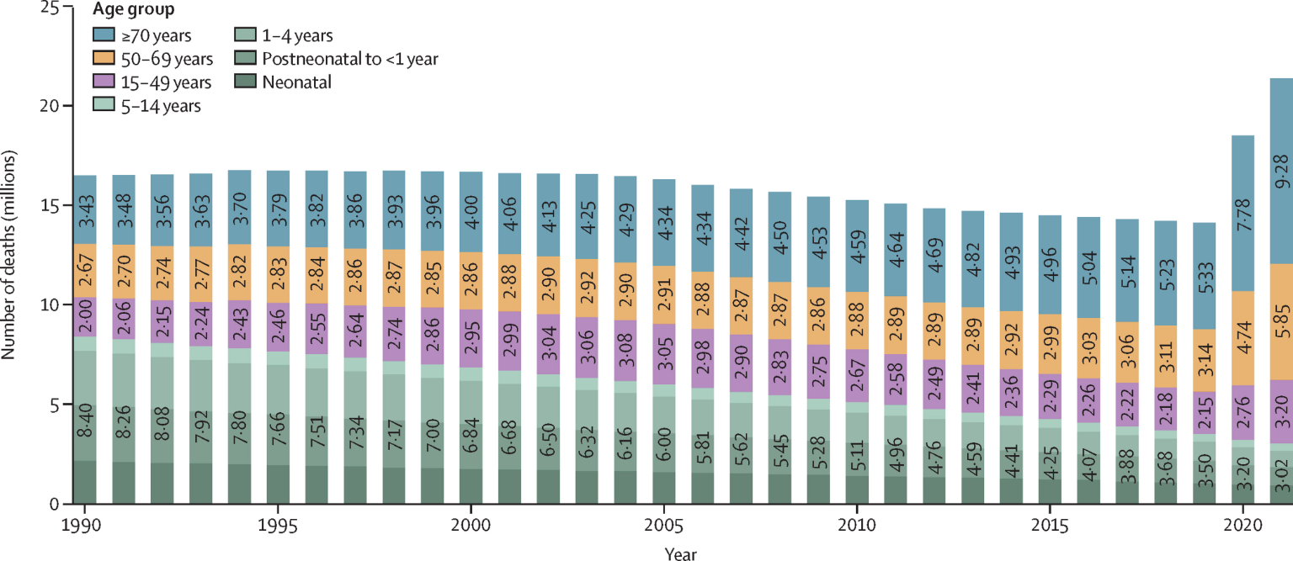
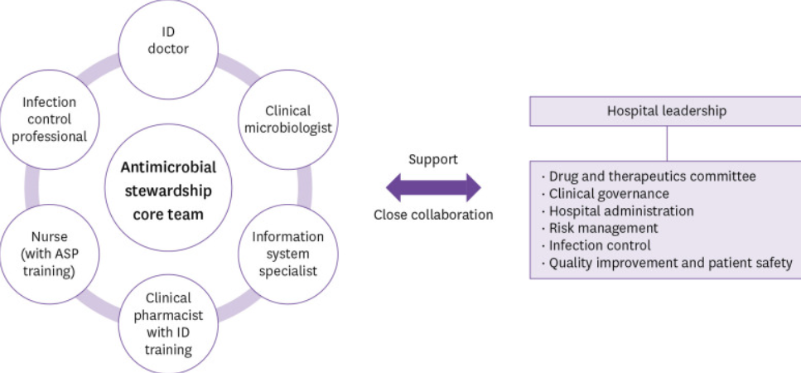
Antimicrobial Resistance in Community and Long-Term Care: Resistance Patterns and Barriers to Stewardship
Name: Krupal Monpara
ID: 2537141
Email: 2537141@student.uwtsd.ac.uk
Supervisor Name - Dr Soban Sadiq
Background and Prevalence Of Antimicrobial Resistance
[ Insert Figure 1: Number of deaths due to AMR here ]
Caption: describe the figure
(Source: Author, Year)
Multidrug-resistant bacteria reduce treatment options and make treatment choices more difficult, and antimicrobial drug resistance (AMR) is the power of microorganisms to withstand the drugs used to treat infections (Gajic, et al., 2025). The resistance to antimicrobial includes the presence of ESBL-producing bacterial strains and methicillin-resistant Staphylococcus aureus (Bitew, et al., 2023; Husna, et al., 2023). The GBD 2021 Antimicrobial Resistance, approximately 1.14 million deaths were directly caused by bacterial AMR, and 4.71 million deaths were attributed to bacterial AMR globally (Naghavi, et al., 2024). It is necessary to recognise that local prevalence drives global mortality estimates, necessitating evidence-based approaches to change care delivery at the local level (Correia, et al., 2025; Shenoy, et al., 2023).
Figure 2: Number of deaths due to Antimicrobial Resistance
(Source: Naghavi, et al., 2024)
According to Bassetti, et al., (2022), the diagnosis of resistant bacteria can be insufficient to correct inappropriate prescribing. Decisions are influenced by diagnostic activities, delays in lab results, concerns about clinical deterioration, lack of staff resources, and communication issues (Alrithi, 2025). A significant gap has emerged in identifying organisational, resource-related and knowledge-related barriers to optimising antimicrobial use in long-term care facilities (Cheong, et al., 2022; Vicentini, et al., 2024). There is a significant gap in care because instructions are not clear on whether current facilities offer a connection between resistance profiles, prescribing and coordination of care across community and social services (Khatri, et al., 2023).
Research Rationale and Evidence Gap
Figure 1: Factors of antimicrobial stewardship
(Source: Cheong, et al., 2022)
Research Question
Research Objectives
What is the baseline prevalence and phenotypic and genotypic profile of multidrug-resistant bacteria in a selected cohort?
Surveillance and microbiological grounding: Quantify local susceptibility profile and resistance mechanisms (e.g. ESBL-producing bacteria, Enterobacteriaceae species, and MRSA strains) within a community or residential care cohort to establish a baseline of clinical necessity.
Behavioural and clinical decision-making: Identify how general practitioners, prescribers, and social care workers navigate diagnostic uncertainty, fear of resident deterioration and time lags in laboratory culture results.
Health system and implementation: Evaluate the operational interface between care homes, primary care networks and diagnostic laboratories to determine where stewardship breakdown occurs (e.g., antimicrobial susceptibility turnaround, lack of de-escalation).
Research Aim
To evaluate clinical, behavioural and organisational determinants of antimicrobial prescribing across community and social care systems and to formulate an evidence-based antimicrobial stewardship (AMS) implementation framework that aligns local microbiological resistance patterns with primary care practice.
Research Methodology: Systematic Review
A systematic review allows for the identification, critical appraisal and synthesis of published research in a transparent manner (Uttley, et al., 2023). Fostering integration of terms such as AMR, ESBL, MRSA, long-term care, and prescribing to search the databases, including MEDLINE, Embase, CINAHL and Scopus, helps to review the research process (Kühn, et al., 2022). The PRISMA is beneficial for extracting the data by emphasising inclusion of setting, population, species, prevalence, susceptibility and resistance genes (Perea-Jacobo, et al., 2023). The research emphasises the quality of studies assessed through validated tools, with a summary of the findings in the form of a narrative synthesis.
References
Alrithi, Y.S. (2025) The Impact of Laboratory Services on Multidisciplinary Clinical Decision-Making and Integrated Patient Care: A Review. The Review of Diabetic Studies, pp.592-600.
Bassetti, S., Tschudin-Sutter, S., Egli, A. and Osthoff, M. (2022) Optimizing antibiotic therapies to reduce the risk of bacterial resistance. European journal of internal medicine, 99, pp.7-12.
Bitew, A., Adane, A. and Abdeta, A. (2023) Bacteriological spectrum, extended-spectrum β-lactamase production and antimicrobial resistance pattern among patients with bloodstream infection in Addis Ababa. Scientific Reports, 13(1), p.2071.
Chadborn, N.H., Devi, R., Goodman, C., Williams, C.D., Sartain, K. and Gordon, A.L. (2023) General practitioners’ role in improving health care in care homes: a realist review. Family practice, 40(1), pp.119-127.
Cheong, H.S., Park, K.H., Kim, H.B., Kim, S.W., Kim, B., Moon, C., Lee, M.S., Yoon, Y.K., Jeong, S.J., Kim, Y.C. and Eun, B.W. (2022) Core elements for implementing antimicrobial stewardship programs in Korean general hospitals. Infection & chemotherapy, 54(4), p.637.
Correia, T., Kuhlmann, E., Lotta, G., Beja, A., Morais, R., Zapata, T. and Campbell, J. (2025) Turning the global health and care workforce crisis into action: The pathway to effective evidence‐based policy and implementation. The International journal of health planning and management, 40(1), pp.224-233.
Gajic, I., Tomic, N., Lukovic, B., Jovicevic, M., Kekic, D., Petrovic, M., Jankovic, M., Trudic, A., Mitic Culafic, D., Milenkovic, M. and Opavski, N. (2025) A comprehensive overview of antibacterial agents for combating Multidrug-Resistant bacteria: the current landscape, development, future opportunities, and challenges. Antibiotics, 14(3), p.221.
Husna, A., Rahman, M.M., Badruzzaman, A.T.M., Sikder, M.H., Islam, M.R., Rahman, M.T., Alam, J. and Ashour, H.M. (2023) Extended-spectrum β-lactamases (ESBL): challenges and opportunities. Biomedicines, 11(11), p.2937.
Khatri, R., Endalamaw, A., Erku, D., Wolka, E., Nigatu, F., Zewdie, A. and Assefa, Y. (2023) Continuity and care coordination of primary health care: a scoping review. BMC health services research, 23(1), p.750.
Kühn, L., Bachert, P., Hildebrand, C., Kunkel, J., Reitermayer, J., Wäsche, H. and Woll, A. (2022) Health literacy among university students: a systematic review of cross-sectional studies. Frontiers in public health, 9, p.680999.
Naghavi, M., Vollset, S.E., Ikuta, K.S., Swetschinski, L.R., Gray, A.P., Wool, E.E., Aguilar, G.R., Mestrovic, T., Smith, G., Han, C. and Hsu, R.L. (2024) Global burden of bacterial antimicrobial resistance 1990–2021: a systematic analysis with forecasts to 2050. The Lancet, 404(10459), pp.1199-1226.
Perea-Jacobo, R., Paredes-Gutiérrez, G.R., Guerrero-Chevannier, M.Á., Flores, D.L. and Muñiz-Salazar, R. (2023) Machine learning of the whole genome sequence of Mycobacterium tuberculosis: a scoping PRISMA-based review. Microorganisms, 11(8), p.1872.
Shenoy, S., Sharma, P., Rao, A., Aparna, N., Adenikinju, D., Iloegbu, C., Pateña, J., Vieira, D., Gyamfi, J. and Peprah, E. (2023) Evidence-based interventions to reduce maternal malnutrition in low and middle-income countries: a systematic review. Frontiers in Health Services, 3, p.1155928.
Uttley, L., Quintana, D.S., Montgomery, P., Carroll, C., Page, M.J., Falzon, L., Sutton, A. and Moher, D. (2023) The problems with systematic reviews: a living systematic review. Journal of Clinical Epidemiology, 156, pp.30-41.
Vicentini, C., Libero, G., Cugudda, E., Gardois, P., Zotti, C.M. and Bert, F. (2024) Barriers to the implementation of antimicrobial stewardship programmes in long-term care facilities: a scoping review. Journal of Antimicrobial Chemotherapy, 79(8), pp.1748-1761.
Anticipated Research Impact
Evidence anticipation resistance patterns in community and long-term care, helping to inform about susceptibility results and treatment-review decisions. Results regarding the barriers to prescription could inform staff training and enhance communication among general practitioners, care-home staff and diagnostic laboratories (Chadborn, et al., 2023). These are expected contributions and not necessarily proven outcomes and would need to be followed with implementation and evaluation to prove improvement in prescribing quality, patient outcomes, or reduced resistance.
Conclusion and Expected Contribution
In Summary, AMR has the potential to impact vulnerable populations in care, while barriers to stewardship exist in both prescription and organisational settings. Although the effectiveness of implementation is required to be handled, this research intended to establish the foundation for future AMS practice.

