Slide 1
Brand standards audit from deloitte
Marriott Birmingham central
Module code: mx60193
ORGANIZATION CONSULTANCY
LECTURER: DR OLU ADEGBITE
STUDENT: SHAHZIA AHMED

Slide 2
PID OVERVIEW
ANALYSIS OF ISSUES WHICH ARE EFFECTING MANAGERIAL ISSUES AT THE MARRIOT
INCCORPAORATING COVID19 AS NEW LAWS DETERMINE SOCIAL DISTANCING
DEFINING HOW THE MARRIOT CAN REDEFINE THERE POSITION IN BIRMINGHAM WITH RENOVATING THE SOCIAL AREAS.
HOW THIS DOCUMENT HELPS US HELP YOU!

Slide 3

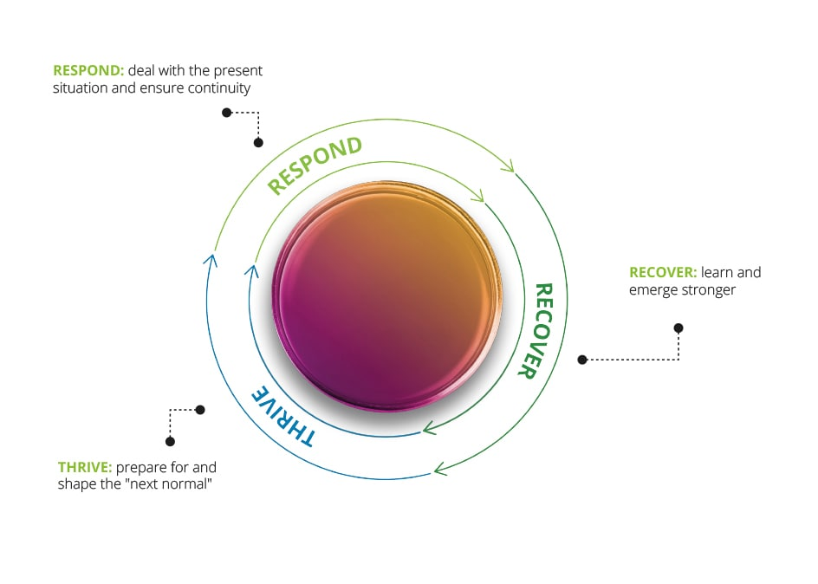
RESPONSE,RECOVER AND THRIVE IS OUR MOTO
At Deloitte we have evaluated the current economic effect on the hospitality industry and have devised a new strategy to respond to industry, recover losses and sustain future loss, lastly to thrive through the adversity and set to “next normal”.
6X0191IIMAGE FROM IMAGE FROM WWW.DELOITTE.COM

Slide 4
Creative Design and Innovation
We combine storytelling, technology, design thinking, strategy, and behavioural science in new and unexpected ways to craft impactful and immersive content, bold new ways of engaging with customers, and entirely new experiences. Design and innovation are core to what we do every day, differentiating both us and our clients as we help brands to elevate their approach to the human experience.
Advertising and Branding We work with CMOs to bring powerful, brilliant, creative ideas to life. Through AoR relationships with our clients and mission critical projects, we build brands, launch new products and services, and help our clients acquire new customers. We deliver all of this using data and insights with the right creative approach, delivered through the right placement: TV Advertising, OOH, Physical Activations, Digital, Social, and more.
content. Working closely with clients and brands, we help them more effectively engage with - and market to – the full funnel of audiences and their existing set of identified customers.

Slide 5
Brand standards Audit identifier's
We have identified three main areas which can be improved upon
Renovation and update of all social and communal spaces this is especially essential in the dining and bar areas.
Update of bedroom furnishings, flooring and refresh of walls doors.
Creating new streams of business to generate revenue from within the Hotel from existing customers to new.

Slide 6
How does this impact the hotel
By creating a new a covid19 compliant social space, this will give the customer the confidence and added knowledge you are being looking after, giving them increasing security, confidence and brand loyalty.
Identifying issues which effect the longevity and which create barriers to increasing revenues.

Slide 7
WE SUGESST
Taking note from the audit the Hotel pre COVID19 is ran in a efficient and well run matter, occupancy rates are high which in turn keeps the hotel busy and the retention of staff is high.
the only area of concern we were able to identify was regarding the update and renovation of social areas as well as some modernisation in bedrooms.
We advise while the premises are in lockdown mode, the social areas i.e restaurant, bar areas be renovated and updated to be inline with Government social distancing laws.

Slide 8
Future suggestions
We would recommend to the Marriot to optimise revenues by utilizing existing resources
Start a new service offering cooked meals to those who are not comfortable with socially interaction at this point, keeping customers engaged and offering familiarity to regulars and giving opportunity to those wanting try something new
Working closely with clients and brands, we help them more effectively engage with - and market to – the full funnel of audiences and their existing set of identified customers.

Slide 9
ADVANTAGES for the Marriott
Starting a new stream of revenue through the kitchen will help the Marriott to retain employment within the sector which may be at threat of downsizing.
The hotel’s strength’s is recognised as an investor in people and won many awards for the highest possible level of service and development to all their associates and customers, this is the fuel required to aid the Recovery process

Slide 10
Estimated returns based on 100 meals being sold daily at the cost of £15 is £10,500 from a seven day return and £42000 from 28 days return period, this clearly shows a healthy profit margin and a clear way to utilize current asset to kick starts a live income stream.

Slide 11
THANK YOU FOR LISTENING
ANY QUESTIONS PLEASE!

Slide 12
BIBLIOGRAPHY
https://www.gov.uk/coronavirus
https://www2.deloitte.com/be/en/pages/human-capital/articles/managing-your-human-capital-through-COVID-19.html
https://www2.deloitte.com/global/en/pages/financial-services/covid-19/covid-19-resources-for-financial-services-leaders.html
https://www2.deloitte.com/be/en/pages/human-capital/articles/managing-your-human-capital-through-COVID-19.html
https://www2.deloitte.com/be/en/pages/consumer-industrial-products/topics/transportation-hospitality-services.html?icid=top_transportation-hospitality-services

