Slide 1
International Hotel Management
Personnel Resourcing & Development
(M5X 01921)
Week 5
Performance Management & Employee Engagement

Slide 2
Previously:
Module Overview – WK1
Human Resource Management – WK2
The Recruitment Process – WK3
Equality and Diversity in the Workplace – WK4

Slide 3
In this session we will…..
The Process of Managing Process
Company Culture
Employee Onboarding and Engagement
Employee Retention
Talent Development
Rule #5 – Understand the “How of Wow”

Slide 4
Performance Management
Performance management helps organisations become more successful and stay ahead of the competition. It essentially involves measuring, reporting and managing progress in order to improve performance, both at an individual level, and at a corporate level. There are many, many performance management tools designed to make the process easier and more effective.

Slide 5
Performance Management in HR
Performance management is about setting clear and measurable objectives for work, and is an important managerial and human resource tool. A well-run performance management system will provide staff with clear objectives for their job, and plenty of opportunities for feedback and discussion with their supervisor

Slide 6
5 Strategies for Effective Performance Management
A large part of working in Human Resources (HR) is regulating performance management. Creating a space where you and your employees can produce excellent work and perform to the best of your abilities is no easy task, but with the right strategies, you can make it work.
Define and Communicate Company Goals and Performance Objectives
Offer Frequent Performance Feedback
Use Peer Reviews
Preemptive Management and Recognition
Set Regular Meetings to Discuss Outcomes and Results

Slide 7
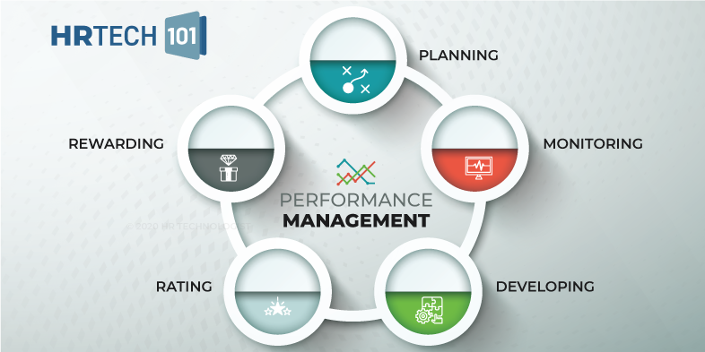
Common tools of Performance Management in HR

Slide 8
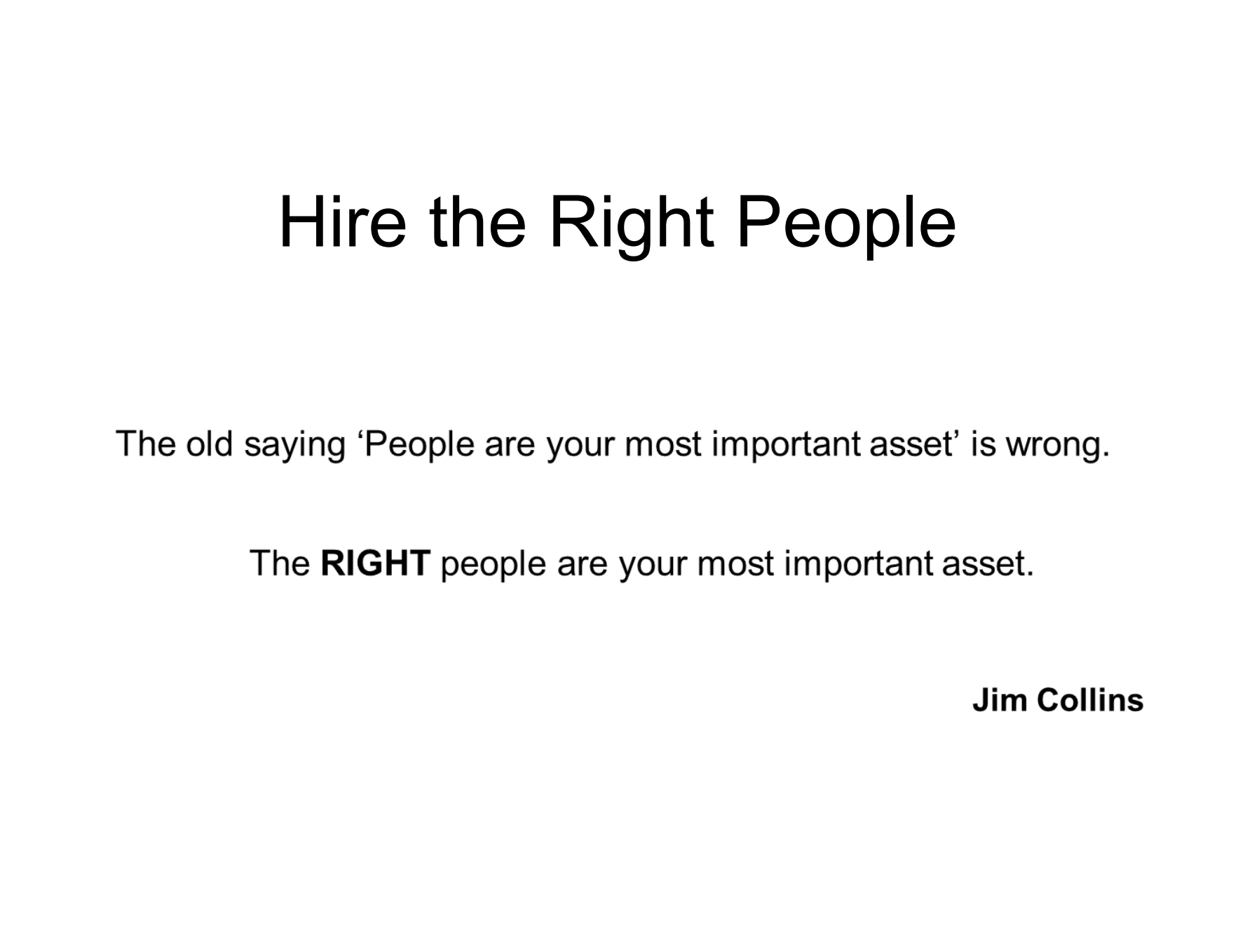

Slide 9
Be the Preferred Employer
Create a large pool: “Compete for Talent Market Share”
Select the right people: – Different jobs are best filled by people with different skills, styles, or personalities – Hire candidates that fit firm’s core values and culture
Focus on recruiting naturally warm personalities for customer-contact jobs

Slide 10
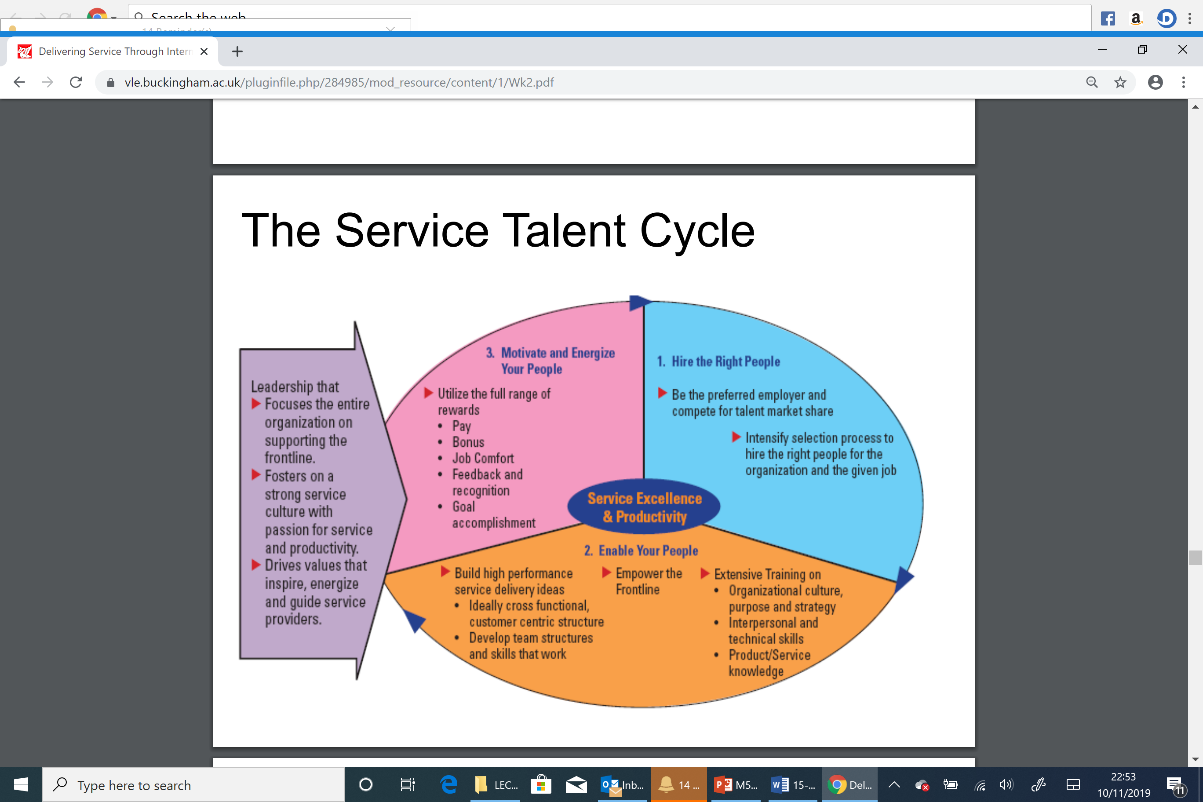
Human Resources Management – How to Get it Right

Slide 11
Tools to Identify Best Candidates
Conduct personality tests
– Willingness to treat co-workers and customers with courtesy, consideration, and tact
– Perceptiveness regarding customer needs
Ability to communicate accurately and pleasantly
Give applicants a realistic preview of the job
– Chance for candidates to “try on the job”
– Assess how candidates respond to job realities
– Allow candidates to self select themselves out of the job
– Manage new employees’ expectation of job

Slide 12
Tools to Identify Best Candidates
Employ multiple, structured interviews
– Use structured interviews built around job requirements
– Use more than one interviewer to reduce “similar to me” biases
• Observe behaviour
– Hire based on observed behaviour, not words you hear
– Best predictor of future behaviour is past behaviour
– Consider group hiring sessions where candidates are given group tasks

Slide 13
Train Service Employees
Service employees need to learn:
• Organizational culture, purpose, and strategy
– Promote core values, get emotional commitment to strategy
– Get managers to teach “why,” “what,” and “how” of job
• Interpersonal and technical skills
• Product/service knowledge
– Staff’s product knowledge is a key aspect of service quality
– Staff must explain product features and position products correctly

Slide 14

Summary

Slide 15
Home Work
Employee Shift Checklist and Job Description
Please Research on Performance Management Tools to use at the Developing Stage of the Performance Management Cycle.

