Slide 1

Course: Business and Management
Name: Judith Churcher
Student ID Number: 2101153
Module: Contemporary Management Approaches
Code: BMSP4002
Assignment 2 – Presentation.

Slide 2
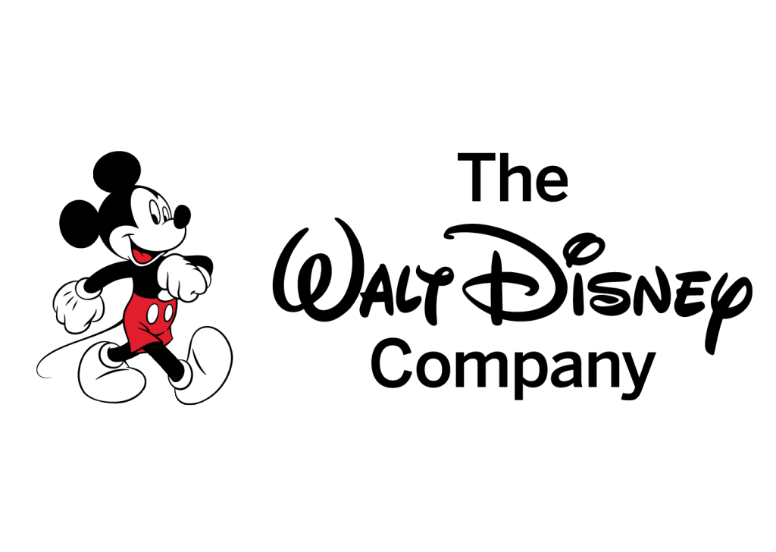
CONTEMPORY MANAGEMENT APPROACHES
– THE WALT DISNEY COMPANY

Slide 3

Introduction
Approach to Strategy
Approaches to organisation and management
Corporate social responsibility
Group and teamwork

Slide 4
Walt Disney History – How it started.
Walt Disney was a gentleman who came to California back in 1923. ‘Disney, 2018, say that he started off doing cartoons one of which called Alice’s Wonderland. On October 16th, 1923, he has managed to sell a pilot film and then company originally started out with the name Disney Brothers Cartoon Studio. But soon after his brother decided that it should be renamed to Walt Disney studios.’
From then they made comedies for four years, working from the back of an office in Hollywood.
In 1937 they had a hit with their first animated feature film Snow White and the Seven Dwarfs and became the highest grossing film of all time.
They went from strength to strength and opened Disney stores and theme parks around the world and to this day are still a successes and are known for their name for family entertainment.

Slide 5
Mission statement
According to ‘Investopedia, (2021) a mission statement is used by companies to describing and explain in short what their aims and values are.
Walt Disney’s Mission Statement:
“To entertain, inform and inspire people around the globe through the power of unparalleled storytelling, reflecting the iconic brands, creative minds, and innovative technologies that make ours the world’s premier entertainment company.” (The Walt Disney Company, 2020)
Walt Disney’s Vision Statement:
“To be one of the world’s leading producers and providers of entertainment and information.” (The Walt Disney Company, 2020)

Slide 6
Aims and objectives as a company
A company will set aims and objectives to be able to achieved goals. The purpose of this is to allow businesses to see what their focus is. To be able to move forward they should be motivational for employees to be more likely to want to achieve these goals. According to the ‘BBC, 2021, they will show their stakeholders i.e investors and employees for a better chance of support on new projects.’
“The Walt Disney Company's objective is to be one of the world's leading
producers and providers of entertainment and information, using its portfolio of brands to differentiate its content, services and consumer products. The company's primary financial goals are to maximize earnings and cash flow, and to allocate capital toward growth initiatives that will drive long-term shareholder value.” (Porsga, 2021)

Slide 7
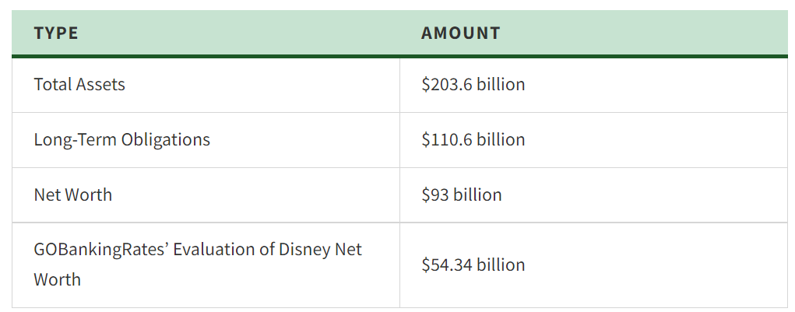
Profitability – Walt Disney
Profitability is ability of a company to use its resources to generate revenues in excess of its expenses. In other words, this is a company’s capability of generating profits from its operations.(My Accounting Course, 2021)
Disney end of the financial year ended October 2021 with a total revenue exceeding $67 billion.
Despite the pandemic and being at a loss of $2.8 billion in 2020 they had a 3% increase in 2021.
Go Banking Rates (2021)

Slide 8
Organisational stakeholders
A party that have interest in a company and can affect or be affected by the business. Usually, the primary stakeholders will be; investors, employees, customers and suppliers. They rely on each other to be able to reach goals. For it to be a continuing success they need to be managed correctly.
Disney’s External Stakeholders include:
Non-governmental organisations
Multi-stakeholder initiatives
Labour unions
Peer companies
Multi-lateral institutions
Government agencies
Socially responsible investors
Industry associations

Slide 9
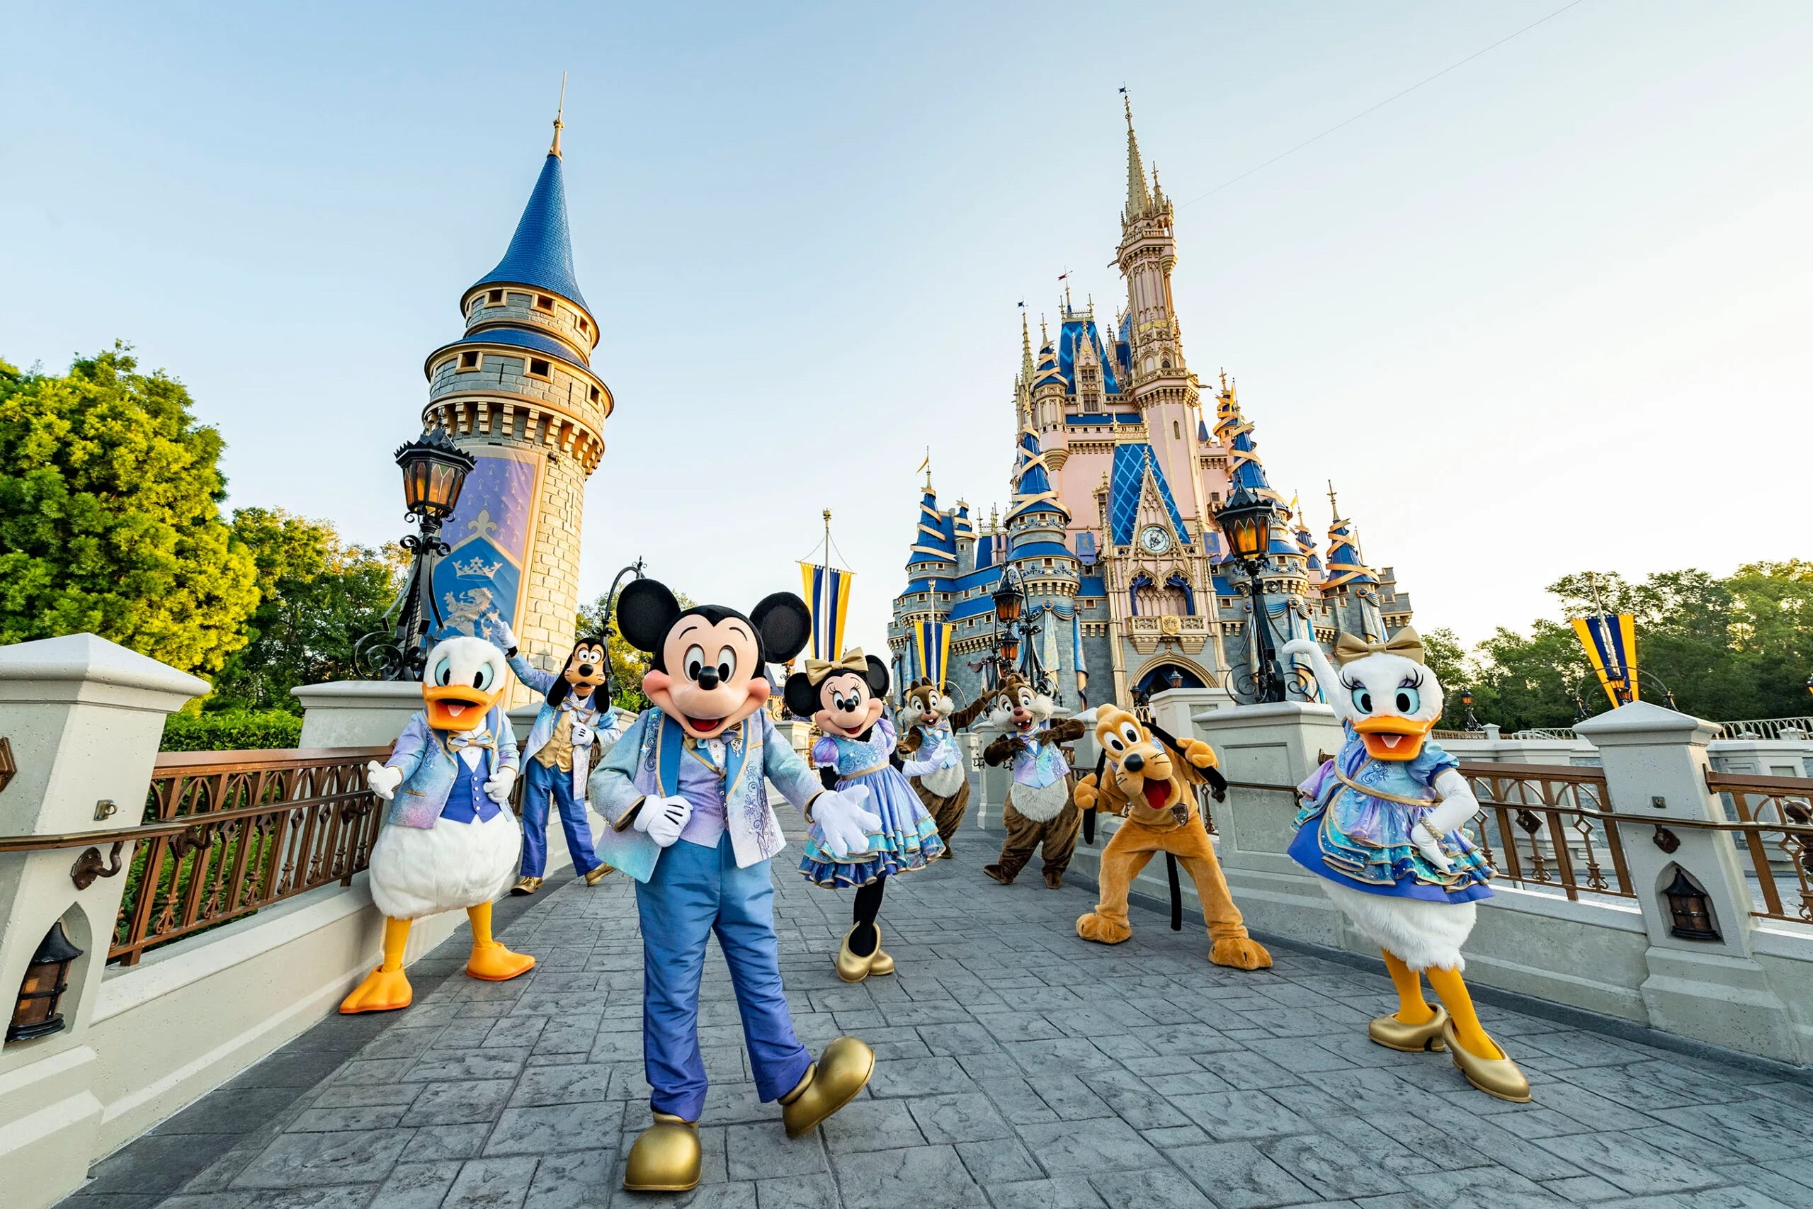
Ethical standpoint
This is what they deemed to be correct in accordance with principles of conduct.
Disney have a ‘Standards of business conduct – ethical standards.’ They include:
Responsibility to guests and customers
Responsibility to cast members and employees
Responsibility to the company and shareholders
Responsibility to other businesses
Responsibility to communities
(Robertson, 2021)

Slide 10
CSR AND THEIR POLICY
Disney have strategies in place to support these.
Environmentally – Disney have said that they are committed to reducing their greenhouse emissions and minimizing waste and protecting the planet as their business grows.
Human Rights – They are committed to make sure that where Disney products are made the Disney’s International Labour Standards Programme makes sure that it is a safe environment for workforce.
Philanthropic – They have a signature social impact program that grants wishes for children in hospitals.
Economically – To recue their footprint the monitor and check they safety of products in their supply chain.
To ensure that companies are being ethical and beneficial for society, they need to put in corporate social responsibility strategies. ‘CFI , 2021 says that they need to be environmentally responsible, human rights, philanthropic and economically responsible.

Slide 11
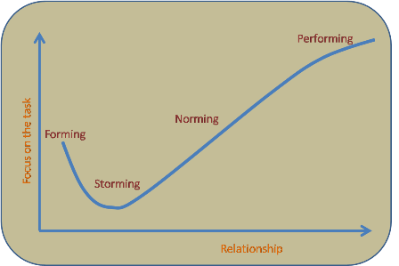
Group and teamwork
There is a teamwork theory by Bruce Tuckerman which was first developed in 1965.
There are 4 phases to his theory:
Forming
Storming
Norming
Performing
Disney are proud to say that “everything that happens at Disney is the result of a team effort.”(Disney, 2021)
They have 4 words for their journey of leadership.
Courage
Confidence
Curiosity
Consistency
They are taught to step out of their comfort zone to pursue their dreams and to keep moving forward.
They engage in many teamwork activities which helps them gain valuable skills that can help them find their true potential.

Slide 12
SWOT ANALYSIS
Strengths:
Diversified business
Uniquely strong brand
Admired corporate culture
Influential creative strategy
Weaknesses:
Seasonal impacts
Remakes/spinoffs
Opportunities:
International growth
Adopt technology advancement and trends
Threats:
Ever-increasing competition
Decreasing profitability
Technology disruptions
Analytix Minds. (2021)

Slide 13
PESTEL ANALYSIS
Political:
Trade policies
Opinionated political views
Economical:
US Market
Economic recession
Social:
Customer behaviour
Online streaming
Cultural diversity
Technological:
Usage of technology
Research and development
Video games
Shaw, H. (2021)

Slide 14
Management approaches
Disney has more of an autocratic leadership approach. Similarly to the Theory X, they allow little or no input from group members.
According to ‘Chris, (2015) there is little input from employees and the leader will make their own choices and have sole control over all decisions.’
Pros
They can make decisions quickly and having a strong leader will allow them to do so without having to consult others.
Does not put pressure on other employees when they have other tasks to complete.
Cons
This style of leadership can cause individuals to be to controlling and dictational.
Can cause a dispute with employees if they have no contribution to some decisions.
There are many different management approaches. Theory X and Theory Y was created by Douglas McGregor in the 1950’s. This theory is all about understanding people's motivations.
Theory X explains how management assume that they dislike or avoid responsibility in their job.
While Theory Y they assume that they like to work on their own initiative and like to be involved in decision making.

Slide 15
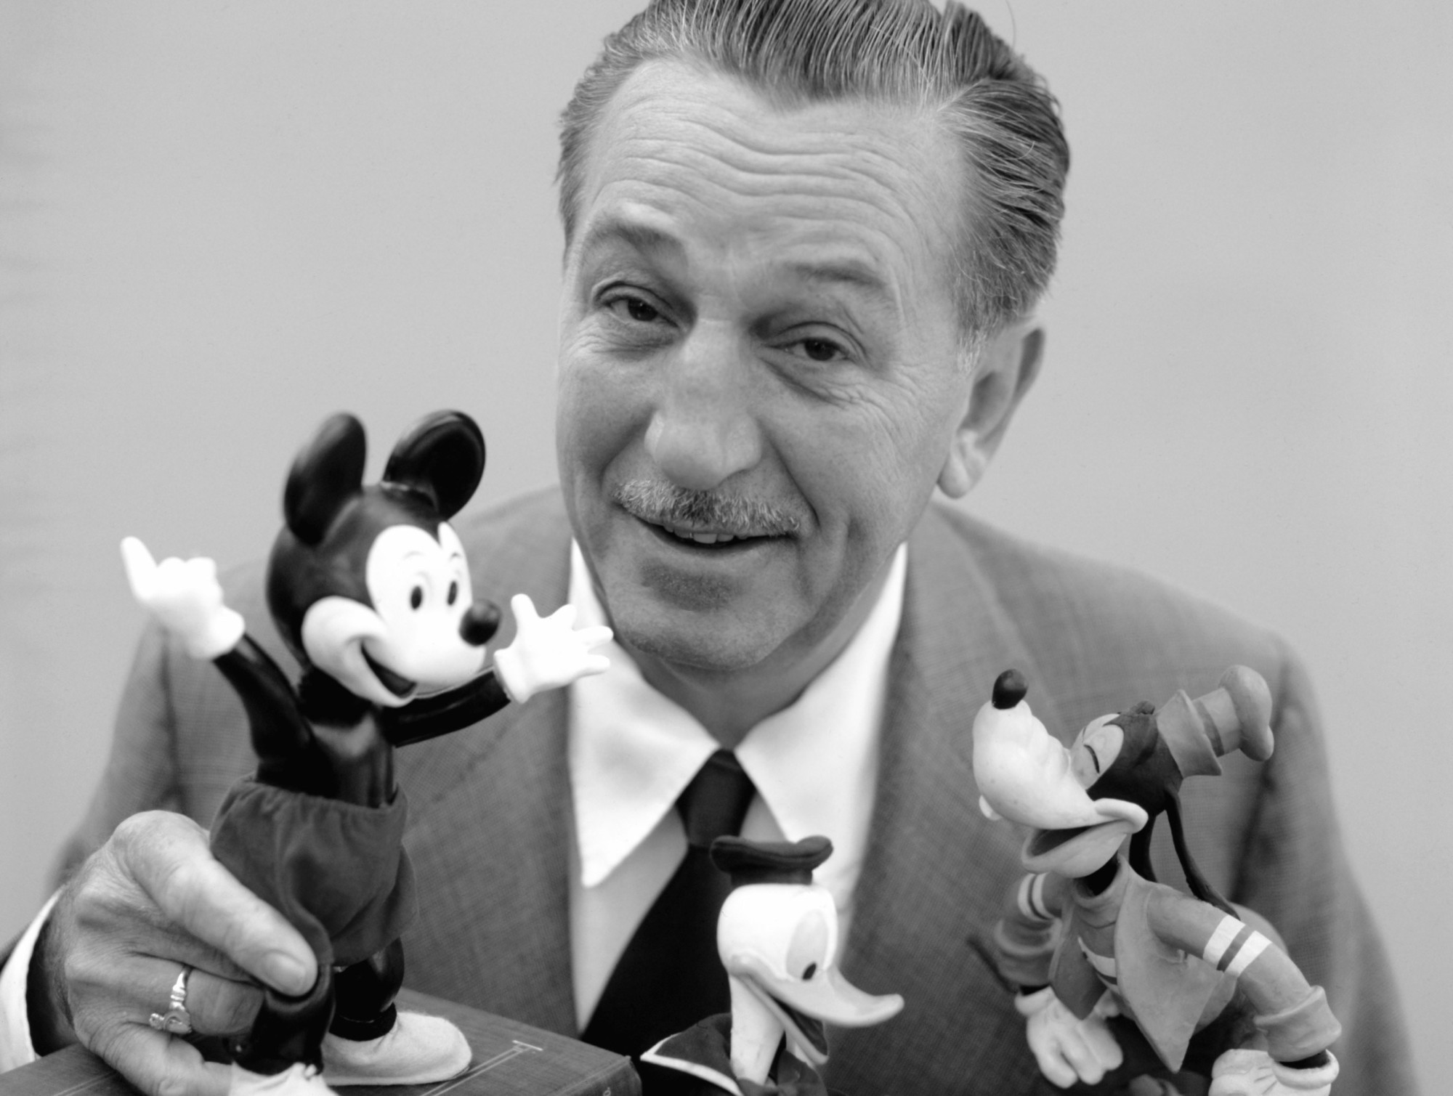
Thank you.

Slide 16
References
Pictures.
Logo. (2021) Disney logo | Logok
Robertson, G. (2021). Walt Disney World Announces New Exciting Events To Celebrate 50th Anniversary. Walt Disney World Announces New Exciting Events To Celebrate 50th Anniversary – TravelAwaits
Garg, T. (2019) Walt Disney Net Worth 2019 The Owner of Disney. Walt Disney Net Worth 2019 | The Owner of Disney - NetworthoPedia
References.
Disney. (2018) History. The Walt Disney Studios | History
Investopedia. (2021) Mission statement definition. Mission Statement Definition (investopedia.com)
Alam, M (2021) Walt Disney: Analysis of Mission & Vision Statement. Walt Disney: Analysis Of Mission & Vision Statement 2022 (visionarybusinessperson.com)
My Accounting Course. (2021) What is Profitability? What is Profitability? - Definition | Meaning | Example (myaccountingcourse.com)
CFI. (2021) What is Corporate Social Responsibility (CSR)? Corporate Social Responsibility (CSR) - Types and Business Benefits (corporatefinanceinstitute.com)
Disney (2018) Social Responsibility. Social Responsibility - The Walt Disney Company
Analytix Minds. (2021) Disney SWOT Analysis 2021. Disney SWOT Analysis 2021 - AnalytixMinds

Slide 17
References continued.
BBC Bitesize. (2021) Setting business aims and objectives. Purpose of setting objectives - Setting business aims and objectives - AQA - GCSE Business Revision - AQA - BBC Bitesize
Porsga, J. (20201) The Walt Disney Company, Goals and Objectives. Goals and Objectives(: - Walt Disney Information. (weebly.com)
Fernando, J. (2021) Investopedia, Stakeholder. Stakeholder Definition (investopedia.com)
The Walt Disney Company. (2021) p.1 Stakeholder Engagement. Stakeholder-Engagement.pdf (thewaltdisneycompany.com)
The Walt Disney Company. (2021) Standards of business conduct – ethical standards. P.g 1-13 Standards-of-Business-Conduct-Ethical-Standards.pdf (thewaltdisneycompany.com)
Disne. (2021) Disney’s approach to leadership and teamwork. DLR-YES-Disney-Approach-to-Leadership.pdf (wdpromedia.com)
Shaw, H. (2021) PESTLE Analysis of Disney. PESTLE Analysis of Disney | SWOT & PESTLE Analysis (swotandpestleanalysis.com)
Go Banking Rates. (2021) How Much Is Disney Worth? How Much Is Disney's Net Worth? | GOBankingRates

