Slide 1
TASK ONE: FEEDBACK LITERACY
Feedback literacy involves closely understanding how you are assessed, what your assessment means and how you can progress.
Your task this week is to highlight your points for improvement and respond.
Open your feedback.
Read closely. Highlight instructions/guidance/suggestions for important points for improvement or necessary changes to your process.
Reflect on these and suggest how and when you will do this in Visual Studies 2.

Slide 2
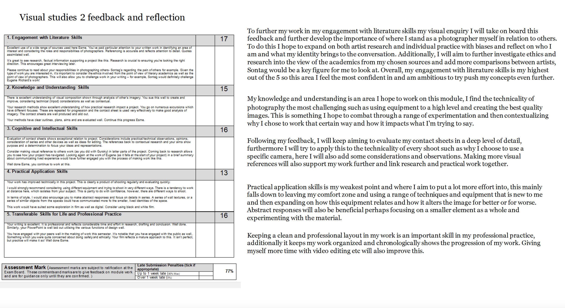
TASK ONE: EXAMPLE

