Slide 1

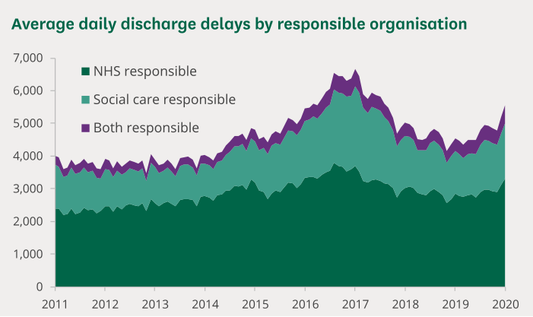
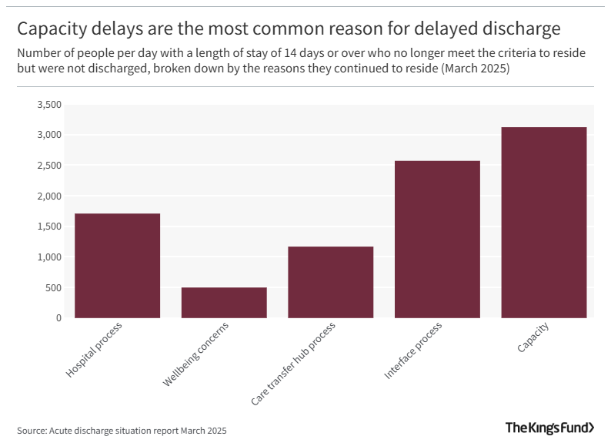
The Impact of Delayed Hospital Discharge on Adult Social Care Services in the UK
Student Name : Jatin Makwana | Student Id : 2521166 | Name of Supervisor : Diola Bijlhout
1. Prevalence
It is a key challenge for health and social care in the UK that patients are discharged from hospital and do not receive the necessary support to care for their needs at home (Heenan, 2021); (Wallis et al., 2024); (Aggarwal et al., 2024). In March 2025, there was a daily average of 9,309 delayed patients in England with a delay of 14+ days, and a significant proportion of these delays were due to capacity problems and, to a large extent, social care (Harris, 2025).
In November 2025, a total of 49,688 patients experienced delays (NHS Support Federation, 2025), with more than 291,000 bed days lost due to these delays (the average delay was about 5.9 bed days), which resulted in more than 15% of inpatients being affected by the delays.
One of the delays that contributes is a lack of adult social care resources like home care packages and bed-based rehab programs (Gridley et al., 2022); (Keemink et al., 2023). This costs NHS resources as well and negatively affects older people and vulnerable patients who need to be in place to make appropriate and timely transitions to the community.
Aim
To systematically review and synthesise existing evidence on the impact of delayed hospital discharge on adult social care services in the UK, with particular focus on service capacity, workforce pressures, quality of care, and outcomes for service users.
Objectives
To identify and review the existing literature on delayed hospital discharge in the UK.
To examine the impact of delayed hospital discharge on adult social care service capacity and resource allocation.
To evaluate the effects of delayed hospital discharge on workforce workload, staffing pressures, and service delivery.
To assess the impact of delayed hospital discharge on the quality of care and outcomes experienced by adult social care service users.
To identify strategies and recommendations reported in the literature for reducing delayed hospital discharge and improving integration between health and social care services.
Figure 2: Number of delayed discharges Source: (Foster, 2023)
Questions
How does delayed hospital discharge affect adult social care services in the UK?
Sub-Questions
How does delayed hospital discharge influence adult social care service capacity?
What impact does delayed discharge have on workforce workload and staffing?
How does delayed discharge affect the quality of care and service-user outcomes?
What interventions have been reported to reduce delayed hospital discharge in the UK?
Reference List
Aggarwal, K., Singh, B., Banker, H., Stoltzfus, M.T., Hong, J., Anamika, F.N.U., Nishkamni, F.N.U., Munjal, J. and Jain, R. (2024). Exploring the Ramifications of Delayed Hospital Discharges: Impacts on Patients, Physicians, and Healthcare Systems. Cureus, [online] 16(5). doi:https://doi.org/10.7759/cureus.61249.
Bottery, S. and Arnold, S. (2025). Delayed Discharges: Why It’s Hard To Say How Many Are Due To Social Care Capacity | The King’s Fund. [online] The King’s Fund. Available at: https://www.kingsfund.org.uk/insight-and-analysis/blogs/delayed-discharges-social-care-capacity [Accessed 2 Jul. 2026].
Campbell, D. (2025). Hospitals in England ‘face dangerous winter overcrowding due to discharge delays’. [online] the Guardian. Available at: https://www.theguardian.com/society/2025/dec/14/hospitals-in-england-face-dangerous-winter-overcrowding-due-to-discharge-delays [Accessed 2 Jul. 2026].
Foster, D. (2023). Delayed hospital discharges and adult social care. [online] House of Commons Library. Available at: https://commonslibrary.parliament.uk/delayed-hospital-discharges-and-adult-social-care/ [Accessed 2 Jul. 2026].
Gridley, K., Baxter, K., Birks, Y., Newbould, L., Allan, S., Roland, D., Malisauskaite, G. and Jones, K. (2022). Social care causes of delayed transfer of care (DTOC) from hospital for older people: Unpicking the nuances of ‘provider capacity’ and ‘patient choice’. Health & Social Care in the Community, [online] 30(6), pp.e4982–e4991. doi:https://doi.org/10.1111/hsc.13911.
Harris, S. (2025). NHS-Social Care Budget Divide Worsens Discharge Delays. [online] Medscape. Available at: https://www.medscape.com/viewarticle/nhs-social-care-budget-divide-worsens-discharge-delays-2025a10005fu [Accessed 2 Jul. 2026].
Heenan, D. (2021). Hospital Social Work and Discharge Planning for Older people: Challenges of Working in a Clinical Setting. Ageing and Society, [online] 43(6), pp.1–18. doi:https://doi.org/10.1017/s0144686x21001124.
Hinde, S., Bojke, L., Richardson, G., Birks, Y., Whittaker, W., Wilberforce, M. and Clegg, A. (2021). Delayed Transfers of Care for Older people: a Wider Perspective. Age and Ageing, [online] 50(4), pp.1073–1076. doi:https://doi.org/10.1093/ageing/afab035.
Keemink, J. r, Glass, D., Dargan, A.K., Sharp, R.J. and Forder, J.E. (2023). The role of adult social care in the prevention of intensive health and care needs: a scoping review - LSE Research Online. Lse.ac.uk, [online] pp.350–378. doi:http://eprints.lse.ac.uk/121263/1/The_role_of_adult_social_care.pdf.
Maynard, A. (2017). Shrinking the state: the Fate of the NHS and Social Care. Journal of the Royal Society of Medicine, [online] 110(2), pp.49–51. doi:https://doi.org/10.1177/0141076816686923.
NHS Support Federation (2025). Delayed discharge explainer: health and care pressure - The Lowdown. LowDownNHS. [online] doi:https://doi.org/107822123.jpg%201000w.
O’Dowd, A. (2025). Patients face ‘dangerous’ waits in hospitals because of discharge delays, leaders warn. BMJ, [online] 391, p.r2641. doi:https://doi.org/10.1136/bmj.r2641.
Potthoff, S., Kane, R.L. and Franco, S.J. (2024). Improving Hospital Discharge Planning for Elderly Patients. Health Care Financing Review, [online] 19(2), p.47. Available at: https://pmc.ncbi.nlm.nih.gov/articles/PMC4194477/ [Accessed 2 Jul. 2026].
Spiers, G., Matthews, F.E., Moffatt, S., Barker, R.O., Jarvis, H., Stow, D., Kingston, A. and Hanratty, B. (2018). Impact of social care supply on healthcare utilisation by older adults: a systematic review and meta-analysis. Age and Ageing, [online] 48(1), pp.57–66. doi:https://doi.org/10.1093/ageing/afy147.
Wallis, J.A., Shepperd, S., Makela, P., Han, J.X., Tripp, E.M., Gearon, E., Disher, G., Buchbinder, R. and O’Connor, D. (2024). Factors influencing the implementation of early discharge hospital at home and admission avoidance hospital at home: a qualitative evidence synthesis. The Cochrane library, [online] 2024(3). doi:https://doi.org/10.1002/14651858.cd014765.pub2.
Figure 1: Capacity delays are the most common reason for delayed discharge
Source: (Bottery and Arnold, 2025)
2. Rationale of your research
Maynard (2017) calls this 'a serious issue'; a persistent and costly problem for UK adult social care services is the failure to discharge patients from hospitals in a timely fashion. That is per month, and it is estimated that by September 2025 some 12,459 patients were lying in a bed medically ready for discharge, representing an estimated cost to NHS England of over £220 million, or more than £2 billion annually (O’Dowd, 2025).
These delays further add to the pressures of occupied hospital beds, add to the record A&E waits, and cause unchosen delays in accessing social care in the community (Campbell, 2025). In adult social care, they burden already over-stretched London borough services and disrupt and decrease care packages and poor patient outcomes, including loss of independence, infections, and poor mental health (Spiers et al., 2018); (Hinde et al., 2021).
4. Research impact
The outcomes of this research will ultimately benefit older adults and vulnerable patients by creating better routes into and out of hospitals, providing for more Independence and well-being in our society, and ensuring the effective and efficient use of hospital resources (Potthoff, Kane and Franco, 2024). It will underpin the planning of adult social care provision, including for better allocation of resources and integrated working with the NHS. Findings will inform evidence for policymakers to create effective policies and give practical suggestions for working in health and social care (HSC) to streamline transitions and reduce pressures for HSC systems.

