Slide 1
Social Inclusion & Equality
Welcome to the module

Slide 2
Objectives
By the end of today’s session, we will have:
defined certain key concepts intrinsically linked with the module title;
visited key vocabulary associated with the themes to be introduced during the module;
begun to explore our own values and attitudes with regard to inclusion and promoting an inclusive society

Slide 3
What do we understand by the term social inclusion?
?
?
?
Social Inclusion
?
?
?
?
?

Slide 4
Examples of Key Vocabulary
Values, attitudes, fairness, tolerance, rights, prejudice,
stereotyping, discrimination, anti-discrimination,
ethnicity, racism, anti-racism, sexism, homophobia,
justice/injustice, equality/inequality, identity, diversity,
inclusion, exclusion, ageism, ableism/disablism,
misogyny, multiculturalism, etc.

Slide 5
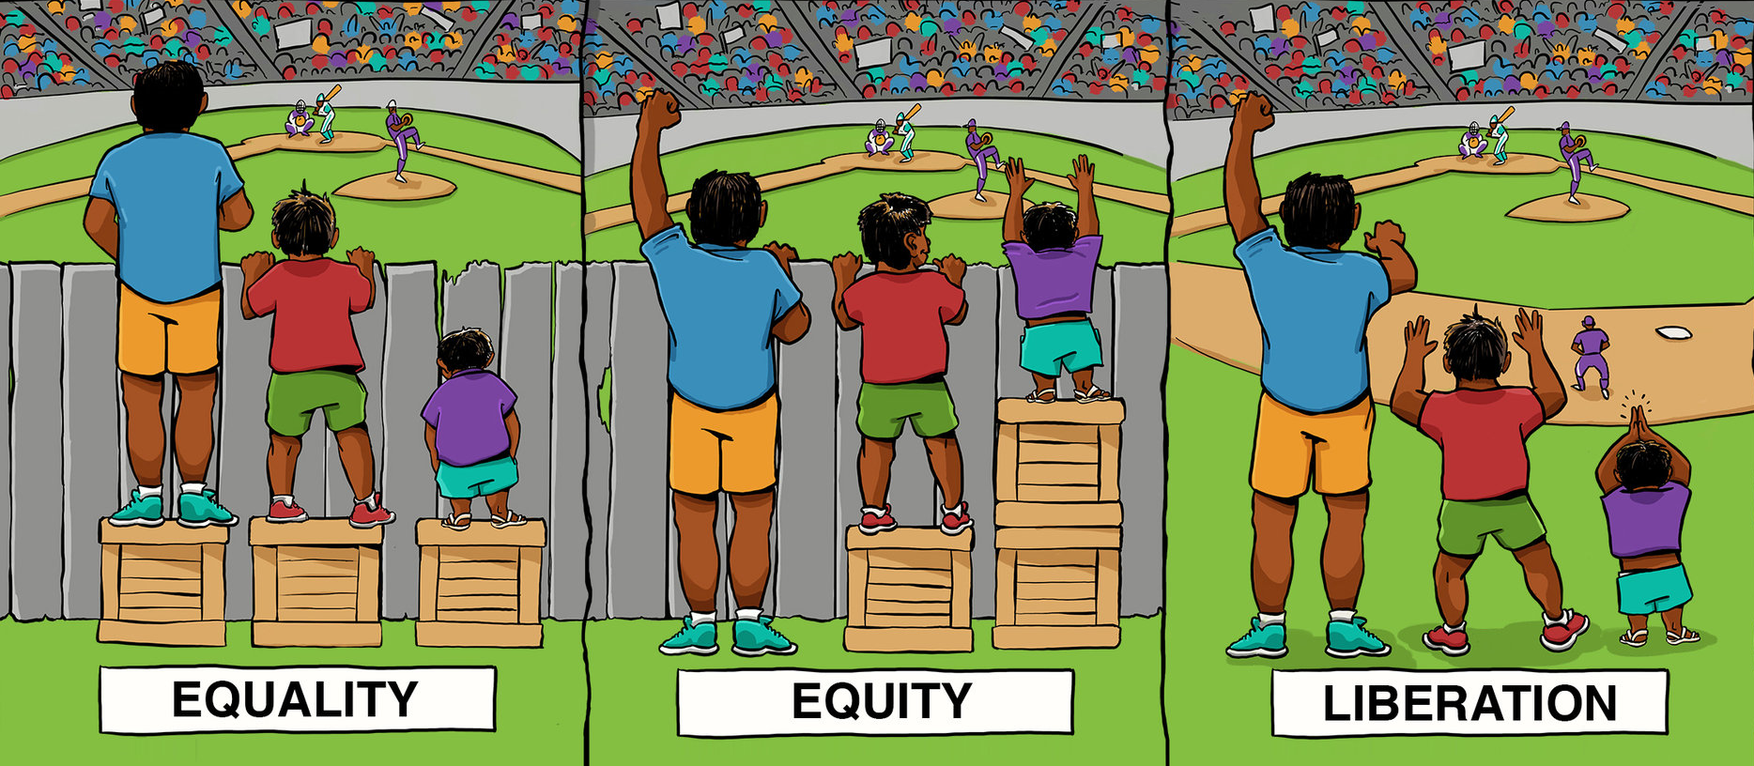
What about equality?

Slide 6
What we will cover……….
Overview of content
Key vocabulary
The nature of an inclusive society
Implications of living in a diverse society.
Prejudice, discrimination and stereotyping
Ageism
How fair is Britain?
Equality Act 2010
Global poverty
UK poverty
Poverty in Wales
Identity
Oppressive language
Racism
Disability and disablism

Slide 7
I N C L U S ION
The module moves away from inclusive education and looks at inclusion from a macro-perspective; the big picture.
We need to re-adjust our concept and definition of inclusion.
Umbrella term under which inclusive education is a strand.
Topics are concerned with the social aspect; the nature of an inclusive society; social inclusion.

Slide 8
One definition
‘Inclusion is a process of identifying, understanding and breaking down
barriers to participation and belonging.’
(National Early Childhood Forum, June 2003)

Slide 9
Inclusive > Exclusive
Inherent in the term ‘inclusive’ is the possibility of being excluded.
In which ways could society be excluding individuals, therefore? Consider this question in groups.
Social inclusion

Slide 10
Barriers
If this is true, we need to explore these barriers, identify and understand them in order to help break them down.
Everyone has a right to be included and participate fully in society and feel that they belong.
We need to understand the concepts and issues which certain individuals perceive as exclusive or actually do exclude them from participating fully in society. Our perceptions are very real.

Slide 11
Society
How would you define society?
Write a definition, then refine it with a partner until you are both satisfied.

Slide 12
Some definitions of society:
A group of people who occupy a particular territory and speak a common language and share a common culture.
A group of human beings, broadly described as being separate from other groups by mutual interest, beliefs and common cultural bonds.

Slide 13
More….
A long-standing group of people sharing cultural aspects such as language, dress, norms of behaviour and artistic forms.
A society is a grouping of individuals which is characterised by common interests and may have distinctive culture and institutions. Members of a society may be from different ethnic groups…

Slide 14
Do these definitions satisfy us? How do they resonate with your own?

Slide 15
Big concept
Definition of society
Local? National? Global? Specific? General?
Different communities of people make up different societies.
It’s possible to belong to one or lots of different communities at the same time. We have multiple identities. We can belong to different societies.
SOCIETY is a big concept.
We will consider this further at another time.

Slide 16
What about this......?
Margaret Thatcher famously declared in the 70s that there is no such thing as ‘society’. There are only individuals and families.
She is not alone. Some theorists believe that the most remarkable and insidious feature of the present-day edition of social ills is that they arise mostly from the absence of society, rather than from its pressures.
(From: Bauman, Z. (2008) The Absence of Society)

Slide 17
Let’s move on: Inclusive society
What does this term mean to you? Write down some thoughts. Share with a partner.
Think of some ideas and words which would be true of an inclusive society.

Slide 18
Social inclusion: some information - from Serbia!
http://www.youtube.com/watch?v=d3KOFZeuQmw

Slide 19
A society for all
An inclusive society is ‘a society for all’ (The World Summit for Social Development, 1995).
Inclusive societies are stable, safe, just and tolerant.
They respect diversity, equality of opportunity and participation of all people, including disadvantaged and vulnerable groups and persons.

