Slide 1
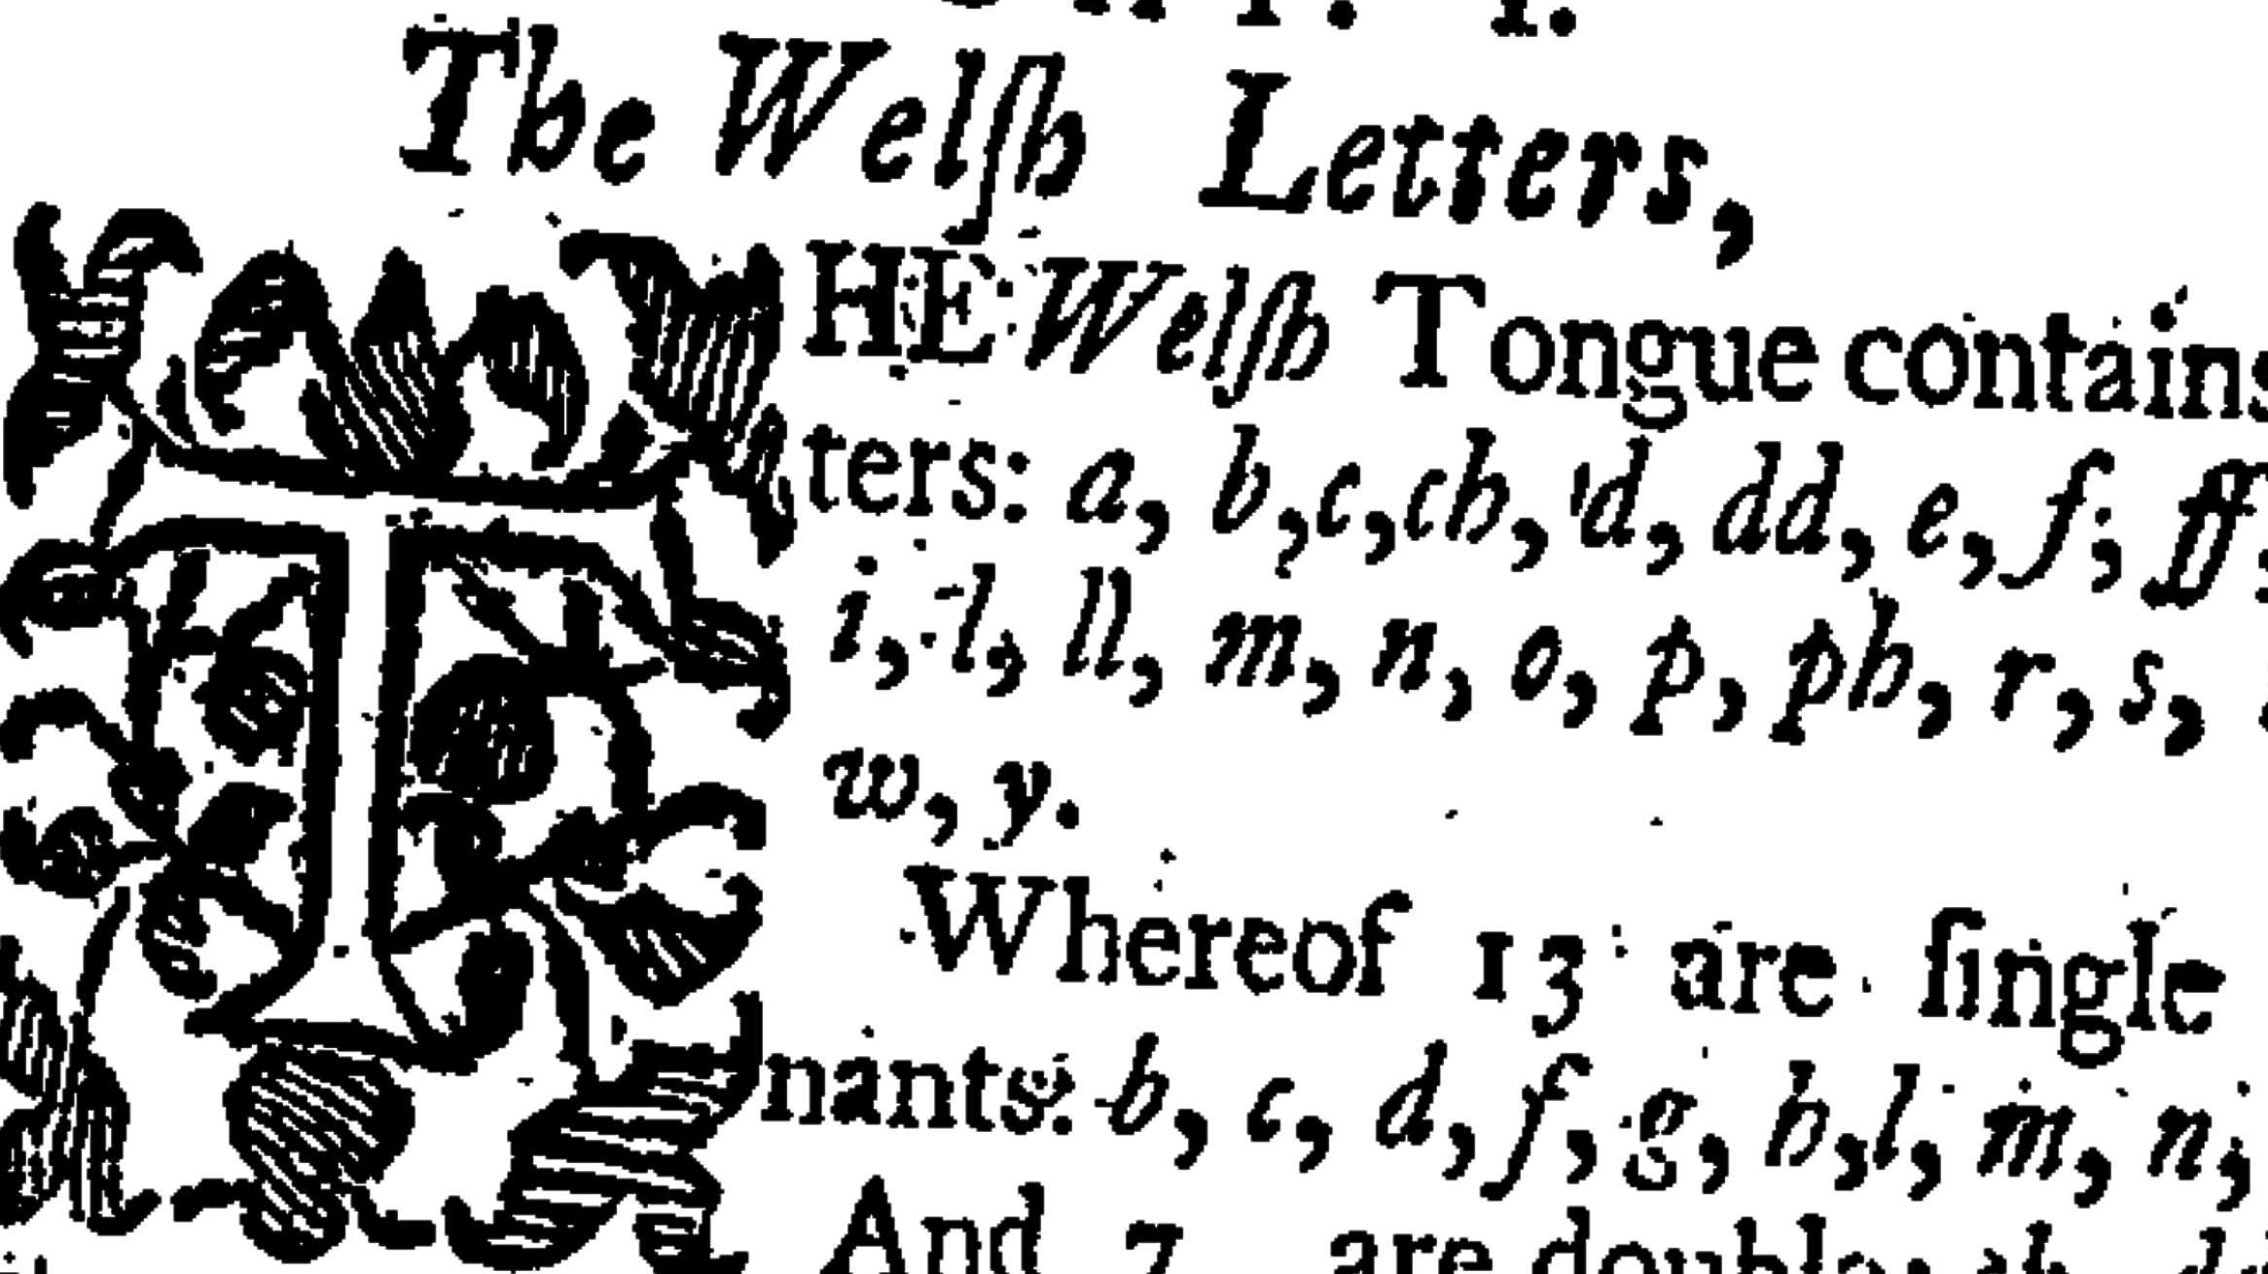
Early Modern Era 1700AD – 1800 AD

Slide 2
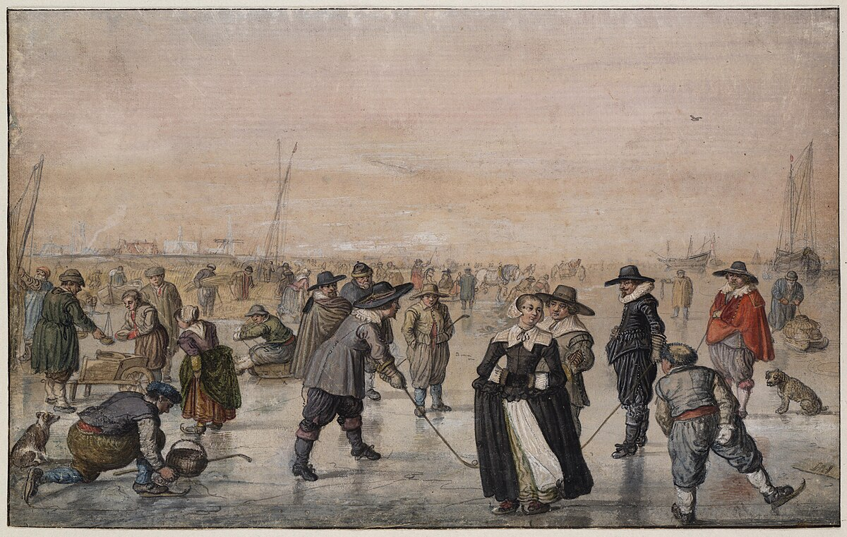
1700
By the seventeenth century Welsh was the language of the people. The overwhelming majority continued to be monoglot Welsh speakers.

Slide 3
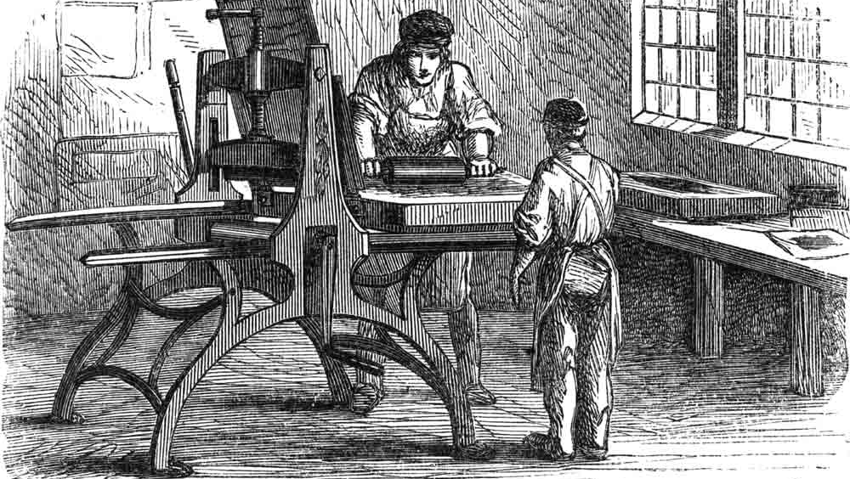
Welsh Language Press
The first book printed in Wales was published in New Castle Emlyn in 1718 - CAN O SEN I HEN MEISTR TOBACCO.
The printing press moved to Carmarthen, which became the center of the publishing industry in Wales. Before long other towns like Merthyr, Denbigh, Aberdare and Caernarfon began publishing Welsh books.

Slide 4
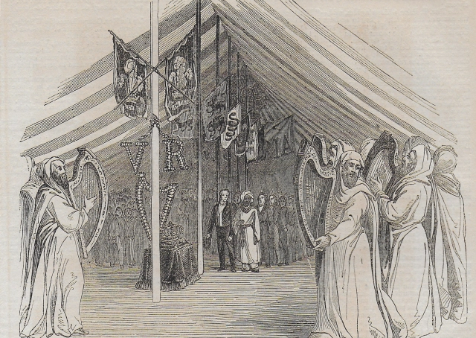
Eisteddfod
With the success of the printing press the eisteddfod saw a revival. The first one held in Cardigan in 1176 hosted by Lord Rhys followed in Carmarthen in 1451.
Advertisements for eisteddfodau appeared in the press creating a significant growth in their popularity.

Slide 5
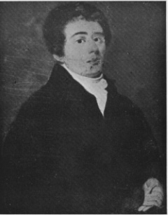
Griffiths Jones
Griffith Jones, Llanddowror had a profound impact on the language, as the founder of the Welsh Circular Schools. Within 25 years of 1731, 3,495 schools had opened and 250,000 people learned how to read in Welsh.
Literacy figures were higher in Wales during the period than anywhere else in Europe.

Slide 6
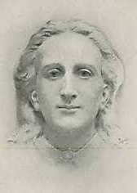
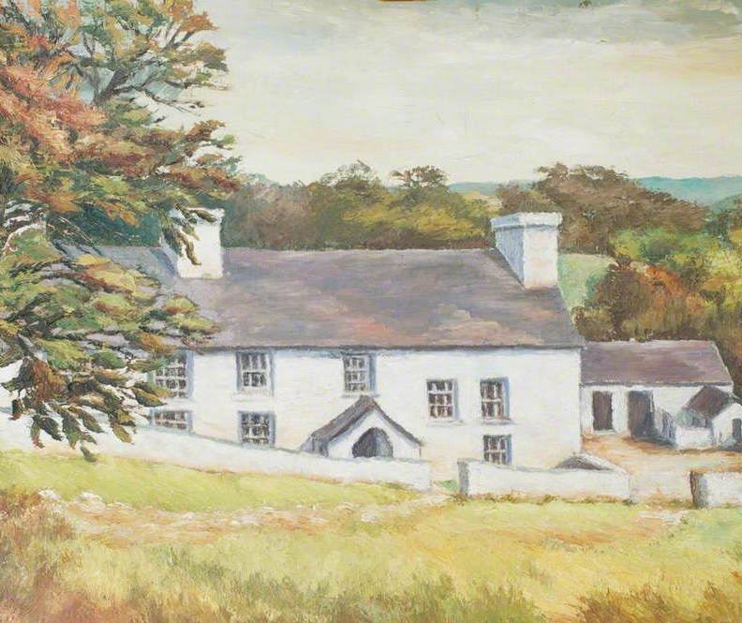
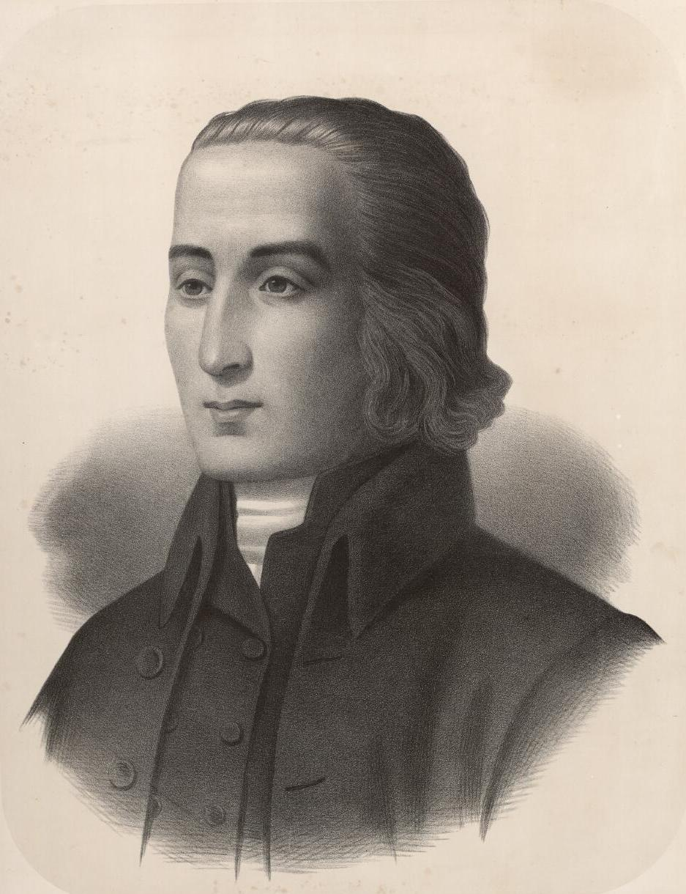
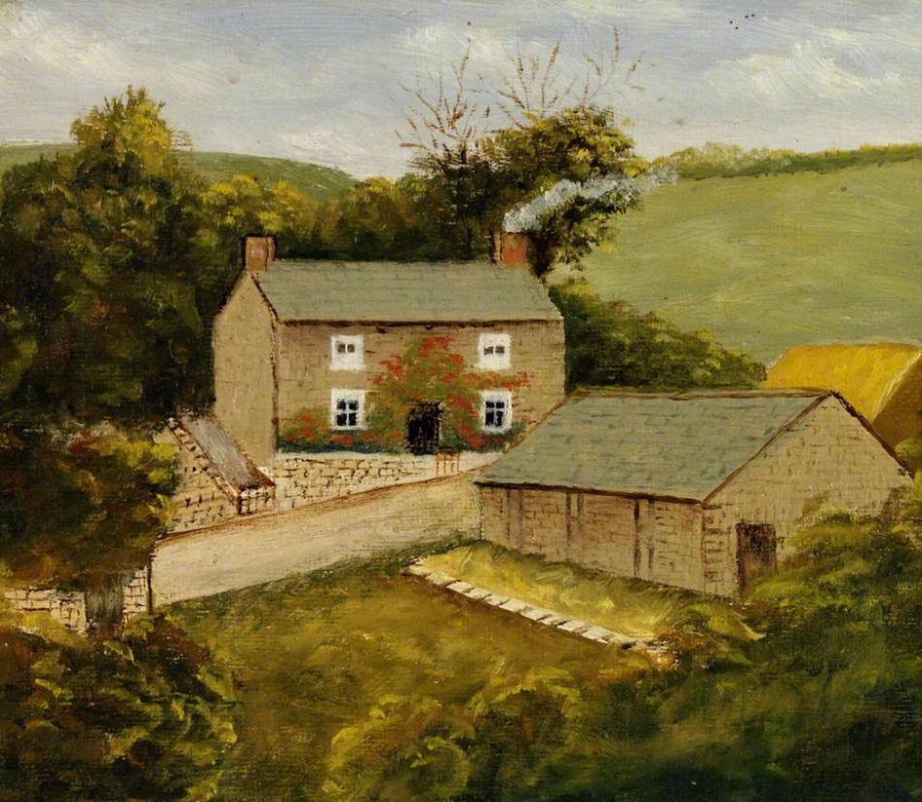
Methodist Reformation
The Methodist Reformation led by powerful and passionate preachers David Rowland and Howell Harries. The Reformation focused on winning Welsh-speaking souls.
Hymns played a central role in the revival, such as William Williams Pantycelyn ‘Guide me, O thou great Jehovah’ and Ann Griffiths, Dolwar Fach’s ‘Wele'n sefyll rhwng y myrtwydd’.

Slide 7
Victorian Era
1800 AD – 1900 AD

Slide 8
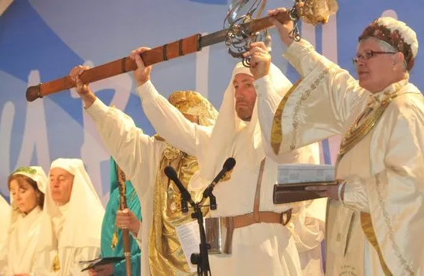
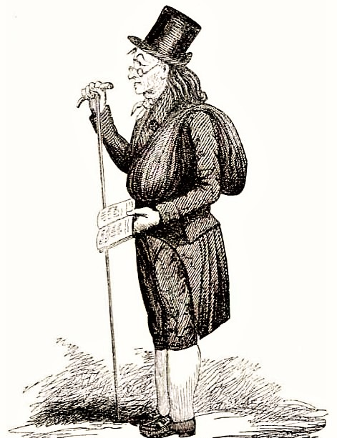
Iolo Morgannwg

Slide 9
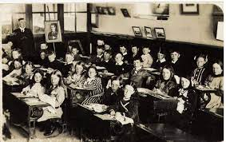

The Treachery of the Blue Books
Concerned with law and order in Wales following the Chartist uprising and the Rebecca riots the government commissioned an enquiry into the state of education in Wales.
In April 1847, the commissioners compiled a report of 1,252 pages, published in three volumes. The content caused a storm of protest and was referred to as the ‘Treachery of the Blue Books’. The report was very critical of the Welsh language

Slide 10
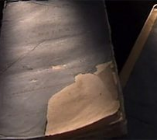
“The Welsh language is a vast drawback to Wales, and a manifold barrier to the moral progress and commercial prosperity of the people. It is not easy to over-estimate its evil effects."

Slide 11

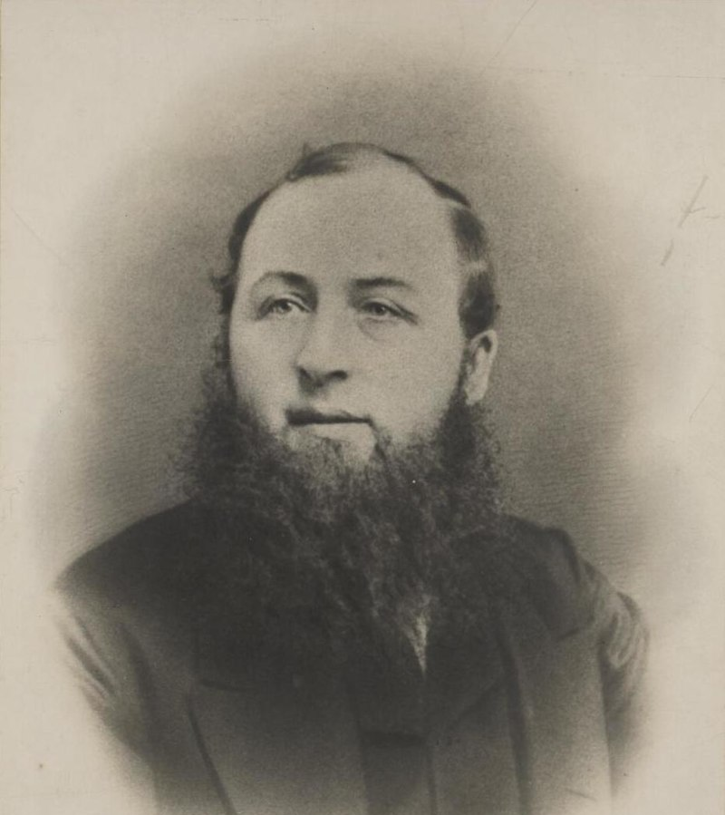
John Ceiriog Hughes

Slide 12

Patagonia – Michael D. Jones

Slide 13
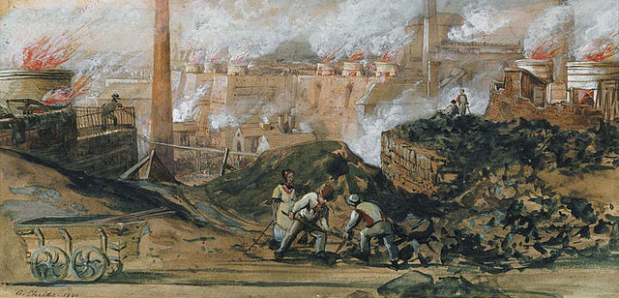
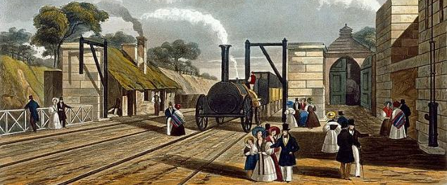
Change - Industrialisation

Slide 14
Twentieth Century

Slide 15
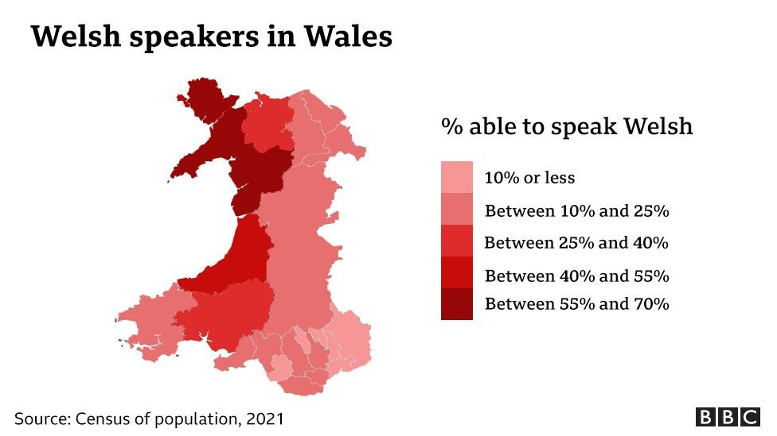

Slide 16


Slide 17
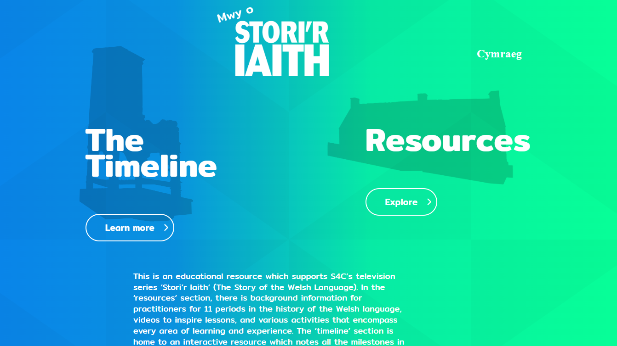
https://mwyostoririaith.cymru/en/

