Slide 1

Understanding the role of police constable
(BMPL4019a)

Slide 2

What are professional standards?
Can you think of any:-
Where you currently work?
Being here today as a student?

Slide 3
What does it mean to act "ethically"?
Ethical policing requires respect and empathy. We show respect and empathy by acting with respect. We show respect and empathy by listening to and understanding different perspectives. We show respect and empathy by understanding the impact of emotions and welfare (College of Policing, 2023).
Examples of unethical policing:-
Use of Excessive Force
Tampering With Evidence
Police Brutality
Coerced Confessions
Sexual Assault
Lying on Police Reports
False Imprisonment or Arrest
Witness Tampering and Intimidation
Being disrespectful
Not respecting the 9 protected characteristics as set out by the Equality Act 2010

Slide 4

Task- Equality Act 2010
What are the 9 protected chararcterists?
What does "protected characteristic" mean?

Slide 5
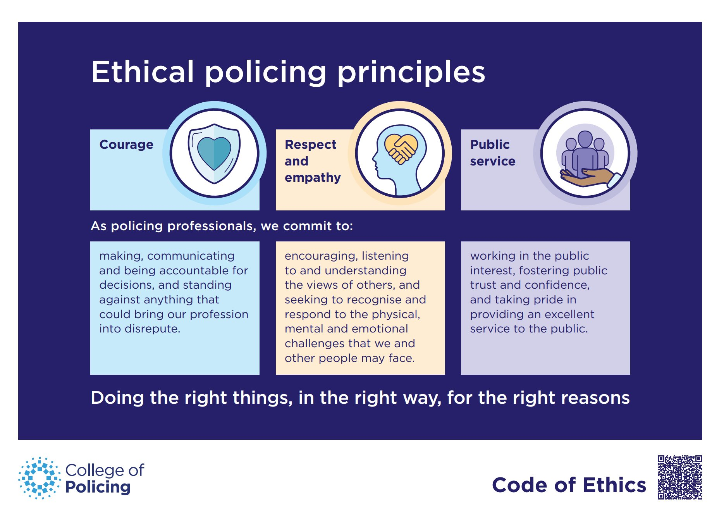
Code of Ethics
TASK-
Research into each of the 3 elements above and make a note of what they mean

Slide 7
Code of Practice for Ethical Policing
(statutory code)
Police Act 1996
What is the purpose of this Code?
Sets out the actions that chief officers should carry out to ensure that they lead an ethical culture, where staff are supported and directed to use the ethical policing principles in decision making and to demonstrate professional behaviour.
It also describes what needs to be done to proactively and positively identify and respond to misconduct and corruption when it occurs.
Ensures:-
Ethical and professional behaviours
Challenges unethical behaviours
Looks out for staff welfare
Openness and Candour
Recognising and responding to misconduct
Police service should be delivered in a fair, ethical and unbiased manner

Slide 8
Ten standards of Professional Behaviour and Policing principles (Police Federation, 2023)
Honesty and Integrity
Police officers are honest, act with integrity and do not compromise or abuse their position.
Authority, Respect and Courtesy
Police officers act with self-control and tolerance, treating members of the public and colleagues with respect and courtesy. Police officers do not abuse their powers or authority and respect the rights of all individuals.
Equality and Diversity
Police officers act with fairness and impartiality. They do not discriminate unlawfully or unfairly.
Use of Force
Police officers only use force to the extent that it is necessary, proportionate and reasonable in all the circumstances.

Slide 9
Ten standards of Professional Behaviour and Policing principles (Police Federation, 2023)
Orders and Instructions
Police officers only give and carry out lawful orders and instructions. Police officers abide by police regulations, force policies and lawful orders.
Duties and Responsibilities
Police officers are diligent in the exercise of their duties and responsibilities.
Confidentiality
Police officers treat information with respect and access or disclose it only in the proper course of police duties.
Fitness for Duty
Police officers when on duty or presenting themselves for duty are fit to carry out their responsibilities.

Slide 10
Ten standards of Professional Behaviour and Policing principles (Police Federation, 2023)
Discreditable Conduct
Police officers behave in a manner which does not discredit the police service or undermine public confidence in it, whether on or off duty. Police officers report any action taken against them for a criminal offence, any conditions imposed on them by a court or the receipt of any penalty notice.
Challenging and Reporting Improper Conduct
Police officers report, challenge or take action against the conduct of colleagues which has fallen below the Standards of Professional Behaviour.

Slide 11
Does this apply to a police officers personal life?
Police Regulations 2003- Reg 6 (1)- "The restrictions on a private life...shall apply to all members of a police force"
A police officer must not pursue a course of conduct which members of the public may perceive as favourtism, and especially not be active in politics. In addition, a police officer "shall not wilfully refuse or neglect to discharge any lawful debt"

Slide 12
Maintaining professional standards
Regulation 20 of the Police Regulations 2003 states that every member of a police force:-
"shall carry out all lawful orders and shall at all times punctually and promptly perform all appointed duties and attend to all matters within the scope of [their] office as a constable."
Why is this important?

Slide 13
Professional Standards procedures
The College of Policing APP (authorised professional practice) identifies four aspects of the professional standards operations in policing. These relate to:
dealing with and countering corruption;
vetting;
complaints and misconduct
police standards governance.

Slide 14
Professional Standards procedures
Each force has it's own Professional Standards Department responsible for dealing with routine complaints and misconduct charges internally.
More serious cases of police wrong doing might be dealt with by the National Crime Agency (NCA) or the Independent Office for Police Conduct (IOPC)
Other bodies play an important role in maintaining and enhancing standards across policing, such as the His Majesty’s Inspectorate of Constabulary and Fire & Rescue Services (HMICFRS).

Slide 15

What about when standards slide?
Police Reform Act 2020- strict procedure for the recording of complaints which is regulated by the IOPC (Independent Office for Police Conduct)
Home Office- made significant changes:-
One of 2 categories:-
Conduct matters- Where behaviours fall short of the standards of professional behaviour
Complaints- Allegations made by members of the public concerning he behaviour of a police officer

Slide 16
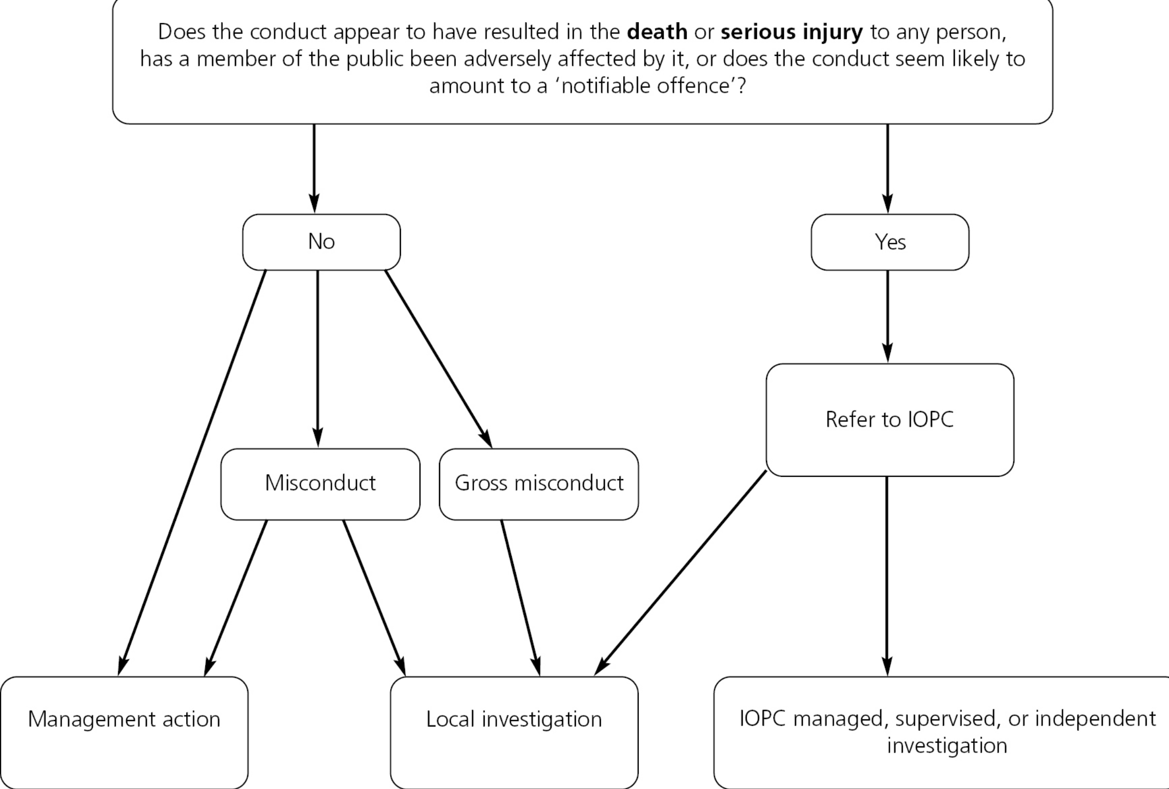
Conduct matters

Slide 17
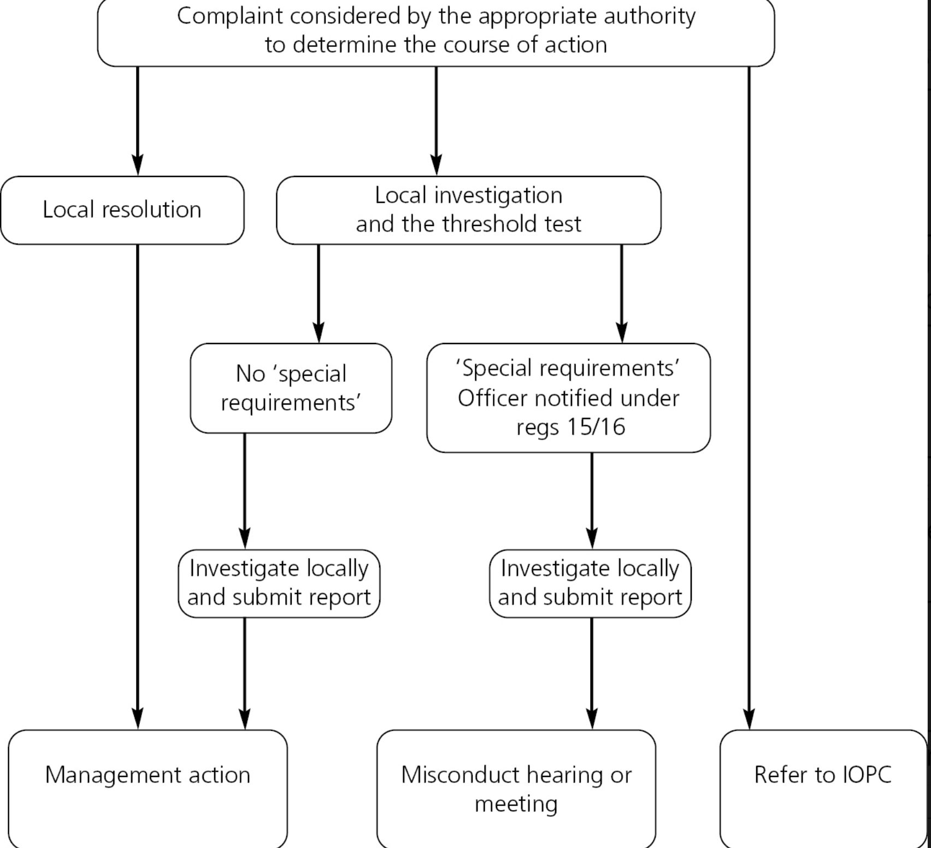
Complaints

Slide 18
Ten standards of Professional Behaviour and Policing principles (Police Federation, 2023)
Honesty and Integrity
Police officers are honest, act with integrity and do not compromise or abuse their position.
Authority, Respect and Courtesy
Police officers act with self-control and tolerance, treating members of the public and colleagues with respect and courtesy. Police officers do not abuse their powers or authority and respect the rights of all individuals.
Equality and Diversity
Police officers act with fairness and impartiality. They do not discriminate unlawfully or unfairly.
Use of Force
Police officers only use force to the extent that it is necessary, proportionate and reasonable in all the circumstances.

Slide 19
Ten standards of Professional Behaviour and Policing principles (Police Federation, 2023)
Orders and Instructions
Police officers only give and carry out lawful orders and instructions. Police officers abide by police regulations, force policies and lawful orders.
Duties and Responsibilities
Police officers are diligent in the exercise of their duties and responsibilities.
Confidentiality
Police officers treat information with respect and access or disclose it only in the proper course of police duties.
Fitness for Duty
Police officers when on duty or presenting themselves for duty are fit to carry out their responsibilities.

Slide 20
Ten standards of Professional Behaviour and Policing principles (Police Federation, 2023)
Discreditable Conduct
Police officers behave in a manner which does not discredit the police service or undermine public confidence in it, whether on or off duty. Police officers report any action taken against them for a criminal offence, any conditions imposed on them by a court or the receipt of any penalty notice.
Challenging and Reporting Improper Conduct
Police officers report, challenge or take action against the conduct of colleagues which has fallen below the Standards of Professional Behaviour.

Slide 21
Obligations
The Code of Ethics, the HRA, the GDPR, and CoP information all set out obligations to manage police information in ways that are both effective and meet certain ethical and professional standards.
Many of these obligations are made manifest through standing orders and policies such as the local policing ‘Information Management Strategy’. However, the same principles also apply for all levels of police staff, regardless of rank or role.

Slide 22
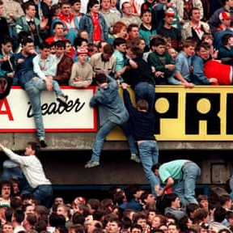
Hillsborough Disaster- public apology
https://youtu.be/Gy66D-VqgtU

Slide 23
Police complaints
TASK-
Research into the IOPC...
Who are they?
What is there role?
What is the procedure for logging a complaint?
How many complains were logged in 2022/23?
How many complaints did SWP, Gwent and DPP receive during 2022/23?
Which police force received the highest number of complaints during 2022/23?

Slide 24
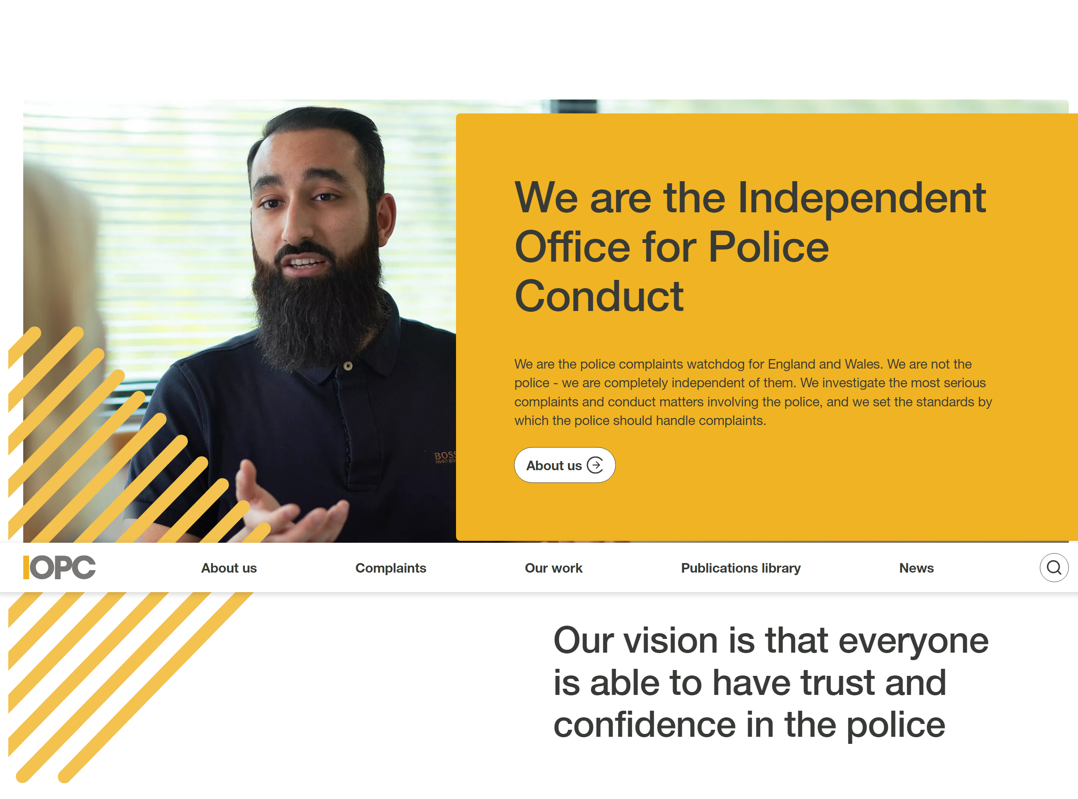
IOPC
Independent Office for Police Conduct
Want to know how the complaints process works? (youtube.com)

Slide 25

Number of complaints logged with IOPC 2022/23
Total- 81,144
SWP-2,509
GWENT-514
DPP- 1057
MET- 11,779- Most complaints

Slide 26
IOPC assessment review upon receiving a complaint
Local- Less serious matters and IOPC will not be involved. Forces Professional Standards Department would carry out an inquiry.
Investigation involving IOPC;-
Direct- complaints or allegations of misconduct that are of considerable significance and probable public concern.
Independent- incidents that cause the greatest public concern, have the greatest impact on communities and implications on the reputation of the police.

Slide 27
Outcomes from misconduct hearing
If misconduct found at a disciplinary meeting, one of the following may apply:-
Written warning
Final written warning
Reduction in rank
Dismissal without notice

Slide 28
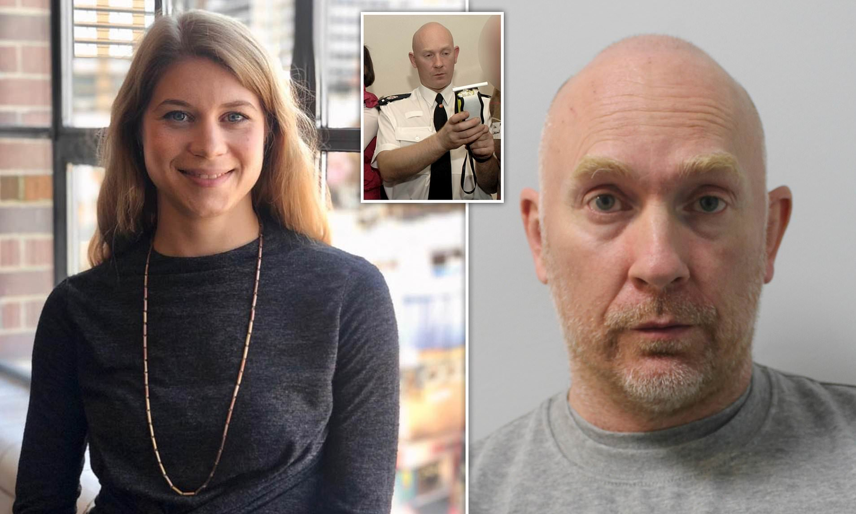
Wayne Couzens- what sanctions did he face?
Predatory behaviour and watching porn on duty: UK’s rotten policing revealed (youtube.com)

Slide 29
Police barred list and how it works
Barred and advisory lists were introduced as a way of improving police integrity.
Increase accountability of those who were dismissed.
Shows staff that have been dismissed following investigation under the Police (conduct) Regulations 2020 or Police Performance Regulations 2020

Slide 30
How does the barring list work?
(College of Policing, 2023)
Where an individual has been dismissed, the force sends a report to the College of Policing. This contains information set out in Regulations.
The College then updates the barred list with those details. The same process is used for the advisory list.
The College makes decisions on whether it is appropriate to publish the information on the barred list, taking into account:
national security
other ongoing investigations
any significant harm that may be caused to the individual or others.
In the vast majority of cases, the information is published.

Slide 31
Barred for 5 or 3 years
Individuals who have been on the barred list for a period of five years – or three years where their dismissal was related to gross incompetence – are able to apply for a review of their barred status. The College considers their application with reference to the:
individual's demonstration of their suitability to re-join policing
circumstances of their original dismissal
effect that removing them from the list may have on public confidence in the police

Slide 32
What impact do cases like Wayne Couzens have on the public’s perception of the police?
Heightened attention of police failings and a trend towards distrust has spurred stronger negativity Opinions about the IOPC are directly influenced by this broader context.
61% of the public feel negatively towards the Government, 42% feel negatively about the Metropolitan Police, and negativity towards the police reaches its highest level since January 2020 (27%).
News stories about police failings, misconduct and criminality coupled with the damning Casey Review have triggered confidence in the police to deal fairly with complaints to fall to its lowest point since testing began (32%) in 2017.(IOPC,2023)

Slide 33
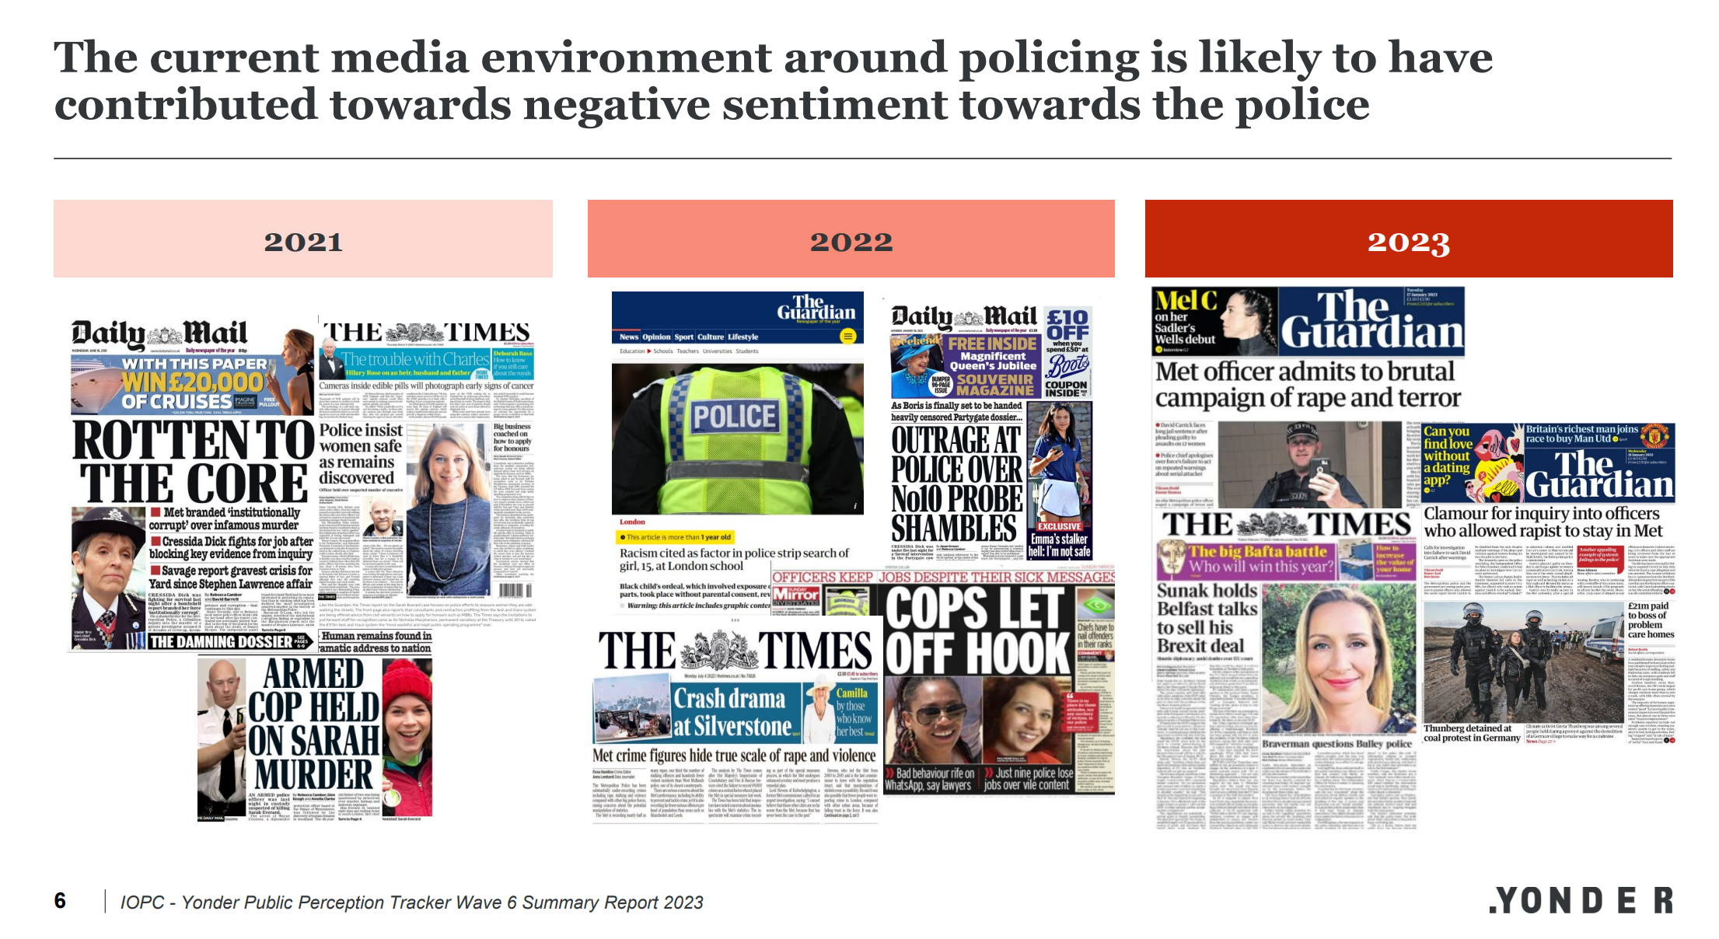

Slide 34

Nicola Bulley case- information sharing
Police critisised for releasing personal information regarding Nicola:-
Alcohol consumption
Menopause.

Slide 35
Case Exercise 1
You are on duty with your tutor constable who takes you to their favourite tea stops.
Usually, you call in one each day for a cuppa and a catch up but as this is the week before Christmas it seems that each one is expecting a visit.
To your surprise on each visit the occupant provides your tutor with a little wrapped present which he tucks away into his laptop bag as the gifter wishes him a Merry Christmas and thanks him for looking after the community.
What are your thoughts?

Slide 36
Case Exercise 2
You are on duty and attend the execution of a drugs warrant.
Whilst on the premises you see the sergeant open a safe and remove £40 from inside tucking it into their back pocket. They see you see them take the money and state “scum, they wont miss anything, keep it quiet or I will ruin your probation”.
Consider this situation, whether any offences are being committed and what would you do?

Slide 37
Case Exercise 3
You are on your traffic familiarisation week and out on patrol with a very young, keen traffic officer. He has been showing you the radar gun and targeting speeders. One of the speeders he stops is a very attractive female who flirts with your colleague, offering their telephone number. Your colleague, ever the professional books the female for speeding but accepts their telephone number and later arranges to take them out on a date.
What are your thoughts?

Slide 38
Case Exercise 4
You are a new to role student officer and your children attend the local primary school, one of their friends has stated when they attended your house on the weekend that they really enjoy visiting as you do not shout at each other the same way that mammy and daddy do and that they would rather live with you. This statement troubles you as you are worried that there may be domestic violence at the child’s house. As a police officer you realise that you should probably do something about this but are a little reserved as the child’s father is an Inspector who works in HQ.
What might you do with this information?

Slide 39
Case Exercise 5
You are on your initial student officer course at police headquarters and a what if conversation has taken place with one of the trainers. You colleague asked whether or not someone that had failed to disclose a previous conviction on their application form would be kicked out of the police service. The trainer stated that this disclosure would be required at time of vetting and failing to disclose could be deemed to be dishonest and the staff member being asked to leave. The student who raised this concern seems to be quite troubled and has difficulty getting to sleep that night, you check on them and they tell you that they have failed to disclose but if they are found out, they will not only lose their job but their home and possibly their family too.
Discuss what you would do?

Slide 40
Case Exercise 6
Your tutor is at it again!
It is Saturday and they have forgotten to buy their lottery ticket, so they nip in to the local shop and buy a line in the lottery.
It is only £2 and most of the money goes to good causes.
Discuss whether or not this is acceptable?

