Slide 1

Llanelli's industrial revolution
By Ciprian Borcea

Slide 2
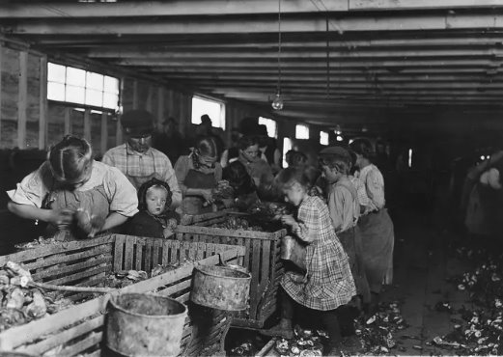
The industrial revolution – introduction of the life in the 19th century
The late 18th and early 19th centuries saw the start of the industrial revolution, which turned rural European and American societies into industrialised ones. It is regarded as one of the most important historical periods, characterised by innovation and prosperity that supported global urbanisation. New machinery began to produce products that had previously been made by hand; however, the industrial revolution had profound consequences that went beyond advancements in science and business. It was a historic turning point that deeply impacted many aspects of daily life, including labour, where women and children were frequently forced to work in hazardous and poor conditions. Cities grew because of the growth of factories because people travelled there in search of employment. This resulted in dirty water, poorly constructed housing, and poor sanitation, all of which posed health risks to the population. The industrial revolution also brought about the division of labour, which resulted in horrific living conditions for the working class and lower class, while the upper class profited from it by creating the foundation for capitalists. (History.com, 2023)
History.com (2023).

Slide 3
The role of steam power In Britain
The beginning of an incredible period of industrialisation that transformed industries like manufacturing, textiles and transportation was led by the invention of the steam engine, created by James Watt. The steam engines made it possible for the textile industry to run industry equipment like the power loom, which drastically increased the output while fostering economic expansions. In addition, the manufacturing sector also benefited from the invention of steam engines; it made it possible for machines to operate different processes at a higher rate. This resulted in the emergence of massive factories that were not constrained by location, which in turn promoted urbanisation and changed the availability of labour.(Rennie, 2019)
Engineers like George Stephenson (1781–1848), known as the "Father of Railways," transformed the transportation sector by introducing steamships and locomotives. Due to his inventions, which included the renowned locomotive "Rocket," trade and travel times were greatly reduced. Owing to their reliance on steam engines, coal mining activities increased dramatically to fulfil the growing need for fuel. As a result, areas with abundant coal reserves, such as South Wales, became industrial powerhouses. (Science and Industry Museum, n.d.)​

Slide 4
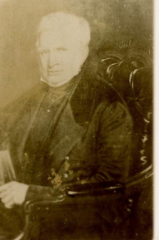
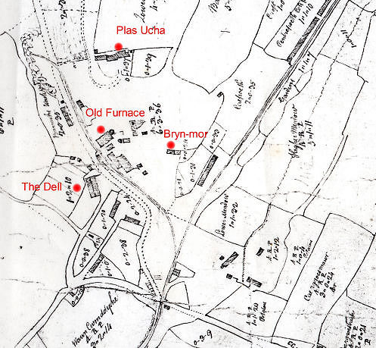
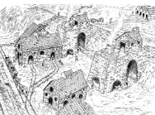
Key people – industrialisation of Llanelli ( case study)
Llanelli Community Heritage. (n.d.). Alexander Raby: Ironmaster & Coalmaster. Retrieved from https://www.llanellich.org.uk/files/395-alexander-raby-ironmaster-coalmaster (Author: Lyn John; Published: 28 July 2018; Last Updated: 24 January 2022)
Llanelli Community Heritage. (n.d.). Alexander Raby: Ironmaster & Coalmaster. Retrieved from https://www.llanellich.org.uk/files/395-alexander-raby-ironmaster-coalmaster (Author: Lyn John; Published: 28 July 2018; Last Updated: 24 January 2022)
When Alexander Raby, an Englishman, crossed Falcon Bridge in 1796, Llanelli's industrial revolution began. The incident turned the tiny fishing village into the largest coal and steel hub in South Wales. Raby contributed to the industrial development of the town as a businessman, ironmaster, and coal baron. Before assuming control of their iron in 1796, Raby initially provided funding to iron founders John Gevers and Thomas Ingman. He built his home in Cwmddyche, which came to be known as Furnace village, and a second furnace in Stradey in 1800 in order to grow his business. As Raby supplied weapons to the war effort, its influence grew during the French wars. By building a dock and installing high-pressure steam engines, he embraced new technology. Because of Raby's actions, Llanelli's population increased, and he constructed more than a hundred houses to meet the city's housing needs. However, disagreements, accounting errors, and economic crises were the main reasons for Raby's downfall. His industrial empire failed by 1825, bringing an end to an era. The village of Furnace and the remnants of Raby's blast furnace now stand as monuments to this important person in Llanelli's industrial past.
Llanelli Community Heritage. (n.d.). Alexander Raby: Ironmaster & Coalmaster. Retrieved from https://www.llanellich.org.uk/files/395-alexander-raby-ironmaster-coalmaster (Author: Lyn John; Published: 28 July 2018; Last Updated: 24 January 2022)

Slide 5
Geographical and industrial overview of Llanelli
Llaneli is situated in Carmarthenshire, South Wales. Llanelli boasts a strategic position near the Loughor Estuary, on the southwest of Wales. This location contributed significantly to its industrial development. Llanelli's industrial success was largely attributed to its proximity to large deposits of iron ore and coalfields. Llanelli's industrial operations relied heavily on the South Wales Coalfield, which is among the biggest in Britain, to supply the coal required for energy and production processes. The development of its tinplate and steel industries depended heavily on its plentiful access to coal and iron ore, which enabled Llanelli to effectively utilise these resources and maintain its industrial momentum. Llanelli's geographical advantages were bolstered by its strong transport infrastructure. The town's coastal location was not only important for maritime trade, but it also facilitated the development of ports necessary for exporting goods, particularly tinplate, to global markets. Furthermore, the introduction of the railway in the nineteenth century altered Llanelli's industrial landscape by providing faster, more reliable connections to other industrial centres and markets. These transport networks helped to distribute raw materials to Llanelli's factories and ship finished goods, cementing the city's reputation as an industrial powerhouse. The convergence of Llanelli's strategic location, resource availability, and transportation links accelerated its transformation into an industrial hub during the Industrial Revolution. Llanelli's industries developed specially tinplate manufacturing, which earned the town the nickname 'Tinopolis' due to its dominance in the sector. This nickname represented Llanelli's significant contribution to the industrial landscape, not just in Wales, but throughout the British Empire. The town's ability to capitalise on its geographical advantages demonstrated the significance of location in industrial development. The geographical characteristics that had positioned Llanelli as an ideal site for industrialisation aided not only its economic development but also shaped its social landscape. ("The Rise of Llanelli Through the Industrial Period," 2019 )

Slide 6
How did coal form in South Wales?
Coal formation is an important part of South Wales' geological history. Coal is an essential resource that plays a significant role in society, as a fossil fuel that has been a vital source for revolutions and industrialisations. Coal forms through the decomposition of organic material. In context of South Wales, the primary phase of coal formation in this region occurred during the Carboniferous period, around 360 million years ago. This era was distinguished by vast swampy ecosystems that supported abundant vegetation. Over millions of years, these lush plant deposits accumulated, paving the way for the formation of the rich coal reserves found in South Wales today.

Slide 7
Key dates and figures
Llanelli's industrial development began in the late 18th century.
Alexander Raby arrives in Llanelli in 1796, becoming a pivotal figure in the industrial landscape.
Stradey's second boiler is built in 1800, marking the start of industrial expansion.
1802: Parliament passes legislation authorising the construction of a railway connecting Llanelli to Mynydd Mawr.
Early nineteenth century: Llanelli's population explodes as a result of industrial growth.

Slide 8
Conclusion
In perspective, Llanelli's journey through the Industrial Revolution exemplifies the intersection of vision, resources, and industry. Alexander Raby's arrival in the late 18th century marked a watershed moment in the town's history, propelling it into a vibrant industrial landscape. The key dates and events, ranging from the construction of furnaces and railways to the use of steam power, form a narrative of progress and transformation. The key players in this industrial transformation were Alexander Raby, John Gevers, and Thomas Ingman, whose entrepreneurial spirit and strategic investments fueled the flames of innovation. The region's abundant coal had a wide-ranging impact, driving iron production, powering steam engines, and shaping infrastructure. Specific industries and developments, such as the Stradey furnace, the Carmarthenshire Railroad Company, and the growing population, highlight Llanelli's vibrancy at this time. The legacy of Raby's empire, despite financial difficulties and eventual decline, laid the groundwork for Llanelli's development into a major industrial town. Even though the coal-fired furnaces have gone, the remnants of Llanelli's industrial heritage still bear witness to the Industrial Revolution. Today, the town serves as a historical canvas, painted by the fervour of ironmasters and the constant hum of steam engines—a testament to a past era that continues to shape Llanelli's identity and resilience.

Slide 9
Reference list
1 . History.com (2023). Industrial Revolution. Retrieved February 22, 2024, from https://www.history.com/topics/industrial-revolution/industrial-revolution#impact-of-steam-power
2 . Rennie, D. (2019, February 14). James Watt And The Steam Engine. All That’s Interesting, edited by J. Kuroski. Retrieved February 22, 2024, from https://allthatsinteresting.com/james-watt-steam-engine
3. Lloyd, S. (2019). GENUKI: A History of Carmarthenshire, Carmarthenshire. Retrieved from https://www.genuki.org.uk/big/wal/CMN/Llanelli/Lloyd
4. Llanelli Community Heritage. (n.d.). Alexander Raby: Ironmaster & Coalmaster. Retrieved from https://www.llanellich.org.uk/files/395-alexander-raby-ironmaster-coalmaster
5. GENUKI. (n.d.). Llanelli - Lewis 1833. Retrieved from https://www.genuki.org.uk/big/wal/CMN/Llanelli/Lloyd
6. Jackson, A. A. (British Geological Survey). (n.d.). Bedrock Geology UK South: Carboniferous. Earthwise. Retrieved from https://earthwise.bgs.ac.uk/index.php/Bedrock_Geology_UK_South:_Carboniferous
7. The Guardian. (2015). James Watt: Genius Exaggerated... https://www.theguardian.com/theobserver/2015/may/31/james-watt-genius-exaggerated (Accessed: 22 February 2024)

