Slide 1
Myth and mythology: How Stories Shape the World
Professor Ruth Parkes

Slide 2
Graeco-Roman textual sources
Written sources are of two types:
  Ancient texts that use myths: literary and documentary texts, epic, drama, philosophy, travel writing…
  Ancient texts that collect and explain myths: “textbooks” and compilations of myths
…and remember, only a fraction of the ancient material survives to us today

Slide 3
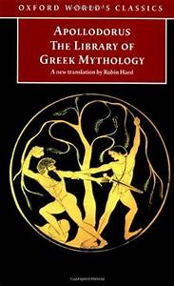
Ancient compilations of myth
Like we do, the ancients also sought to systematise mythological material
This gives us some of the best overview sources:
  Apollodorus Library of Greek Mythology (Greek: 1/2nd C CE)
  Hyginus Stories (Latin: 1st C CE)
Both compile and compress earlier sources

Slide 4
Aethra bore to Aegeus a son Theseus, and when he was grown up, he pushed away the rock and took up the sandals and the sword, and hastened on foot to Athens. And he cleared the road, which had been beset by evildoers. (Apollodorus Library 3.16)
And as special awards Agamemnon got Cassandra, Neoptolemus got Andromache, and Ulysses got Hecuba. But some say that Helenus got her, and crossed over with her to the Chersonese; and that there she turned into a bitch, and he buried her at the place now called the Bitch's Tomb (Apollodorus Library Epitome 5.23)
Be careful: quick reading of ancient compilations can give the impression that there is a “true” version of each myth
But these compilations, too, give only a snapshot view, one version to be put alongside many others

Slide 5
Ancient texts using myth
Far more sources either tell mythological stories in their own right
Key examples are:
  Homer’s Iliad and Odyssey (c 800 BCE?)
  Hesiod’s Theogony (Greek, 8th/7th century BCE?)
  Ovid’s Metamorphoses (Latin, 1st century CE)
  Plutarch Lives (Greek, ½ century CE)
…or include them in passing, in philosophical discussion, in descriptions of travel or historical events, etc:
  Pausanias Descriptions of Greece (Greek, 2nd century CE)

Slide 6
So how do you find the texts?
Online: there are several reliable sites hosting translations of Greek and Latin sources
  Perseus at Tufts: Greek and Roman material
  The Internet Classics Archive
Online via UWTSD: Loeb Classical Library
The site theoi.com combines text and encyclopaedia articles – but use with caution!

Slide 7
But what if I don’t know the text?
Brill’s New Pauly can help if you are looking for a mythological character (e.g. Herakles, Theseus, Medea)
This is an academic encyclopaedia of the ancient world – it covers far more than mythology

Slide 8
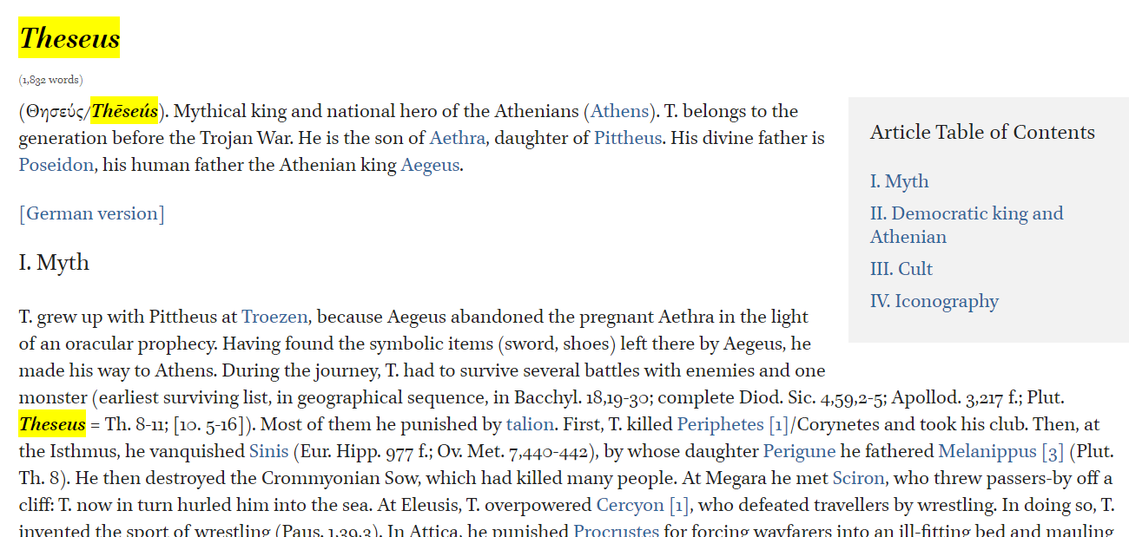
The in-text references to ancient texts in the article allows you to follow up…
…and the end-of-article bibliography gives information on key scholarly works on Theseus

Slide 9
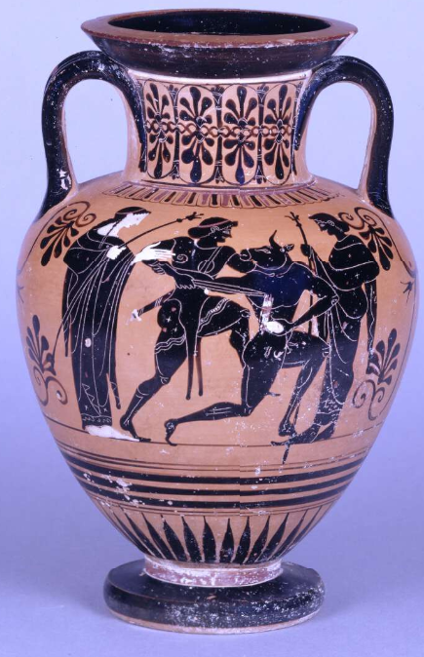
Beyond text: iconography
The New Pauly articles also have a section on depictions of myth in art (iconography)
Like ancient texts using mythology (rather than just describing it), depictions of mythological characters and events in art are some of our most important sources
…not to mention a key way in which Greeks and Romans engaged with myths
Left: Amphora with vase painting showing Theseus killing the Minotaur. Athena and Zeus stand by. BM1843,1103.21

Slide 10
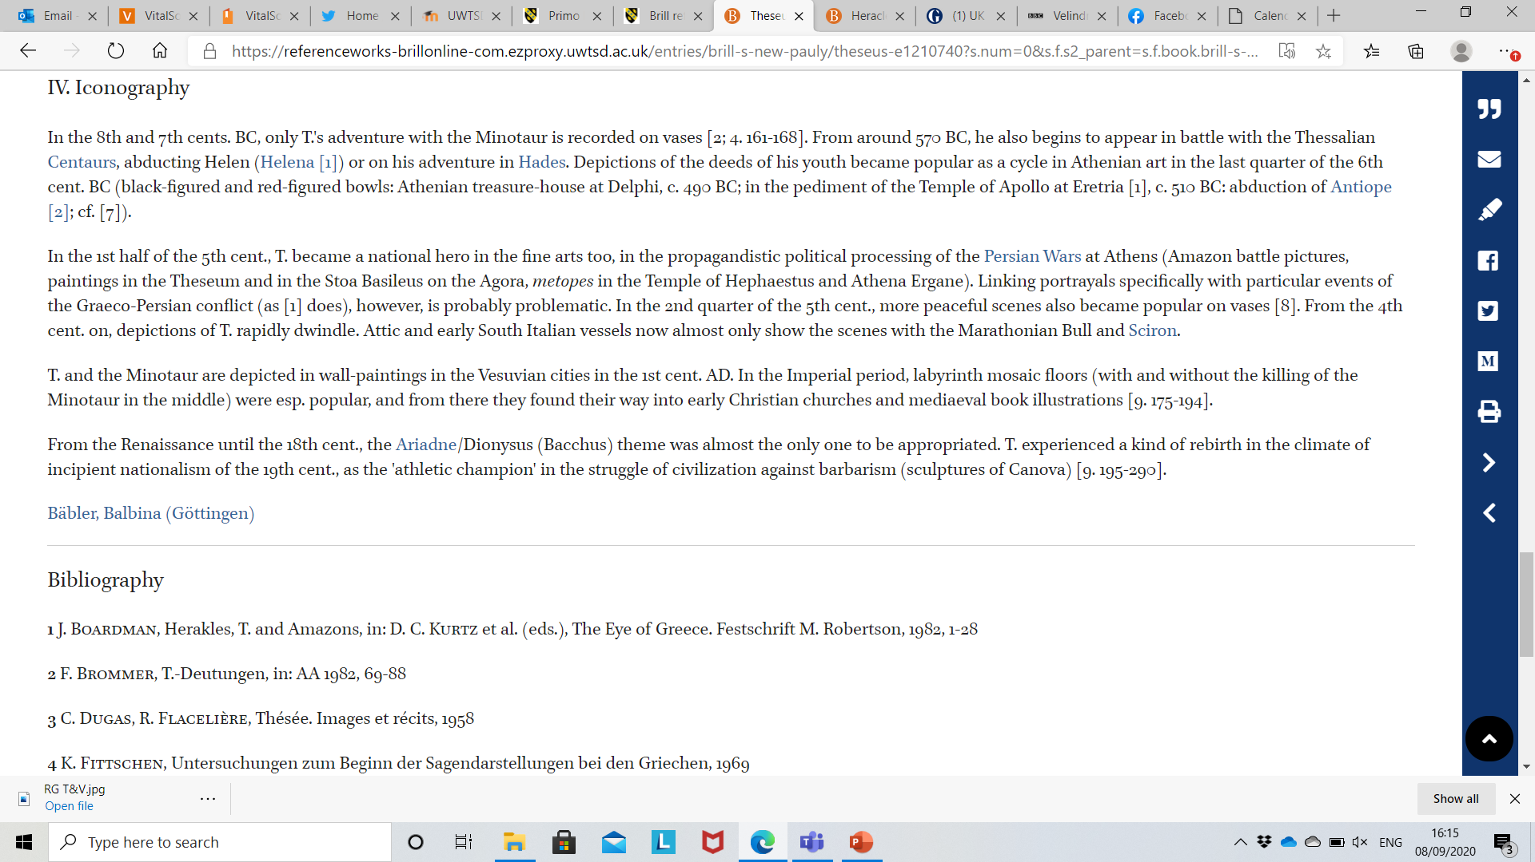
Bäbler, B. ‘Theseus IV Iconography’. Brill’s New Pauly. Ed. Hubert Cancik et al. Brill Reference Online.

Slide 11
The Beazley Archive
Housed with the Oxford Classical Art Research Centre (CARC), the Beazley Archive offers an online version of the largest reference work on vase painting (Corpus Vasorum Antiquorum)
Using their pottery database, you can search for data and images of mythological motifs in vase painting
NB the hard copy Lexicon Iconographicum Mythologiae Classicae (Iconographic Lexicon of Classical Mythology) is housed in the Tony Brothers library, currently in storage: it captures sculpture and other art too.

Slide 12
Summary
Key primary sources for studying ancient mythology are:
  Texts: ancient compilations + ancient use
  Iconography: vase painting + sculpture
Key ways of accessing these (and secondary sources) are:
  The Perseus site
  The Loeb Classical Library
  The New Pauly online
  The Beazley Archive

