Slide 1
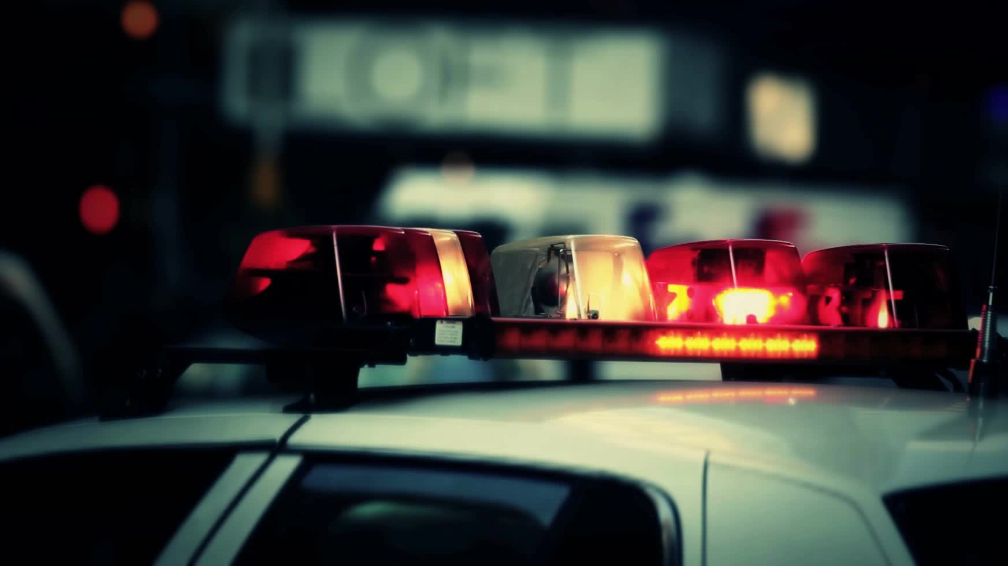
Roads Policing
Week 4 Part 2

Slide 2
Aims and Objectives
Identify the offence of ‘driving without due care and attention’ and ‘without reasonable consideration’ contrary to Section 3 Road Traffic Act 1988.
2. State the definition of the terms ‘driving’, ‘mechanically propelled vehicle’, ‘road’, and ‘public place’ in relation to the Road Traffic Act 1988.
3. Describe the terms ‘without due care and attention’, ‘without reasonable consideration’ including any defences.
4. Describe the offence of ‘wanton and furious driving’ contrary to Section 35 Offences Against the Person Act 1861. 5. Recognise the offence of ‘Causing death by careless driving whilst under the influence of drink/drugs contrary to Section 3A Road Traffic Act 1988.

Slide 3
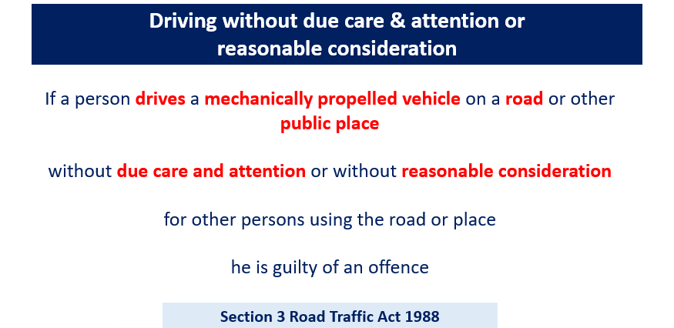
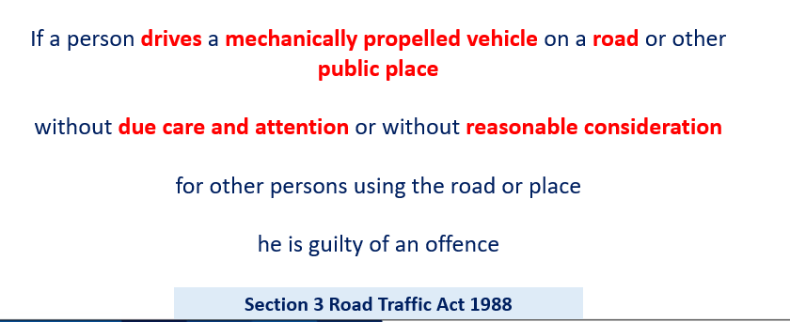
Driving without due care & attention or reasonable consideration.

Slide 4
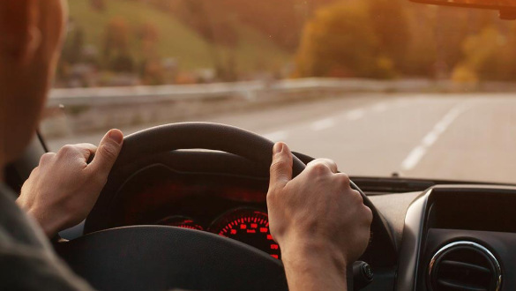
Recap – what is the definition of drives?
Drives – not defined under the RTA 1988 – generally accepted as ‘having control of the propulsion, steering and brakes’
Notes:
Mechanically Propelled Vehicle – any vehicle that is propelled mechanically Road – any highway or any other road to which the public has access and includes any bridges over which a road passes.
Public place – for the purposes of the Road Traffic Act 1988, the term ‘public place’ has been defined as ‘any place to which the public have open access is a public place, even if payment must be made to gain entry

Slide 5

What is driving without due care and attention?
Notes:
Discuss and students to provide examples.

Slide 6
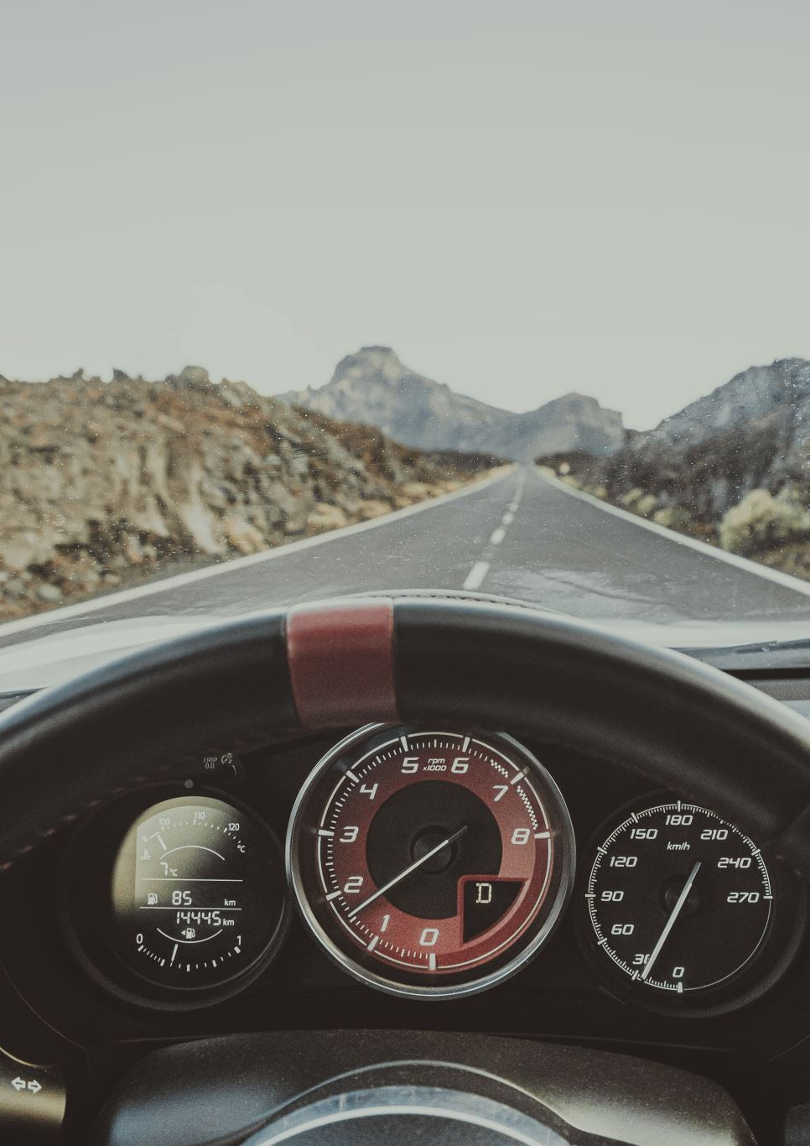
Without due care and attention.
A person is regarded as driving without due care and attention if (and only if) the way he/she drives falls below what would be expected of a competent and careful driver.
The standard of care and attention is an objective one and in no way related to the degree of proficiency or experience attained by the individual driver.
The standard is the same in the case of a driver who is a learner holding a provisional licence as it is in the case of the holder of a full driving licence.
Notes:
The application of this standard enables the offence to cover cases ranging from momentary lapses in concentration or minor errors of judgment to deliberately bad or dangerous driving which falls short of a Section 2 offence. The element that distinguishes dangerous driving from careless driving is that the dangerous driver falls far below the required standard while the careless driver merely falls below the required standard.

Slide 7
overtaking on the inside;
driving too close to another vehicle;
driving through a red light by mistake;
turning into the path of another vehicle;
the driver being avoidably distracted by tuning the radio, lighting a cigarette etc.
flashing lights to force other drivers to give way;
misusing lanes to gain advantage over other drivers;
unnecessarily staying in an overtaking lane;
unnecessarily slow driving or braking;
dazzling other drivers with un-dipped headlights
Notes:
CPS - 2025

Slide 8
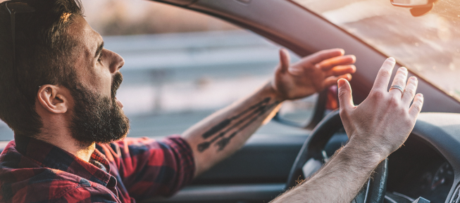
Without reasonable consideration
To drive “without reasonable consideration, it is necessary to cause some actual inconvenience to another road user.
Notes:
The full phrase referred to in this part of section 3 of the Road Traffic Act 1988 is 'without reasonable consideration for other persons using the road'. It is a subjective test that has to be decided by the court on the evidence before it. The other persons can include other drivers, passengers in the vehicle, or pedestrians and cyclists. It can include leaving a turn indicator on too long to give a misleading signal, or a bus driver taking a corner too fast so that passengers are thrown out of their seats and injured. On a procedural note it is good evidence to ask the driver if he knows what action the Highway Code recommends in the situation.

Slide 9
The full phrase referred to in this part of section 3 of the Road Traffic Act 1988 is 'without reasonable consideration for other persons using the road’.
It is a subjective test that must be decided by the court on the evidence before it.
Other persons can include other drivers, passengers in the vehicle, or pedestrians and cyclists.
It can include leaving a turn indicator on too long to give a misleading signal, or a bus driver taking a corner too fast so that passengers are thrown out of their seats and injured

Slide 10
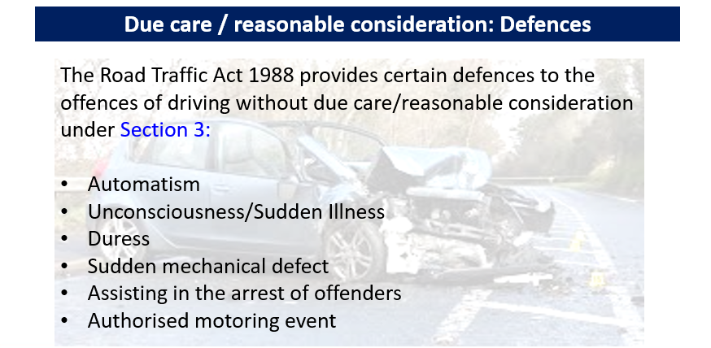
Notes:
Students to discuss what these are recapping previous lesson

Slide 11

Any Questions?

