Slide 1
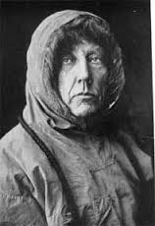
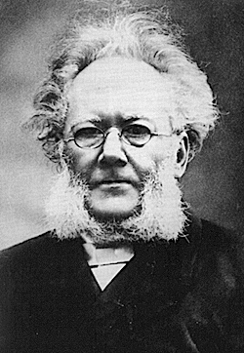
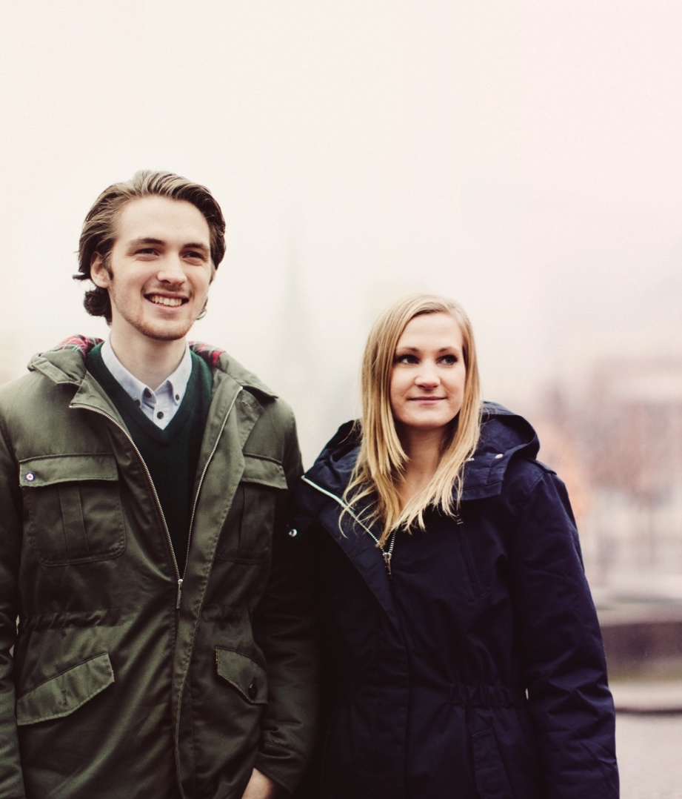
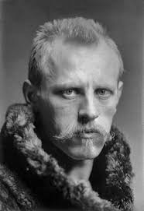
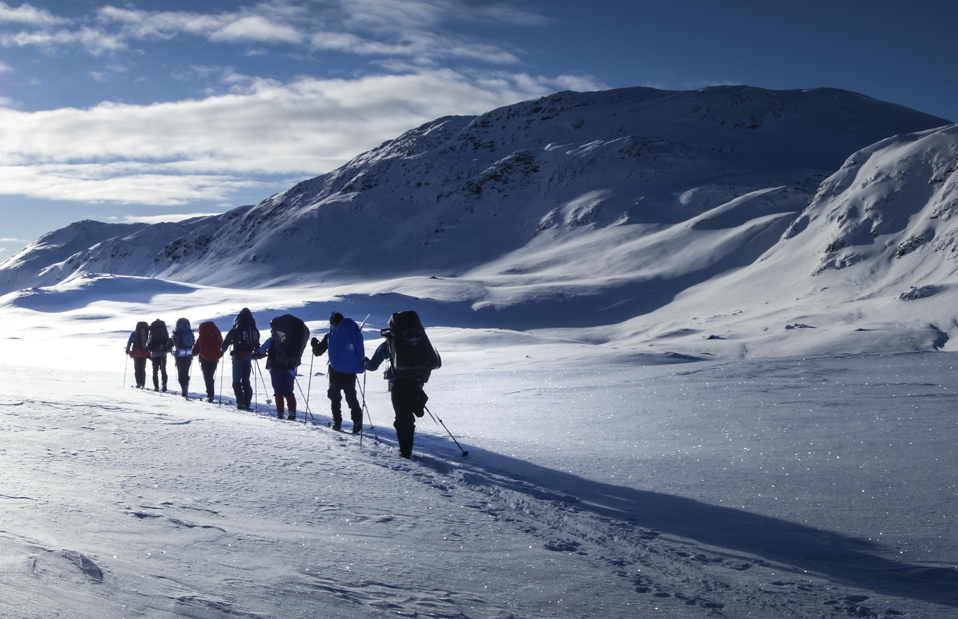
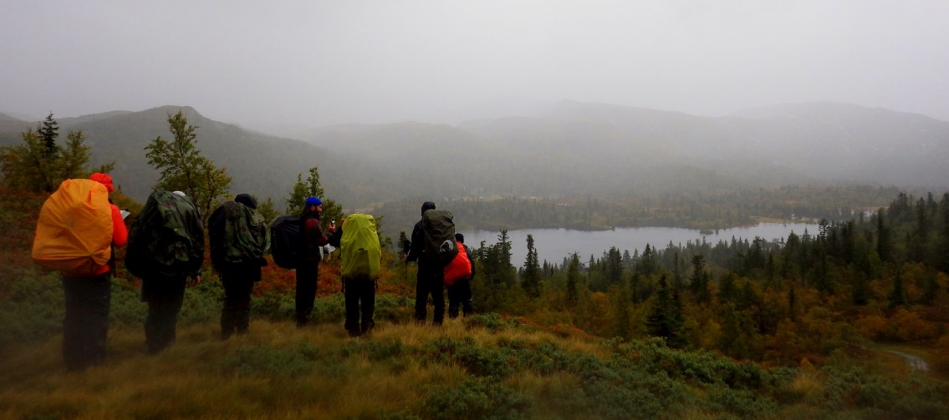
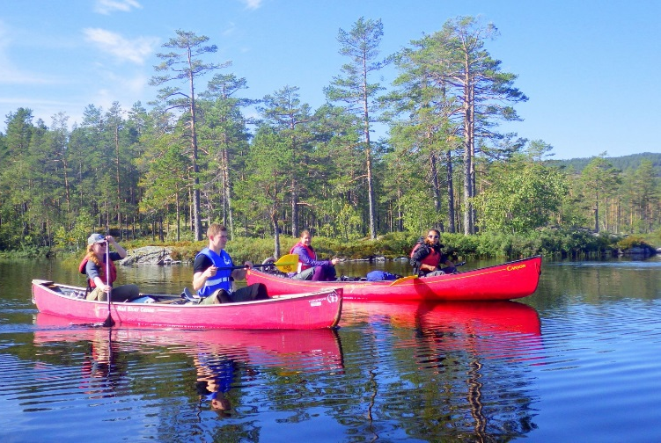
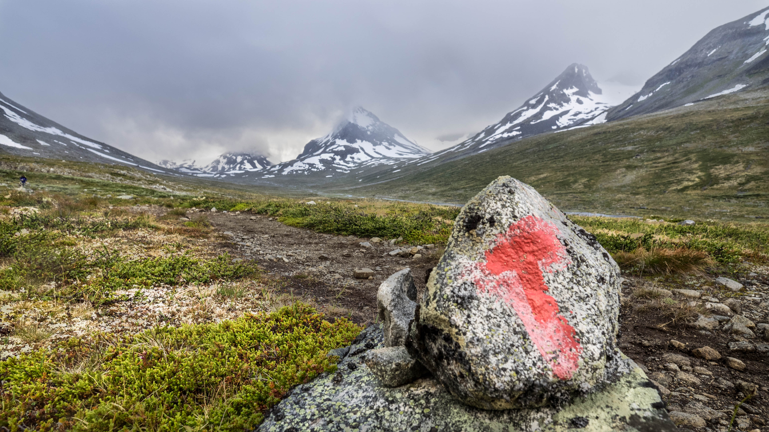
The Norwegian concept of “Friluftsliv“
Simon K. Jeppesen
Assistant Professor
Institute for Sports, Physical Education and Outdoor Life

Slide 2
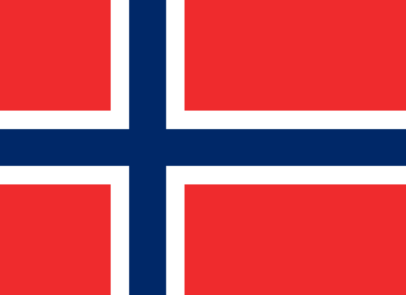
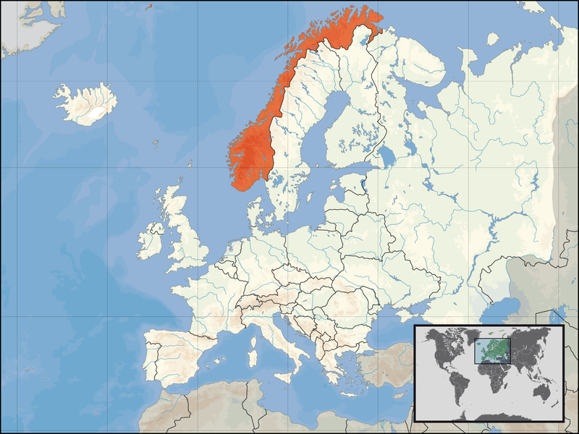
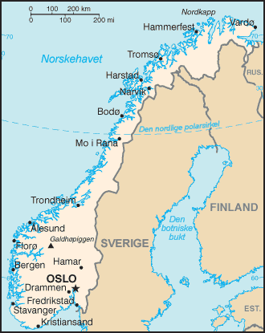
Norway – a country in the corner of Europe
Norway: 5,30 mill. people; 385.000 km²; 13,7 people/km²
Wales: 3,06 mill. People; 20.768 km²; 147,3 people/km²
                (Wikipedia)

Slide 3
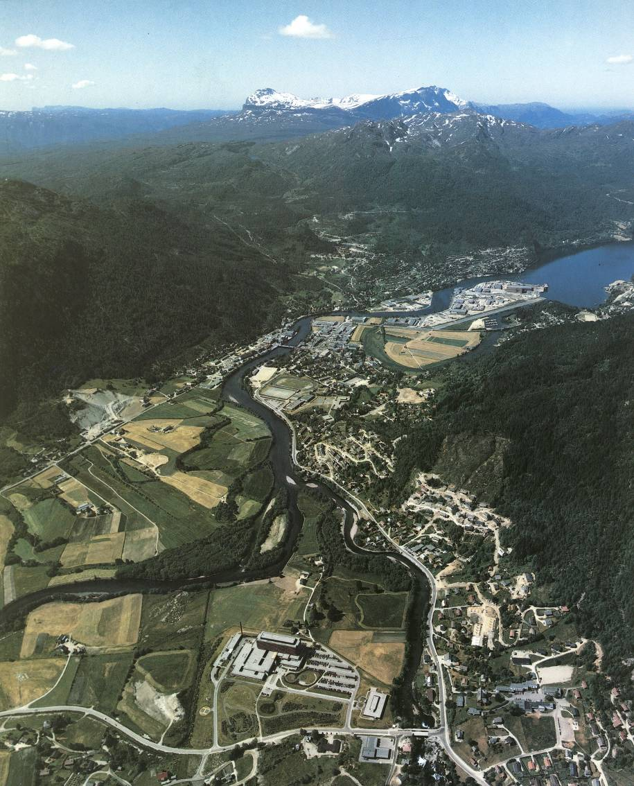
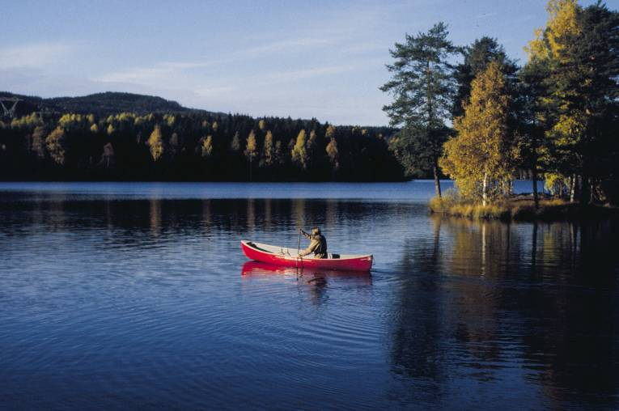
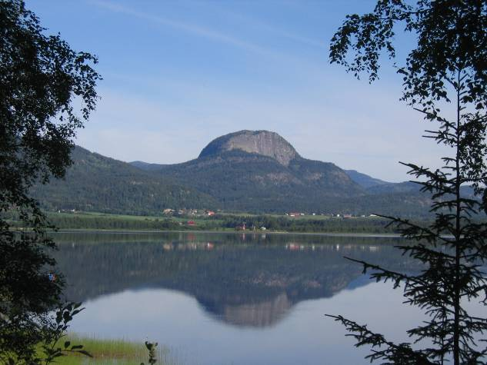
Living close to nature
90% of the country is considered uninhabitable
20 Min. out of down town Oslo

Slide 4
What is “friluftsliv“?
Henrik Ibsen (1828-1906)
  Important cultural figure: Poet, author, playwright, theatre director, cultural critic
  Henrik Ibsen used the word “friluftsliv“ in his poem “på viddene“ from 1859
  Translated as “on the heights“ by William Norman Guthrie in 1910
I den øde seterstue
al min rige fangst jeg sanker
der er krak og der er grue
friluftsliv for mine tanker
Here in this deserted dwelling I have housed my wealth of treasure; There’s a bench, a stove, sweet smelling Air, and time to think at leisure.

Slide 5
What is “friluftsliv“?
Friluftsliv – fri-lufts-liv
  Free/open-air-living; Free/open-air-life
  Freedom for your life/actions/thoughts
  A state of mind were nature is a important component to reach that state
  About finding freedom and clarity of mind through nature
  “a deeper view of life“ vs. “the fumbling lowland life“
  The poem struck a nerve with many urban middle class men
I den øde seterstue
al min rige fangst jeg sanker
der er krak og der er grue
friluftsliv for mine tanker
Here in this deserted dwelling I have housed my wealth of treasure; There’s a bench, a stove, sweet smelling Air, and time to think at leisure.

Slide 6
Building a nation
1380-1814 Norway under Danish rule
1814-1905 Norway and Sweden was in a union
  The swedish king was also king of Norway
17th of may 1905 Norway becomes a independent nation
The Norwegian cultural elite had since the beginning of the 18th century been actively trying to build a Norwegian cultural identity and define what it means to be a true Norwegian.

Slide 7
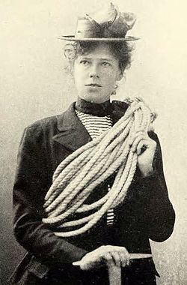
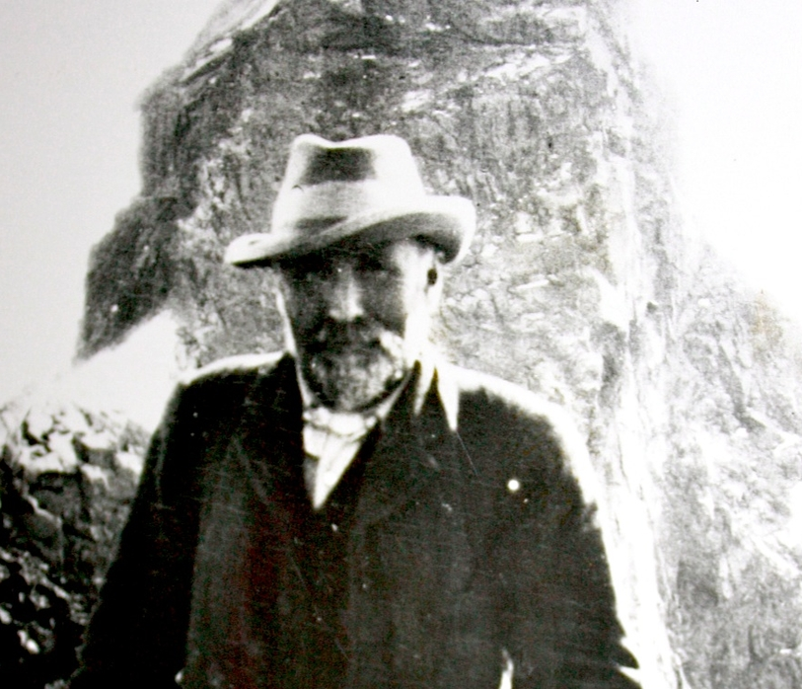
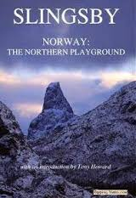

The Northern Playground
18th century and before: Mountains and glaciers were considered to be awful, ugly and dangerous by most Norwegians
Early industrial time (in the UK from about 1850)
British Leisure Class (economically independent)
William Cecil Slingsby (1849-1928)
”Either he is english or he is crazy”
Therese Bertheau (1861-1936)
”Three in Norway by the two of them” (Lees and Clutterbuck)

Slide 8
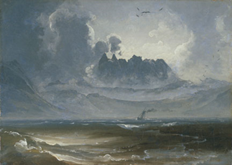
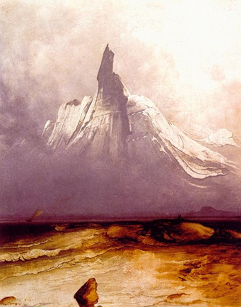
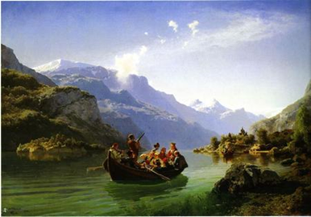
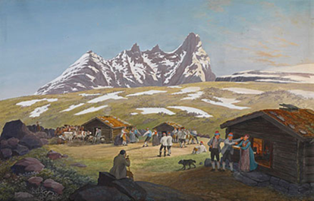
The Northern Playground
18th century and before: Mountains and glaciers were considered to be awful, ugly and dangerous by most Norwegians
Early industrial time (in the UK from about 1850)
British Leisure Class (economically independent)
William Cecil Slingsby (1849-1928)
”Either he is english or he is crazy”
Therese Bertheau (1861-1936)
”Three in Norway by the two of them” (Lees and Clutterbuck)
Inspired by the early english tourists and a growing nationalism the Norwegians slowly started to see the beauty of the Norwegian landscape
But Norway needed a catalyst – a charismatic person of the common people to bring these new nature values to the masses

Slide 9
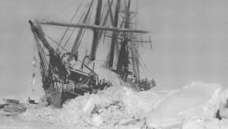
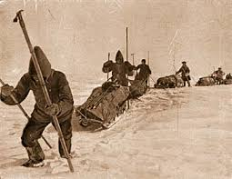
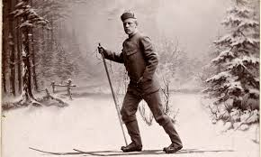
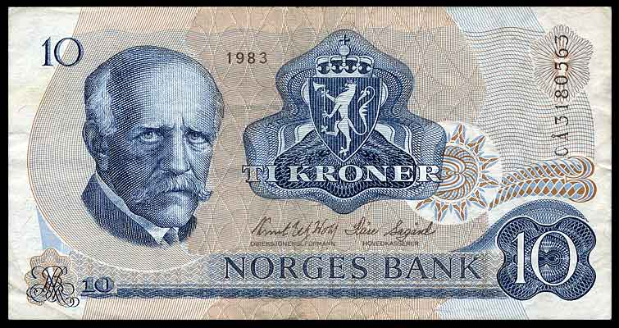
Fridtjof Nansen – a Norwegian icon
Fridtjof Nansen (1861-1930)
  Polar Explorer, scientist, author, diplomat, humanist
  1888 – Nansen and his team are the first to cross the Greenlandic Ice cap
  1893-1896 – Leading an expedition trying to reach the North Pole
  1922 Nobel Peace Prize (exchange of prisoners of war, starvation in the Soviet Union)
  Very charismatic and a strong spokesperson for friluftsliv
  Promoter of building character through the simple life in nature
  Talk to the youth 1921 (excerpt)

Slide 10
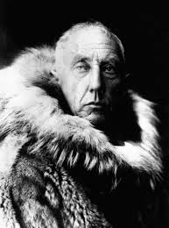
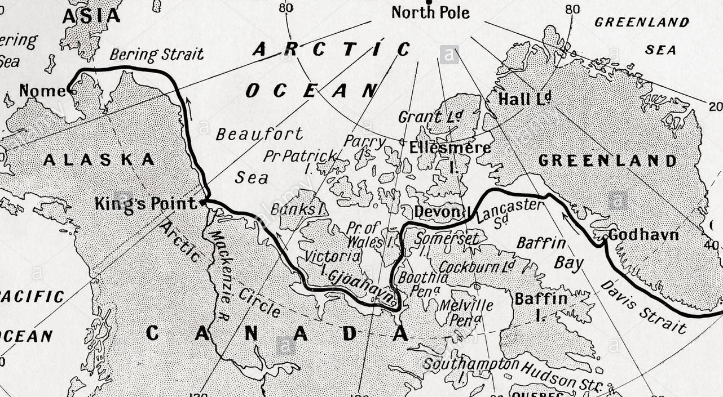
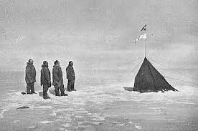
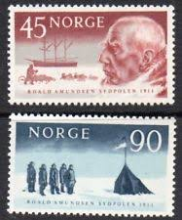
Amundsen – another Norwegian icon
Roald Amundsen (1872-1928)
  Polar explorer, author
  Inspired by Nansen
  1903-1906 The first to navigate through the North-western Passage
  14th dec. 1911 – reached the South Pole in a tight race with Robert Scott
  Became a national hero and a role model for young men in Norway
  Died in a plane crash in the Arctic Ocean in 1928 (still a mystery what happened)

Slide 11
Culturel identity
So what binds Norwegians together? / What and whom represents norwegianess?
  the great explorers; Nansen, Amundsen etc.
  the great sportsmen (skiers!)
  the unique nature and the people living there (the mountain farmers) - independent, free, strong, ascetic, creative
Friluftsliv – becomes a moral project
Thriving in nature and mastering a life in the outdoors is understood and celebrated as a statement of being Norwegian
“Norwegians are born with skis on their feet”
The idea of the simple life at the “hut” and the hut as a retreat is a strong Norwegian concept
  Inspired by hunting huts and mountain farms (seter)
Late 18th century and early 19th century – recreation in nature is still mostly for the upper classes

Slide 12
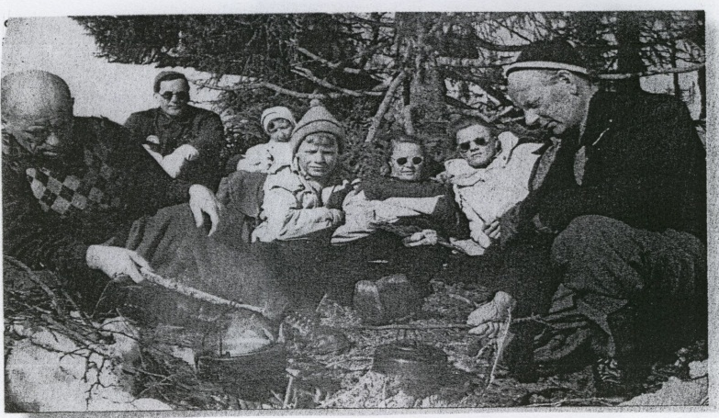
Democratization of friluftsliv (1920s-1960s)
The working class gained the right to the Sunday of work and one week of vacation.
The labor movement encouraged the working class to get out of the cities and adopt friluftsliv into their new leisure time.
Above the tree limit everybody is equal – even the king!
To the right - Einar Gerhardsen. Prime minister 1945-51; 1955-65. “arctitect of the Norwegian welfare state” and a strong spokesperson for friluftsliv.
The right to roam was written into law in 1957 with a strong involvement from the labor movement.

Slide 13
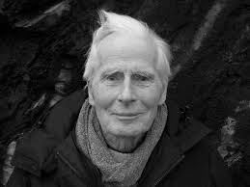
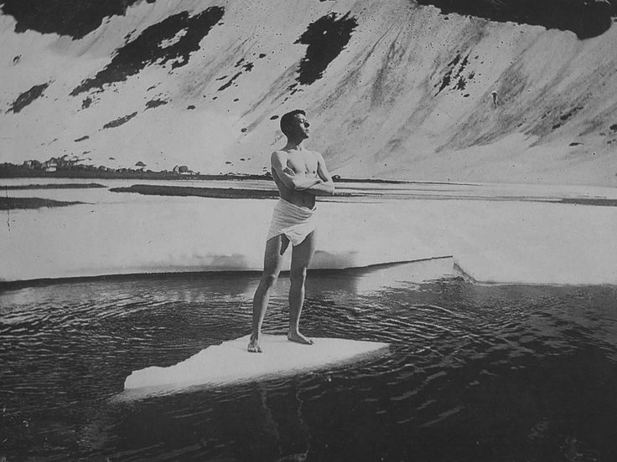
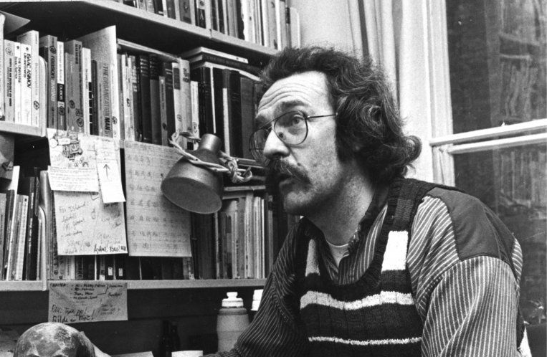
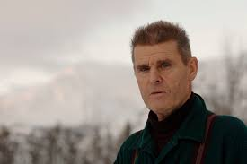
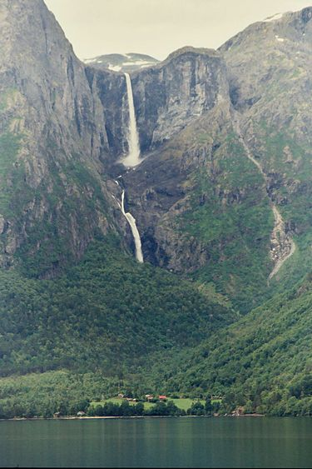
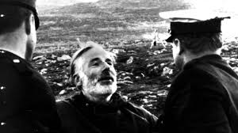
Friluftsliv as counter culture
Friluftsliv and environmentalism 1970’s
  Arne Næss, Peter Wessel Zapffe, Sigmund Setreng Kvaløy, Nils Faarlund
  Alternative to consumer society
  Arne Næss: Deep Ecology, ecophilosophy
  Friluftsliv:
    The rich life with simple means
    Rich in time poor in things
    A way home
    With nature/into nature vs. against nature
  Mardøla-aksjonen 1970

Slide 14
Friluftsliv understood as a cultural phenomenon
Friluftsliv is a cultural construct and helped the Norwegians to create a strong national identity
Culturel projects
  18th century: Building a nation and norwegianess
  1920s-1960s: Strengthen the labor movement, walfare state, strengthen democracy, the right to roam
  1970s - ??: Environmentalism
  Today and beyond?? (physical/mental health, status, (green) lifestyle, individualism, personal, counter culture)
The interpretation and the meaning of friluftsliv will differ between individuals, groups, classes and cultures (ex. rural/urban)

Slide 15

Friluftsliv in the Norwegian educational system
Background
Before 1967 – mainly socialization to friluftsliv within the family/community
1967 Ulykkkespåsken – 16 dead in a severe snow storm during easter – poorly prepared for rough weather
National dicussion about norwegians being poorly prepared for winter conditions
In academia
1967 Norges Høgfjellskole established (Norwegian high mountain academy)
1972 Friluftsliv as a academic study at Norges Idrettshøgskole (Norwegian University of Physical Education)
1982 Friluftsliv as a academic study in Bø
  - The largest friluftslivs study in Norway today with ca. 120 students (1st year, 2nd year & 3rd year students combined)
Today – more then 20 friluftsliv or friluftsliv-related studies in Norway
Outside academia
Ca. 100 boarding schools (Folkehøgskoler) in Norway. Most of them offer classes with a strong focus on friluftsliv
Many nature kindergardens
At all elementary school levels and in high school (written into the school law)

Slide 16
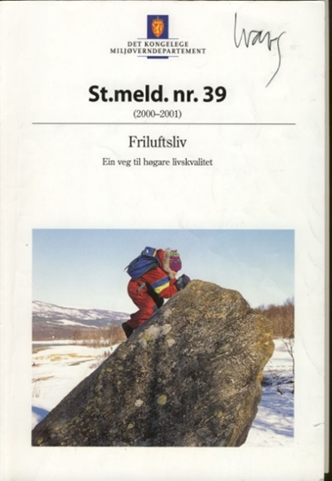
Friluftsliv – a path to a higher quality of life
Friluftsliv is staying and physical activity in open air in leisure time with the purpose of change of surroundings/environment and experiencing nature.
(Norwegian Ministry of Environment)
Key themes:
  Physical, use of the body
  Change/leisure
  Contemplation
  Nature experience
Alternative definitions of Friluftsliv
  Friluftsliv is meetings between human and nature, and meetings between people in nature…
  Friluftsliv is the simple life in nature…

Slide 17

Aims and Goals in todays friluftsliv policy
Right of access/Right to roam (law of 1957)
Ancient right to roam - Gulatingloven of 1200 (probably older but not written down)
To secure the access to land through legislation, by managing, by encouraging and stimulating (info, education..)
To promote the simple (common) friluftsliv that are in harmony with nature
Friluftsliv for everybody
No competition
Not motorized
Source: White paper on Friluftsliv, ME

Slide 18
Right of access (law of 1957)
In generel you can basically move anywhere in the open countryside without any permission from landowner:
  Walking, skiing, biking, riding, paddling/rowing, sailing, swimming
  Pick berries/mushrooms/wildflowers
  Resting and overnight camping for 48 hours (150 m from nearest inhabited cabin)
  You can make bonfire (ex. april 15th – sep 15th in woodland)
  Fishing without license in the sea (in freshwater you need a license)
  In winter you can cross agricultural land

Slide 19
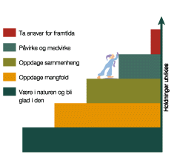
Friluftsliv in the elementary school system and developing citizenship
Development of abstractional thinking with regards to nature and quality of life.
You want to preserve what you love.
Ladder of nature appreciation:
  Be in nature and learn to thrive in nature
  Discover diversity in nature
  Se connections/patterns in nature
  Participate and influence in society
  Take responsibility for the future

Slide 20
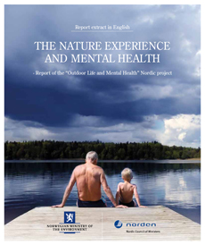
Participation and motivation
High participation
  94% of Norwegians are active in some kind of friluftsliv at least once a year
  80% of Norwegians go on walks close to home on average two times a week
  26% of Norwegians do some kind of friluftsliv at least three times a week
  6% of Norwegians do not participate in friluftsliv (Statistical bureau, poll 2014)
Motivation
  Contemplation, Spiritually, emotional
  Joy of nature/quietness
  Physical activity
  (Statistical bureau, poll 2014)

Slide 21
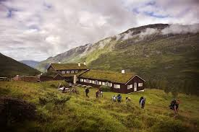
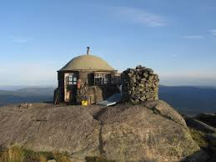
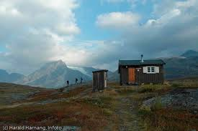
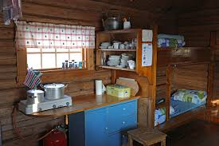
The Norwegian Trekking Association
Founded 1868
290.000 members
500 huts spread over the whole country
Maintains 20.000 km of hiking tracks
In winter 7.000 km of marked tracks (marked with sticks/branches)
Magazine – Fjell og Vidde
Staffed/unstaffed huts – honor principle
Pantry in some huts – honor principle
You can get your own key for the self-service/no-service huts
Membership 680 kr/year – about 60 pounds

Slide 22
Friluftsliv in Norwegian society - summary
Friluftsliv is:
  national History
  cultural heritage
  an important part of Norwegian identity
  developing and changing as the culture change
A strong belief in the positive effects on:
  Physical and mental health
  Cultural legacy
  Social competence, citizenship
  Environmental awareness, readiness to act sustainable

Slide 23
Any questions?

Slide 24
Interested in coming to Norway to study ”friluftsliv”?
Talk to former exchange students
How does it look like??? Facebook: ”friluftsliv, bø, usn”
Questions (good ones!): simon.jeppesen@usn.no
Outdoor Education fall semester:
https://www.usn.no/academics/find-courses/sports-physical-education-and-outdoor-life/outdoor-life-culture-and-ecophilosophy/
Outdoor Education at spring semester:
https://www.usn.no/academics/find-courses/sports-physical-education-and-outdoor-life/nordic-skiing-and-outdoor-life/
The Norwegian Trekking Accociation
https://english.dnt.no/
https://english.dnt.no/routes-and-cabins/

