Slide 1

How the academic, industry, and digital skills module has helped me prepare for university.
Lily May Lewis 2501492
Academic, Industry, and Digital Skills
BMPT….
Lisa Bassler
Notes:
Today, I am going to be doing a presentation on how the academic, industry, and digital skills module, or otherwise known as the AID module, has helped me prepare for university.

Slide 2
AI Acknowledgement Statement
I confirm that I have not used any AI tools in the research and creation of this assignment. I confirm that I have not presented any AI generated materials as my own work. I confirm I have copies of my drafts, notes, and other resources I used, which I may be asked to provide in evidence.

Slide 3
Introduction.
This presentation will discuss the academic, industry, and digital skills that I have learnt while completing this module.
The AID module has helped me develop my skills and gather a better understanding of how to be a success during my time at university
The skills that I have learnt during this module include interpersonal skills; time management; academic integrity; presenting; effective communication; active listening; managing stress; and many more.
Notes:
I have created this presentation to discuss three skills that I have developed during my time completing this module at university. The academic, industry, and digital skills that I have developed while completing the AID module have helped me through my first year of university, as well as preparing me for my next two years in education.
The academic, industry, and digital skills module has helped me gather a better understanding of what skills are needed to be successful at university, and how to continue improving and working on those skills.
The skills that I have learnt during this module include interpersonal skills, time management, academic integrity, and many more. However, I will be closely focusing on three skills during this presentation.
In this presentation I am going to be discussing 1 academic skill, 1 industry skill, and 1 digital skill that has helped prepare me for university.
I will begin by explaining my chosen skill and its importance. Then, I will reflect on my development and how I have developed the skill during the module. Next, I will analyse future academic development, and finally I will evaluate how transferrable the chosen skill is in a professional setting.

Slide 4
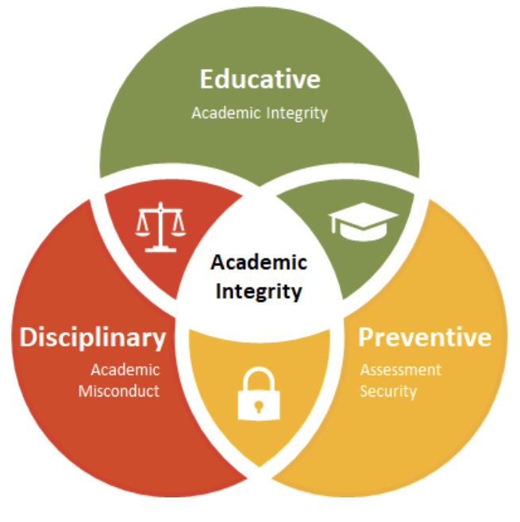
Academic Skill.
What is academic integrity?
The ability to remain honest (Britland, n.d).
Accountability.
Fairness.
Responsibility.
Correct use of AI (Eke, 2023).
Mackay (2021).
Notes:
The first skill I am going to be discussing is academic integrity.
When completing the first assignment for this module, I learnt more about academic integrity and its importance.
The University of Reading states that academic integrity is an absolute necessity when it comes to studying in university. This source defines academic integrity as the ability to remain honest, fair, and responsible for the work you complete (Britland, n.d).
Academic integrity is an important academic skill because it determines the success of your journey in university as well as in future jobs.
While discussing academic integrity, I feel that it is important to discuss the use of AI. As AI is becoming a more popular research tool in today’s society, it is crucial that students are educated on academic integrity and how to properly use AI.
An article created states that AI, ChatGPT in particular, is becoming a big threat to students’ academic integrity. The reason I am bringing up AI in this presentation is because in this module I have learnt how to use AI correctly and provide academic integrity in each assignment.
Referring back to in class learning, some of the consequences of academic misconduct include failing modules, suspensions, and this can result in damage to someone’s mental well being.
Learning about academic integrity has helped me prepare for university because it has given me a better understanding of how to keep my work fair, honest, and reliable.

Slide 5

Future academic benefit and transferability.
Academic integrity allows independence and creativity.
The tourism and events industry is all about expressing ideas and being creative (Bristol, n.d).
Academic integrity ensures trust in the work-place (L.boro.ac.uk, 2024) .
Zarch (2025).
Notes:
Learning about academic integrity has been a crucial part of my first year in university. In assignment 1 I mentioned how academic integrity is a transferrable skill and will benefit me in university, and I am now going to dive deeper into that.
During lesson 3 of the AID module, we learnt the many forms of academic misconduct. These include plagiarism, self-plagiarism, collusion, misuse of AI, and contract cheating.
This knowledge will academically benefit me in the future because it will ensure that I comply with university standards and all my work is academically correct.
Academic integrity is a transferrable skill to the tourism and events sector because it ensures trust and honesty in the workplace (L.boro.ac.uk, 2024).
The tourism and events industry is an industry known to be very fun and uplifting. Therefore, it is important for the industry to hire staff that can be trusted and responsible for holding events/taking part in tourism.
The University of Bristol states that academic integrity allows us express our own ideas and be independent, which is key for the tourism and events industry (Bristol, n.d).

Slide 6
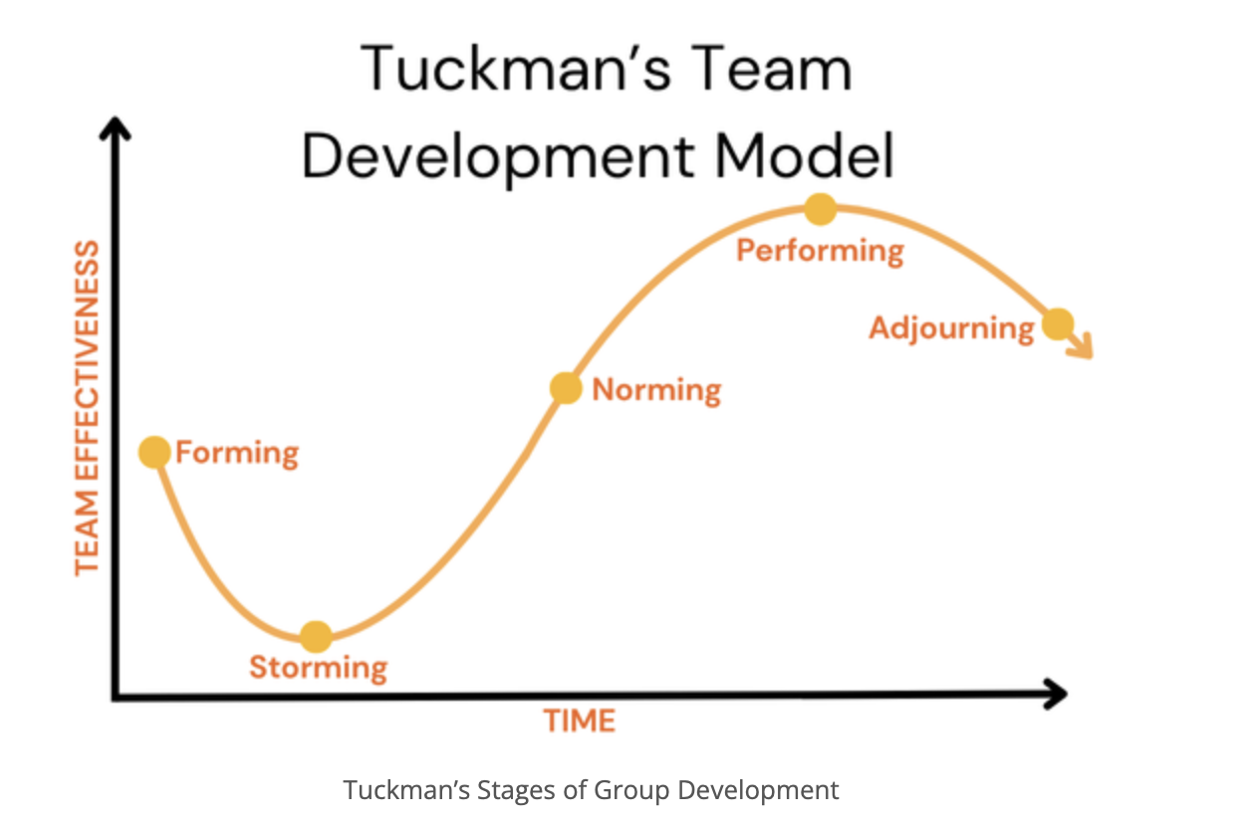
Industry Skill.
What is teamwork?
The idea that when people are combined as a unit, the effect is greater (NCVO, 2023).
Being creative with one another and using all skills to be the best you can be.
Stephan, (2017).
Notes:
The second skill I am going to be discussing is teamwork. Teamwork is an industry skill that I have learnt and become more familiar with on this course. The tourism and events industry is heavily orientated around teamwork, which is why I have chosen to discuss it.
Teamwork is described as the idea that when people are combined as a unit, the effect and impact it has is greater than someone working as an individual (NCVO,2023).
Successful teamwork is a mix of many different things including effective communication, active listening, cultural understandings, and many more. I feel that this is one of the most impactful skills that I have learnt in this module because it is a combination of all the other skills I have learnt.
When completing this module, I learnt about Tuckman’s Stages of Team Development. This theory states that there are 5 stages of working in a team including Forming, Storming, Norming, Performing, and Adjourning.
As you can see on this slide, I have put an image showing the stages of Tuckman’s theory. This theory shows that teams go through many different hurdles and obstacles before they become a successful team, and this is one of the most important things I have learnt in university.

Slide 7

Future academic benefit and transferability
The tourism and events industry is a ‘people’ industry.
Having the understanding that everyone is different and learning how to deal with this.
Hogarty (2022).
Notes:
The understanding of how a team works is crucial in university. From my own experiences, when being put into groups for certain projects at university, it can often be a challenge. People have opposing opinions, some are more outspoken than others, and this can be difficult to deal with when its an unfamiliar situation. However, learning about Tuckman’s theory helped me to understand that this is completely normal, and now that I know about this type of teamwork situation I know what to expect in the future.
Teamwork is a vital skill that will benefit me academically because as previously said, it will ensure that I can work professionally with others as a student and be aware of complications that may occur.
As well as this, teamwork is a skill that is used in every industry, so its important to be able to communicate and perform professionally in a team setting, to ensure future success.
The tourism and events industry is a people industry. Therefore, it is vital that I know how to deal with people and work alongside others to be the best version of myself.

Slide 8

Digital Skills.
LinkedIn Learning:
Todd Dewett (2019) Managing Stress.
Who triggers your stress?
What makes the stress level increase?
Where does the stress become overwhelming?
When is the stress present?
Notes:
Finally, the last skill I would like to discuss is my digital skills which is LinkedIn Learning. When completing the academic, industry and digital skills module I was lucky enough to have taken part in a session where we learnt about LinkedIn Learning. LinkedIn learning is a tool that can be used by anyone to complete certain modules on something that you are interested in learning more about. There is a full list of online courses that users can choose from to take part in. LinkedIn learning provides courses that are taught through multiple video clips and is a great way to learn many other skills.
While completing the AID module, I also completed a LinkedIn Learning course to further improve my studies.
The course I completed was about Managing Stress. The reason I chose this particular module on LinkedIn is because I feel that all students get stressed out about so many different things including homesickness, workload, work-life balance, and the overall pressure of university. I thought that it was important for me to complete the course to understand what students go through and to learn how to cope with stress.
Without LinkedIn learning I wouldn’t have benefitted from this module. Therefore, it is a very impactful digital skill that I have learnt here.
As you can see on the slide, when completing the course, I discovered that there is a 4-step concept designed to manage stress. The first thing to discover is WHO triggers your stress, WHAT makes the stress level increase, WHERE does the stress become overwhelming, and WHEN is the stress present. The author of this course suggested that once all of these factors have been identified, it is easier to manage and control stress levels.

Slide 9
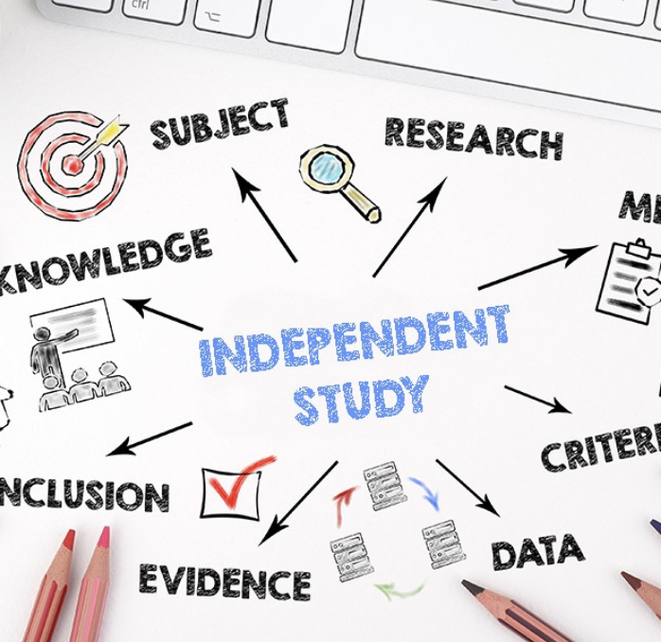
Future academic benefit and transferability.
LinkedIn Learning allows me to extend my education beyond university topics.
I can use LinkedIn Learning for future modules during my time in university to do independent research.
Independent learning is key for freedom and working at your own pace (Zaky, 2025).
Zaky (2025).
Notes:
Having learnt about the LinkedIn Learning tool, I have the opportunity to use it in the future. I will be using this tool for future modules in my second year of education. When faced with challenges in future modules or being uncertain of something, I can now use this tool to do some independent learning and further improve my education. Independent learning is just as important as in class learning because it helps you gather a better understanding of things and apply it where its needed.
Independent learning gives you the freedom to learn things at your own pace without the usual lecture room setting (Zaky, 2025).
LinkedIn Learning will definitely benefit me academically in the future because it is a tool that I can always refer back to and make use of when its needed.

Slide 10

Conclusion.
Improvement of many skills.
Knowledge and understanding in university
Growth in personal confidence as well as academic confidence
Bettering myself and my studies
Getting the absolute most out of university!
Notes:
To sum up my presentation, the key skills that I have gained when completing the AID module are academic integrity, teamwork, and the use of LinkedIn Learning.
This module has helped me prepare for university by giving me the skills I need to progress academically. Also, the skills I have learnt are completely transferrable and will be useful when I move onto my career in the tourism and events industry.
On this final slide I have put many ways in which this module has helped me prepare for university and the future. The AID module has helped me increase my knowledge and understanding, made my confidence grow in a personal matter as well as academic, and also helped me better myself as an individual for my studies, and finally I have had the opportunity to get the most out of university by continuing to learn and improve.
Thank you for listening to my presentation and I hope you have enjoyed.

Slide 11
Reference List.
Britland, S (n.d.) LibGuides: Academic Integrity Toolkit: What do we mean by academic integrity? Available at: https://libguides.reading.ac.uk/academicintegrity/about#s-lg-box-12528286 (Accessed 27/4/26).
Eke, D.O (2023) “ChatGPT and the rise of generative AI: Threat to academic integrity?,” Journal of responsible technology, 13. Available at: https://doi.org/10.1016/j.jrt.2023.100060 (Accessed 27/4/26).
Hogarty, S (2022) Nine characteristics of great teamwork. Available at: https://www.wework.com/ideas/professional-development/management-leadership/nine-characteristics-of-great-teamwork (Accessed 28/4/26).
Lboro.ac.uk (2024) What is Academic Integrity? | Academic Integrity | Loughborough University. Available at: https://www.lboro.ac.uk/students/academic-integrity/what-is-academic-integrity/ (Accessed 29/4/26).
Mackay, R (2021) Academic integrity is not plagiarism. Learning and Teaching. Available at: https://www.monash.edu/learning-teaching/news/blog/academic-integrity-is-not-plagiarism (Accessed 28/4/26).
NCVO (2023) Why teamwork is important. Available at: https://www.ncvo.org.uk/help-and-guidance/running-a-charity/employing-managing-staff/managing-developing-staff/developing-effective-teams/why-teamwork-is-important/ (Accessed 28/4/26).
Stephan, F (2017) Tuckman’s Stages of Group Development – Kaizenko. Available at: https://www.kaizenko.com/tuckmans-stages-of-group-development/ (Accessed 28/4/26).
University of Bristol (n.d.) Academic integrity. Available at: https://www.bristol.ac.uk/students/support/academic-advice/academic-integrity/ (Accessed 27/4/26).
Zaky, F (2025) LinkedIn Available at: https://www.linkedin.com/pulse/power-independence-learning-farha-zaky-hzwac/ (Accessed 28/4/26).
Zarch, M (2026) LinkedIn Available at: https://www.linkedin.com/pulse/why-tourism-events-important-hospitality-industry-asadi-zarch-4ghrf/ (Accessed 28/4/26).

