Slide 2
Marketing Essentials
BMIH4005

Slide 3
Before we start
As there are quite a few of us here, please ensure that your microphone is muted during all teaching until you are asked a question or there is a group discussion to prevent background noise.
You should attend every class and have a private space to work so that you can concentrate fully on the lesson.
You should not be at work, shopping, driving or caring for children. If you cannot fulfil this criteria you will be removed and marked as absent.
Your camera must be always on during lectures please. - use the Teams university background to protect your privacy.
YOU must join via a laptop or PC/MAC
You will be removed and logged as absent if you fail to adhere to these
This and all sessions will be recorded so that you can watch it again
Notes:
Next week onwards there will be no excuse accepted……………………….

Slide 4
Why is this important?
-This is a Full Time University course and as such the University definitions of engagement and decorum apply as they would in a physical classroom.
-Your Cameras must remain ‘On’ for the duration of the session in order to ensure equal engagement and for your lecturers to observe your full attendance of the session which is a condition for student loans/maintenance to be authorised.
-You should be using a desktop or laptop device with a camera, speakers and a microphone so that you will be able to engage in the session on equal footing with your classmates.
-You will be asked to share your screen and “present” your work, access documents, engage in writing activities use websites and create presentations which are either difficult or impossible on a phone.

Slide 5
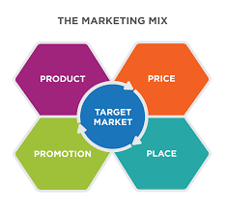
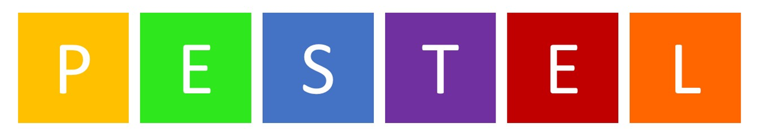

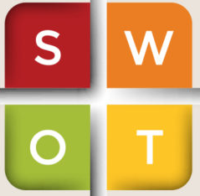
Recap
Last week gave an overview of…
Who is accredited as the author of the Marketing mix?
Booms and Bitner wrote 3 extra P’s, what were they and why?
When we say Place! What do we mean?
Notes:
Recap

Slide 6
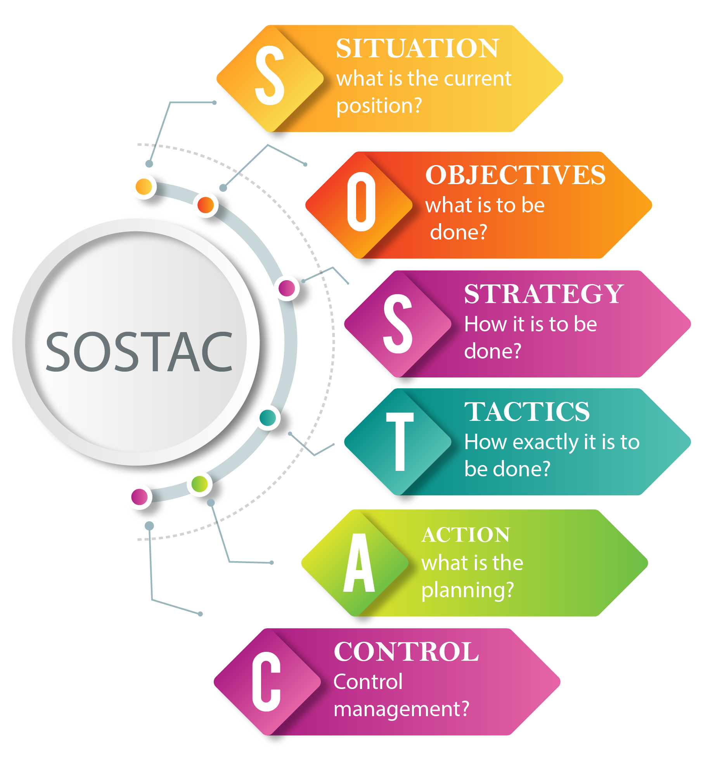
Objectives
Strategy

Slide 7
Setting Objectives
Objectives should be quantified in terms of success or failure criteria
Why?
Timescales should be set
Communications objectives relate what effect there should be on the mind of the consumer

Slide 8

Market Research:
“The systematic design, collection, analysis and reporting of data relevant to a specific marketing situation facing an organisation”
(Kotler 2014)
Notes:
So in order to gather the information on what our customers needs and wants, we do market research
Have any of you taken part in market research?
Who has received a phone call for a survey? Or been stopped by someone?

Slide 9

Notes:
Lets watch this video on brands that you will recognise make some notes.

Slide 10

Market Research
Allows a company to determine whether a new strategy, product or service is feasible
Helps companies identify and develop new sectors in the marketplace
Enables companies to test the demand for a new service, product or feature before actually launching it
Boosts the overall success of marketing, advertising and promotional campaigns
Assesses current market trends to allow companies to develop strategies to adapt to these trends
Helps companies determine the optimal product placement for a product

Slide 11
Primary and secondary data
Secondary research involves:
Assessing data that has been collected and published by others.
Online statistical information
Books, library, published company information etc,
Primary market research include:
Gathered first hand from the target markets / customers/ source you want to know about.
Interviews
Focus groups.
Questionnaires / surveys

Slide 12
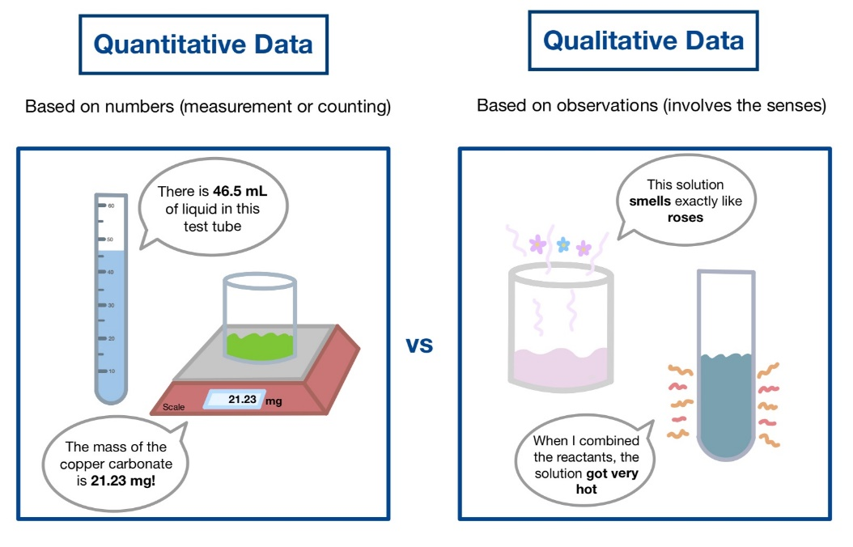
Quantitative vs Qualitative
Notes:
Quantitative vs qualitative question example:
Quantitative – Do you like this product? (binary yes or no answer) can be quantified and assigned numerical values.
Qualitative – How do you feel about this product? (forces an explanation) responses will need to include descriptions and provides opportunity to explain and justify, cannot be easily numerically assigned.

Slide 13
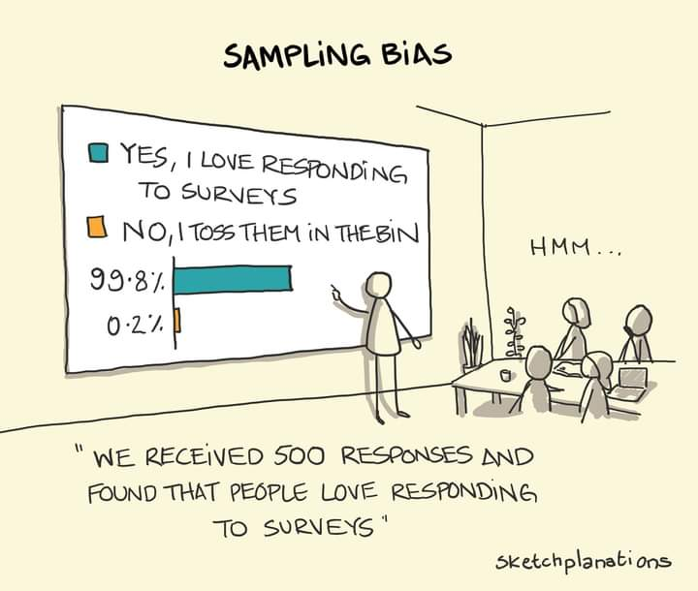
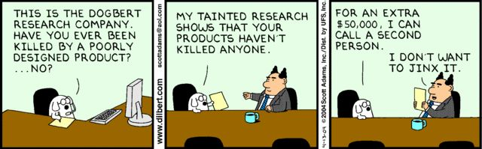
Sample Selection
The marketing researcher should not just choose the nearest convenient sample, since “without a defensible sampling strategy, the results of the study may be ambiguous or misleading”
(Lonner and Berry, 1986)
Notes:
Many ways to target, who, when and how many we target can have impact.
Can be affected by events social/political/leisure etc,
As marketers we must consider going to where our target market go, this can be physical or online. How we interpret data must take into consideration how the data was gathered

Slide 14
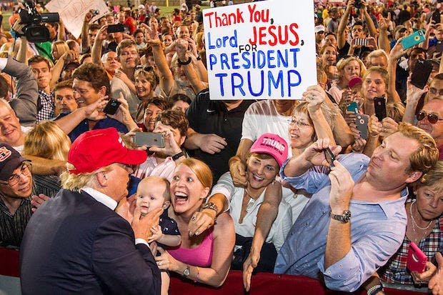
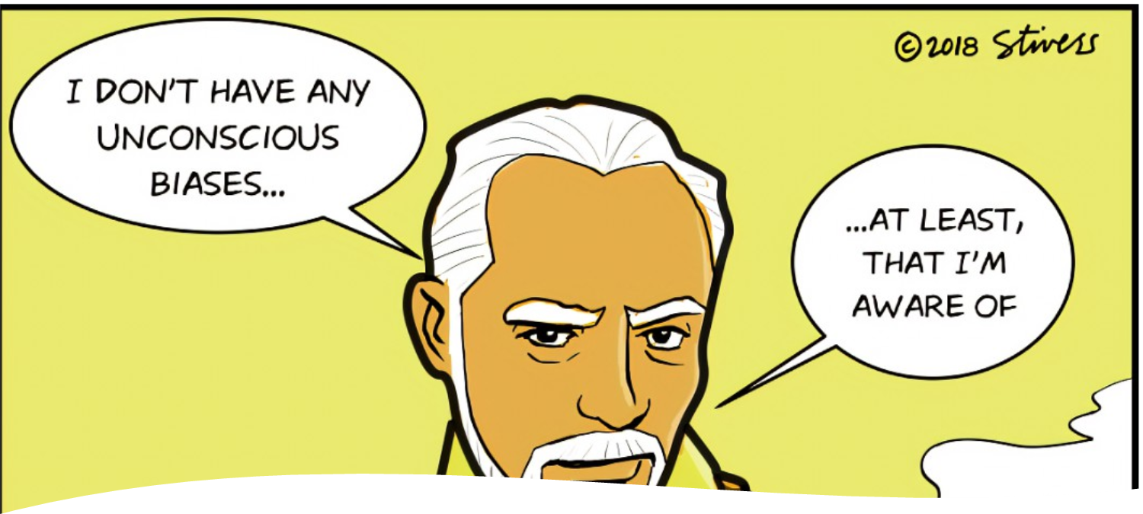
Response Bias
Bias is a generic term for all nuisance factors threatening validity”
(Van de Vijver and Leung, 1997)
Response bias consists of two phenomena
‘response sets’ and ‘response style’.
‘Response sets’ Desire, at either a conscious or an unconscious level, to give a particular picture of oneself by the way one responds” and includes social desirability bias and acquiescence
‘Response style’ Respondent’s tendency to answer in a manner that is unrelated to test content, but which is related to the form of the stimulus, is referred to as response style
(Watkins and Cheung, 1995)

Slide 15

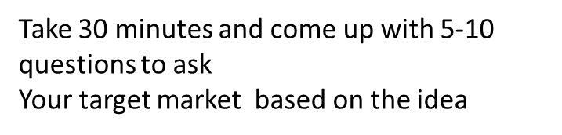
Take 30 mins in groups using whiteboard to brain storm
Think about a new product or service for a customer segment at a family destination hotel!
And consider the best way to go about market research for this product.
Think about what you would like to know about the target market (identify the segment)? Needs and wants
Put together several questions-
What would you need to know if you were to introduce that new product or service to that target market.

Slide 16

S.M.A.R.T. Goals are…
What now?
We have identified from market research and our situational analysis that there are opportunities/weaknesses to address…
Lets be SMART!
Specific
Measurable
Attainable
Realistic
Timely
Notes:
Why is it important to set goals, e.g shared vison for all, keeps us on track, helps identify all areas that need to be considered, consistency etc...

Slide 17

Specific
Specific goals answer the following questions:
Who: Who is involved?
What: What do I want to accomplish?
Where: Identify a location.
When: Establish a time frame.
Which: Identify requirements/constraints.
Why: Specific reasons, purpose or
benefits of accomplishing the goal.

Slide 18

Measurable
To determine if your goal is measurable, ask questions such as
  How much?
  How many?
  How will I know when it is accomplished?

Slide 19

Attainable
The goal is “do-able”
It is action-oriented
It is “within reach”

Slide 20

Realistic
The goal must be an objective toward which you are both willing and able to work.
Again, it must be “do-able”
People must believe it can be accomplished

Slide 21

Timely
You should establish a timeframe
The timeframe must be realistic
Everyone needs to know the timeframe…make it public

Slide 22

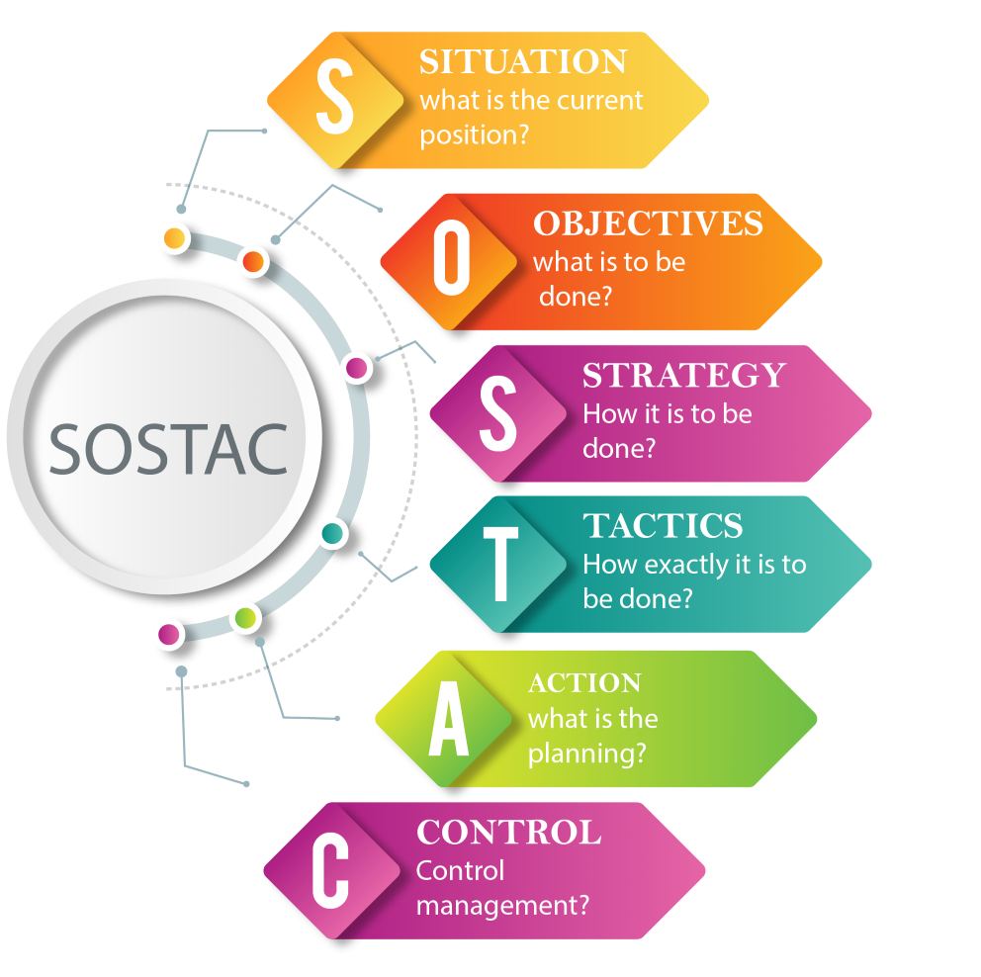
Objectives
For assessment 2:
Set objectives based on the weaknesses/challenges found in the situational analysis and market research.
Specific - What are you going to do? (be specific, don’t be vague)
Measurable – what will be achieved? Quantitative metric.
Attainable – This is ‘Do-able’ because?
Realistic – what's the likely outcome?
Timely – What is the deadline?
“I am going to manage a promotional campaign targeting (Customer segment/profile) addressing the concerns raised from examining customer feedback and reviews (Found from your situational analysis 5C’s)……”
“I will attract 1000 new customers and 100,000 online customer interactions over an 18 month campaign…….”
“ 55 new customers, 5,555 interactions per month over 18 months….”
“This will elevate customers concerns, raise brand awareness and attract a realistic return…….”
“By When?”

Slide 23
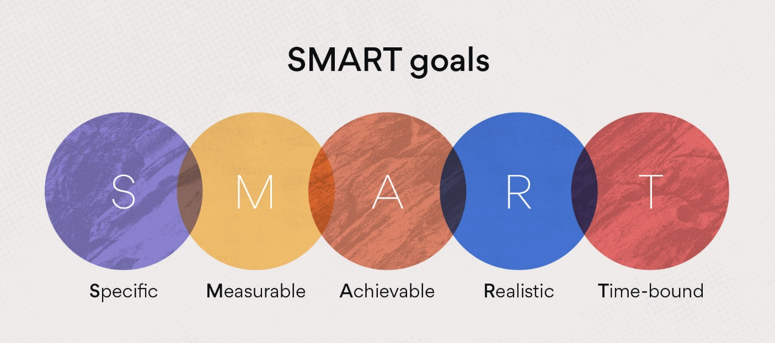
Task 10 mins
Craft a personal professional goal and type in the chat box
Use the S.M.A.R.T. techniques

Slide 24

Strategy
Seeking opportunities to minimize costs and maximize benefits often identified through customer interactions, market research and internal audits
Marketing strategy is the way organisations create value through the coordination and configuration of its activities (The Marketing mix!)

Slide 25
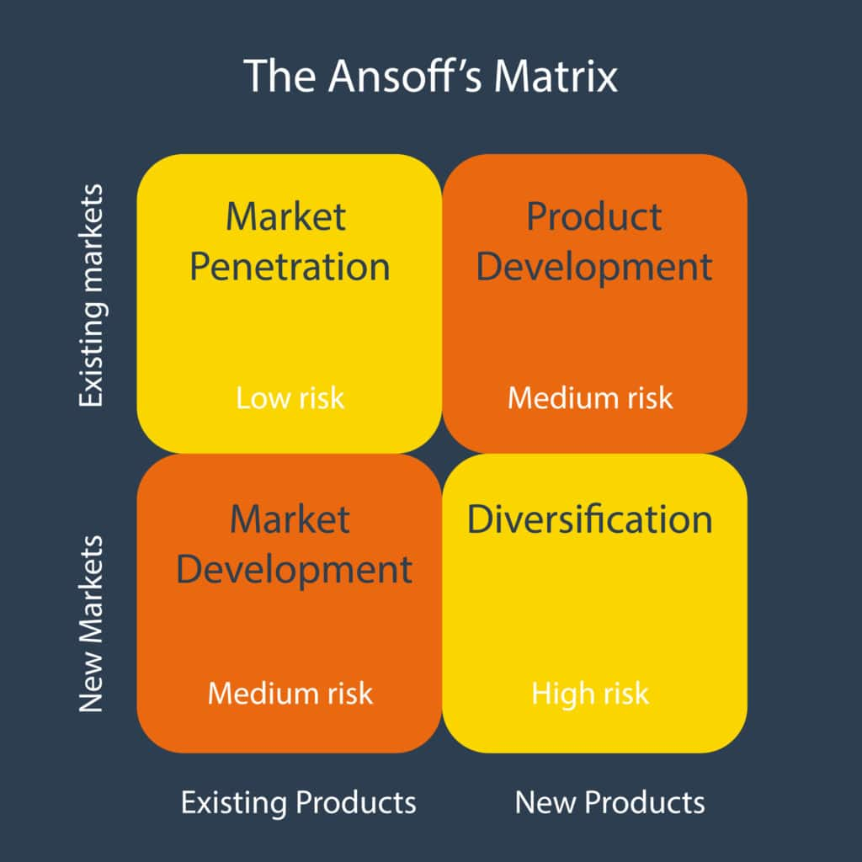
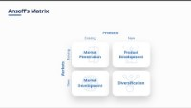
Selling what to whom?
Notes:
Ansofs matrix offers a number of market development strategies

Slide 26
Ansoff product/market growth matrix
Purpose: help managers consider whether/how to grow their business through existing or new products or in existing or new markets
  Evaluate degree of risk
    Risk increases proportionally to the degree of change
Demonstrates four basic corporate level strategies
  Market penetration (existing products in existing markets)
  New product development (new products in existing markets)
  Market development (existing products in new markets)
  Conglomerate diversification (New products for new markets)

Slide 27
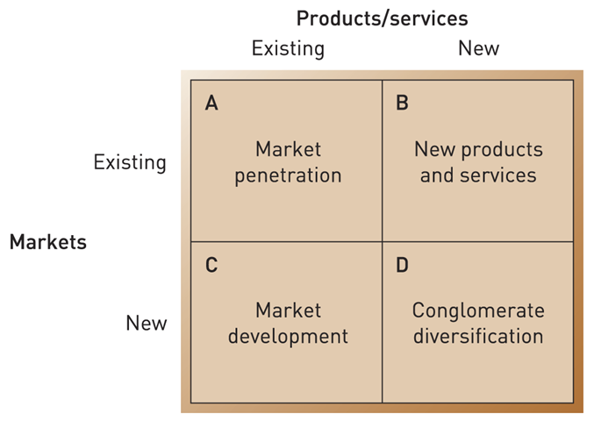
Market Penetration
Objectives
Existing products to existing markets – only better
To seek assertively to increase market share
Maintain existing customers and reduce defecting customers
What does it involve?
  concentrating on core capabilities
  investment in brand, brand identity, functionality, support tools, and bundling
  Knowing customers
Advantages
  strategy based on known skills and capabilities --> very low risk strategy..!
  production and marketing skills can be developed and improved to create a competitive advantage.
  Costs can often be effectively identified (i.e. advertising/promotions)
Notes:
So what are these strategies? And how do they compare?
MP: It involves marketing existing Pdcts onto existing Mkts – only better. It is a strategy that aims at doing better one is already doing well.
Objective is to increase market share, reduce churn and expand revenues (through ARPU).
Ways to do it: brand investment, customer care, added functionalities, online support tools, etc. but also bundling – selling you more than what you bargained for.
Low risk strategy as it is based on what the firm has already been doing for some time - you try to be better at it.
Low risk, high success rate, as earlier examples demonstrate.
Importantly, the cost of MP and other LGS can (sometimes) be identified through advertising expenses, etc.

Slide 28

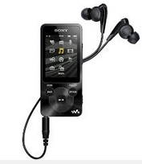

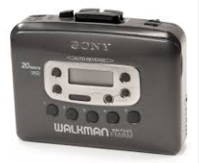


Product Development
What does it involve?
  making substantial modifications or additions to present products in order to increase their market penetration within existing customer groups
  i.e. new edition of a textbook
    most material remains the same and only incremental changes are implemented
  often linked to an attempt to extend or prolong the product life cycle
Can be expensive and risky
  Need to master new technologies & capabilities
  Delays and increased costs
Notes:
PD: new product to existing market → implies substantial modifications to existing products to extend the lifecycle of the product.
Example: the 5th, 6th, or 7th edition of a textbook. Most of the material used remains the same, only incremental changes are implemented
Walkman, ~CD player, mp3 player, largely modified product for similar customers
Expensive and risky. Example: Hospitals upgrading online patient files and medical records.

Slide 29
Market Development
Objectives
  to recruit new customers for existing products
  What does it involve?
  Tapping into related market areas
Key themes
  good option when product development is risky and/or expensive
  small modifications to increase attractiveness to new segments (remember: modification always increases cost of production!)
  new uses for a product or service
  appropriateness for different countries with particular tastes or requirements
  marketing and branding skills vital for attracting new customers
  coordination challenges (similar products for different tastes)
  Important to remember what the main market is..!
Notes:
MD – offering existing products in new markets → similar to a strat of specialisation.
Aim: to try and reach out to consumers or markets that were not the original target market by making changes to products and making them more suited to the needs of related markets
→ Low risk, as product is based on firm's own resources and capabilities. Can be very successful, but danger in loosing sight of your main market.
Can also be a source of cost: need to make changes to the products to suit related markets’ tastes and usages.
I read a fascinating story about a baking soda manufacturer whose sales were declining because more ladies were working full time and so were not doing as much baking anymore. The baking soda manufacturer surveyed their clients and discovered that their clients were actually using baking soda for dozens of uses that were nothing to do with baking. They used baking soda as a fridge deodorant, a washing powder, a stain remover and much more.
The baking soda manufacturer created a wide range of brand new products like fridge deodorizers, laundry powders etc based on this feedback. And they made millions of dollars of brand new sales as a result of these new uses for baking soda.

Slide 30
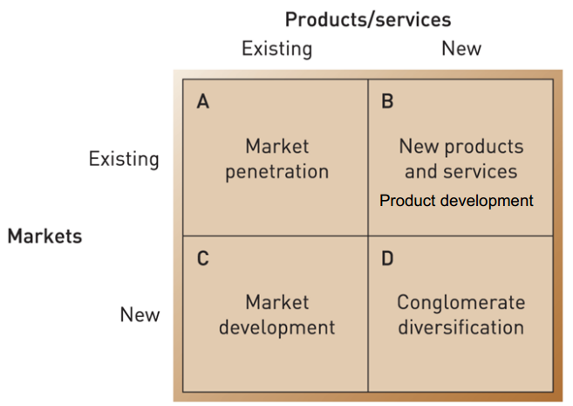
Summary
Increase market share
Sales, promotion, advertising
Dominance in growth markets
New products to existing markets
R&D
New dimensions to old products
Insight into customers
Selling existing to new markets
International expansion
New distribution channels (i.e. online)
A more corporate decision looking at new products to new customers.
Mergers & acquisitions
Portfolio management
New brands new business models
Notes:
Diversification drivers- less of a concern for marketers when managing an existing brand
Synergies with already existing products
Similar materials, can utilize same manufacturing plants, machines, processess etc.
Synergies with already existing skills and competencies
Leadership capabilities, experience, knowledge of markets and customers
Often acts as platform for international expansion
Taking core competence on step further
i.e. Higher value product for developed markets and more streamlined version for emerging economies
Scale and scope of operations
Potentially higher degree of benefits than in unrelated diversification

Slide 31
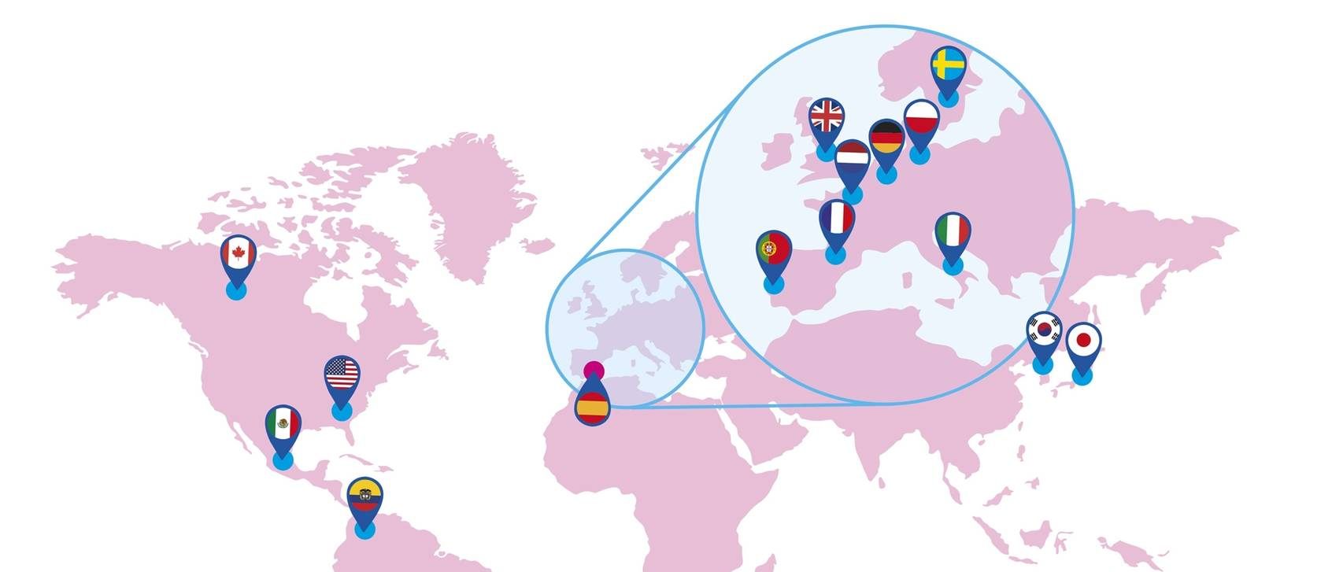
Internationalisation, Advertising & Branding Strategy
Notes:
One of the likely strategic opportunities available may be internationalisation

Slide 32

Current Advocacy: Three Approaches
Global- One message no change but translated.
Glocal - standardized creative strategy with highly adapted execution depending on audience.
Local Highly adapted creative strategy accompanied with highly adapted execution, often made and managed locally to capture the social prevalent trends and idealisms (large scale coordination).
Notes:
Overal we can look at international marketing in 3 ways –
Global – the same in every way except for language, (lower cost, easier to implement, metrics can be general)
Glocal - same artistic approach and overall aim, but culture, nuances and message can be adapted)
Local – highly tailored approach marketing “nodes” where strategy will be devised and implemented locally (branding is often still centralised).

Slide 33
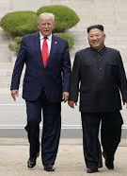
What is International Branding?
According to Whitelock and Fastoso (2007, p. 266), “international branding is a field within international marketing concerned with the challenges that companies face when their brands cross national borders. These challenges relate to the essence of the brand in terms of brand name, brand visual (e.g. logo, colours) and sound elements (e.g. jingles, music), and brand personality”.
More recently, however, international branding appears to apply to the whole complex of decisions involved in the development of a brand at an international level.
de Chernatony et al. (1995, p. 10), for instance, talk about the “international brand‐planning process” as one that affects decisions in relation to two elements of a brand: the brand's “core essence” (i.e. brand personality and positioning), and the brand's “execution” (through, e.g. media and advertising).

Slide 34
Brands: The Fundamentals
A brand includes a unique name, symbol, logo, colour, or registered trademark as well as a unique package design (Foroudi et al., 2017).
A brand plays an important role in no(Jin et al., 2019).
notifying consumers about the maker of a product A brand protects consumers and producers from competitors who attempt to provide similar products in a competitive market.
Kotler and Armstrong (1996) argued that a company defines its brand not only as its own product or service, but also by reference to design, a name, a trademark, or all of these elements that it uses to differentiate its products or services from those of its competitors.
A brand can be described as a “cluster of values” (de Chernatony, 2009, p. 104).
Notes:
A recap on what we have looked at with Brands.

Slide 35


The International Problem
Advertising messages should be congruent with the values of local culture has been long advocated (Zhang and Gelb, 1996; Boddewyn et al., 1986; Belk et al., 1985; Harris, 1984; Hornik, 1980; Buzzell, 1968).
Pollay and Gallagher (1990) summarized this position by noting that cultural values are the core of advertising messages and typical advertisements endorse, glamorize and reinforce cultural values.
Empirical studies have found that advertisements reflecting (some) local cultural values are more persuasive than those that ignore them (Gregory and Munch, 1997; Taylor et al., 1997; Han and Shavitt, 1994; Hong et al., 1987; Madden et al., 1986; Marquez, 1975).
Notes:
Video discusses marketing examples of linguistic and cultural failure in internationalisation

Slide 36
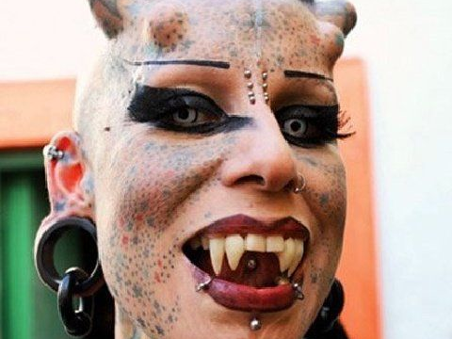

Identity
The term “identity” is widely used in various academic disciplines such as psychology, sociology, communications and marketing. Identity generally connotes individuality, uniqueness or the characteristics or distinctiveness of a given person, organization, product, or service (Ghodeswar, 2008)

Slide 37
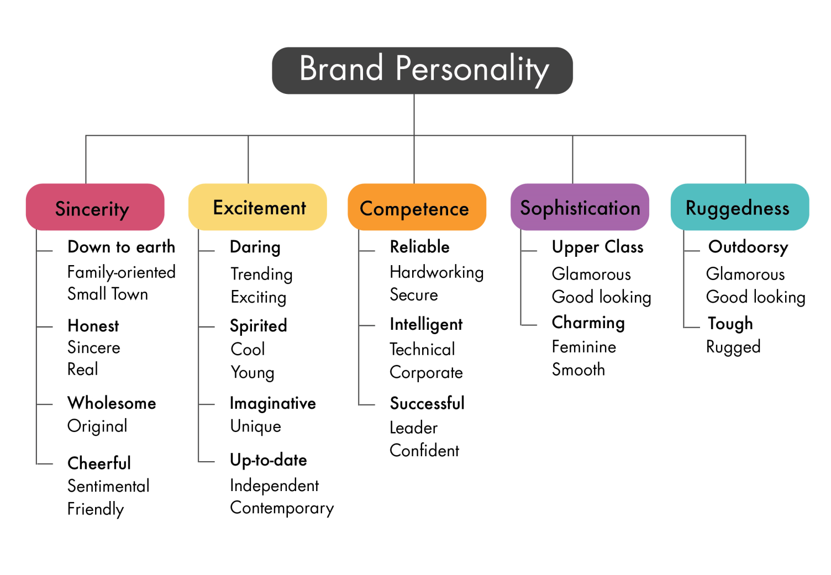
Aaker’s Brand Personality Dimension Model
Brand personality reflects “the set of human characteristics associated with a brand” (Aaker, 1997).
Brand personality forms part of a brand image held by consumers and refers to the anthropomorphisation of brands (Aaker, 1997)
Brands are treated like a person with whom one might like to form a relationship
Notes:
recap

Slide 38
Simply……
International branding shares the basic brand management and development techniques as the domestic counterpart, except that a firm must operate in an unfamiliar macro-marketing environment.
The macro-marketing environment in any overseas market comprises, economic, sociocultural and technological elements (Preble, Rau, & Reichel, 1988; Subramanian, Fernandes, & Harper, 1993).
Compared with a firm’s domestic customers, customers within an overseas market may also have different tastes, preferences, values, expectations, and behaviours.

Slide 39
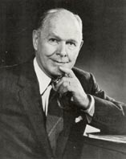



Strategy
Strategy summarises how your new objectives will be achieved –
We may need to revisit the brands value proposition. A value proposition is the “the full mix of benefits on which a product is differentiated and positioned. It is the answer to the customer’s question ‘why should I buy your product?’” - Kotler et al. (2018, p.232).
How will you communicate the value proposition, how will it be delivered – The Marketing Mix!
A change of strategy means a change in the marketing mix (our current methods)
Once SMART targets are identified each ‘P’ will need to be examined to gear towards the new strategy.
e.g – if the organisation decides that we need to focus on changing the brands reputation we due to poor reviews we may need to find out which area is lacking in performance and re address.
Jerome-
(McCarthy, 1960)
Bernard & Mary
(Booms & Bitner, 1981)
Notes:
The Marketing Mix | UWTSD MIX (teachable.com)

Slide 40
Next Week!
What time we have left is an opportunity to ask questions and receive guidance for your 1st assessment.
Tactics Communications mix RACE and communications channels.
Action Gannt charts for comms schedule Control metrics and measuring success.

Slide 41
References
Aaker, J.L. (1997) “Dimensions of brand personality,” Journal of Marketing Research, 34(3), pp. 347–356. Available at: https://doi.org/10.1177/002224379703400304.
Brookes, M.Alinay,L. and Atkas,G (2015) opportunistic behaviour in hospitality franchise agreements. International journal of hospitality Management, 46,120-129
Connell,J .(1992) Branding hotel portfolios. International Journal of contemporary Hospitality management 4,26-32
De Chertony ,L. and Dall’Olmo Riley, F (1998) a positioning analysis of hotel brands experts' interpretations. Journal of marketing management, 14, 417-444
Delmas, M.A and Burbano, V.C (2011) The drivers of greenwashing. California Management Review, 54(1), 64-87.
Dev, C.S Morgan, M.S and Shoemaker, S (1995) a positioning analysis of hotel brands, Cornell Hotel & Restaurant Quarterly, 36, 48-55
Emery, B. (2012) Sustainable Marketing. Harlow: Pearson Education.
Fishbein ,M. and Ajzen, I. (1975) Belief, Attitude, Intention and Behaviour: An introduction to theory and Research. Reading, MA: Addision Wesley.
Frambacja, R.T Prahbhub, J. and Verhallence, T.M.M (2003) The influence of business strategy on product activity; the role of market orientation. Journal of international Research in marketing, 20,377-397.
Ghodeswar, M.B. (2008) Building Brand Identity in Competitive Market: A Conceptual Model. Journal of Product and Brand Management, 17, 4-12. Jones,P (1999) multiunit management in the hospitality industry: a late C20 phenomenon. Journal of contemporary Hospitality Management ,11,1155-1645.
Jin, C.H., Yoon, M.S. and Lee, J.Y. (2019) “The influence of Brand Color Identity on Brand Association and loyalty,” Journal of Product & Brand Management, 28(1), pp. 50–62. Available at: https://doi.org/10.1108/jpbm-09-2017-1587.
Kotler,P (2003) Marketing management,11thEd.Upper Saddle River, NJ. Pearson Prentice Hall

Slide 42
References
Kotler, P. and Armstong, G. (2018) Principles of Marketing, 1tth Edn. Harlow:Pearson.
Mcdonalds.com. 2018. The Financials - McDonald's Franchise | McDonald's UK. [online] Available at: <https://www.mcdonalds.com/gb/en-gb/franchising/the-financials. > [Accessed 9 June 2022].
Moravcikova ,D. Krizanova, A.Kliestikova,J. and Rypakova, M. (2017) Green marketing as the source of the competitive advantage of the business. Sustainability, 9 (12), 2218
Ottman, J.A. and Reailly, W.R (1998) Green marketing: Opportunity for innovation, 2nd Edn. Upper saddle River, NJ: Prentice Hall.
Porter ,M.E. (1980) Competitive strategy: Techniques for analysing industries and competitors. New York, Free Press
Ries ,A. and Trout,J. (1986) Marketing Warfare. New York, McGraw-hill.
Ross, D and Deck Jr, D.W (2011) Student guide to greenwashing. Bquest, pp. 1-20. Available at www.westga.edu/~bquest/2011/greenwashing11.pdf (accessed 17/11/2022)
Signori,S. and Forno, F (2016) Closing the attitude-behaviour gap: The case of solidarity Purchase groups. Agriculture and Agricultural Science Procedia, 8, 475-81.
J Whitelock & F. Fastoso (2007). Understanding International Branding: Defining the Domain and Reviewing the Literature. International Marketing Review, 24(3), 252-270.

Slide 43
I look forward to seeing you next week.
If you have any questions in the meantime, please send an email from your student account
Lecturer@uwtsd.ac.uk

