Slide 1
Investigation and Evaluation into the Impact of the E-Survey as a Marketing Tool and its Ability to Gather Statistics
Major PROJECT, iq building – Room 205 19th September, 2019
Lauren Paige Collins – P134209

Slide 2
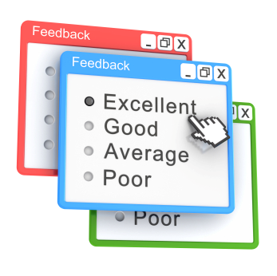
Introduction
This project required three topics of focus:-
  The impact of the e-survey in terms of usability, society acceptance and validity of the design
  Website technologies and social media platforms employing the e-survey as a marketing tool
  How successful is the E-Survey at collecting data
Research methodologies were applied to aid in with investigation process. These involved sufficient research, experimental survey and a case study.
The results that were collected were analysed and contributed to the conclusion of the study.
Figure 1.
Notes:
Figure - https://amimagazine.global/e-marketing/e-surveys/

Slide 3

Aims and Objectives
Aim
The Investigation and Evaluation into the Impact of the E-Survey as a Marketing Tool and its Ability to Gather Statistics
Objectives
Research into existing reports regarding paper-based surveys and the recorded success.
Research into how Social Networking sites and Websites technologies use the E-Survey for data collection.
Create a survey using a suitable software and have the survey completed with the use of an Eye Tracker, by the target audience.
Research into how surveys have become an effective marketing tool. Find out if people are becoming a population of statistics by completing surveys.
Figure 2.
Notes:
Figure - http://www.ukm.my/alumni-fsk/en/undergraduates-alumni-affairs/aim-objectives/

Slide 4

Discussion Topics
Findings of Literature Review
Overview of Research Methodology
Analysis
Results
Software Problems
Evaluation
Conclusion
Recommendations
Figure 3.
Notes:
Figure - http://www.clker.com/clipart-587954.html

Slide 5
Literature Review
Within the literature review, many different topics were discussed and evaluated to aid with meeting the set objectives. These include:
A definition of a survey and the available survey methods
Social media platforms employing the e-survey
Website technologies employing the e-survey
The types of e-surveys the benefits and strategies of using them
And the EyeTribe eye tracker

Slide 6
Statistics
Sorman stated from research conducted “that 45% of survey takers are willing to spend up to five minutes completing a survey, while only a third are willing to spend up to 10 minutes”.[1]
Global Digital Report 2019 reported that “the number of social media users worldwide in 2019 is 3.484 billion, up 9% year-on-year”. [2]
Java came first in the ‘The Top 20 Programming Languages’,[3] and Wix.com was voted the best in the ‘Top 10 Website Builders’[4]

Slide 7
Findings of Literature Review
Conducting a literature review permitted a detail investigation to be conducted by analysing secondary data through online resources, articles, books and journals.
The findings indicate that both social networks and websites heavily rely on the e-survey and has increased in popularity as a result.
The survey has had to evolve into the e-survey to ensure it remains in demand.
The e-survey has proved to be a cost effective method and is very beneficial for collecting the right data, for the right topic with access to the right target market.

Slide 8
Research Methodology
The research onion was applied to this study, to identify the necessary methods required to be completed this study. The below four methods were applied:-
The Research Philosophy and Approach
Research Strategy
Including Experimental Survey and Case Study
Reliability and Validity
Study Population and Sample

Slide 9

Experiment & Case Study
Experiment conducted with a Survey and the use of an Eye Tracker
  Survey was created on the online survey builder, Survey Planet.
  Students and staff within the university were approached and
  asked to participate in the survey. 10 experiments were conducted.
Case Study
  Conducted on the Student Services department within the university.
  Meeting was arranged with the department manager and member of staff from the department to gain approval.
  Further 8 students participated in the survey alone for additional responses.
Figure 4.
Notes:
Figure - https://app.surveyplanet.com/

Slide 10
Analysis
An analysis was conducted on three different experimental sections that were included within the study.
The case study, the process of creating the survey and the final survey produced and the results that it collected.
Feedback services provided by Survey Planet were used within the analysis. The results were presented in doughnut and bar charts and comment boxes.
Accompanying this, available online surveys were completed using the eye tracker. This was conducted to test the usability of those.
The information collected from the 10 experiments that completed the e-survey using the eye tracker.

Slide 11

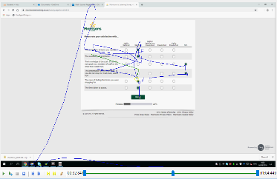
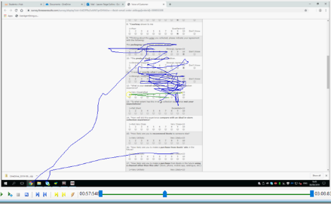


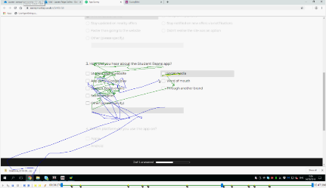
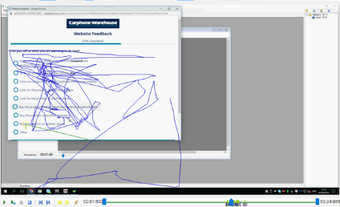


Morrisons
Boots
Figure 5.
Figure 6.
Student Beans
Carphone Warehouse
Figure 7.
Figure 8.

Slide 12
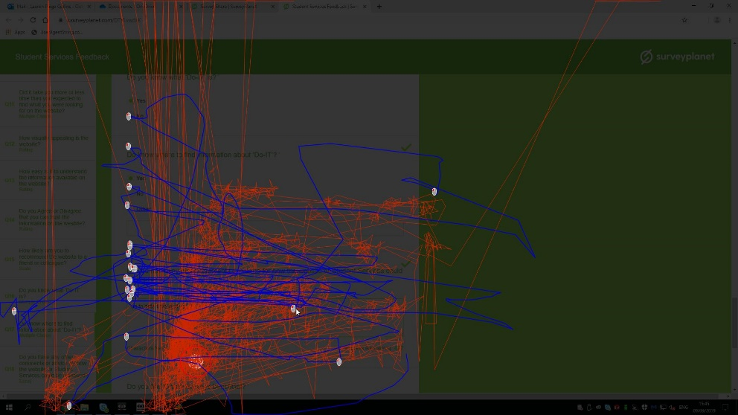
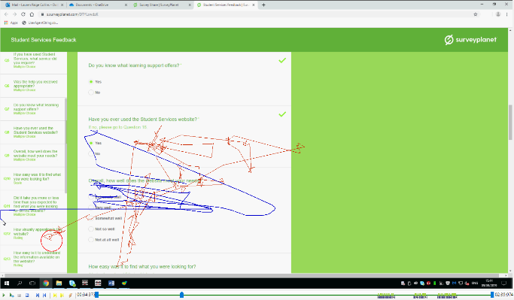


Figure 8.
Figure 9.
Figure 10.

Slide 13
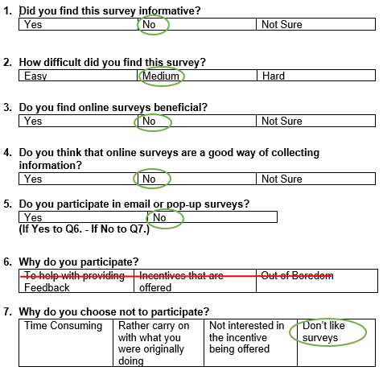
Figure 11.

Slide 14
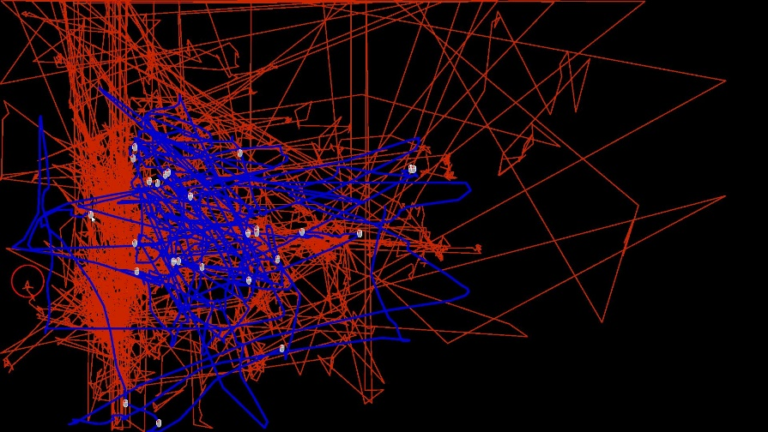




Figure 12.
Figure 13.
Figure 14.

Slide 15
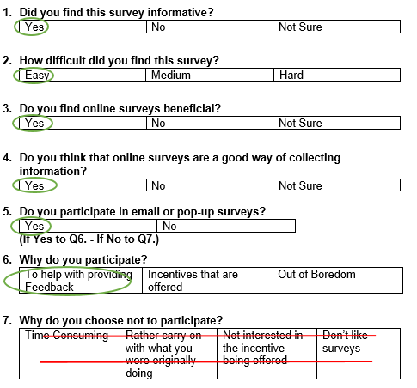
Figure 15.

Slide 16
Results
Usability Testing
Each of these surveys were easy to use and kept the participant interested.
The attention maps show that the user remains focused in responding to the questions and did not get distracted.
Experimental Survey
Most of the participants completed the survey in very similar ways.
Nearly every participant was focused and interested, which allowed the eye tracker to generate interesting gaze and mouse data.

Slide 17
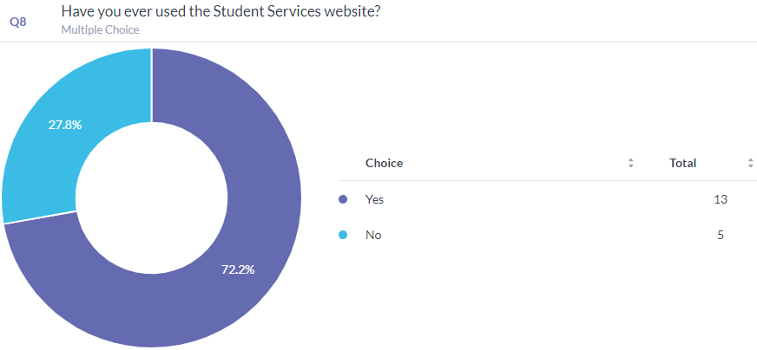
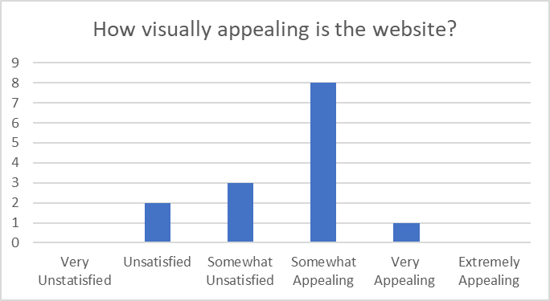
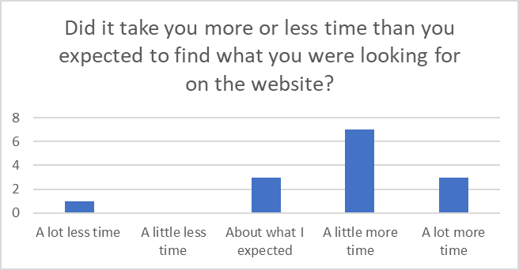
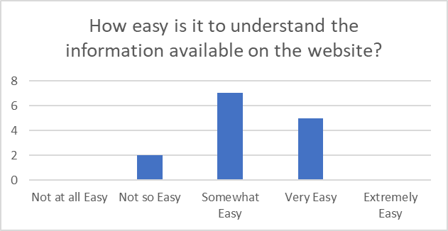
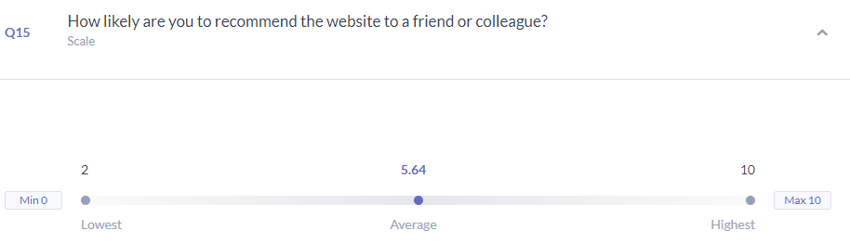
Figure 16.
Figure 17.
Figure 18.
Figure 19.
Figure 20.

Slide 18
Results
E-Survey Data
This particular survey was successful at collecting the required information, to be used by the case study.
It collected valid information from both students and staff within the university regarding Student Services and the departments website.
A considerable amount of feedback was retrieved in regard to the department website.
There were many other questions included within the survey which retrieved valuable information, in regard to how the respondents view and feel about the website.

Slide 19

Software Problems
A number of issues arose when using the OGAMA software, which had a considerable effect on the experiments.
The browser within OGAMA being incompatible with the online survey builder.
Recordings not saving , as a result of ‘Database is locked’ and ‘Database or disk is full’ errors.
OGAMA crashing or freezing when having a back log of data, resulting in “Could not commit transaction. See Inner Exception for more details’ error or ‘Object reference not set an instance of an object’ error.
Figure 21.
Notes:
Figure - http://www.ogama.net/

Slide 20
Evaluation
Conducting this study allowed for a deeper understanding of how popular e-surveys are.
Both social media networks and websites heavily use the e-survey to collect data from customers.
Paid advertising and Cookies and Links have a major influence on the responses received.
The use of the eye tracker would be beneficial to aid organisations understand what requested respondents look for when participating, which encourages those to build e-surveys that meet user requirements.

Slide 21
Evaluation
The process of conducting the study allowed for the set objectives to be successfully completed, in order to meet the aim, which was testing the e-surveys ability to gather efficient information.
The data that was collected from conducting the survey was expected, as a result of previously using the website. However, the data will be effective if the department of student services use the feedback to improve.
If further research was to be conducted in this field, the survey would be conducted at a later date, to reach more students of different education levels.

Slide 22
Conclusion
Conducting the literature review allowed for thorough research to be conducted into each subject area involved in the study.
Evaluating the survey methods available, allowed for clear of understanding of why the e-survey is now most popular.
Applying a case study allowed for an effective survey to be produced based on a website that required feedback.
Conducting the experimental survey alongside the case study, allowed for a thorough analysis to be completed on how people react to surveys and also gathered valuable data to be further applied.
Producing this study has contributed to existing research on the usability and effectiveness of e-surveys and has shown that organisations could benefit from understanding exactly how participants partake and what is expected.

Slide 23
Recommendations
While the project was completed successfully, there are a few recommendations that could be applied for further research to be conducted. These include:-
Focus on the topic of the e-survey alone for secondary research.
Use the eye tracker across a number of days, as a result of the recurring errors.
Attempt a greater survey sample, by conducting the survey during term time at the university.

Slide 24
References
[1] A. Sorman, “4 Effective Methods to Increase Your Survey Response Rates,” 2016. [Online]. Available: https://blog.marketo.com/2017/01/4-effective-methods-to-increase-your-survey-response-rates.html. [Accessed 10 July 2019].
[2] D. Chaffey, “Global social media research summary 2019,” 12 February 2019. [Online]. Available: https://www.smartinsights.com/social-media-marketing/social-media-strategy/new-global-social-media-research/. [Accessed 03 July 2019].
[3] B. Putano, “A Look At 5 of the Most Popular Programming Languages of 2019,” 30 August 2019. [Online]. Available: https://stackify.com/popular-programming-languages-2018/. [Accessed 04 September 2019].
[4] N. SCHÄFERHOFF, “10 Best Website Builders,” 16 May 2019. [Online]. Available: https://websitesetup.org/website-builders/. [Accessed 20 August 2019].
Table of Figures
Figure 1. https://amimagazine.global/e-marketing/e-surveys/
Figure 2. http://www.ukm.my/alumni-fsk/en/undergraduates-alumni-affairs/aim-objectives/
Figure 3. http://www.clker.com/clipart-587954.html
Figure 4. https://app.surveyplanet.com/
Figures 5 – 10 OGAMA Generated Visualisations
Figure 11 Follow Up Questions Example
Figure 12 – 14 OGAMA Generated Visualisations
Figure 15 Follow Up Questions Example
Figures 16 – 20 https://app.surveyplanet.com/
Figure 21 http://www.ogama.net/

Slide 25
Thank You for Listening!
Any Questions?

