Slide 1
Room Cleaning Excellence Training
Student Name: Kamrul Khan
Student ID: 20227511
Lecturer: Muhammad Cassamo
Module: Operating Hotel Facilities BMIH4006
Meeting Brand Standards and Ensuring Safety

Slide 2
Table of Contents
Introduction
The Employee Engagement Model
Brand Standards
Health and Safety Procedures
Industry Best Practices
Room Cleaning Checklist
Employee Engagement in Practice
Case Studies
Conclusion

Slide 3
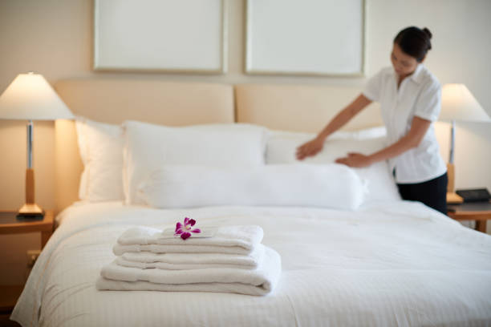
Introduction
Hotel cleanliness is the bedrock of guest satisfaction and business success in the hospitality industry. It's the face of quality service, setting the tone for a guest's experience and influencing their decision to return or recommend the hotel to others.
Source: Google

Slide 4

The Employee Engagement Model
The Zinger, Deloitte, and Deloitte Models represent pyramid structures focused on employee engagement, emphasizing well-being, meaningful work, and fostering an inclusive culture. Aligning management strategies with these models cultivates involvement, respect, and challenge, pivotal for successful strategies in the hospitality industry.
Source: Google

Slide 5

Brand Standards
Brand standards encompass a brand's graphic elements: logos, color palettes, typography, and photography, ensuring consistency across all interactions. At Holiday Inn, Sunderland, these standards define rules, maintain consistency, and add value. Examples of these standards in the hotel's cleanliness efforts showcase how they contribute to a professional and reliable image, benefiting both staff and guests.

Slide 6
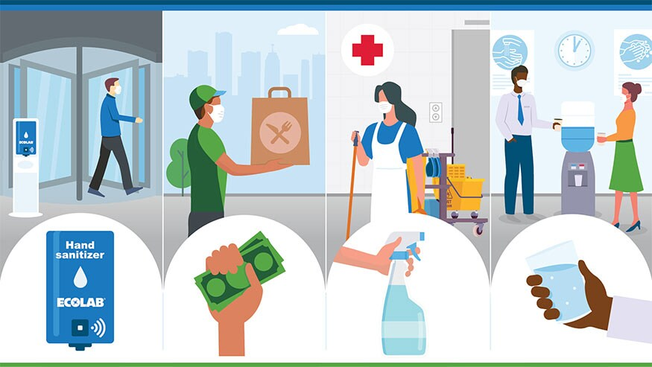
Health and Safety Procedures
Occupational Health and Safety (OHS) procedures are vital in hotel cleaning, ensuring workplace safety, risk reduction, and injury prevention. Employers prioritize OHS policies, identify hazards, and provide necessary training, which is critical for maintaining a safe and efficient environment.
Source: Google

Slide 7
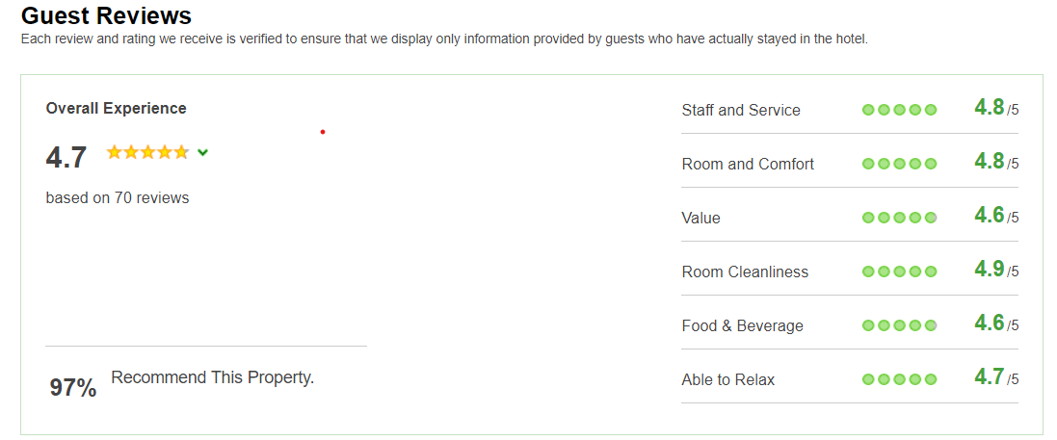
Industry Best Practices
Employee engagement is critical for a hotel's success, significantly impacting guest satisfaction, service quality, staff retention, and brand loyalty. This engagement reduces recruitment and training costs and fosters a positive work environment. Success stories and testimonials from the hospitality industry showcase how these practices directly impact and elevate cleaning services, contributing to a better overall guest experience.
Source: ihg.com

Slide 8
Room Cleaning Checklist
The ultimate room cleaning checklist is a comprehensive guide designed to maintain a clean and organized space. It encompasses daily, weekly, monthly, and quarterly cleaning tasks, including special cleaning secrets and ingenious interior cleaning techniques. Visuals, such as before-and-after images, effectively demonstrate the checklist's effectiveness in transforming spaces.

Slide 9
Employee Engagement in Practice
Gallup's Q12® framework underscores the pivotal role of employee engagement in a company's success. Engaged employees directly correlate with improved business outcomes, such as reduced absenteeism, lower turnover, and heightened customer loyalty. Real-life scenarios within the cleaning services context showcase how engaged teams directly elevate guest satisfaction and enhance overall team performance.

Slide 10
Conclusion
The Room Cleaning Excellence Training places a spotlight on brand standards, guest satisfaction, employee engagement, and health and safety procedures. Encouraging consistent cleaning practices elevates brand reputation and minimizes risks. Practical examples and case studies within the Room Cleaning Checklist guide team members, ensuring a consistently clean hotel environment.

Slide 11
References
Maintenance one (2023). Why Are Cleaning Services Mandatory in Hotels. [Blog] 23 May. Available at: https://www.maintenance-one.com/why-are-cleaning-services-mandatory-in-hotels/. (Accessed: 15 October 2023)
‌Justin R. (2023). 3 Employee Engagement Models for a Happier, More Profitable Workplace. [Blog] 15 August. Available at: https://www.contactmonkey.com/blog/employee-engagement-models. (Accessed: 15 October 2023)
‌Ref1ection (2021). The Importance of Brand Guidelines. [Blog] Available at: https://reflectioncreativemedia.com/the-importance-of-brand-standards/. (Accessed: 15 October 2023)
‌Eva L. (2023). The six best employee engagement strategies for hotels [Blog] 13 July. Available at: http://www.mews.com/en/blog/employee-engagement-hotels [Accessed 12 Oct. 2023]
‌Real Simple Editors. (2023). The Ultimate Cleaning Checklist. [Blog] Available at: http://www.realsimple.com/home-organizing/cleaning/house-cleaning-schedule [Accessed 12 Oct. 2023].
‌Inc, G. (2023). How to Improve Employee Engagement in the Workplace. [Blog] Available at: https://www.gallup.com/workplace/285674/improve-employee-engagement-workplace.aspx#ite-357638. [Accessed 12 Oct. 2023].
Wood, R. (2013) Key Concepts in Hospitality Management. London: Sage.
Sharma, N., Chaudhary, N. and Singh, V. (2019) Management Techniques For Employee Engagement In Contemporary Organizations. Hershey, Pennsylvania: IGI. Global.
Vallen, G. & Vallen, J. (2012) Managing Hotel Operations. London: Pearson.
Tesone, D. (2010) Principles Of Management For The Hospitality Industry. 1st ed. London: Routledge.

