Slide 1

Gary Yates
Student No: 1803568
ECYW6003
Period Poverty in Wales
Notes:
Hello as many of you know my Name is Gary Yates, and I am currently in my final year of the Youth and Community degree. Today I will be speaking about Period Poverty in Wales, as I believe this is a major issue which deserves major addressing of the uncertainty with in. I want to apologise for the nature of this talk and I appreciate there may be some shocking factors from within this presentation. Please make yourself comfortable as I will be delving quite deeply into this very important topic that is. Period Poverty, and finally please make sure if you have any questions or comments there will be a point at the end of the presentation to ask them.

Slide 2

Children in Poverty experiences of adolescence
A child is any person aged 0 – 18 including Youth according to the UN convention rights of the child
Around 200,000 children are living in poverty in Wales, or one in three of the total, according to a new report from Save the Children charity. In addition, as many as 90,000 live in severe poverty. On both counts, Wales has the highest rate of child poverty of any nation in the UK.
Chamberlain, R Mullineux, R. (2012).
(O'Grady, 2018)
Notes:
Wales is the poorest Country There is a change in the nature of poverty. Ideas and measurements are often defined without speaking to those directly affected or measured exclusively on the basis of revenue according to All together in Dignity ATD Fourth World UK, this was carried out between 2016 to 2019. Further to this a charter for change: protecting Welsh children from the impact of poverty also commented saying The Welsh Government publishes a progress report on their child poverty strategy every three years, and with the last update published in 2016, we are now due a further progress report.

Slide 3
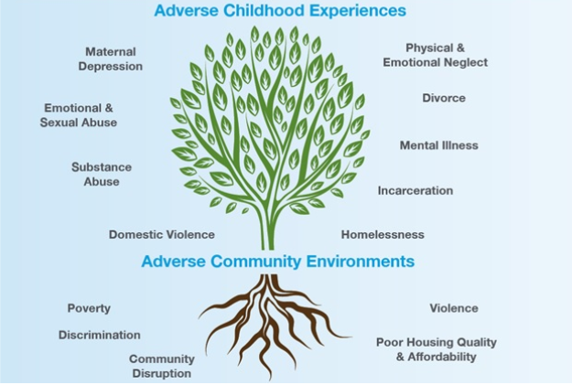
Poverty and ACE’s: The Pair of ACE's
(Ellis and Dietz, 2017)
(Hartley, 2020)
Poverty is not an Adverse Childhood Experience .
poverty and socioeconomic inequality considered potential “causes” of ACEs (Walsh et al, 2019)
In a study of the relationship between abuse/neglect and poverty, Bywaters et al, (2016) show that many children who are not from families in poverty will experience abuse or neglect, and that most children in families who are living in poverty will not experience it.
is caused by many interlocking factors.
direct effect - through material hardship or lack of money to buy in support
Indirect effect -parental stress and neighbourhood conditions
Notes:
I will not be going into major detail on this but I feel it fair to at least mention the poverty and the aces (adverse childhood experience). To draw this into a little bit of context I have chosen the pair of aces which is the adverse childhood experiences and also within that you have the adverse community environments so without going into it too deeply, I just like to point out that there are nine points on the adverse childhood experience side, and for the adverse community environments side there is six points that need addressing in order for a young person to have a fighting chance of mitigating those circumstances. This needs to be addressed in order to avoid such things like physical and emotional neglect mental illness poverty community disruption violence and so on.

Slide 4
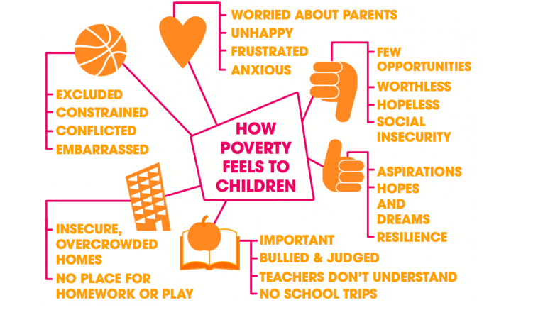
Impacts of Poverty on young people
CPAG, (2021)
(https://cpag.org.uk/child-poverty/effects-poverty)
Notes:
Finances One thing we need to be aware of is that those aces can have impacts upon poverty in which young people are facing so to break this down a little bit I thought it would be appropriate to show just how much those different effects can seem to young people bearing in mind as youth workers we are dealing with those ages of 11 years through to 25 years predominantly. This can affect things like education, health and the communities so in order to break this down a bit more I feel that some young people may be missing out on certain things that perhaps their peers may have all the community has.

Slide 5
What is Period Poverty?
Period poverty’ means being unable to access sanitary products and having a poor knowledge of menstruation often due to financial constraints. In the UK, 1 in 10 girls can’t afford to buy menstrual products, while 1 in 7 have struggled to afford them, according to a representative survey of 1,000 girls and young women aged 14-21 by Plan International UK.
Notes:
I will be repeating the 1 in 10 statistics in the UK. Read this slide and emphasise the importance of Period Poverty also remember to mention one in 10 girls can’t afford to buy menstrual products. One in four girls and young women across the UK said they felt unprepared for the state of their period and one in seven said they didn’t know what was happening this was taken back in July 2017. For the purpose of privacy, I will be using false names to protect the identities of young people. Young Pauline made a comment saying “it comes out between your thingy and your bottom” this young person was very young. A survey that was carried out in 2010 mentions that 44.5% of disabled people didn’t receive any sex education at school this was courtesy of Leonard Cheshire disability survey, 2010. Next Slide

Slide 6
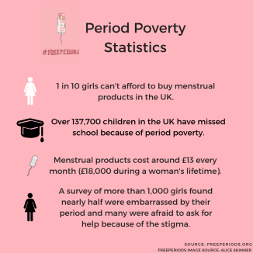
UK Period Poverty Shocking Statistics
https://www.sjun.org.uk/st-johns-tackles-period-poverty/
Notes:
• I am now going to be throwing in some facts which might seem shocking and both alarming. Nearly 800 million women and girls menstruate daily worldwide. Period poverty encompasses the shame, guilt and cost barriers around access to sanitary products. One in 10 girls in the United Kingdom is unable to afford sanitary wear, resulting in detriment to their self-esteem, education and overall quality of life. Eliminating period poverty has often been the focus of non-profits and the U.K.’s government.
• 12% of Girls PLAN International UK surveyed had been told NOT to talk about Periods in Front of their Mothers.
• 11% of Girls surveyed had been told not to talk about their periods in front of their fathers.

Slide 7
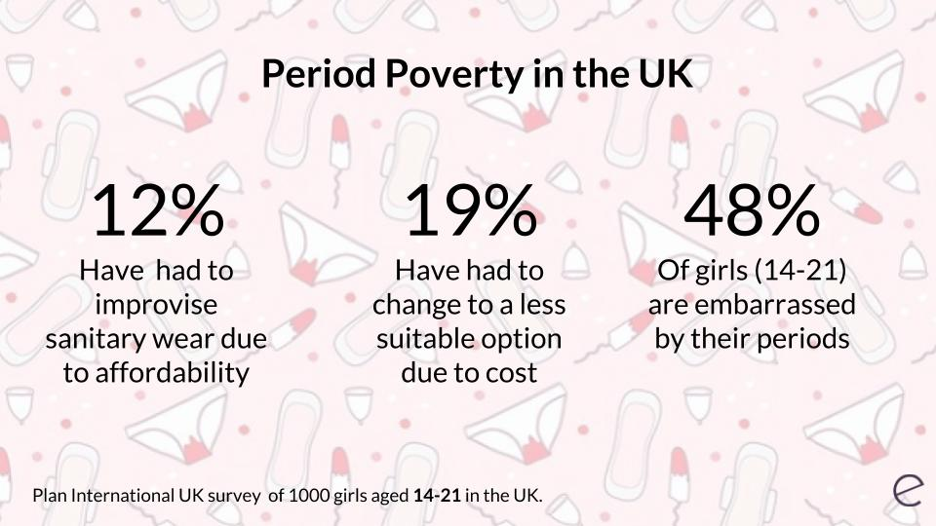

Period Poverty
https://elara.care/culture/period-poverty-everything-you-need-to-know/
https://twitter.com/plaid_cymru/status/1029650534704275457
The Period Dignity Grant for Schools will provide over 141,000 girls in Welsh primary and secondary schools with a range of sanitary products.
Local authorities up until 2020 to provide sanitary products through schools, food banks and shelters to those who may otherwise struggle to afford them and £700,000 to improve school toilet facilities.
https://gov.wales/period-dignity-thousands-benefit-multi-million-pound-funding-schools
Notes:
In 2017, period poverty gained exposure in the media after a teacher in Leeds contacted a local charity after becoming concerned that girls were missing school because they couldn’t afford period products. Elara (2019), First Minister Mark Drakeford has announced that free sanitary products will be available in schools across Wales with £ 2.3 million in funding from the Welsh Government. The First Minister, Mark Drakeford, said: we are committed to supporting period dignity and maintaining our investment in schools to help bring period poverty to an end. In March, we declared free sanitary products would be available to all women in Wales’ hospitals – it is only just that the same happens across our schools. It is essential ample sanitary products, as well as good facilities, are available to all female learners so they can manage their periods with confidence and remove what is an unnecessary barrier to their education.

Slide 8
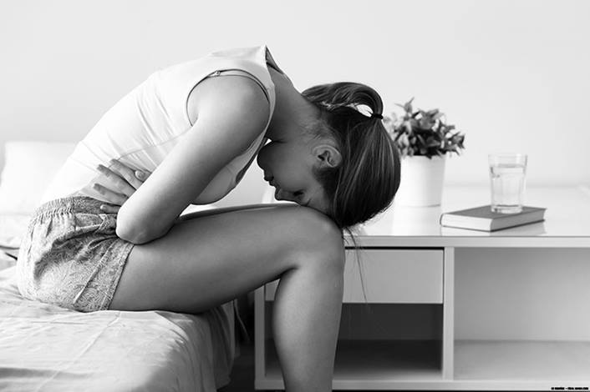

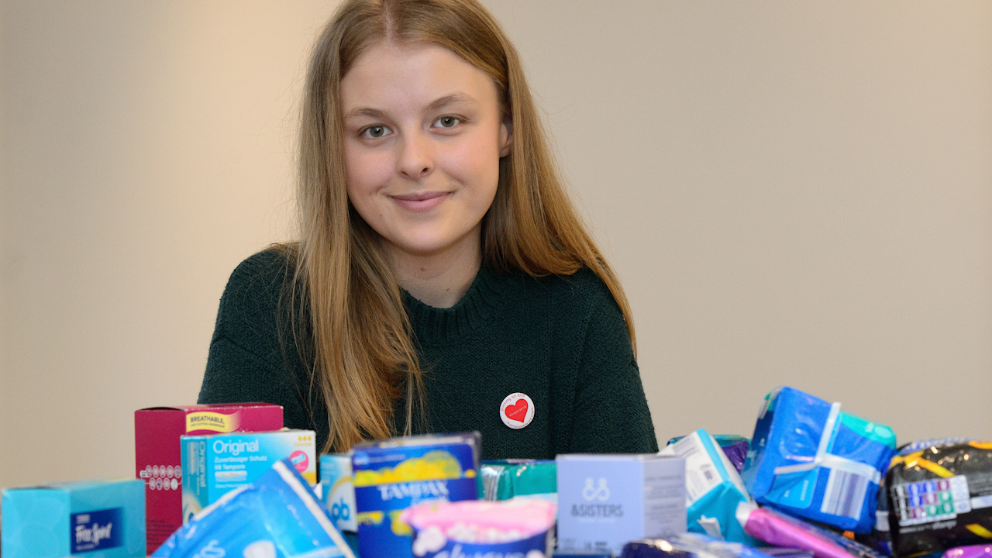
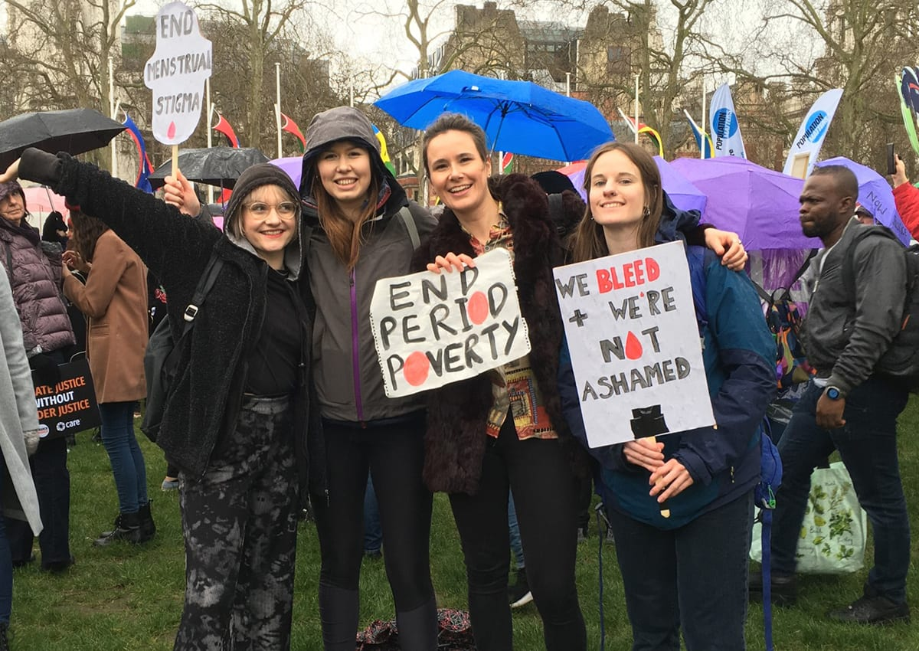
Effects of Period Poverty on Young Females
Impacts/ Exclusion/ Oppression and ACE’s
https://www.nationwidechildrens.org/family-resources-education/700childrens/2020/10/period-problems-4-common-menstrual-issues-for-young-women
https://plan-uk.org/file/plan-uk-break-the-barriers-report-032018pdf/download?token=Fs-HYP3v
https://eco-age.com/resources/why-we-need-to-talk-about-period-poverty/
https://www.walesonline.co.uk/news/wales-news/love-your-period-cardiff-molly-17635219
Notes:
Period poverty is often misunderstood as simply the lack of affordability of menstrual supplies. While this is a huge part of the issue, period poverty or menstrual health also incorporates the far wider issues of stigma, shame, lack of education and lack of access to both products and information. While menstrual stigma causes women and girls* to internalise feelings of shame, disgust and embarrassment at their own healthy bodies, the lack of access to products and guidance causes girls to drop out of school and to strive for fewer opportunities.
Irregular Periods
Heavy Periods
Painful Periods
Acne

Slide 9
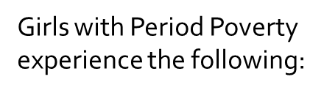
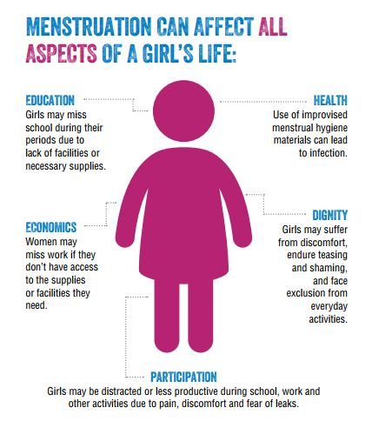
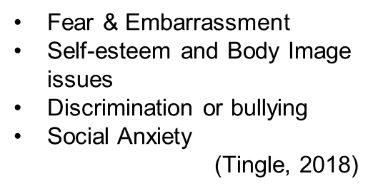
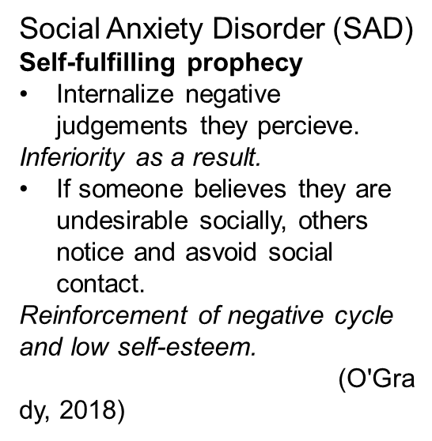
More adverse effects from Period Poverty
https://stories.plancanada.ca/a-bloody-shame-6-reasons-why-menstruation-is-keeping-girls-out-of-school/
Notes:
Furthermore, to this the effects that this is having on young girls and women in general is that it is keeping girls from achieving in life and thus making education not very good. Embarrassment, Shame

Slide 10

Stigma surrounding menstruation
Period taboo: Why can't we talk about menstruation?
Notes:
Bodyform.co.uk, P41 Break the Barriers Stigma BBC Ireland Period poverty is an issue facing too many girls when they should instead concentrate on their class work - 40 percent of girls in the UK have used toilet roll because they could not afford feminine hygiene products and 68 percent said they felt less attentive during menstruation in school or college. So, why is it so tough to talk about menstruation?
Claire Best, a volunteer for The Red Box Project NI, told BBC News NI, "If you're a girl who lives in a single-parent family with your dad, you could be too embarrassed to ask about your period or for sanitary products,"
For people, especially for younger girls, periods can be really difficult.

Slide 11
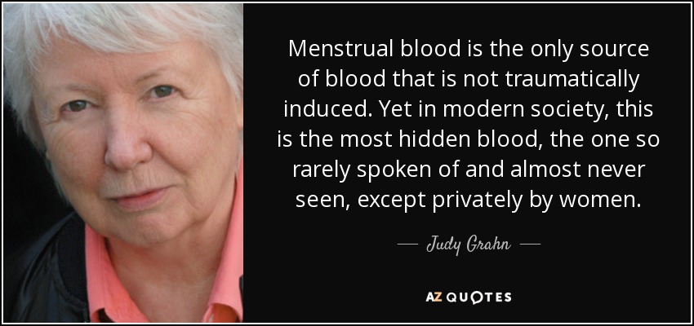
Quote on Menstruation
Notes:
American Poet and Feminist This is a powerful quote by Judy Grahn who is an American poet and a feminist and this strikes as a powerful and very true statement which I believe is very true

Slide 12
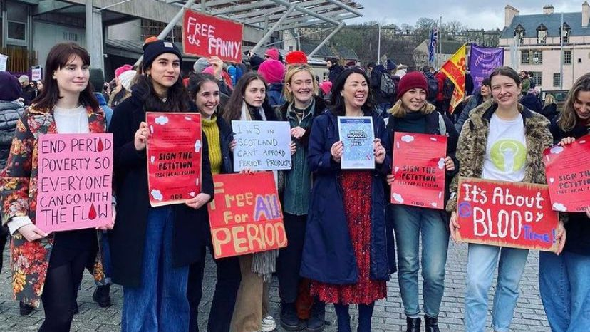
Scotland becomes the first country in the world to make period products free for all
https://www.abc.net.au/news/2020-11-25/scotland-becomes-first-nation-to-offer-period-products-for-free/12917880
Notes:
Scotland becomes the first country in the world to make period products free for all On Tuesday, following its first introduction in 2017, members of the Scottish Parliament (MSPs) passed the Period Products (Free Provision) (Scotland) Bill unanimously.

Slide 13
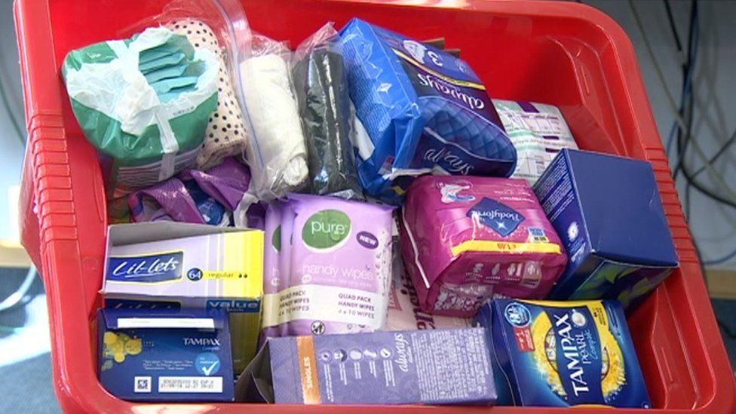
In Wales
Period poverty is to be helped with £3.3m for free sanitary products
Notes:
The Welsh Government has recently in the beginning of 2020 given much needed input for the urgent need to provide sanitary pads and tampons, however there only seems to be provision for secondary schools and perhaps colleges

Slide 14

Two young girls from Carmarthenshire have started this campaign
Notes:
On a local level Two young girls from Carmarthen have been out making sure that all schools and colleges and the university were aware of the huge impact this could make on the young people on a local level

Slide 15
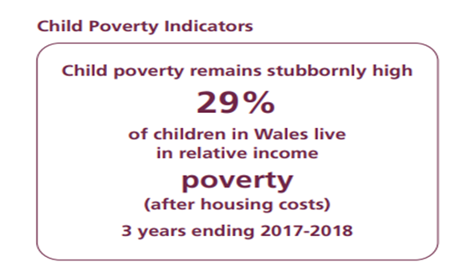
Children in Wales
(National Umbrella Body representing child rights)
Annual survey on child poverty in Wales.
Managing and co-ordinating the End Child Poverty Network Cymru.
Proactively engaging with Welsh Government members in the development and delivery of legislation and policies relating to child poverty.
Organising National and regional child poverty events.
Representing Wales on the UK Social Mobility and Child Poverty Commission.
Lobbying the UK Government around non-devolved matters, including welfare reform.
Engage with the work programmes of other working groups and forums which focus on the wider poverty agenda or specific policy issues.
Engage with and lobby local partners to help ensure that policies and programmes are in place locally which tackle child poverty.
Engage on the issues relating to child poverty at a European level and promote the work and approach taken in Wales through our work with Eurochild.
Produced consultation responses, identify policy priorities and develop written reports and publications.
Providing information, advice and a signposting service for our member organisations in relation to external services and policies.
Poverty - Children in Wales
Child poverty strategy: assessment of progress 2019 e (senedd.wales)
Notes:
• UNCRC articles
• Poverty
the Welsh Government should:
• Provide clear and strong leadership on tackling child poverty to ensure all children in Wales are able to reach their full potential, by engaging with the UK Government, public bodies in Wales and with all sectors including employers
• Put in place and monitor a specific child poverty delivery plan with ambitious milestones and targets, to drive the implementation of national strategy, which promotes evidenced programmes and services to ensure that no child is disadvantaged in realising their rights under the UNCRC because of family income
• Ensure that tackling child poverty remains a priority within new arrangements under the Wellbeing of Future Generations (Wales) Act and that clear accountability measures are in place

Slide 16
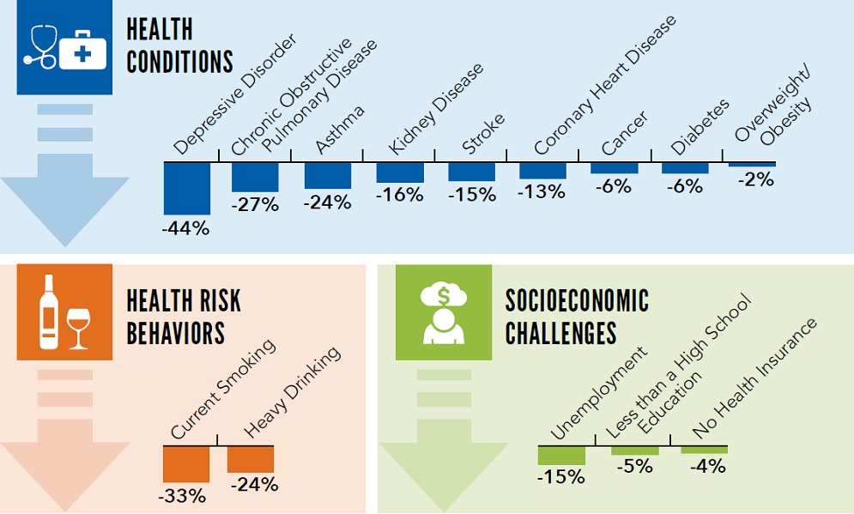

Impact into Adulthood and Cost of ACE's
https://www.cdc.gov/vitalsigns/aces/data-visualization.html
https://www.cdc.gov/vitalsigns/aces/data-visualization.html
Notes:
• the Welsh Government should:
• Provide clear and strong leadership on tackling child poverty to ensure all children in Wales are able to reach their full potential, by engaging with the UK Government, public bodies in Wales and with all sectors including employers
• Put in place and monitor a specific child poverty delivery plan with ambitious milestones and targets, to drive the implementation of national strategy, which promotes evidenced programmes and services to ensure that no child is disadvantaged in realising their rights under the UNCRC because of family income
• Ensure that tackling child poverty remains a priority within new arrangements under the Wellbeing of Future Generations (Wales) Act and that clear accountability measures are in place

Slide 17

Interventions to help raise awareness of period poverty
How could the National Occupational Standards for Youth Work aim to support Children in Period Poverty?
YW10 Advocate with and on behalf of young people so that their interests are represented.
YW13 Access information with and for young people for informed decision making.
YW 18 Engage with Young People to Promote their emotional Wellbeing and Mental Health
YW19 Develop a culture and ethos that promotes inclusion and values diversity
YW21 Secure funding and resources for youth work

Slide 18
Youth Work breaking down barriers to Period Poverty and Stigma
Quiz
Workshops
Let’s talk menstruation and breaking the stigma and taboos
Straight talking and drop the euphemisms I.E aunty flow is here
Educate young people on the stigma that surrounds this very real issue!
Notes:
Fun Quizzes, Funding and collections for free products TUC

Slide 19
Thank You
Thank you for listening, and if you have any questions please feel free to ask them now!

Slide 20
References
Sheridan, M.A. and McLaughlin, K.A., 2016. Neurobiological models of the impact of adversity on education. Current Opinion in Behavioral Sciences, 10, pp.108-113.
Chamberlain, R Mullineux, R. (2012). Wales has worst child poverty in UK. Available: https://www.poverty.ac.uk/report-wales-child-poverty/wales-has-worst-child-poverty-uk. Last accessed 15th Feb 2020.
Hood, A, Waters, T.. (2017). Benefit cuts set to increase child poverty, with biggest rises likely in North East and Wales. Available: https://www.ifs.org.uk/publications/10029. Last accessed 15th Feb 2020.
O'Grady, S., 2018. Social Anxiety Disorder: When Fear Leads to Isolation. [online] WebMD. Available at: <https://blogs.webmd.com/mental-health/20180830/social-anxiety-disorder-when-fear-leads-to-isolation> [Accessed 19 February 2021].
Tingle, C., 2018. Break the Barriers: Girls' Experiences of Menstruation in the UK. Plan International UK.
NSPCC, 2020. Children and the law | NSPCC Learning. [online] NSPCC Learning. Available at: <https://learning.nspcc.org.uk/child-protection-system/children-the-law#heading-top> [Accessed 19 February 2021].
Hartley, J., 2020. If You Want Better Fruit, You've Gotta to Deal with Roots. [online] New Orleans ACEs Connection (LA). Available at: <https://www.acesconnection.com/g/new-orleans-aces-connection-la/blog/building-community-resilience-through-systemic-awareness> [Accessed 19 February 2021].
Welsh Government. (2015). Programme for Children and Young People. Available: https://gov.wales/sites/default/files/publications/2019-06/seven-core-aims-for-children-and-young-people.pdf. Last accessed 15th Feb 2020.
N/A. (2015). Programme for Children and Young People. Available: https://gov.wales/sites/default/files/publications/2019-06/seven-core-aims-for-children-and-young-people.pdf. Last accessed 15th Feb 2020.

Slide 21
References Continued
Ellis, W.R. and Dietz, W.H., 2017. A new framework for addressing adverse childhood and community experiences: The building community resilience model. Academic Pediatrics, 17(7), pp.S86-S93.
Walsh, D., McCartney, G., Smith, M., & Armour, G. (2019). Relationship between childhood socioeconomic position and adverse childhood experiences (ACEs): A systematic review. Journal of Epidemiology & Community Health, 73(12), 1087–1093.
Bywaters, P., Bunting, L., Davidson, G., Hanratty, J., Mason, W., McCartan, C. and Steils, N., 2016. The relationship between poverty, child abuse and neglect: an evidence review. York: Joseph Rowntree Foundation.
Williamson, D., 2015. Wales suffers the joint-highest rate of child poverty in the UK. [online] WalesOnline. Available at: <https://www.walesonline.co.uk/news/wales-news/fifth-welsh-children-now-living-9524140> [Accessed 19 February 2021].
Cuthrell, K., Stapleton, J. and Ledford, C., 2009. Examining the culture of poverty: Promising practices. Preventing School Failure: Alternative Education for Children and Youth, 54(2), pp.104-110.
N/A. (2015). Keeping Young People in School - Alternatives to Exclusion Selwyn College, University of Cambridge. Available: https://www.vrc.crim.cam.ac.uk/files/images/Sadteenagerbbc.jpg. Last accessed 15th Feb 2020.
Conroy, Bacon Jr. (2020). There’s A Huge Gap In How Republicans And Democrats See Discrimination. Available: https://fivethirtyeight.com/features/theres-still-a-huge-partisan-gap-in-how-americans-see-discrimination/. Last accessed 15th Feb 2020.
Youth.Gov. (2011). Risks and Protective Factors. Available: https://youth.gov/youth-topics/tag/about-tag/risks-protective-factors. Last accessed 15th Feb 2020.
N/A. (2019). Data Visualization: Preventing ACEs could reduce a large number of health conditions.. Available: https://www.cdc.gov/vitalsigns/aces/data-visualization.html. Last accessed 15th Feb 2020.
N/A. (2019). New child-friendly version of the UNCRC published by UNICEF. Available: https://www.togetherscotland.org.uk/news-and-events/news/2019/08/new-child-friendly-version-of-the-uncrc-published-by-unicef/. Last accessed 15th Feb 2020.

Slide 22
References Continued
N/A. (2020). The UK’s National Occupational Standards (NOS) for IT, Cyber Security and Analytics. Available: https://www.tpdegrees.com/news/have-your-say-nos-for-it-cyber-security-and-analytics/. Last accessed 15th Feb 2020.

