Slide 1


Module Name: Effective Team-working and Communication
Module Code: BMSW4009
Assignment Name: Group Presentation
Student Names:
Adelina Georgiana Cozma (2431275)
Employability Skills

Slide 2

Group Dynamics & Building Successful Relationships

Slide 3


How people in a group interact and behave. (Forsyth, 2019)
Roles, norms, cohesiveness, communication, and power dynamics are all things that affect people. (Johnson & Johnson, 2017)
Find out how productive, happy, and good at making decisions the group is. (Levi, 2017)
It can be helpful or harmful, depending on how it is set up and how people get along with each other. (Forsyth, 2019)
Group Dynamics
Notes:
Forsyth (2019) says that group dynamics are the important processes and structures that affect how a group acts. These include how people talk to one another, how power is divided, what roles people are expected to play, and how emotions work.
Good group dynamics benefit teams:
plan work
keep the group together
handle disputes in a positive way
Bad dynamics may cause people to not understand each other, have poor morale, and have unresolved issues.

Slide 4
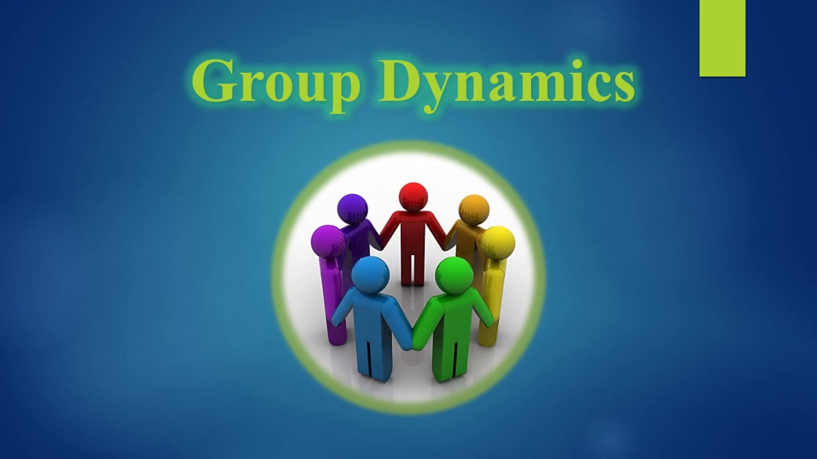
Why Group Dynamics Matter?
Figure out how well and how much work your team will do (Johnson & Johnson, 2017).
Affect creativity and finding solutions (Levi, 2017).
Influence psychological safety and member involvement (Forsyth, 2019).
Change the way people fight and work together (Johnson & Johnson, 2017)
Notes:
Teams are like systems that work together. Johnson & Johnson (2017) shows how good group dynamics build trust and teamwork. Levi (2017) stresses that the environment of a group affects how well people do, how happy they are, and how they deal with conflicts.

Slide 5
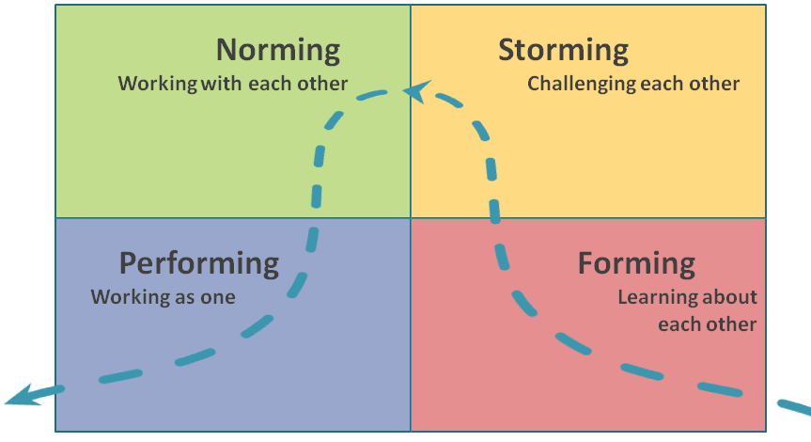
Team Development
Forming: orientation, politeness, testing boundaries (Tuckman, 1965)
Storming: conflict, competition, resistance (Tuckman, 1965)
Norming: cohesion develops, norms established (Tuckman, 1965)
Performing: interdependence, productivity (Tuckman, 1965)
Belbin’s Team Roles: e.g., Coordinator, Implementer, Shaper, Completer-Finisher, Resource Investigator, Teamworker, Plant, Monitor-Evaluator, Specialist (Belbin, 2010).
Our team: Roles we each played, strengths (e.g., creativity, organization), weaknesses (e.g., conflict avoidance, over-analysis), and how we addressed them (Aritzeta et al., 2007).
Challenges: Role overlap, missing roles, adapting to fill gaps (Wheelan, 2016).
Notes:
Tuckman (1965) describes predictable stages teams progress through. Bonebright (2010) shows how the model has remained relevant across decades. Teams often cycle back through stages when undergoing change. Finding these stages is crucial for leaders to help manage a team's progress and conflict. We analysed our team using Belbin’s Team Role framework (2010), which helps identify individual strengths and weaknesses.
Balanced roles improve performance. Adapting and rotating roles, which we did, resulted in better collaboration and skill development.

Slide 6


How to build successful relationships
Develop open communication channels (Levi, 2017)
Practise active listening (Johnson & Johnson, 2017)
Support emotional intelligence skills (Levi, 2017)
Encourage empathy and perspective-taking (Forsyth, 2019)
Provide regular constructive feedback (Johnson & Johnson, 2000)
Celebrate contributions and successes (Levi, 2017)
Clarify roles and shared goals (Belbin, 2010)
Team success is decided by group dynamics (Forsyth, 2019).
Open the Design Ideas pane for instant slide makeovers.
When we have design ideas, we’ll show them to you right there.
Notes:
In the end, the application of theoretical models, such as Tuckman’s, Belbin’s and Thomas-Kilmann’s, is a good one to further effective approach relationship building and to conflict management in teams. This holistic view promotes cooperation, reduces conflict and improves team performance overall (Levi, 2017; Rahim, 2002).”

Slide 7
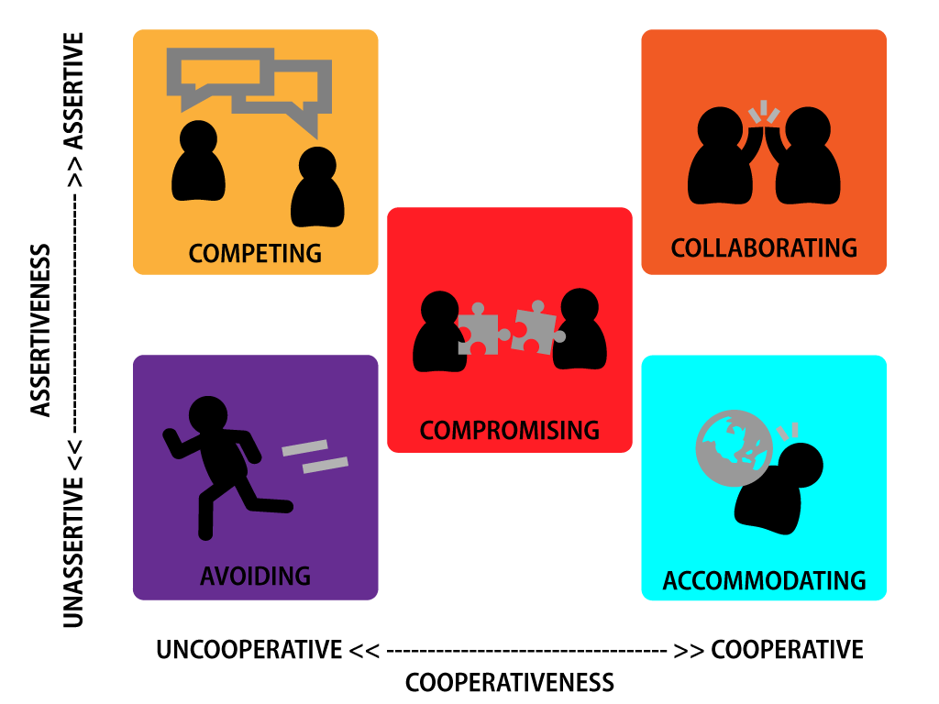
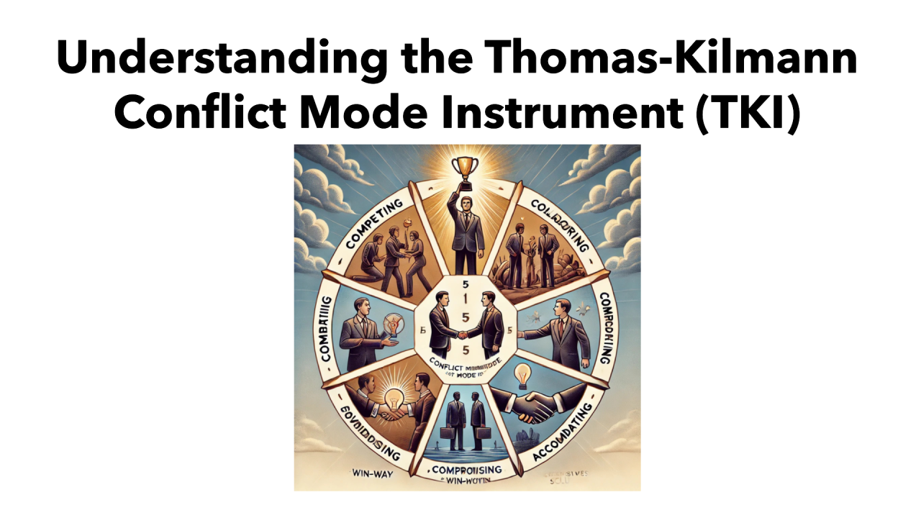

Thomas-Kilmann Conflict Mode Instrument
Five modes: Competing, Collaborating, Compromising, Avoiding, Accommodating (Thomas & Kilmann, 1974).
Seek a situation-specific style of resolution for conflict (Rahim, 2002)
Notes:
There is no ‘one size fits all’ approach to resolving conflict (Thomas and Kilmann, 1974). For example, in situations where integrative solutions will be helpful, ‘Collaborating’ is needed while ‘Avoiding’ helps resolve issues in more trivial areas (Rahim, 2002). Such modes enable healthy relationships while conflict resolution takes place in productive ways.”

Slide 8
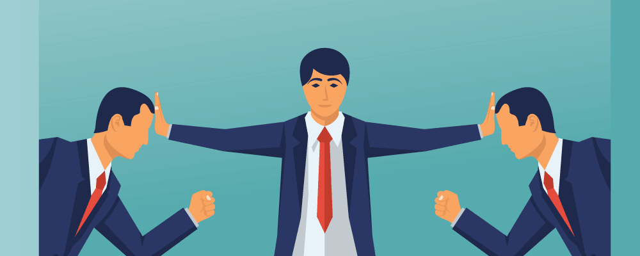


Conflict Handling and Resolution strategie
Conflict is unavoidable: It may be helpful if handled properly (Jehn, 1995).
The Thomas-Kilmann paradigm has five parts: competing, collaborating, compromising, avoiding, and accommodating (Thomas & Kilmann, 1974).
Good tactics include talking openly, mediation, and utilising organised frameworks (De Dreu & Van Vianen, 2001).
• How we do things: Used open conversation and compromise to settle issues over tasks and schedules.
Notes:
Conflict is normal in every group (Jehn, 1995). The Thomas-Kilmann model (1974) offers five strategies; we discovered that collaboration and compromise were the most effective for us. For example, when two members requested the same job, we spoke about our choices openly, which led to a fair rotation. De Dreu and Van Vianen (2001) suggest organised communication as a way to handle conflicts. We did this by establishing rules for talks and making sure everyone's voice was heard.

Slide 9
References Adelina Cozma
  Belbin, R.M. (1981) Management Teams: Why They Succeed or Fail. Oxford: Butterworth-Heinemann.
  Belbin, R.M. (2010) Team Roles at Work. 2nd edn. Oxford: Butterworth-Heinemann.
  Belbin, R.M. (2012) Team Roles at Work. 2nd edn. London: Routledge.
  Bonebright, D.A. (2010) ‘Forty years of storming: A historical review of Tuckman’s model of small group development’, Human Resource Development International, 13(1), pp. 111–120. Available at : DOI: 10.1080/13678861003589099
  Forsyth, D.R. (2019) Group Dynamics. 7th edn. Boston: Cengage Learning.
  Johnson, D.W. and Johnson, F.P. (2000) Joining Together: Group Theory and Group Skills. 7th edn. Boston: Allyn and Bacon.
  Johnson, D.W. and Johnson, F.P. (2017) Joining Together: Group Theory and Group Skills. 12th edn. Boston: Pearson.
  Levi, D. (2017) Group Dynamics for Teams. 5th edn. Los Angeles: Sage Publications.
  Rahim, M.A. (2002) ‘Toward a theory of managing organizational conflict’, International Journal of Conflict Management, 13(3), pp. 206–235. Available at : DOI: 10.1108/eb022874
  Thomas, K.W. and Kilmann, R.H. (1974) Thomas-Kilmann Conflict Mode Instrument. Tuxedo, NY: Xicom.
  Tuckman, B.W. (1965) ‘Developmental sequence in small groups’, Psychological Bulletin, 63(6), pp. 384–399.Available at : DOI: 10.1037/h0022100

