Slide 1

Task 1 Presentation- Strategies for Effective Communication in a Business Setting
Effective Team Working and Communication (BMSW4002_BIRM)
Elizabeth Idehen Akpasubi & Dennis Brown
Student Number: 2119449
Lecturer’s name: Hafiz Rahman

Slide 2
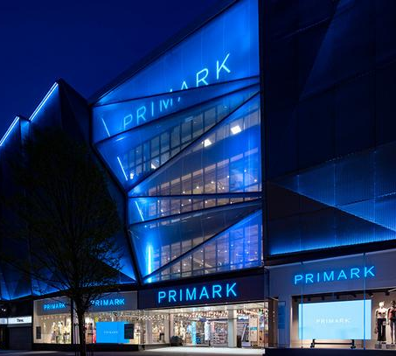
Purpose of presentation
We will be presenting the organisation Primark analysing the communication methods, strategies, and communication barriers between Primark and the external stakeholders (customers, employees, suppliers).

Slide 3
Primark
Irish multinational quick fashion retailer founded in 1969 by the Weston family. Primark is headquartered in Dublin. It is a division of Associated British Foods, operates stores in both the US and Europe. Because American retailer J. C. Penney owns the Penneys trademark overseas, it is not utilised outside of Ireland. Headquarters Boston, Massachusetts, United States. Founder Arthur Ryan, revenue 5.593 billion since 2021. Primark is employing more than 65,000 thousand colleagues in 14 countries. The retailer has 398 stores allocated worldwide. Every aspect of what Primark does is centred on everyday affordability, from high-quality necessities to unique fashion, trend setters to multigenerational families. (Primark 2022)
External stakeholders' customers, workers and suppliers. Other outside parties with a stake in Primark also have an influence over it. Governments, advocacy organisations, local communities, all have varied degrees of influence, stake in how the store does business (David 2022).
To be sustainable, Primark is the corporation that upholds its values, convictions. Primark's beliefs dictate the first step in its responsibility to its employees. The organisation should treat all its workers fairly, equally, according to its core values. The company's commitment to moral behaviour, business processes is another strategy. The business participates in a variety of CSR initiatives to uphold its social obligations. The company's HER project aims to raise awareness of the value of maintaining personal hygiene, health among its female employees. The society gains from this education when it is passed on to the workers' families.
Communication with customers
Primark tries to fulfill the demands of its clients by offering reasonably priced, stylish clothing.
Most other clothing retailers don't invest much in advertising. Primark heavily relies on social media to interact with customers, maintain their reputation, stay visible the company prefers to generate publicity online over paying for advertising. Primark capitalises on the online excitement by developing digital marketing strategies; this is how the company primarily interacts with its customers.
Social media
Primark uses Facebook, twitter, Instagram, Pinterest, google plus, primania where users can upload pictures of their clothes. This tool aids the business in developing its brand personality, increasing brand recognition. This platform demonstrates that the business is affordable and trend-aware (Cardoso 2022).

Slide 4
Primark website
The site is another approach to maintain communication with customers. Primark posts information on the newest arrivals of products, company principles, current projects like programmes in developing nations, environmental choices so that customers are aware of the company's activities (Cardoso 2022).
Video campaigns
Primark has launched a few video campaigns in recent years despite having a limited marketing, advertising budget. They also publish video campaigns from various departments, the new season's product line on their Facebook page.
Feedback
Customers can give feedback to Primark for them to continue receiving their satisfaction. Positive feedback can be utilised to market the company's products and services, the company will be able to improve both their customer service, products due to this. Primark offers consumers the option to win prizes in exchange for taking an online survey using the survey code found on each receipt (Cardoso 2022).
Communication with employees
Training, development primark provides its staff with the necessary training, growth possibilities. An introduction session is attended by all new employees as a means of introducing them to the team and their respective roles. The company offers its employees additional opportunities for training to help them advance within the company, join the management team. The company also gives its employees access to tools and resources to help them take on better roles within the company. These training opportunities can be tailored to the needs of individual employees in areas like team leadership, admiration, retail, customer service.
Rewards, benefits programmes for development, training, health insurance, bonus programme, variable shifts, entitlement to competition, possibilities for promotion (Cardoso 2022).

Slide 5
Communication with suppliers
Programmes in the third world countries the ethical trade team at Primark visited cotton workers in India and created a programme to improve farmer education. Primark creates programmes in the nations that provide its clothing.
Surveys
In Bangladesh, where Primark's clothing production is based, certain structural studies of the buildings have been done by the retailer. The company tried to determine whether the structures posed a risk to the lives of the workers. Primark is very concerned about the working conditions of those who make their products, so they are constantly interacting with them, creating programmes, surveys to better communicate with them. By doing this, they can understand their needs, concerns, establish this relationship, the company benefits from having better workers (Cardoso 2022).
Primark Communication Disadvantages
Primark makes the most use of social media the company generates online awareness without investing a lot of money. The company heavily relies on social media to spread the word, increase brand awareness, but Primark has some restrictions. One of the main restrictions is the absence of online store, which has limits because customers occasionally prefer to shop from home or make purchases online when a product is unavailable in-store, most competitors offer online shopping options.
Another issue that Primark needs to be concerned with is the spread of bad press online. Primark lacks brand transparency, engages customers online, responding to questions on social media (Sophie and Irina 2013).
Benefits of effective communication
Connecting with clients, sponsors, any other external bodies requires effective communication. Customers are more likely to remain loyal to a company if they feel that they have been heard and valued. Companies with devoted clients develop a reputation for dependability and best customer care (Vogel 2022).
Trust
To make the greatest choices for the team, company, primark must be able to listen to others, explore ideas, viewpoints, engage in discussions. As employee's complete tasks, express thoughts, ideas, establish goals for both themselves the company, communication can help increase trust between them and management (Johnson 2021).

Slide 6
Team building
The more communication there is within a team, the better the working environment will be for employees. Additionally, if team members feel comfortable approaching more senior employees with concerns or questions, this creates loyalty and trust (Johnson 2021).
Better relationships
Listening to individuals in the workplace
Respecting, making others feel heard by responding to emails
Customers become more pleasant when the business is interacting with them
Increased job satisfaction
Employees who practise effective communication at work, feel trusted by their co-workers are more likely to report higher levels of job satisfaction. How interested team members are in their work will depend on the environment established (Johnson 2021) .
How should primark use the theories relating to models of communication?
Understanding communication theories in business may not be the solution to all problems, but they can help clarify the mysteries around human behaviour perhaps more importantly, help, define the kind of leader, workplace, culture primark wants to promote.
Shannon and Weaver Model – technological communication
The Shannon and Weaver model considers noise that compromises the accuracy of the message being transmitted. As a result of the environment's many data sources, the message sent from the sender to the recipient may be changed in unfavourable ways. This change in the message's content could cause misunderstandings, confusion regarding the message. According to the Shannon and Weaver model, to accomplish effective communication, the communicator (primark) must be aware of the environmental and process-related noise sources. The communicator must then deal with these sources of noise by altering the channel, timetable, equipment used for communication. For instance, in a commercial setting, sources of communication noise could be other employees, tools employed for internal communication (Bennett 2021).

Slide 7
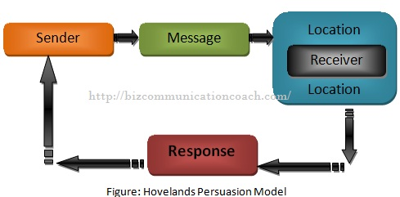
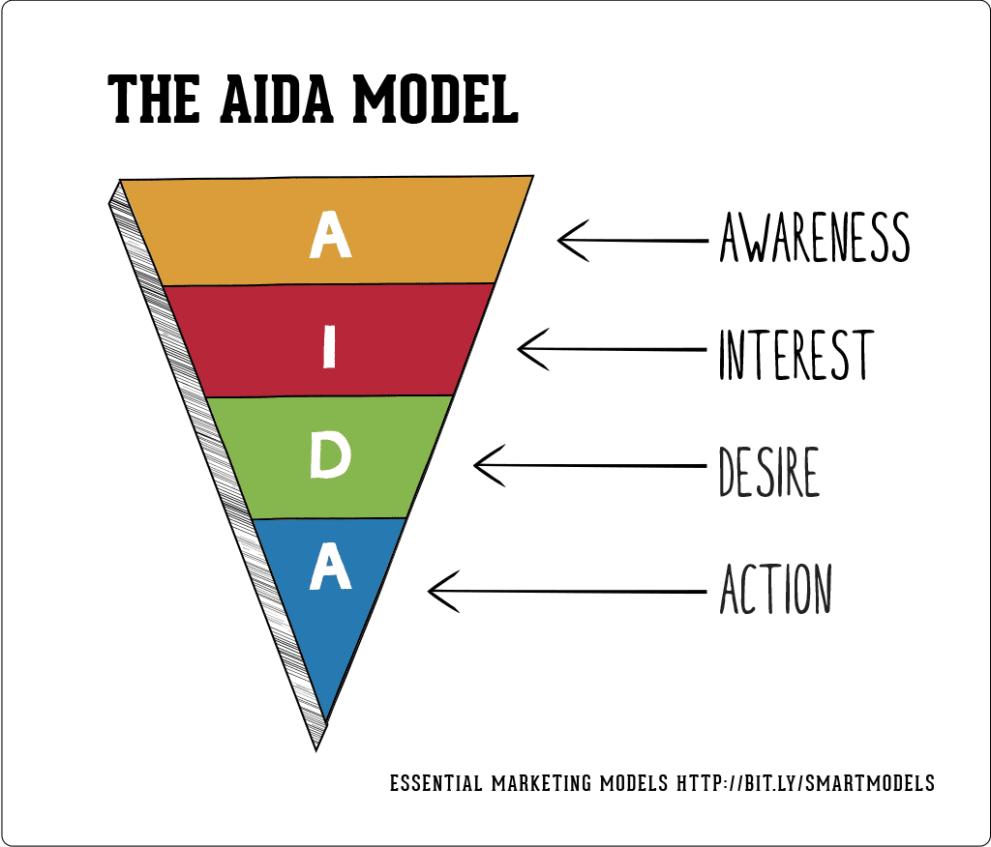
Example: A project team leader calls her workers on the phone to request that they improve the introduction from a greeting to a sales presentation. The model consists of 6 elements sender, encoder, channel, decoder, receiver, noise.
Thayer's Model
This approach connects organisational structure and personal business communication. Thayer has demonstrated in the model how attempting to complete any work through personal communication has a significant impact on the corporate communication process (Business communication 2021).
This model also demonstrates how an individual's communication skills operate at the organisational level. Four factors biological, psychological, social, technological can have an impact on the behaviour of the transmitter, recipient. In fact, this model illustrates how an individual's impact on the communication process in an organisational setting.
Below is the template: (Lewis 2021)
AIDA Model
Persuasive communication framework that comes from the marketing industry. Awareness, interest, desire, action are its four stages. It is an effects hierarchy model that adheres to the CAB procedure. It begins by fostering cognition, awareness, then affect, desire, action, stimulation, behaviour (Lewis 2021).
The system is presented as a funnel, signifying the decreasing number of individuals anticipated to advance to each step.
This model's first stage focuses on awareness. Making as many people as possible aware of the product, good, brand is the goal.
Suspects are people who have an interest in the service. After becoming aware, individuals express an interest in knowing more about the product. They desire to gain knowledge about its particulars and how it might apply to their life.
At this point, potential customers are clearly interested in the goods, would like to purchase it. They might still need to overcome some obstacles to reach a choice. They may face pricing or behavioural difficulty as barriers, but they are largely prepared to become clients.
This transition from prospect to customer requires thoughtful, intentional activity on the part of the person. This act typically manifests as purchase (Lewis 2021).
.

Slide 8
Handy's model of culture
Four different kinds of culture power, role, task, person.
Managers at Primark use slang instead of other language to quickly communicate ideas, assume that staff members would understand what they mean, according to the Handy's approach. When managers use formal language with staff members, it conveys a sense of authority, elevates them in the hierarchy. Additionally, the firm has unspoken expectations, guidelines that mandate staff members must conduct themselves professionally, be properly dressed in their uniforms when dealing with consumers (Brenyah and Obuobisa-Darko,2017). This demonstrates the necessity for Primark employees to act responsibly, professionally. Employees, managers of the company dress differently, indicating that supervisors have more power and rank than sales staff.
Types of barriers that can prevent effective communication between organisation, external stakeholders
The following five categories can be used to identify communication barriers:
Physical barriers: due to their surroundings, people can encounter difficulties in communicating.
Emotional barriers - this barrier may be caused by the speaker's previous feelings toward the matter or other participants in the conversation.
Cultural obstacles - these limitation result from differences in several areas, including power distance, religion, language, and tradition.
Cognitive barriers are a combination of emotional, cultural barriers, such as word meaning influencing the message during communication.
Systematic obstacles - these obstacles are caused by a lack of organisation in the environment, which is frequently observed in offices where duties are not clearly defined, expressed (Lombardo 2022).

Slide 9
Examples of different channels of communication
Physical buildings with open spaces are desirable because they enable quick and effective communication among co-workers. Businesses start to physically block good communication the moment they close the door to their office, put walls between external stakeholders. Sometimes these challenges are unsolvable when businesses have offices in various places, but there are ways around them, such as video technology and other technologies (Disqus 2022).
Emotional self-confidence is important for overcoming psychological difficulties. Individuals will be able to convey the knowledge they are providing with people clearly if they have a thorough understanding of it. The likelihood that persons getting the information will understand it and be able to act on it is increased by knowing. When interacting with others, our emotions can sometimes take over. Emotions like rage, pride, worry can affect our judgement and hinder effective communication. Being able to stay calm and the emotions of others around will result in a more highly effective team. Emotional intelligence is a very crucial ability to develop if a person want to be seen as a leader within the organisation.
Language is challenging to communicate with someone whose first language is not English. However, businesses also deal with other language related issues. Every generation speaks differently, speech limitations might make it difficult to understand what individuals are saying, and unfamiliar individuals may find it challenging to understand industry specific language. These language difficulties can be solved by employing practical measures like translation services, studying the fundamentals of the other language, and using numerous forms of communication like video (Disqus 2022).

Slide 10
The channels of communication used by Primark and channels that can be used to improve communication
There are two main channels of communication which are used when liaising with both external and internal correspondents, however the two types are very close in how they would be how information is narrated to them both, but fundamentally whether communicating eternally or internally there are two main channels in which information is relayed is by verbal communication or written.
Over the last century the internet has become an integral part of most businesses and plays a fundamental role in the smooth and efficient running of the business and the ability to be able to communicate both internally and externally instantaneously has been revolutionary for internal and external communication within the business.
There is commonly a set of principals which larger businesses such as Primark follow when communicating in both a verbal and written manner within the hierarchy of the internal employee structure and they are horizontal, vertical and diagonal communications the main principals of the directional communications which Primark follows are:
The Horizontal Communication relates to communication between employees or departments within Primark who are on the same hierarchy as each other meaning they are not above each other within the hierarchy of the business.
Vertical Communication is typically linked to how information is communicated between employees in a higher positions within Primark and lower positions essentially portraying information moving up and down a ladder between employees who are higher up within the business.
Diagonal Communication is a cross between horizontal and vertical communication between Primark employees, in theory this is where communication takes place between employees of different ranks but still only allows for specific rankings of employees to be able to communicate despite their position in the hierarchy of employees and therefore an order of diagonal communication is followed for information to reach the highest level of employees.

Slide 11
References
Bennett, M. (2021) Models of Effective Communication in Organizations - The Dovney Center, The Dovney Center. Available at: https://dovney.com/models-of-effective-communication-in-organizations (Accessed: 31 July 2022).
Johnson, E (2021)What are the benefits of effective communication skills? | iHASCO. Available at: https://www.ihasco.co.uk/blog/entry/3234/what-are-the-benefits-of-effective-communication-skills%E2%80%8B (Accessed: 31 July 2022).
Vogel, K (2021)What are the benefits of workplace communication? | RingCentral. Available at: https://www.ringcentral.com/us/en/blog/top-7-benefits-of-workplace-communication/#:~:text=Effective%20communication%20helps%20organizations%20connect,credibility%20and%20superior%20customer%20service.%E2%80%8B (Accessed: 31 July 2022).
Cordoso, J (2019) Primark and Customers. Available at: https://joanacardoso.weebly.com/primark-and-customers.html (Accessed: 31 July 2022).
David, J., Rahman, M. and Rahman, M. (2022) Stakeholders of Primark (Stakeholder Analysis), howandwhat. Available at: https://howandwhat.net/stakeholders-primark-stakeholder-analysis/#:~:text=Other%20external%20stakeholders%20of%20Primark&text=For%20instance%2C%20governments%2C%20pressure%20groups,the%20operations%20of%20the%20retailer.%E2%80%8B (Accessed: 31 July 2022).
Types Models of Communication in Business (2015). Available at: https://bizcommunicationcoach.com/types-models-of-communication-in-business/#:~:text=The%20circular%20model%20of%20Business,for%20effective%20Two%20Way%20Communication.&text=The%20figure%20shows%20that%20person,to%20person%20Y%20(Receiver).%E2%80%8B (Accessed: 31 July 2022).
Lewis, E (2019) The AIDA Marketing Model: A Simple Introduction - The World of Work Project . Available at: https://worldofwork.io/2019/06/the-aida-marketing-model/#:~:text=The%20AIDA%20model%20is%20a,before%20stimulating%20action%20(Behavior).%E2%80%8B (Accessed: 31 July 2022).
Study.com (2022) Barriers to Communication. Available at: https://study.com/learn/lesson/physical-barriers-communication.html (Accessed: 31 July 2022).
About Us | Primark (2022). Available at: https://www.primark.com/en-gb/about-us (Accessed: 31 July 2022).

Slide 12
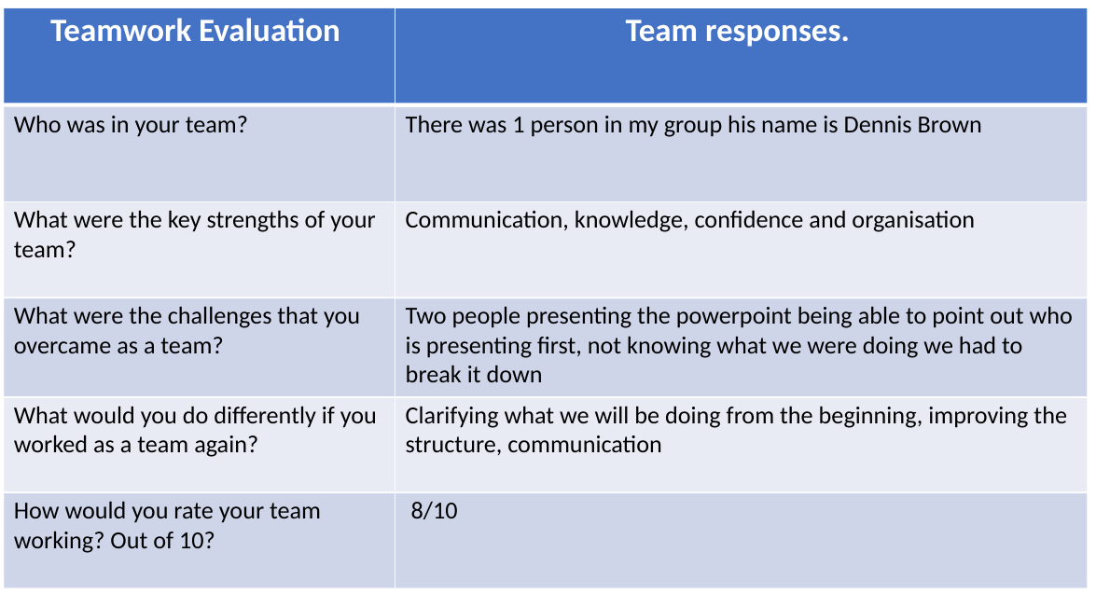
Task 2 Team Evaluation

